Slide 1
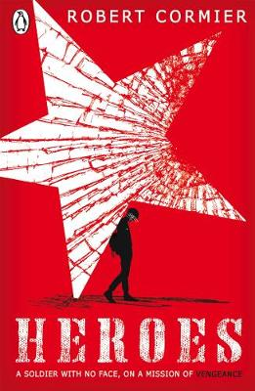
Week Commencing: Monday 11th January
LESSON 1

Slide 2
Chapter Two
Answer the following questions.
At the beginning of this chapter, how does the writer show that this is the beginning of the action of the book, in terms of time?
2. How does the first description of Nicole establish her character? Look carefully at the words used about her in the paragraph beginning ‘Nicole Renard was small and slender’.
3. In the five paragraphs that follow the sentence ‘I knelt there like a knight at her feet’, how does the writer describe Francis’s words and actions to show that he is very young here?
4. Look at the paragraph beginning ‘I was so startled by her voice’. How does the author show that Francis is very young here?
Do Now

Slide 3
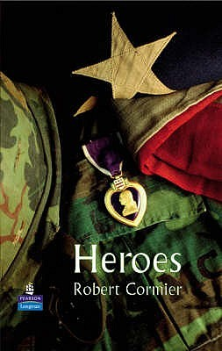
Chapter THREE
You now need to read Chapter 3 (pages 10-16).
Reading Activity

Slide 4
In a nightmare Francis re-lives a terrible experience from the war. How does Robert Cormier use imagery to convey the horror of war? Pick out quotes and annotate language used by Cormier to create such a vivid memory.
I don’t want to think about them, those GIs in my platoon. I don’t want to recite their names. I want to forget what happened there in France but every night the recitation begins, like a litany, the names of the GIs like beads on a rosary. I close my eyes and see them advance in scattered groups through the abandoned village, ruined homes and debris-cluttered streets, our rifles ready, late afternoon shadows obscuring the windows and doorways and the alley entrances, and we are all tense and nervous and scared because the last village seemed peaceful and vacant until sudden gunfire from snipers erupted from those windows and doorways and cut down the advance patrol just ahead of our platoon. Now I can hear Henry Johnson’s ragged breathing and Blinky chambers whistling, between his teeth, the village too still, too quiet. ‘Jesus,’ Sonny Orlandi mutters. Jesus: meaning I’m scared and so is everybody else, clenched fists holding firearms, quiet curses floating on the air, grunts and hisses and farts, not like the war movies at the Plymouth, nobody displaying heroics or bravado. We are probably taking the final steps of our lives in this village whose name we don’t even know and other villages are waiting ahead of us and Eddie Richards asks of nobody in particular: ‘What the hell are we doing here, anyway?’ And he’s clutching his stomach because he has had diarrhoea for three days, carrying the stink with him all that time so that everybody has been avoiding his presence. Now gunfire erupts and at the same time artillery shells – theirs or ours? – boom in the air and explode around us. We run for cover, scrambling and scurrying, hitting the dirt, trying to become part of the buildings themselves but not safe anywhere.
I find myself in a narrow alley, groping through rising dust, and two German soldiers in white uniforms appear like grim ghosts, rifles coming up, but my automatic is too quick and the head of one of the two soldiers explodes like a ripe tomato
Mastery

Slide 5
How does Robert Cormier use imagery to convey the horror of war?
Cormier instantly destroys the romantic image of war by offering the realism of ‘nobody displaying heroics or bravado.’ These nouns allow a reader to visualise that all the soldiers were scared and in fear. It straight away dispels the myths of war and moves away from the propaganda.
A second way that Cormier uses imagery to convey the horrors of war is with the use of a simile:
Mastery

