Slide 1
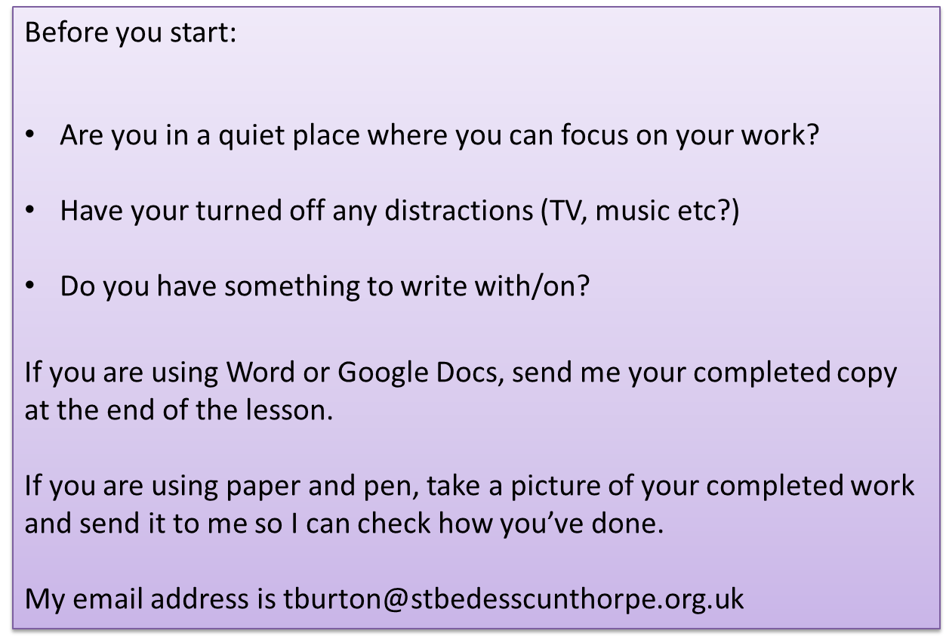


Slide 2

Let’s read chapter 12
As we read, think about the decisions each character makes and what has made them come to these decisions.

Slide 3
Chapter 12
A heat wave gripped Frenchtown, the heat almost visible in the air. People moved as if in a slow-motion movie, gathering on front lawns and piazzas in the evening after the shops closed, hoping for a breeze to cool them off. Men walked slowly as they went off to work in the shops as weary looking in the morning as they were late in the day after their shifts were over.
For three days, I haunted Sixth Street at all hours, standing across the street and looking up at the second floor of Nicole’s house, venturing sometimes into the yard, hoping that I might catch a glimpse of her coming or going or at a window. Despite the heat, the piazza on Nicole’s second-floor tenement remained vacant. The windows were open to allow cooler air to enter the tenement but no one came or went.
Nicole’s father left the tenement to go to the shop just before seven o’clock in the morning and returned shortly after five in the afternoon and I avoided him, kept away from the street during those times.
A small boy in the house across the street from Nicole’s rode his bicycle endlessly on the sidewalk and gazed at me occasionally as I waited. Finally, squinting against the sun, he asked: “Why are you here all the time?”
I shrugged. “Waiting.”
“Are you the boogeyman?” he asked, scratching his chin.
Yes, I wanted to say. A kind of boogeyman who does terrible things like letting his girl get hurt and attacked, purposely avoiding even in my mind that terrible word: what had actually happened to her.
The boy waited a moment for my reply, then pedaled back into his yard, silent as he gazed at me over his shoulder. He went into the house and did not come out again.
• • •
In Laurier’s Drug Store, rumors were rampant about Larry LaSalle’s sudden departure from Frenchtown so soon after his arrival. Someone said his furlough had been canceled, that his outfit had been recalled to duty for a big push in Europe against the Nazis. There was talk of a Western Union messenger bicycling down Mechanic Street in the middle of the night, bringing a telegram to the tenement Larry LaSalle rented on Spruce Street.
“That wasn’t a messenger,” Mr. Laurier scoffed. “That was Crazy Joe Touraine trying to cool off from the heat of the day …”
I could not sleep at night. Lay on the bed and stared up at the ceiling, glad for the heat that was so relentless, as if it were part of the hell that I had earned.
• • •

Slide 4
Finally, on the fourth day, I saw her emerging from the hallway to the piazza on the first floor.
She did not move away as I came into the yard.
“Nicole,” I called.
She saw me, frowned, drew back a step, then paused, as if waiting for me to approach.
“Nicole.” My voice breaking, not like the days of my shyness with her but because my heart was so full it destroyed her and me as I spoke it.
Her eyes met mine. She didn’t say anything for a long moment and when she finally spoke, her voice was harsh.
“You were there all the time,” she said.
I couldn’t reply, could find no words to utter in my defense. Because I had no defense.
“You didn’t do anything.”
The accusation in her voice was worse than the harshness.
“I know.” I wasn’t sure whether I spoke those words or only thought them.
“You knew what he was doing, didn’t you?”
My head so heavy, pounding with blood, that I could barely nod in agreement.
Leaning against the banister, she asked: “Why didn’t you do something? Tell him to stop. Run for help. Anything.”
“I’m sorry,” I said, knowing how pitiful those words must sound to her.
She shook her head, turning away, and I couldn’t afford to let her go.
“Are you …,” I began to ask, but hesitated as she turned back and looked at me again. What word could I use? Are you hurt? Torn apart?
“Are you all right?” I asked.
“No, I’m not all right,” she answered, anger flashing in her eyes. “I hurt. I hurt all over.”
I could only stand there mute, as if all my sins had been revealed and there was no forgiveness for them.
Finally, I asked: “What can I do?”
“Poor Francis,” she said at last. But no pity in her voice. Contempt, maybe, as her eyes swept me. She flung her hand in the air, a gesture of dismissal. “Go away, Francis,” she said. “Just go away.”
And she herself went away, pulled away from the banister, stepped into the hallway, one moment there, the next moment gone.
I waited for her to appear again.
I waited through long empty minutes.
Somewhere a door slammed. Later, a dog barked, a car roared by.
I finally went away.
• • •

Slide 5
Later that week, I went to church after supper and slipped into Father Balthazar’s confessional, waiting there until Mr. Boudreau, the janitor, closed the doors for the night. Finally I stepped out into the old smell of burning wax and incense and walked through the shadows to the back of the church. I climbed the stairs to the choir loft and opened the door that led to the exterior of the tallest steeple. Father Balthazar had shown me the door during my altar boy days.
I started climbing in the darkness, up the steep steps that workers climbed to repair portions of the steeple. The heat intensified and the stairs narrowed as I ascended, my heart beating heavily, my breath coming in gasps, the sound like cloth ripping.
Pausing to gather strength and wait for my heart and lungs to calm down a bit, I looked for the stone door that could be swiveled aside to allow access to the outer surface of the steeple. My fingers found it. Grunting, gasping, I managed to move it aside on its rusty hinges. I looked out at Frenchtown below me, the dark shapes of the three-deckers, the shadowed streets, the stars closer than I’d ever seen them as if I could reach out and pluck one of them from the sky.
Despite the calmness of the summer night, a gust of wind caught me by surprise, cooling the perspiration on my face and forehead. I rested there, bathing in the sudden coolness. Then peered out again, craning my neck to look down at the cement sidewalk below. How long would it take to plunge toward the sidewalk? Still staring down, I began to mumble a prayer, in French, the old Notre Père, the way the nuns had taught us, then stopped, horrified at what I was doing. Saying a prayer before committing the worst sin of all: despair. I thought of St. Jude’s Cemetery and the pitiful graves set apart from the rest, the ones who had taken their own lives and could not be buried in consecrated ground. I thought of my mother and father—could I disgrace their name this way? Did you hear what Lefty’s son did last night, jumped to his death from the steeple of St. Jude’s?
I could not die that way. Soldiers were dying with honor on battlefields all over the world. Noble deaths. The deaths of heroes. How could I die by leaping from a steeple?
The next afternoon I boarded the bus to Fort Delta, in my pocket the birth certificate I had altered to change my age, and became a soldier in the United States Army.

Slide 6
Religious Language
In Chapter 12 Francis feels guilty and blames himself for what happened to Nicole. He believes that he should be punished and considers suicide.
Here Francis feels responsible for what happened and the use of religious language adds to the enormity of what Francis believes he has done. Francis is in the depths of despair and feels that he has been condemned to hell. Nicole’s anger and disgust only intensify his self-hatred and despair.

Slide 7
Religion
Pick out and write down vocabulary linked to religion in chapter 12

Slide 8
Religion
Why is this vocabulary important in chapter 12? What does it suggest about Francis and his thoughts?
‘my sins’
church
‘no forgiveness’
confessional
‘the hell that I had earned’
‘burning wax and incense’

Slide 9
Answer these questions about Chapter 12 in as much detail as possible.
What is the weather like at the start of the chapter? Why has Cormier included this?
What happens to Larry LaSalle? Why?
How does Francis feel about the events at the Wreck Centre?
How does Nicole react when she meets Francis? Is she right?
What does Francis consider doing?
What decision does Francis make? What could be his motives for doing this?
Please send me the work from this lesson as soon as you’ve finished.

