Slide 1
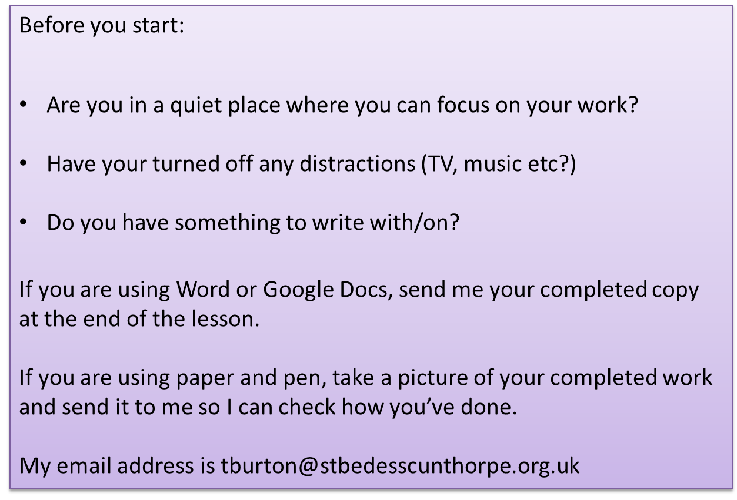

Slide 2
The Nightmare
How does Robert Cormier use imagery to convey the horror of war?
In a nightmare Francis re-lives a terrible experience from the war.
As we read the extract on the following slide, make a note of any imagery that stands out to you.

Slide 3
I don’t want to think about them, those GIs in my platoon. I don’t want to recite their names. I want to forget what happened there in France but every night the recitation begins, like a litany, the names of the GIs like beads on a rosary. I close my eyes and see them advance in scattered groups through the abandoned village, ruined homes and debris-cluttered streets, our rifles ready, late afternoon shadows obscuring the windows and doorways and the alley entrances, and we are all tense and nervous and scared because the last village seemed peaceful and vacant until sudden gunfire from snipers erupted from those windows and doorways and cut down the advance patrol just ahead of our platoon. Now I can hear Henry Johnson’s ragged breathing and Blinky chambers whistling, between his teeth, the village too still, too quiet. ‘Jesus,’ Sonny Orlandi mutters. Jesus: meaning I’m scared and so is everybody else, clenched fists holding firearms, quiet curses floating on the air, grunts and hisses and farts, not like the war movies at the Plymouth, nobody displaying heroics or bravado. We are probably taking the final steps of our lives in this village whose name we don’t even know and other villages are waiting ahead of us and Eddie Richards asks of nobody in particular: ‘What the hell are we doing here, anyway?’ And he’s clutching his stomach because he has had diarrhoea for three days, carrying the stink with him all that time so that everybody has been avoiding his presence. Now gunfire erupts and at the same time artillery shells – theirs or ours? – boom in the air and explode around us. We run for cover, scrambling and scurrying, hitting the dirt, trying to become part of the buildings themselves but not safe anywhere.
I find myself in a narrow alley, groping through rising dust, and two German soldiers in white uniforms appear like grim ghosts, rifles coming up, but my automatic is too quick and the head of one of the two soldiers explodes like a ripe tomato

Slide 4
Looking at Language – techniques
I don’t want to think about them, those GIs in my platoon. I don’t want to recite their names. I want to forget what happened there in France but every night the recitation begins, like a litany, the names of the GIs like beads on a rosary. I close my eyes and see them advance in scattered groups through the abandoned village, ruined homes and debris-cluttered streets, our rifles ready, late afternoon shadows obscuring the windows and doorways and the alley entrances, and we are all tense and nervous and scared because the last village seemed peaceful and vacant until sudden gunfire from snipers erupted from those windows and doorways and cut down the advance patrol just ahead of our platoon. Now I can hear Henry Johnson’s ragged breathing and Blinky chambers whistling, between his teeth, the village too still, too quiet. ‘Jesus,’ Sonny Orlandi mutters. Jesus: meaning I’m scared and so is everybody else, clenched fists holding firearms, quiet curses floating on the air, grunts and hisses and farts, not like the war movies at the Plymouth, nobody displaying heroics or bravado. We are probably taking the final steps of our lives in this village whose name we don’t even know and other villages are waiting ahead of us and Eddie Richards asks of nobody in particular: ‘What the hell are we doing here, anyway?’ And he’s clutching his stomach because he has had diarrhoea for three days, carrying the stink with him all that time so that everybody has been avoiding his presence. Now gunfire erupts and at the same time artillery shells – theirs or ours? – boom in the air and explode around us. We run for cover, scrambling and scurrying, hitting the dirt, trying to become part of the buildings themselves but not safe anywhere.
I find myself in a narrow alley, groping through rising dust, and two German soldiers in white uniforms appear like grim ghosts, rifles coming up, but my automatic is too quick and the head of one of the two soldiers explodes like a ripe tomato.
Alliteration
Simile
Triple
Rhetorical question

Slide 5
Looking at Language – techniques
I don’t want to think about them, those GIs in my platoon. I don’t want to recite their names. I want to forget what happened there in France but every night the recitation begins, like a litany, the names of the GIs like beads on a rosary. I close my eyes and see them advance in scattered groups through the abandoned village, ruined homes and debris-cluttered streets, our rifles ready, late afternoon shadows obscuring the windows and doorways and the alley entrances, and we are all tense and nervous and scared because the last village seemed peaceful and vacant until sudden gunfire from snipers erupted from those windows and doorways and cut down the advance patrol just ahead of our platoon. Now I can hear Henry Johnson’s ragged breathing and Blinky chambers whistling, between his teeth, the village too still, too quiet. ‘Jesus,’ Sonny Orlandi mutters. Jesus: meaning I’m scared and so is everybody else, clenched fists holding firearms, quiet curses floating on the air, grunts and hisses and farts, not like the war movies at the Plymouth, nobody displaying heroics or bravado. We are probably taking the final steps of our lives in this village whose name we don’t even know and other villages are waiting ahead of us and Eddie Richards asks of nobody in particular: ‘What the hell are we doing here, anyway?’ And he’s clutching his stomach because he has had diarrhoea for three days, carrying the stink with him all that time so that everybody has been avoiding his presence. Now gunfire erupts and at the same time artillery shells – theirs or ours? – boom in the air and explode around us. We run for cover, scrambling and scurrying, hitting the dirt, trying to become part of the buildings themselves but not safe anywhere.
I find myself in a narrow alley, groping through rising dust, and two German soldiers in white uniforms appear like grim ghosts, rifles coming up, but my automatic is too quick and the head of one of the two soldiers explodes like a ripe tomato.
Alliteration
Simile
Triple
Rhetorical question
Now take a few minutes to highlight as many other examples of these techniques as you can.

Slide 6
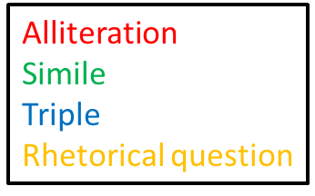
Here are some of the techniques you could have had – how many did you find?
I don’t want to think about them, those GIs in my platoon. I don’t want to recite their names. I want to forget what happened there in France but every night the recitation begins, like a litany, the names of the GIs like beads on a rosary. I close my eyes and see them advance in scattered groups through the abandoned village, ruined homes and debris-cluttered streets, our rifles ready, late afternoon shadows obscuring the windows and doorways and the alley entrances, and we are all tense and nervous and scared because the last village seemed peaceful and vacant until sudden gunfire from snipers erupted from those windows and doorways and cut down the advance patrol just ahead of our platoon. Now I can hear Henry Johnson’s ragged breathing and Blinky chambers whistling, between his teeth, the village too still, too quiet. ‘Jesus,’ Sonny Orlandi mutters. Jesus: meaning I’m scared and so is everybody else, clenched fists holding firearms, quiet curses floating on the air, grunts and hisses and farts, not like the war movies at the Plymouth, nobody displaying heroics or bravado. We are probably taking the final steps of our lives in this village whose name we don’t even know and other villages are waiting ahead of us and Eddie Richards asks of nobody in particular: ‘What the hell are we doing here, anyway?’ And he’s clutching his stomach because he has had diarrhoea for three days, carrying the stink with him all that time so that everybody has been avoiding his presence. Now gunfire erupts and at the same time artillery shells – theirs or ours? – boom in the air and explode around us. We run for cover, scrambling and scurrying, hitting the dirt, trying to become part of the buildings themselves but not safe anywhere.
I find myself in a narrow alley, groping through rising dust, and two German soldiers in white uniforms appear like grim ghosts, rifles coming up, but my automatic is
too quick and the head of one of the two soldiers explodes like a ripe
tomato.

Slide 7
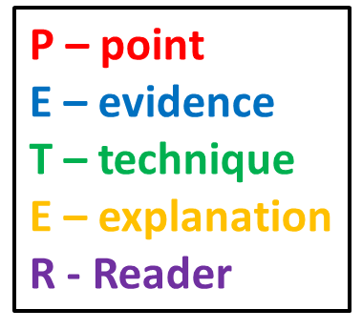
Task: Using your annotations write 2 P.E.T.E.R paragraphs answering the question: How does Robert Cormier use imagery to convey the horror of war?
Cormier uses imagery to convey the horrors of war with the use of a simile: ‘two German soldiers in white uniforms appear like grim ghosts’. The alliteration of ‘grim ghosts’ here immediately makes us focus on the idea of death. There’s also the ‘white uniforms’ which adds to the idea of paleness and lack of life. By this stage, the reader should be left in no doubt that there is only death here.

Slide 8
Some sentence starters -
Cormier uses imagery very effectively in chapter three.
The phrase … creates the effect of..
The image … is also very powerful as it creates…
and the line … makes the reader feel…

