Slide 1
Before you start:
Are you in a quiet place where you can focus on your work?
Have your turned off any distractions (TV, music etc?)
Do you have something to write with/on?
If you are using Word or Google Docs, send me your completed copy at the end of the lesson.
If you are using paper and pen, take a picture of your completed work and send it to me so I can check how you’ve done.
My email address is tburton@stbedesscunthorpe.org.uk

Slide 2
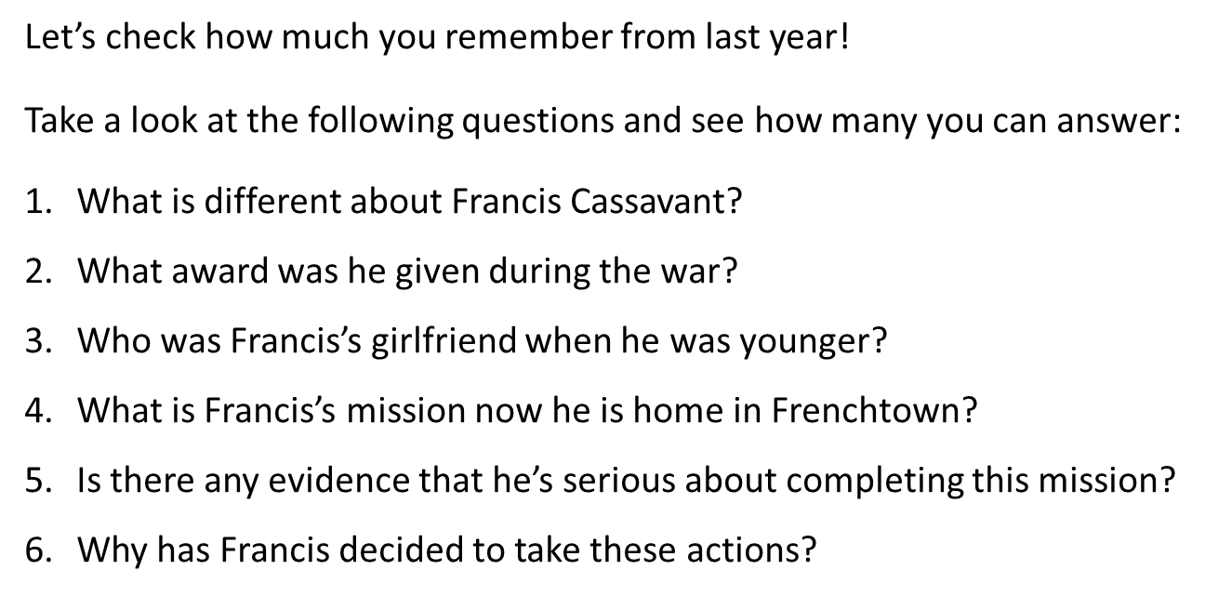
When you’ve finished, click to see the answers (no cheating!)

Slide 4
Today’s question:
How does the writer try and create sympathy for Francis?
Let’s look again at the first page of the novel:

Slide 5
How does the writer use language to describe Francis and evoke empathy from a reader?
Let’s read the text:
My name is Francis Joseph Cassavant and I have just returned to Frenchtown in Monument and the war is over and I have no face.
Oh, I have eyes because I can see and ear-drums because I can hear but no ears to speak of, just bits of dangling flesh. But that’s fine, like Dr Abrams says, because it’s sight and hearing that count and I was not handsome to begin with. He was joking, of course. He was always trying to make me laugh.
If anything bothers me, it’s my nose. Or, rather, the absence of my nose. My nostrils are like two small caves and they sometimes get blocked and I have to breathe through my mouth. This dries up my throat and makes it hard for me to swallow. I also become hoarse and cough a lot. My teeth are gone but my jaw is intact and my gums are firm so it’s possible for me to wear dentures. In the past few weeks, my gums began to shrink, however, and the dentures have become loose and they click when I talk and slip around inside my mouth.
I have no eyebrows, but eyebrows are minor, really. I do have cheeks. Sort of. I mean, the skin that forms my cheeks was grafted from my thighs and has taken a long time to heal. My thighs sting when my pants rub against them. Dr Abrams says that all my skin will heal in time and my cheeks will someday be as smooth as a baby’s arse. That’s the way he pronounced it: arse. In the meantime, he said, don’t expect anybody to select you for a dance when it’s the Girls’ Choice at the Canteen.
Now take a few minutes to highlight or note down anything which makes you feel sympathy for Francis. When you are ready to move on, just click your mouse or press the space bar.

Slide 6
Let’s look at some examples together:
My name is Francis Joseph Cassavant and I have just returned to Frenchtown in Monument and the war is over and I have no face.
Oh, I have eyes because I can see and ear-drums because I can hear but no ears to speak of, just bits of dangling flesh. But that’s fine, like Dr Abrams says, because it’s sight and hearing that count and I was not handsome to begin with. He was joking, of course. He was always trying to make me laugh.
If anything bothers me, it’s my nose. Or, rather, the absence of my nose. My nostrils are like two small caves and they sometimes get blocked and I have to breathe through my mouth. This dries up my throat and makes it hard for me to swallow. I also become hoarse and cough a lot. My teeth are gone but my jaw is intact and my gums are firm so it’s possible for me to wear dentures. In the past few weeks, my gums began to shrink, however, and the dentures have become loose and they click when I talk and slip around inside my mouth.
I have no eyebrows, but eyebrows are minor, really. I do have cheeks. Sort of. I mean, the skin that forms my cheeks was grafted from my thighs and has taken a long time to heal. My thighs sting when my pants rub against them. Dr Abrams says that all my skin will heal in time and my cheeks will someday be as smooth as a baby’s arse. That’s the way he pronounced it: arse. In the meantime, he said, don’t expect anybody to select you for a dance when it’s the Girls’ Choice at the Canteen.

Slide 7
“I have no face.”
A face gives identity; a reader would find this shocking. It’s a very short sentence which tells the absolute truth as Francis sees it.

Slide 8
“I have no face.”
A face gives identity; a reader would find this shocking. It’s a very short sentence which tells the absolute truth as Francis sees it.
His ears are “just bits of dangling flesh”
The powerful verb, ‘dangling’ helps to give a vivid picture, it is emotive language.

Slide 9
“I have no face.”
A face gives identity; a reader would find this shocking. It’s a very short sentence which tells the absolute truth as Francis sees it.
His ears are “just bits of dangling flesh”
The powerful verb, ‘dangling’ helps to give a vivid picture, it is emotive language.
“My nostrils are like two small caves”

Slide 10
“I have no face.”
A face gives identity; a reader would find this shocking. It’s a very short sentence which tells the absolute truth as Francis sees it.
His ears are “just bits of dangling flesh”
The powerful verb, ‘dangling’ helps to give a vivid picture, it is emotive language.
“My nostrils are like two small caves”
The use of a simile adds further imagery to the young soldier’s injuries. What connotations are there for the word cave? Is it scary? If someone has caved in have they given up/in?

Slide 11
“I have no face.”
A face gives identity; a reader would find this shocking. It’s a very short sentence which tells the absolute truth as Francis sees it.
His ears are “just bits of dangling flesh”
The powerful verb, ‘dangling’ helps to give a vivid picture, it is emotive language.
“My nostrils are like two small caves”
The use of a simile adds further imagery to the young soldier’s injuries. What connotations are there for the word cave? Is it scary? If someone has caved in have they given up/in?
“I do have cheeks. Sort of.”

Slide 12
“I have no face.”
A face gives identity; a reader would find this shocking. It’s a very short sentence which tells the absolute truth as Francis sees it.
His ears are “just bits of dangling flesh”
The powerful verb, ‘dangling’ helps to give a vivid picture, it is emotive language.
“My nostrils are like two small caves”
The use of a simile adds further imagery to the young soldier’s injuries. What connotations are there for the word cave? Is it scary? If someone has caved in have they given up/in?
“I do have cheeks. Sort of.”
The sentence forms are simple/short. ‘sort of’ is a vague term he is applying to his own statement – does he believe he has cheeks? The words are also emotive, a reader learns the reality of his feelings towards his injuries – he is unsure.

Slide 13
Writing your response
Firstly, the writer uses emotive language to shock a reader: ‘I have no face.’ This immediately evokes empathy from a reader because a face gives identity. A reader will question the events that led to Cassavant’s injuries. Furthermore, the writer has chosen to end the compound sentence with this horrifying information to leave a lasting impression.
A second way that a reader is made to feel sorry for the character is with the powerful verb, ‘dangling’. This gives a vivid visual image for a reader because …
P – point
E – evidence
T – technique
E – explanation
R - Reader

Slide 14
Task: Using your annotations write two of your own P.E.T.E.R paragraphs answering the question: How does the writer use language to describe Francis and evoke empathy from a reader?

