Slide 1
Heroes by Robert Cormier
LO: *To introduce the main theme of the short novella Heroes.
*To read the first chapter.
ST: I can comment on the important themes of the novel.
Notes:
19 lessons all together! But can be expanded upon.

Slide 2
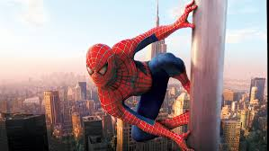
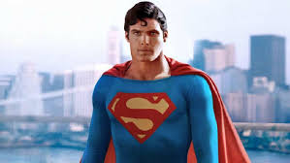
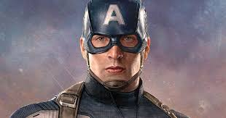
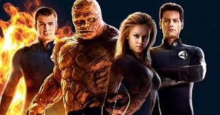
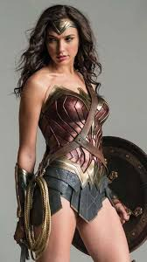
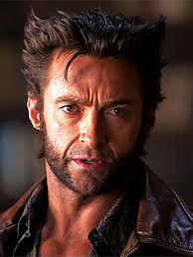
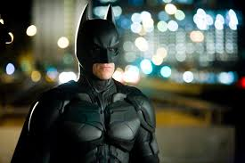
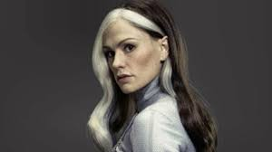
Starter: Who are they? What do they have in common?

Slide 3
Task: Heroism
The title of the book introduces us to the novel’s main theme: heroism.
What is a hero? In pairs discuss the following and mind-map your ideas on a clean page in your books:
What makes a person a hero?
List as many real or fictional heroes as you can.
Do the people in your list share any key qualities? What are these heroic qualities?
How are heroes treated by others?
What would you imagine a war hero to be like?

Slide 4
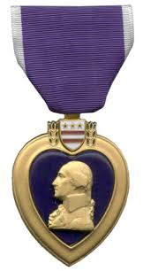
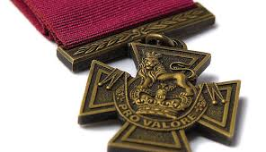
Do you know what these are?
The Victoria Cross is awarded for valour in combat.
The Purple Heart is a United States military decoration awarded in the name of the President to those wounded or killed while serving, on or after April 5, 1917, with the U.S. military.
Do you know what they are awarded for?

Slide 5
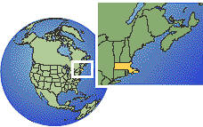
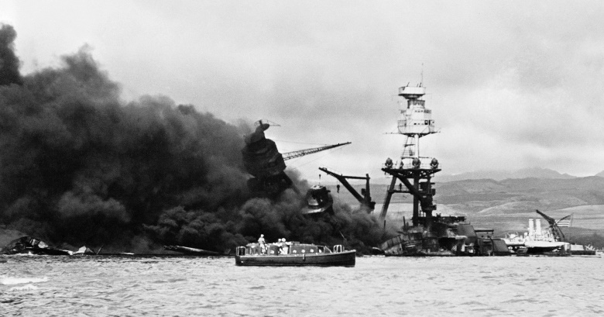
Robert Cormier
Independently take notes.
Robert Cormier was born in Leominster, Massachusetts, United States, in the French-Canadian section of the town called French Hill in 1925. He had his first short story published when a college professor, Florence Conlon, sent one of his stories to The Sign, a national Catholic magazine, without his knowledge for $75. Cormier began his professional writing career scripting radio commercials and went on to become an award-winning journalist.
In 1941, as he was studying at high school, the USA entered the Second World War after the Japanese attack on Pearl Harbour. It was an event that affected Cormier profoundly and influenced his writing throughout his career. He died on 2nd November 2000, only two years after Heroes was published.

Slide 6
Context – World War Two
Independently take notes.
The Second World War began in 1939 and ended in 1945. During its six year existence it had engaged much of the world in conflict. It was the deadliest war in history with 62 million lives lost.
The USA entered the war in 1941 following the Japanese attack on the American fleet in Pearl Harbour on 7th December 1941. 2,408 Americans were killed in the attack and the following day America declared war on Japan. Three days later Germany, (Japan’s ally), declared war on the United States. America lost many troops fighting in Europe and were involved in the successful D-day invasions of German occupied France. The war in Europe ended on 7 May 1945 after the Germans signed an unconditional surrender.
The novel ‘Heroes’ explores how the war touched the lives of millions of people living in small towns across America.

Slide 7
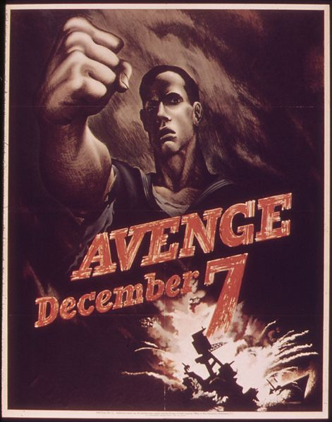
Sub-Heading: Life during the war
Independently take notes.
The lives of ordinary Americans changed forever after 7th December 1941. Men and women were encouraged to join the armed forces, some were as young as sixteen, who, like Francis in the novel, altered their birth certificates so they could go and fight. Many were eager to become heroes.
Fear of air strikes meant that families had to put out their lights and cover their windows at night. This was known as a blackout. Families would listen to the radio or go to the cinema to find out news about the war.

Slide 8
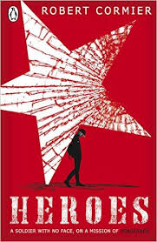
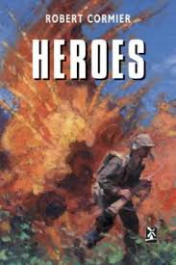
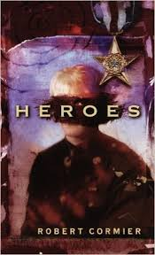
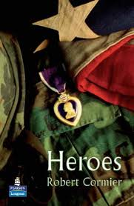
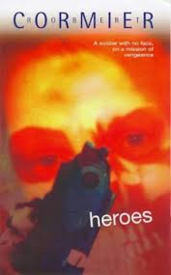
Task: Look at the front covers of the novel and the synopsis.
Annotate your ideas around the images.
TASK: What are your first impressions of the novel? Do the front covers and blurb attract you and make you want to read the book or do they put you off? Why?

Slide 9
Synopsis: What techniques have been used to interest a reader? Annotate your handout.
‘What if I told him I am not the hero he thinks I am …?’
Maimed and disfigured whilst fighting in the war, young Francis Cassavant must hide both his face and his identity when he goes back home to Frenchtown. For his past holds a bitter secret, one which he has vowed to revenge and which he can resolve only through his final, desperate plan: to destroy the man who betrayed him as a boy, bringing Francis dishonour and guilt.
Left now without a face or a future, yet sustained by his deep sense of shame, Francis watches. He thinks of the gun in his duffel bag and waits, alone, for the return of another supposed hero.

Slide 10

Extension task: Make a prediction as to what may happen in the novel.

