Slide 1
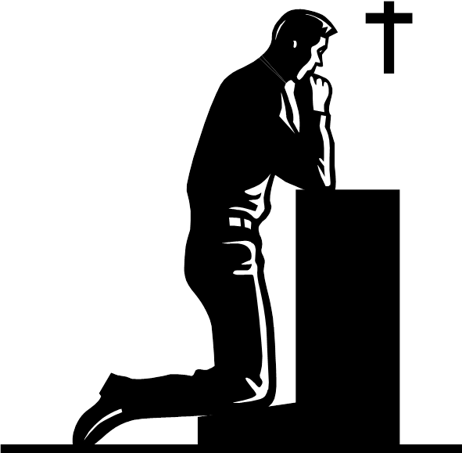
Long Term Memory Starter: What have we learnt about Francis? Consider the description of the character, his actions, interactions and the dialogue the character uses.
Do Now

Slide 2
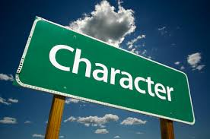
Task: Let’s read chapter 2.
Will Nicole be an important character in the novel? Why?
Reading Activity

Slide 3
Nicole: What are your first impressions of Nicole? What words and phrases are used to describe her?
Nicole is … | Quote to show this … | What it tells us about her …
Attractive | ‘the most beautiful girl ..small and slender, with shining black hair.’ | She stands out from the crowd, pretty and delicate. Francis thinks she is wonderful.
Mastery

Slide 4
Francis:
How is the young Francis different to Francis the war veteran?
Francis the veteran
Young Francis
Checking Understanding

Slide 5
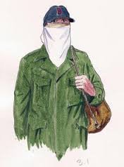
Francis now and then.
How would you improve this first paragraph for THEN?
The young Francis we meet in chapter two is a very shy boy.
From the moment he first sees Nicole he falls in love with her.
He sees her as perfectly pure and beautiful. Francis is naïve and innocent, his ambition is to read all the books in the public library. This is a stark contrast to Francis the war veteran; a man filled with despair and rage, desperately seeking revenge.
Now can you write your comments for the second section ‘NOW’.
Mastery

Slide 6
Chapter Two
Answer the following questions.
At the beginning of this chapter, how does the writer show that this is the beginning of the action of the book, in terms of time?
2. How does the first description of Nicole establish her character? Look carefully at the words used about her in the paragraph beginning ‘Nicole Renard was small and slender’.
3. In the five paragraphs that follow the sentence ‘I knelt there like a knight at her feet’, how does the writer describe Francis’s words and actions to show that he is very young here?
4. Look at the paragraph beginning ‘I was so startled by her voice’. How does the author show that Francis is very young here?
Checking Understanding

Slide 7
Task: Re-read the description of the wreck centre. What does the language suggest? What atmosphere and mood is created and how?
In the next few days the men worked frantically, scraping and painting, replacing doors and windows, tarring the roof. But the work was haphazard. Workers dropped hammers, spilled paint, stumbled over each other and occasionally pulled brown paper bags from their pockets and took quick gulps from hidden bottles…
When the workers finally completed the job , the building still looked unfinished. The white paint didn't completely cover the dark patches of mildew on the clapboards and the shutters sagged next to the windows.
Mastery

