Slide 1
Chapter 3 - Heroes by Robert Cormier
LO: To analyse how Cormier uses language to convey themes in the novel.
ST: I can develop my analysis of language used for effect.

Slide 2
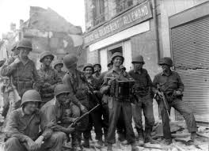
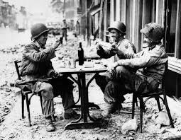
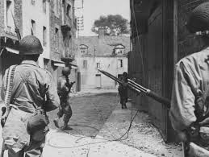
Starter: Chapter 3 List words that you associate with these pictures.

Slide 3
The Nightmare
In a nightmare Francis re-lives a terrible experience from the war. How does Robert Cormier use imagery to convey the horror of war?
Read, highlight and annotate language used by Cormier to create such a vivid memory.

Slide 4
I don’t want to think about them, those GIs in my platoon. I don’t want to recite their names. I want to forget what happened there in France but every night the recitation begins, like a litany, the names of the GIs like beads on a rosary. I close my eyes and see them advance in scattered groups through the abandoned village, ruined homes and debris-cluttered streets, our rifles ready, late afternoon shadows obscuring the windows and doorways and the alley entrances, and we are all tense and nervous and scared because the last village seemed peaceful and vacant until sudden gunfire from snipers erupted from those windows and doorways and cut down the advance patrol just ahead of our platoon. Now I can hear Henry Johnson’s ragged breathing and Blinky chambers whistling, between his teeth, the village too still, too quiet. ‘Jesus,’ Sonny Orlandi mutters. Jesus: meaning I’m scared and so is everybody else, clenched fists holding firearms, quiet curses floating on the air, grunts and hisses and farts, not like the war movies at the Plymouth, nobody displaying heroics or bravado. We are probably taking the final steps of our lives in this village whose name we don’t even know and other villages are waiting ahead of us and Eddie Richards asks of nobody in particular: ‘What the hell are we doing here, anyway?’ And he’s clutching his stomach because he has had diarrhoea for three days, carrying the stink with him all that time so that everybody has been avoiding his presence. Now gunfire erupts and at the same time artillery shells – theirs or ours? – boom in the air and explode around us. We run for cover, scrambling and scurrying, hitting the dirt, trying to become part of the buildings themselves but not safe anywhere.
I find myself in a narrow alley, groping through rising dust, and two German soldiers in white uniforms appear like grim ghosts, rifles coming up, but my automatic is too quick and the head of one of the two soldiers explodes like a ripe tomato

Slide 5
Task: Using your annotations write 2 of your own P.E.T.E.R paragraphs answering the question: How does Robert Cormier use imagery to convey the horror of war?
Cormier describes the war as horrific. Firstly, he uses imagery to convey the horrors of war with the use of a simile: ‘two German soldiers in white uniforms appear like grim ghosts’. This creates an immediate link with death and creates the impressions that the men appear silently. The word ‘grim’ also makes us think of the grim reaper.

Slide 6
Some sentence starters -
Cormier uses imagery very effectively in chapter three.
The phrase … creates the effect of..
The image … is also very powerful as it creates…
and the line … makes the reader feel…

Slide 7
Chapter Three
Extension Questions
1. Find the sentence ‘I stare at the final proof that Nicole has gone away’ (page 14). How does the writer move from one time period to another here?
2. In the page following this, what is suggested about Nicole, and how she changed after Francis left?
3. In the section beginning ‘I can never trace the moment …’ (page 18), how does the writer move from one time period to another?
4. In the section beginning ‘I don’t want to think about them’ (page 18), in what ways is it suggested that the soldiers are not heroes? How is it suggested that war is brutal and nasty rather than heroic?

Slide 8
Chapter 4 - Heroes by Robert Cormier
LO: To explore the key theme of heroism.
ST: I can develop my understanding of the author’s craft.

Slide 9
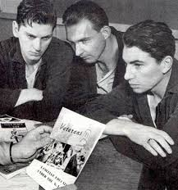
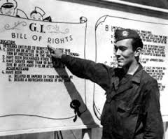
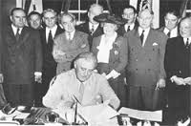
Let’s read chapter 4.
Why is the Wreck Centre so important to Francis?
What was the GI Bill?
Why was Arthur Rivier famous in Frenchtown before the war?
The legislation provided a range of benefits for returning World War II veterans, including funding for college, home loans and unemployment insurance.
GI = ‘Government issue’

Slide 10
Before and After
In chapter four Francis meets an old friend, Arthur Rivier. How has Arthur changed since the war?
Before the war | After the war
‘a star first baseman for the Frenchtown Tigers.’ | ‘His eyes are bleary and bloodshot’
Why do you think Cormier includes this character?
What could his story represent?

Slide 11
Heroism
In the novel Cormier presents different types of heroes. Francis is a decorated war hero and Arthur was a sporting hero before the war. However in chapter four Francis says that he is not the hero that others think he is.
What does he mean by this?
What does this reveal about Francis’s self esteem?
Why doesn’t Francis join in the drinking and conversation?
What is the topic of conversation in the St Jude club?
What are Francis’s plans for the future?
What could this suggest?

Slide 12
Chapter 5 - Heroes by Robert Cormier
LO: To explore Cormier’s use of foreshadowing in chapter 5.
ST: I can develop my understanding of the author’s craft.

Slide 13
Starter: What are the connotations of ‘wreck’?
Let’s read chapter 5.

Slide 14
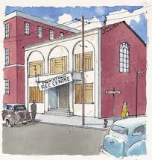
Task: Summarise the ‘Wreck’ centre’s history in no more than 25 words. What does the violent history suggest about the place?

Slide 15
Task: How is Francis portrayed as a young boy in Chapter 5? What do we learn about his early life? Mind map your ideas and support each one with a quote from the chapter.
Francis

Slide 16
Chapter 5 - Heroes by Robert Cormier
LO: To examine the character Larry LaSalle in chapter 5.
ST: I can develop my understanding of the author’s craft.

Slide 17
Re-cap the structure of events in chapter 5 in the following 6 grid format.
Starter
Whose view is it? (narrative perspective) what is the focus at the start? | When is it set? (how is time ordered? Chronologically/flashback/ year, minutes? Days? Hours? | Where is it set? Place, location, setting?
Who is there? What characters are introduced? What do you learn about them? | What conventions have been used in this chapter? Patterns/ Repetition? | How does the focus change? The end? Is it circulatory?

Slide 18
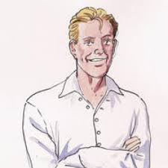
Larry LaSalle
What are your first impressions of Larry LaSalle?
Mind-map words, phrases and quotations to describe him.

Slide 19
Task: Using your ideas answer the following question in FOUR detailed P.E.T.E.R paragraphs – How does Cormier present the character Larry LaSalle?
Cormier presents the character Larry LaSalle as …
In Chapter 5 Cormier introduces the character Larry LaSalle. He is described as…
Larry LaSalle is described as….
Larry LaSalle is portrayed by Cormier as a … this suggests….
Chapter 5 introduces the character of Larry LaSalle, he is portrayed as…
Presented in Chapter 5, Larry LaSalle is …

Slide 20
Task: Self assess your work.
Have you followed the P.E.T.E.R structure?
Give yourself a target.

Slide 21
Extension:
Design a poster advertising the summer vacation activities run at the ‘Wreck’ centre.
You must use details from the chapter.
Remember to use persuasive language, bold fonts, dates and times etc.

