Slide 1
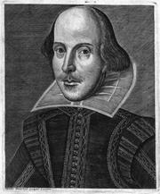
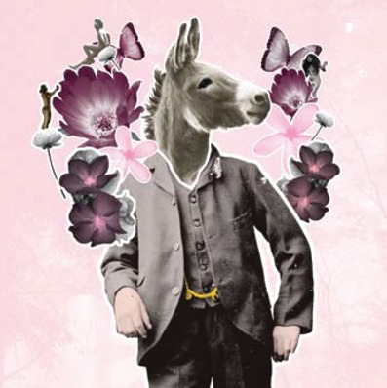
“I quite like donkeys. Not so sure about fairies though…”
Love,Emotions And Conflict
LO: Writing in character using correct spelling, punctuation and grammar
Learning Content
“Are you giggling at me-haw hee-haw?”

Slide 2
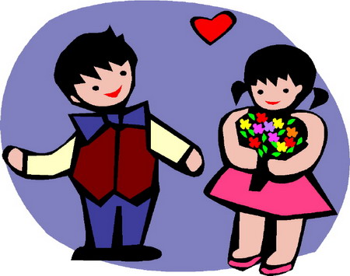
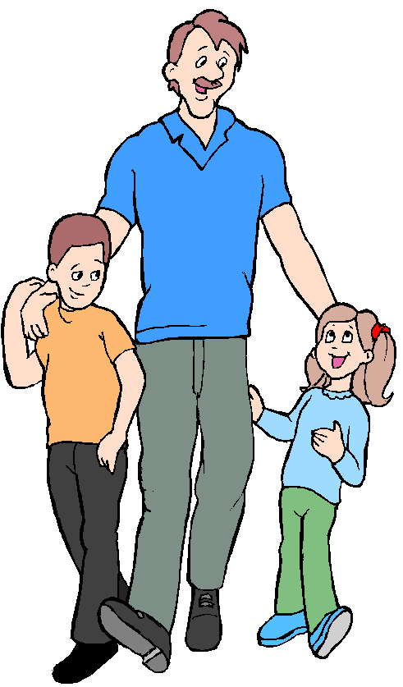
Love and Conflict
The characters are subject to the
difficulties between ‘love’ and ‘conflict’.
“Explain who is in love in Act 1, Scene 1 of A Midsummer Night’s Dream.”
“Explain the conflict in Act 1, Scene 1 of the play.”
Thinking & discussing
Why do young people in love
sometimes
experience conflict
with their parents or guardians?
“TASK: Work with your partner to discuss your experiences. List 5 famous examples that you know.”

Slide 3
Why was Hermia’s refusal to marry Demetrius so unusual? What risks was she taking?
Thinking & discussing
What would be the issues today?

Slide 4
Feelings and Emotions in A Midsummer Night’s Dream
TASK: read to end of Act 1, Sc 1, p11-17 Ca/p5-9 Ox
How is each character feeling?
Hermia’s father tells her that
she must marry Demetrius.
Lysander runs away with Hermia.
Helena tells Demetrius about
Lysander and Hermia’s plans.
Hermia and Helena discuss Demetrius
Reading & thinking Task
Hermia and Lysander discuss
their feelings p11,13
Look at the speech patterns
How does it reflect their emotions?
How does Hermia feel about: her father, Lysander?

Slide 5
Feelings and Emotions
TASK: imagine that you are Hermia, write a diary entry
explaining how you feel about the current situation
What do we need
to include
in a diary entry?
Use the first person
‘I’ and ‘we’.
Present tense.
Explain what has just
happened to you.
Time (day, hour)
Writing task
Hermia tells Helena about
Her and Lysander’s plans.
Describe your feelings.
You must use at least 5 different
feelings and emotions.
Include a message to Egeus,
your father
Try to explain how you think
the other characters might be
feeling at this point in the play.
Varied and accurate: Vocabulary, Sentence structure, spelling, punctuation and grammar.
Future plans, hopes, dreams.

Slide 6
Sentence Starters
In Athens…
Earlier…
Theseus told us…
I can not believe…
This can’t be happening…
It is unfair that…
I have heard…
I don’t believe…
However…
This situation is…
I will follow…
I am feeling…
If only I could…
My head…
My heart…
On this night…
Soon…
They don’t know what they are doing…
When I…
We are…
If Egeus knew…
My next move is…
I can only hope…
Tonight is the night…
I will not rest until…
My imagination runs wild…
The conclusion to this night will be…
Eventually they will…
I want…
I wish…
Wrting support
Notes:
Can print out if necessary

Slide 7
Sentence Starters
In Athens…
Earlier…
Theseus told us…
I can not believe…
This can’t be happening…
It is unfair that…
I have heard…
I don’t believe…
However…
This situation is…
I will follow…
I am feeling…
If only I could…
My head…
My heart…
On this night…
Soon…
They don’t know what they are doing…
When I…
We are…
If Egeus knew…
My next move is…
I can only hope…
Tonight is the night…
I will not rest until…
My imagination runs wild…
The conclusion to this night will be…
Eventually they will…
I want…
I wish…
Notes:
Can print out if necessary

Slide 8
Plenary: Self assessment
Read over your own work and check you have done the following things:
I have written in full, clear sentences
I have spelt the key words correctly
I have used the correct layout
I have written in an appropriate style
It needs to be OBVIOUS it is Hermia’s diary.
Homework: complete and illustrate your diary.
Plenary

