Slide 1
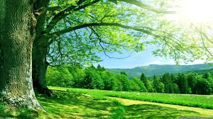
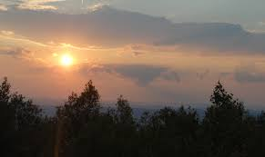
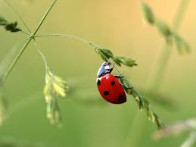
‘Nature Poems’
Hawk Roosting
by Ted Hughes
LO: To analyse the poem and understand the use of language and structure for meaning. ST: I can understand writers’ methods and use subject terminology.
Learning Objective:
AO2: Analyse the language, form and structure used by a writer to create meanings and effects, using relevant subject terminology where appropriate.

Slide 2
Key Words:
Sophistry
Monologue
Caesura
Dictatorship/ fascist
Consider what a predatory bird is.
Consider what attributes a bird like that may need.
Does the natural world have a hierarchy?
What is the ‘food chain’?
Learning Objective:
AO2: Analyse the language, form and structure used by a writer to create meanings and effects, using relevant subject terminology where appropriate.
Notes:
Sophistry = subtle false arguments used to deceive someone.
Fascist = Fascism is a form of far-right, authoritarian ultranationalism characterized by dictatorial power, forcible suppression of opposition, and strong regimentation

Slide 3
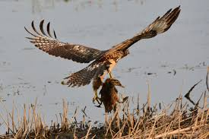
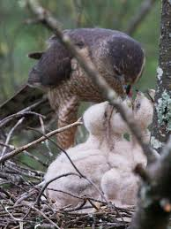
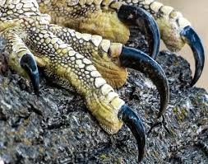
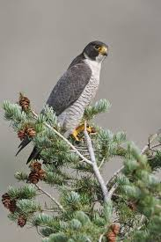
Look at the images below and think about what they represent.

Slide 4
Key Words:
Sophistry
Monologue
Caesura
Dictatorship/ fascist
I sit in the top of the wood, my eyes closed.
Inaction, no falsifying dream
Between my hooked head and hooked feet:
Or in sleep rehearse perfect kills and eat.
The convenience of the high trees!
The air's buoyancy and the sun's ray
Are of advantage to me;
And the earth's face upward for my inspection.
My feet are locked upon the rough bark.
It took the whole of Creation
To produce my foot, my each feather:
Now I hold Creation in my foot
Or fly up, and revolve it all slowly -
I kill where I please because it is all mine.
There is no sophistry in my body:
My manners are tearing off heads -
The allotment of death.
For the one path of my flight is direct
Through the bones of the living.
No arguments assert my right:
The sun is behind me.
Nothing has changed since I began.
My eye has permitted no change.
I am going to keep things like this.
Start with the title, Hawk Roosting
Let’s read the poem by Ted Hughes
What are your initial thoughts?
Learning Objective:
AO2: Analyse the language, form and structure used by a writer to create meanings and effects, using relevant subject terminology where appropriate.

Slide 5
Key Words:
Sophistry
Monologue
Caesura
Dictatorship/ fascist
Let’s have some feedback
Learning Objective:
AO2: Analyse the language, form and structure used by a writer to create meanings and effects, using relevant subject terminology where appropriate.

Slide 6
I sit in the top of the wood, my eyes closed.
Inaction, no falsifying dream
Between my hooked head and hooked feet:
Or in sleep rehearse perfect kills and eat.
The convenience of the high trees!
The air's buoyancy and the sun's ray
Are of advantage to me;
And the earth's face upward for my inspection.
My feet are locked upon the rough bark.
It took the whole of Creation
To produce my foot, my each feather:
Now I hold Creation in my foot
Or fly up, and revolve it all slowly -
I kill where I please because it is all mine.
There is no sophistry in my body:
My manners are tearing off heads -
The allotment of death.
For the one path of my flight is direct
Through the bones of the living.
No arguments assert my right:
The sun is behind me.
Nothing has changed since I began.
My eye has permitted no change.
I am going to keep things like this.
What are your initial thoughts? What is it all about?

Slide 7
Tense? Narration?
What does this suggest?
I sit in the top of the wood, my eyes closed.
Inaction, no falsifying dream
Between my hooked head and hooked feet:
Or in sleep rehearse perfect kills and eat.
The convenience of the high trees!
The air's buoyancy and the sun's ray
Are of advantage to me;
And the earth's face upward for my inspection.
Repetition - What does the ‘H’ do to the pace?
Violence?
What does this suggest about nature ?
The hawks looks down on everything literally and physically.
What makes it easier for the hawk?
Notes:
Tense = present only rhyming couplet eat/ feet suggests how precise it kills are?
Narration = 1st person

Slide 8
What does the harsh consonant emphasise?
Is there any mercy shown here?
My feet are locked upon the rough bark.
It took the whole of Creation
To produce my foot, my each feather:
Now I hold Creation in my foot
Or fly up, and revolve it all slowly -
I kill where I please because it is all mine.
There is no sophistry in my body:
My manners are tearing off heads -
What does this allude to?
What does the enjambment suggest?
Simple mainly monosyllabic language creates sense of control
What does this oxymoron do?
Caesura?
Notes:
Enjambment reflects the hawks power over creation it is the dominant concern. Oxymoron = juxtaposes politeness with extreme violence / savagery

Slide 9
Why is this ironic?
What is his aim?
The allotment of death.
For the one path of my flight is direct
Through the bones of the living.
No arguments assert my right:
The sun is behind me.
Nothing has changed since I began.
My eye has permitted no change.
I am going to keep things like this.
What type of imagery is this?
What does this negative statement suggest about the hawk?
Where does it link to dictatorship?
What is the double meaning of ‘behind me’?
Framing device – beginning and ending with ‘I’ reflects hawk’s arrogance.
Notes:
Allotment = contrast between life and death also they’re in orderly patches of land – graves??
Key word = domination, can control everything for ever, deluded like a fascist government

Slide 10
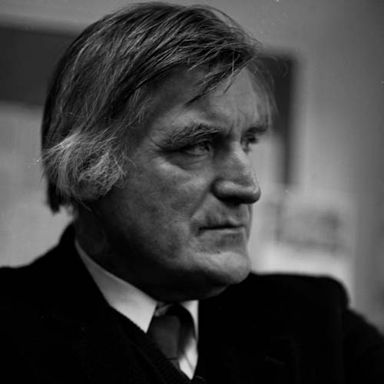
Ted Hughes
Born in Mytholmroyd, Yorkshire in 1930.
Died in 1998.
He published ‘Hawk Roosting’ in 1960.
He served in the Royal Air Force.
Hughes attended Cambridge, where he studied archaeology and anthropology, taking a special interest in myths and legends.
He served as the British Poet Laureate – receiving the Order of Merit from the Queen.
Hughes was married to American poet Sylvia Plath from 1956 until her suicide in 1963 at the age of 30.
Notes:
A portrait of Ted hughes by Rob Lycett. Date: March 19th, 1993. Location: Calder high School, Mytholmroyd, West Yorkshire.

Slide 11
The poem focuses on a hawk boasting about its power, The hawk thinks it is the most important and powerful creature in the world and that it controls the universe. The hawk describes how it likes to kill its prey in a particularly violent way. People have interpreted the poem in different ways – it could be an allegory for the behaviour of political leaders or people in general, or it could be showing the brutality of nature.
Context
Be proactive take your own notes!
Learning Objective:
AO2: Analyse the language, form and structure used by a writer to create meanings and effects, using relevant subject terminology where appropriate.
Notes:
Could it mean the end of the school holidays? Coming back to a new change of year/school/teachers/ does that make you sad.
The loss of good weather? Etc.

Slide 12
This is a dramatic monologue from the point of view of a hawk. In a dramatic monologue an individual character addresses a silent audience – in this poem, the audience could be mankind. The first-person narrative voice gives the hawk authority over the poem’s ideas, while the use of the end-stopping gives several lines a decisive feel, reflecting the hawk’s complete control.
Form
Be proactive take your own notes!
Learning Objective:
AO2: Analyse the language, form and structure used by a writer to create meanings and effects, using relevant subject terminology where appropriate.
Notes:
Could it mean the end of the school holidays? Coming back to a new change of year/school/teachers/ does that make you sad.
The loss of good weather? Etc.

Slide 13
* The poem is set out in six, four line stanzas with the final stanza returning to the imagery of the first verse. * Ordered stanzas- lack of change – equal – continuity of Hawk’s life – 24 lines= 24 hours in a day= continuity. * Hughes does this to show that the Hawk will not allow and does not want change. It is happy with the way things are ordered. * The hawk’s world is disciplined, precise and efficient, and the structure of the poem echoes such qualities. * The lines are short and often end with full stops. The full-stops suggest end, finality, death and assurance. * Hughes uses forceful and blunt sentences to emphasise the single-mindedness of the hawk. These short, abrupt lines suggest the hawk has no time for distractions or differing opinions. *In this way Hughes uses structure to emphasise the unflinching directness and brutality of the hawk.
Structure and tone
Be proactive take your own notes!
Learning Objective:
AO2: Analyse the language, form and structure used by a writer to create meanings and effects, using relevant subject terminology where appropriate.

Slide 14
Key Words:
Sophistry
Monologue
Caesura
Dictatorship/ fascist
How does the poet create a sense of the Hawk’s superiority?
Use Point, Evidence, Analyse (method and meaning) , Link
Learning Objective:
AO2: Analyse the language, form and structure used by a writer to create meanings and effects, using relevant subject terminology where appropriate.

Slide 15
Structure | How is the piece organised on the page? | Can you identify the topic of each stanza? | Are the stanzas equal or unequal?
 | How many stanzas/verses? | Is there rhythm/repetition/enjambment? | What is the line length/rhyme scheme?
Effect
What effect on the reader is the poet aiming to achieve? (How is it intended to make you think/feel?)
What opinion is conveyed by the poet?
What is the purpose of the poet’s choice of language/opinion/theme?
Meaning
What is the poem about?
Can you discover more than one meaning of the poem?
What ideas and themes is the poet portraying?
What is the poet’s point of view?
I sit in the top of the wood, my eyes closed.
Inaction, no falsifying dream
Between my hooked head and hooked feet:
Or in sleep rehearse perfect kills and eat.
The convenience of the high trees!
The air's buoyancy and the sun's ray
Are of advantage to me;
And the earth's face upward for my inspection.
My feet are locked upon the rough bark.
It took the whole of Creation
To produce my foot, my each feather:
Now I hold Creation in my foot
Or fly up, and revolve it all slowly -
I kill where I please because it is all mine.
There is no sophistry in my body:
My manners are tearing off heads -
The allotment of death.
For the one path of my flight is direct
Through the bones of the living.
No arguments assert my right:
The sun is behind me.
Nothing has changed since I began.
My eye has permitted no change.
I am going to keep things like this.
Language | Which words has the poet used to convey meaning? | What are the connotations of the language used? Is there more than one meaning of the word/phrase? | Has the poet used figurative language? (onomatopoeia, alliteration, assonance…) | How has the poet used language to infer meaning?
Imagery | Which images are conveyed to the reader? | Does the poem contain metaphors, similes or personification? | Why do you think the poet has included the images in the poem?

Slide 16
Hawk Roosting
In your opinion, do you believe that the speaker is a) a dictator b) a hawk or c) someone else? | Hughes stated that, ‘Words that will express something of the deep complexity that makes us precisely the way we are.’ How does this poem achieve that? | The first stanza uses rhyme but this quickly slips away. What does this rebellion show about the speaker’s character? | Why does he feel that the earth requires his, ‘inspection’? How does this make him sound as a result?
Explore the imagery used within the lines, ‘My manners are tearing off heads- the allotment of death.’ Consider the straddle across verses ( the previous verse uses enjambment to do this too- why?) | The poem use a dramatic monologue to create an ambiguous speaker. Why do you think the speaker directly addresses the reader? | Hughes was married to famous poet and manic depression sufferer Sylvia Plath. As a result, their relationship was romanticised as idyllic but chaotic. How is the concept of perfection presented in this poem? | Which of the two following words best depicts the speaker? Merciless, misunderstood, superior, perfect, controlling, lonely, unapologetic.
The poem was deemed controversial when published, believed to portray fascism. To what extent do you agree with this viewpoint? | Consider the final line, ‘I am going to keep things like this.’ Is this a realistic statement? Can anyone have ultimate control? | Why do you suppose the mood changes in the final stanza? The line, ‘the sun is behind me,’ sounds as though the speaker is distracted. How might this show a different side to his character? | The speaker ensures that the reader knows, ‘it took the whole of Creation,’ to make him. Can you find other examples of boasting? When do people boast to others in this way?
Meaning | Context | Structure | Language

Slide 17
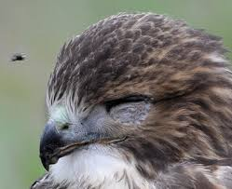
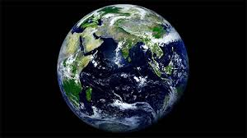
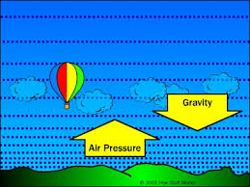
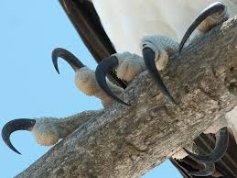
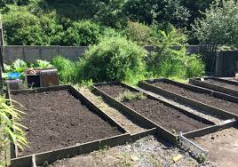
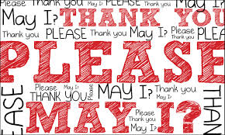
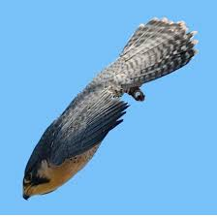
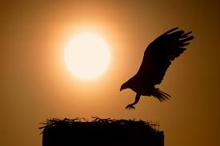
‘Hawk Roosting’ by Ted Hughes Images Task –
Step1. Choose quotations in the poem that match these images.
Step 2. Identify language techniques and word types in at least SIX of these quotations.
THEN answer this question: “How does Hughes use imagery and language to create the feelings of arrogance and power in the poem?
Notes:
Airs buoyancy = balloon

