Slide 1
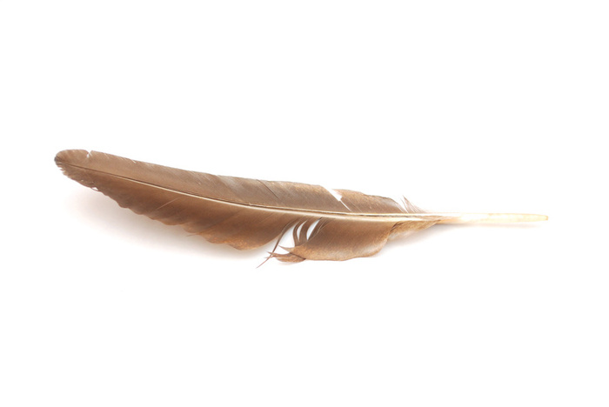
Skellig
Write the date –
Write the title – Context
Underline your title and date
Learning Objectives:
to know the Greek myths David Almond refers to
to understand how these myths relate to ‘Skellig’
Notes:
1

Slide 2
Starter
Look at the following painting
Write down three things you notice about this painting.
Look at the details
(Does anything remind you of ‘Skellig’?
Notes:
2

Slide 3
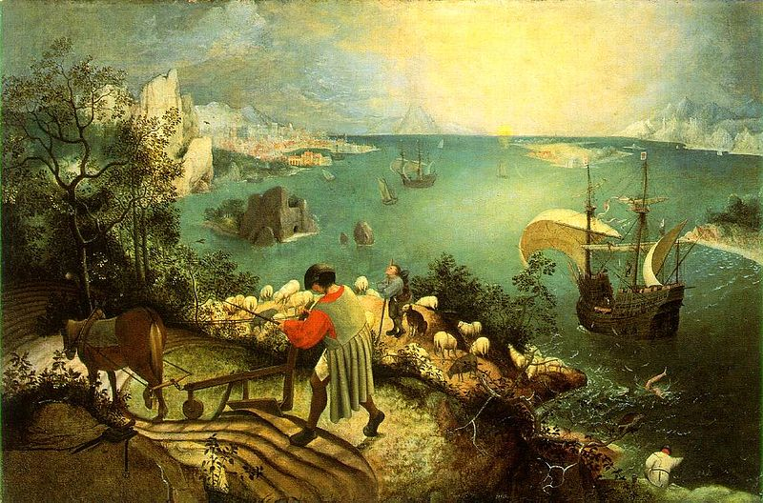

Slide 4
Group Task
Open your books to Chapter 11
What has happened so far?
Notes:
4

Slide 5
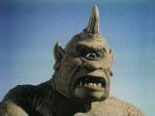
Polyphemus
Polyphemus was a mythological cyclops, a giant who lived alone in a cave. His father was the god of the sea, Poseidon.
Due to a serious storm, a heroic warrior, Oddyseus and his twelve ships were captured by Polyphemus and were unable to escape
Eventually they worked together and blinded him with a wooden stake. While they were escaping, however, Odysseus foolishly told Polyphemus his identity, and Polyphemus told his father, Poseidon, who had blinded him.
Notes:
5

Slide 6
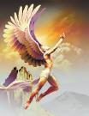
Icarus
Icarus's father, Daedalus, a talented and remarkable craftsman from Athens, attempted to escape from Crete, where he and his son were imprisoned at the hands of King Minos, the king for whom he had built the Labyrinth to imprison the Minotaur (half man, half bull). He was exiled because he gave Minos' daughter a ball of string in order to help Theseus, the enemy of Minos, survive the Labyrinth and defeat the Minotaur.
Daedalus fashioned two pairs of wings out of wax and feathers for himself and his son. Before they took off from the island, Daedalus warned his son not to fly too close to the sun, nor too close to the sea. Overcome by the giddiness that flying lent him, Icarus soared through the sky curiously, but in the process he came too close to the sun, which melted the wax. Icarus kept flapping his wings but soon realized that he had no feathers left and that he was only flapping his bare arms. And so, Icarus fell into the sea in the area which bears his name, the Icarian Sea near Icaria.] It also has been said he flew too close to the sea and the feathers got wet, no longer working due to added weight.
Notes:
6

Slide 7
Individual Task
HELP: ask the person next to you
Answer the following questions in your exercise books in full sentences:
Why do you think David Almond includes the story of Polyphemus in the novel? How does it relate to the story in Skellig?
Why do you think David Almond includes the story of Icarus in the novel? How does it relate to the story in Skellig?
Why do you think Michael asks his mother about shoulder blades?
You have 10mins
End
CHALLENGE: Use details from the stories of Polyphemus and Icarus
Notes:
7

Slide 8
Plenary
In pairs, you will have either a wing or an eye
In the wing write everything you have learnt about Icarus
In the eye write everything you have learnt about Polyphemus
Swap with someone on the other side of the room and add to theirs
Hold up your wings and eyes on your forehead or shoulder blades
Notes:
8

