Slide 1
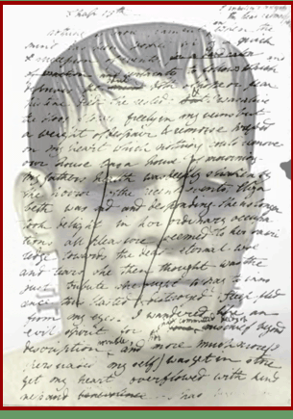
Write down what can you can see – or what you think you can see.
Write 20 words explaining how it makes you feel.

Slide 2
Frankenstein by Mary Shelley
Understand how writers express the thoughts and feelings of characters
Identify and annotate specific language techniques used by the writer for effect.
Write to explain how the writer has created an effect on you.

Slide 3
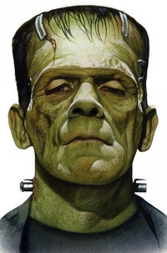
What do you know about this character?
Give him a character/personality
What is he thinking/feeling? How do you know?
CHALLENGE: based on this image alone, what can you infer or deduce about the character?
Start: I infer, because of …………., I think he will be….

Slide 4
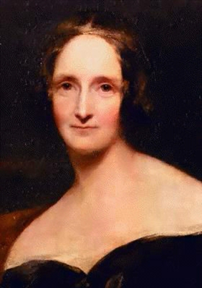
Although she wrote several other books, Frankenstein is her most well known work.
Frankenstein caused a literary sensation in London.
The novel fit smoothly into the popular gothic genre
Frankenstein has lasted over time.
The novel became one of the triumphs of the Romantic movement due to its themes of alienation and isolation and its warning about the destructive power that can result when human creativity is unfettered by moral and social concerns

Slide 5
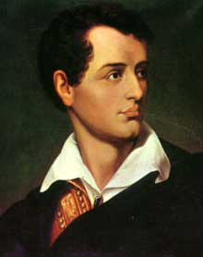
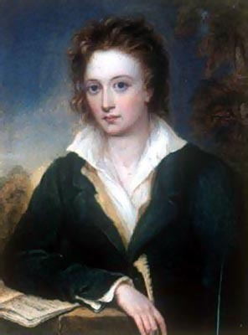
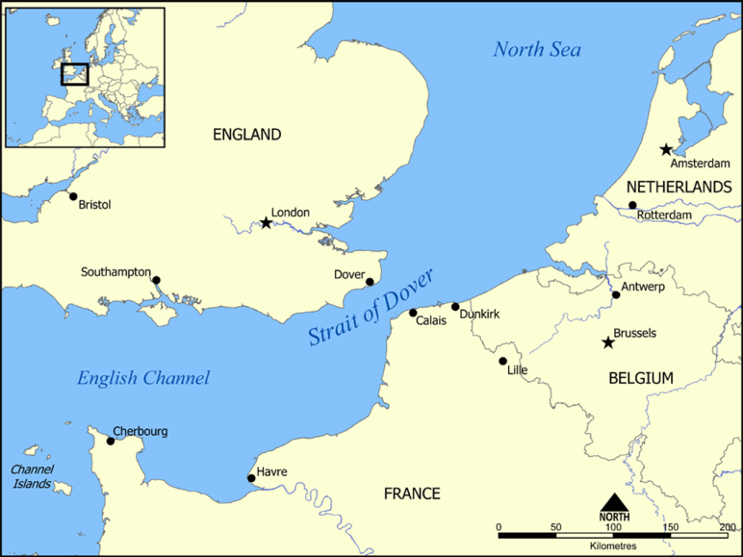
Lord Byron
Mary Shelley
created a competition between himself and…
Percy Bysshe Shelley
To see who could write the best ghost story.
Mary Shelley
Born in London 1797
Died in 1851 with one son and having never remarried.

Slide 6
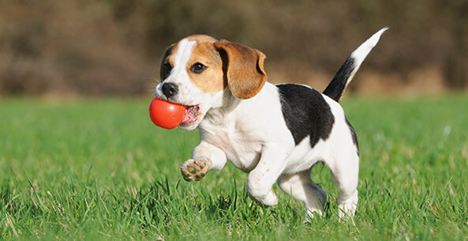
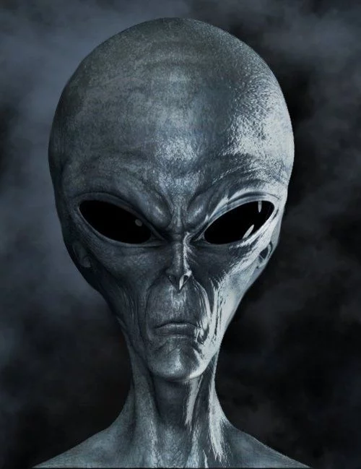
Nouns and noun phrases: list as many other nouns (names) as you can think of, for each thing
Examples:
Animal
Thing
He/she
Bone cruncher
CHALLENGE:
When words like ‘it’, ‘thing’ r ‘object’ are used to describe something, what does it suggest about the attitude towards it?

Slide 7
Frankenstein: Language Analysis
Match the words to their correct definitions: use dictionary/thesaurus
Words from the Extract | Definition/Meaning
Dreary
Toils
Dismally
Convulsive
Catastrophe
Endeavoured

Slide 8
Frankenstein: Language Analysis
Match the words to their correct definitions: use dictionary/thesaurus
Words from the Extract | Definition/Meaning
Dreary
Toils
Dismally
Convulsive
Catastrophe
Endeavoured

Slide 9
Frankenstein: Language Analysis
Check Your Answers
Words from the Extract | Definition/Meaning
Dreary | Depressingly dull and boring
Toils | hard work and efforts
Dismally | In a gloomy or depressed manner
Convulsive | Making jerky movements
Catastrophe | An event causing great damage
Endeavoured | Tried very hard
What can you predict about the text from these lines alone? 20-30 words.
What will the mood be like?

Slide 10
IQ (I’m questioning) how language is used to present Frankenstein’s character

Slide 11
LA: The Monster
You need: pencil, ruler, pen, extract
Read the final paragraph from: ‘How can I describe…’
Highlight all the words that tell us what the monster looks like. (adjectives and nouns)
Now- draw a box approximately 10cm squared in the centre of your page.
SKETCH THE MONSTER BASED ON THE WRITERS’ DESCRIPTION ONLY
Challenge: How does the writer create such a vivid description of the monster? Explain using correct subject terminology.

Slide 12
Analysing the Extract
Part 1: Extract Focus Activities
Highlight all the negative word choices that you can see in the text.
Underline all the descriptions of the weather.
Create a list of quotes describing the creature’s different body parts.
Annotate with: the effect/image these language features create.

Slide 13
Analysing the Extract
Part 2: Development of Ideas:
(Class discussion before writing answers)
How does the negative description link to Victor Frankenstein’s thoughts and feelings about what he has done?
Why does the writer use pathetic fallacy in this scene?
Frankenstein wanted to create something that was perfect.
“His limbs were in proportion, and I had selected his features as beautiful.”
How does reality differ from what he imagined?

Slide 14
Frankenstein by Mary Shelley (1818)
Introduction: Victor Frankenstein describes the moment when, after two years’ work creating a man made from stolen body parts, he brings the creature to life.
It was on a dreary night of November that I beheld the accomplishment of my toils. With an anxiety that almost amounted to agony, I collected the instruments of life around me, that I might infuse a spark of being into the lifeless thing that lay at my feet. It was already one in the morning; the rain pattered dismally against the panes, and my candle was nearly burnt out, when, by the glimmer of the half-extinguished light, I saw the dull yellow eye of the creature open; it breathed hard, and a convulsive motion agitated its limbs.
How can I describe my emotions at this catastrophe, or explain the wretch whom with such infinite pains and care I had endeavoured to form? His limbs were in proportion, and I had selected his features as beautiful. Beautiful! Great God! His yellow skin scarcely covered the work of muscles and arteries beneath; his hair was of a lustrous black, and flowing; his teeth of a pearly whiteness; but these luxuriances only formed a more horrid contrast with his watery eyes, that seemed almost of the same colour as the dun-white sockets in which they were set, his shrivelled complexion and straight black lips.
Dreary
Dull
Miserable
Wretched
Anxiety
Worry
Stress
Disaster
calamity
Misfortune
Unpleasant
Awful
Dark
Sense of foreboding
Sinister
Threatening
Sombre-serious-sad
Half alive/half dead- coming alive

Slide 15
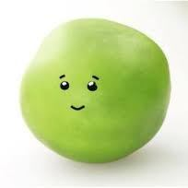
How does Frankenstein feel about his Creation?
Scaffold:
Frankenstein’s Feelings
He has no connection to the creature and doesn’t really care about it.
Evidence:
“the lifeless thing”.
Language Focus (Extension)
By using “thing” it suggests a lack of importance.
Now create at least two of your own!

Slide 16
How does Frankenstein feel about his Creation?
Frankenstein’s Feelings
Point: Clearly, Frankenstein feels horrified by his creation.
Evidence: This can be seen in “my emotions at this catastrophe”.
Analyse the language
This suggests that Frankenstein views the creation as …………………………………………………….
Also, it reveals ………………………………………………………………………………………………………………..
The word (insert type) ‘catastrophe’ shows ………………………………………………………………………………………..
Frankenstein’s horror is also seen in the word (insert type) ‘………………………………..’
This supports my point because ……………………………………………..

Slide 17
Model examples -HA
Example B
Shelley’s overall language is thoughtful and considered. Shelley uses unique metaphors throughout chapter five along with sarcasm and atmosphere. The language Shelley uses shows the emotion sown into her writing. The doctors overall feelings towards his ‘monster’ are portrayed mainly through fear, regret and shame. The language used brings the doctors reactions to life. Shelley strikes at the heart of mankind’s tragedies; life and death. Frankenstein taking control of giving someone life demonstrates that human actions play with peoples emotions and can end in tragedy.
Example A
Mary Shelley creates a grim, distressing atmosphere in the opening of Chapter 5 of her famous gothic novel “Frankenstein” (1816). She conceives this by her careful choice of obscure, descriptive wording which does not just add to the dark atmosphere, but also helps embody the heavy language used, in addition, both the atmosphere and the language contribute to convey Frankenstein’s feelings about his creation. Including wordplay, sarcasm, and alliteration, Mary Shelley’s deliberate use of language devices and wording are often significant but suggestive, insinuating her hopeless story of her painful, monotonous struggle to become a mother. This influenced the Luddite’s opinions on the Industrial Revolution, which is also subtly revealed through Frankenstein’s reactions and descriptions of his monster.

Slide 18
Model examples- M to LA
Frankenstein is a classic novel about one man’s dream to create life. It’s full of sad moments and weird shocks. Victor is sad because his mum died and so he becomes a scientist and learns how to bring dead people back to life. He’s really excited about it and works ever so hard and then when it does happen, Frankenstein is so hideous he’s shocked and horrified and runs away. The writer, Shelley, was a very talented writer and does very well in showing the reader how horrified Victor is.
Overall, Shelley’s use of language in the fifth chapter in one of the most famous gothic horror novels of all time reflects entirely on her experiences surrounding birth. The way she camouflages the most tragic occurrences of her life into her use of metaphors captivates the reader and gives them the chance to delve into her life leading up to the publishing of the novel. The way the situations of her life are moulded into just one chapter displays her experiences, but forces the reader to use symbolism to fully understand and identify where she has placed them.

Slide 19
Homework
Imagine you are Victor Frankenstein. Write a diary entry describing your thoughts and feelings towards the monster you have created. Refer to information in the text we have read in order to make links/references.
Dear dairy,
Today I created the most …..

