Slide 1
Welcome to English Year 7
Notes:
LESSON 1

Slide 2
Title: Eyewitness Account
Learning Objectives: To be able to recall, identify and select features of descriptive writing.
Do Now
Notes:
Discuss the title.

Slide 3
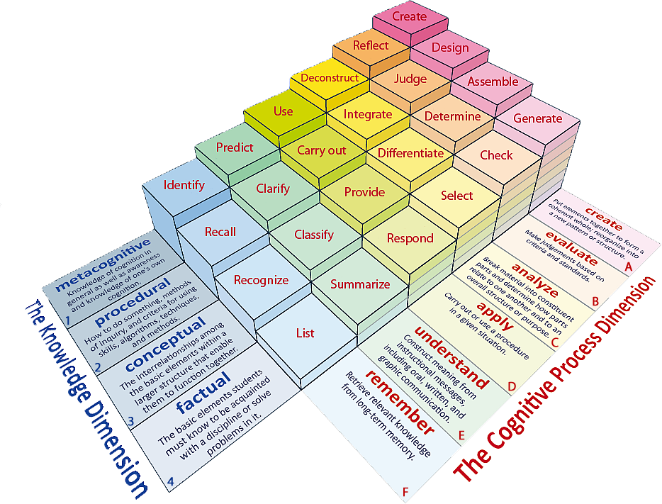
Learning Objectives: To be able to identify; to generate ideas and to use descriptive writing features.
Learning Content

Slide 4
Writing to Describe
Learning Objectives: To be able to identify; to generate ideas and to use descriptive writing features.
Colour
Adjectives/Adverbs
Senses
Sentence structures
Imagery
Emotion
Checking Understanding
Notes:
Discuss with students and ensure they understand each element of Cassie.

Slide 5
Remember CASSIE!
Learning Objectives: To be able to identify; to generate ideas and to use descriptive writing features.
Paragraph 1- Days leading up to the eruption
COLOUR
ADJECTIVES/ ADVERBS
SENSES
SENTENCE STRUCTURES (STARTS)
IMAGERY (SIMILIES)
EMOTIONS
Planning
Notes:
A3 planning sheets- students to fold sheets into 4 boxes- each box forms the plan for students 4 paragraphs.

Slide 6
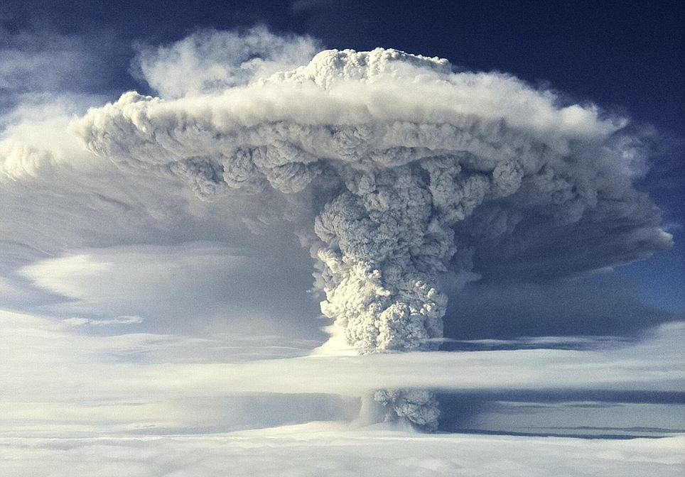

Slide 7
Remember CASSIE!
Learning Objectives: To be able to identify; to generate ideas and to use descriptive writing features.
Paragraph 2- 8.30 Ash and Steam emerge from volcano top.
COLOUR
ADJECTIVES/ ADVERBS
SENSES
SENTENCE STRUCTURES (STARTS)
IMAGERY (SIMILIES)
EMOTIONS
Planning
Notes:
A3 planning sheets- students to fold sheets into 4 boxes- each box forms the plan for students 4 paragraphs.

Slide 8
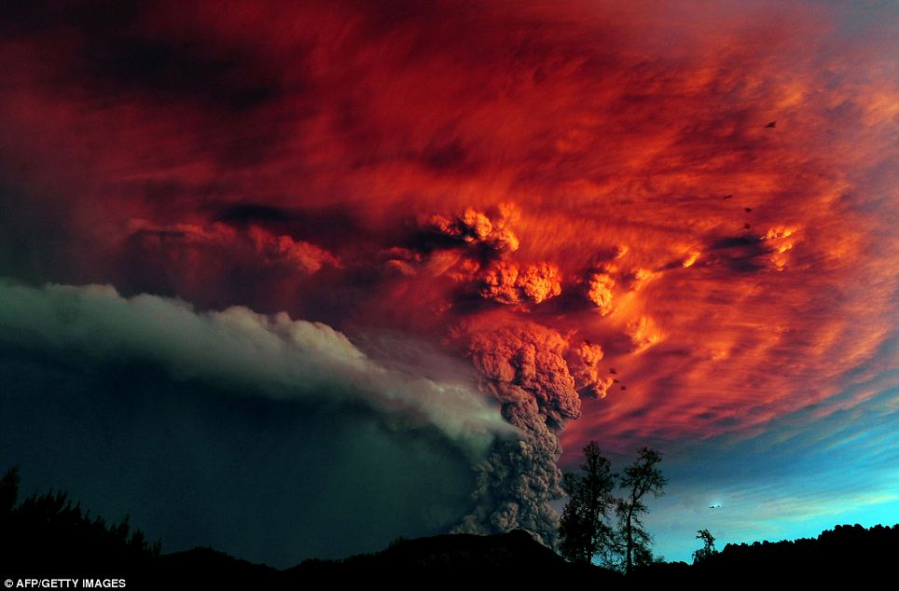

Slide 9
Remember CASSIE!
Learning Objectives: To be able to identify; to generate ideas and to use descriptive writing features.
Paragraph 3- The Eruption
COLOUR
ADJECTIVES/ ADVERBS
SENSES
SENTENCE STRUCTURES (STARTS)
IMAGERY (SIMILIES)
EMOTIONS
Planning
Notes:
A3 planning sheets- students to fold sheets into 4 boxes- each box forms the plan for students 4 paragraphs.

Slide 10
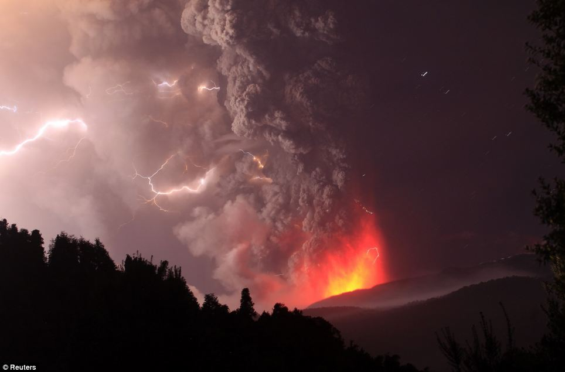

Slide 11
Remember CASSIE!
Learning Objectives: To be able to identify; to generate ideas and to use descriptive writing features.
Paragraph 4- The Aftermath
COLOUR
ADJECTIVES/ ADVERBS
SENSES
SENTENCE STRUCTURES (STARTS)
IMAGERY (SIMILIES)
EMOTIONS
Planning
Notes:
A3 planning sheets- students to fold sheets into 4 boxes- each box forms the plan for students 4 paragraphs.

Slide 12
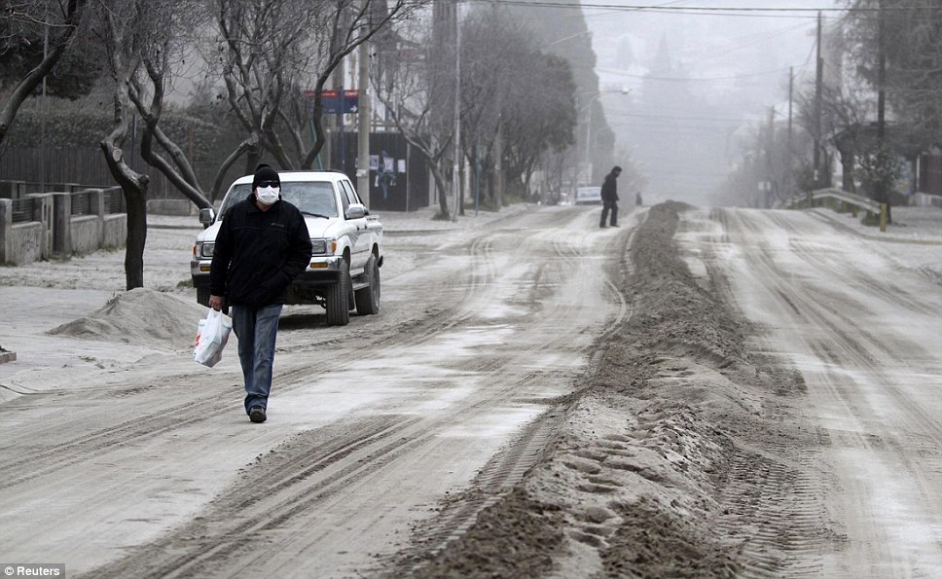

Slide 13
Planning Sheet
Learning Objectives: To be able to use descriptive writing features in order to create an eye witness account.
Refresh your memory.
Have a look at your planning sheet. Remind yourself about what you are going to describe in each of your 4 paragraphs.
Is there anything you want to add in?
Do Now
Notes:
LESSON 6

Slide 14
Learning Objectives: To be able to use descriptive writing features in order to create an eye witness account.
Learning Content
Notes:
Lesson 5

Slide 15
Thesaurus Work
Learning Objectives: To be able to use descriptive writing features in order to create an eye witness account.
Use a thesaurus to replace some of the words on your planning sheet with more ambitious choices.
Remember to use these choices when your write your description.
Unlocking Vocabulary

Slide 16
Learning Objectives: To be able to use descriptive writing features in order to create an eye witness account.
Writing Our Eyewitness Accounts You will be writing a descriptive account of a volcano eruption, from the point of view of an eyewitness, for a geography textbook to be studied in year 5.
Writing Success
You must:
Write in the first person, imagining you are an eyewitness
1. Start with a verb ending in - ing
2. Start with an adjective ending in - ed
3. Start with an adverb ending - ly
4. Start with a preposition e.g. over, at, on
5. Use simple, compound, complex sentences
Use the senses to describe
Use sophisticated vocabulary
Use figurative language e.g. similes, metaphors, personification etc.
Writing Task
Writing to Describe
C
A
S
S
I
E

