Slide 1
Title: Eyewitness Account
Learning Objectives: To be able to recall, identify and select features of descriptive writing.
Do Now
Notes:
Discuss the title.

Slide 2
Task: Eyewitness Account
Learning Objectives: To be able to recall, identify and select features of descriptive writing.
You will be writing a descriptive account of a volcano eruption, from the point of view of an eyewitness, for a geography textbook to be studied in Year 7.
Checking Understanding
We need to identify the GAP
Notes:
With an writing task discuss the three areas you need to identify- GAP.

Slide 3
How do I succeed at writing?
Learning Objectives: To be able to recall devices; to generate ideas and to use descriptive writing features.
Using a variety of sentences in a controlled way
Using a full range of punctuation
Organising writing in a controlled and sequenced way to guide the reader
Using paragraphs to support the meaning and purpose of the text
Developing ideas with imaginative details
Styling your work so it is appropriate for year seven textbook and an eyewitness account
Using a wide range of vocabulary
Do Now
Notes:
LESSON 2

Slide 4
Task: Eyewitness Account You will be writing a descriptive account of a volcano eruption, from the point of view of an eyewitness, for a geography textbook to be studied in year 5.
Learning Objectives: To be able to recall devices; to generate ideas and to use descriptive writing features.
Mastery
What does an erupting volcano
look like?

Slide 5
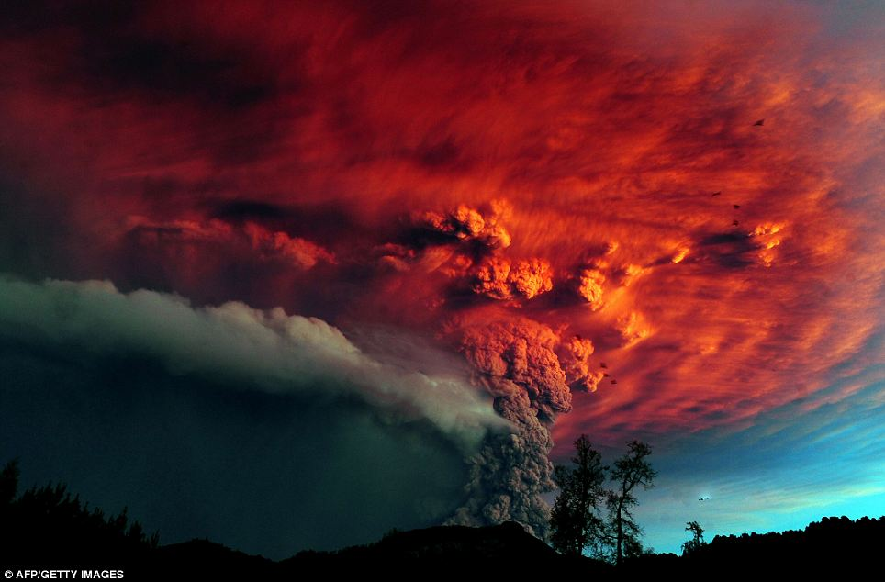

Slide 6
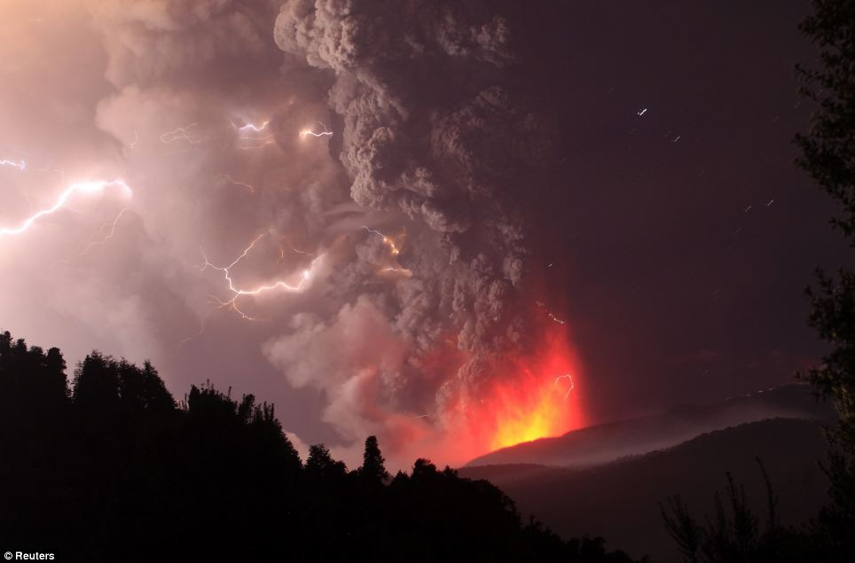

Slide 7
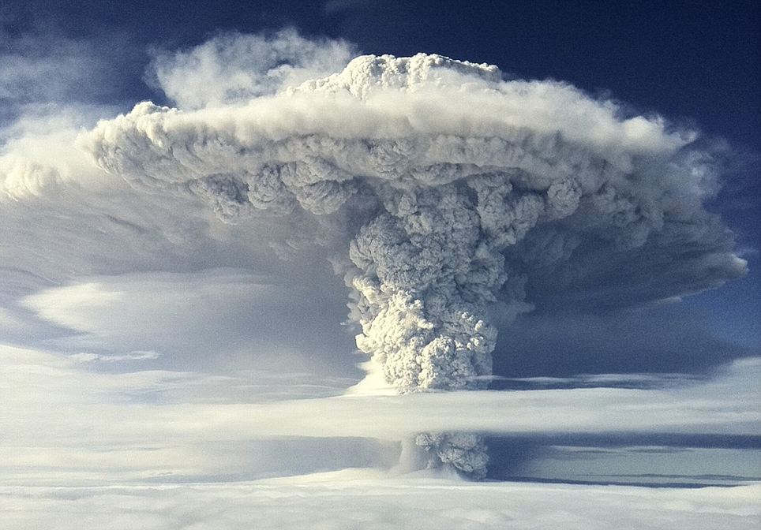

Slide 8
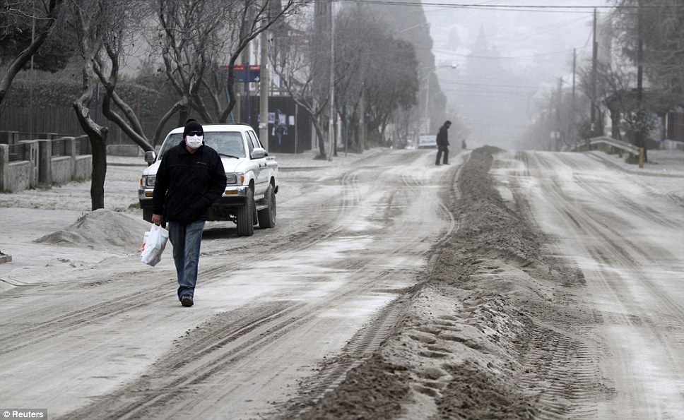

Slide 9
Mt. St. Helen’s Eruption
Learning Objectives: To be able to recall devices; to generate ideas and to use descriptive writing features.
What does an erupting volcano look like?
Video
Video 2
TASK: Mind map any words or phrases that you could use to describe this.
Mastery
Notes:
Watch videos to see images

Slide 10
FACT: 8.30 – ash and steam emerge from volcano top
Learning Objectives: To be able to recall devices; to generate ideas and to use descriptive writing features.
The day had only just started. People were eating breakfast, driving to work, walking the dog. All seemed normal. The sky was blue and the sun was warming the ground. I looked out of the window to check whether or not to peg out the washing, when, in the distance, I noticed that the usual silhouette of the Mountain was blurred by what appeared to be a lone, dense, storm cloud.
Mastery
Notes:
Discuss what the next sentence could be, using the information learned from the videos.

Slide 11
Writing Success- It is all about the Details!
Learning Objectives: To be able to recall devices; to generate ideas and to use descriptive writing features.
Mastery
Select 4 facts from your notes that you will use in your account.
Now, write a brilliant descriptive sentence for each fact.

Slide 12
Homework:
Learning Objectives: To be able to recall devices; to generate ideas and to use descriptive writing features.
Write descriptive sentences about a volcano for all 5 senses.
Due:
Homework

Slide 13
Learning Objectives: To be able to identify; to generate ideas and to use descriptive writing features.
In order to get a good level you need to be able to use a variety of sentence structures to achieve different effects.
Can anyone explain what a simple, compound or complex sentence is?
Do Now
Notes:
LESSON 3

Slide 14
Learning Objectives: To be able to use descriptive writing features in order to create an eye witness account.
Writing Our Eyewitness Accounts You will be writing a descriptive account of a volcano eruption, from the point of view of an eyewitness, for a geography textbook to be studied in year 7.
Writing Success
You must:
Write in the first person, imagining you are an eyewitness
1. Start with a verb ending in - ing
2. Start with an adjective ending in - ed
3. Start with an adverb ending - ly
4. Start with a preposition e.g. over, at, on
5. Use simple, compound, complex sentences
Use the senses to describe
Use sophisticated vocabulary
Use figurative language e.g. similes, metaphors, personification etc.
Writing Task
Writing to Describe
C
A
S
S
I
E

