Slide 2
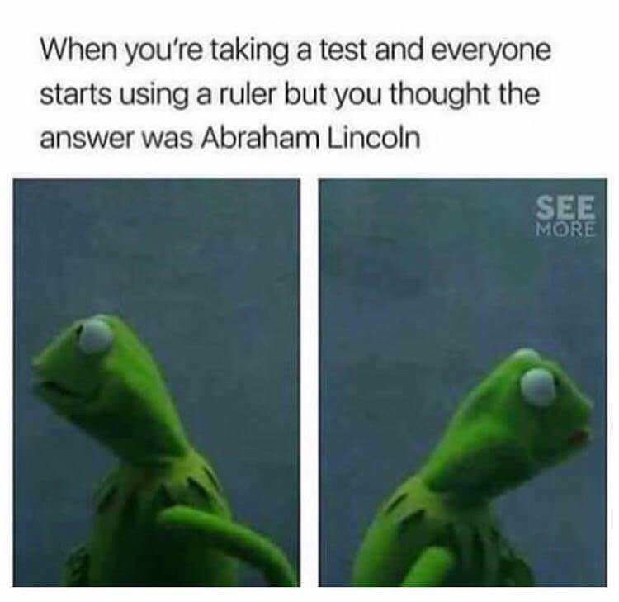
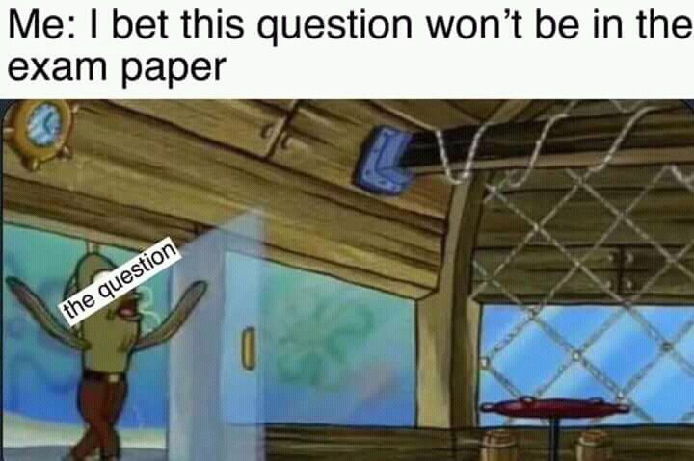

Slide 3
Write about Mrs Birling and how she is presented at different points in the play.
In your response you should:
• refer to the extract and the play as a whole • show your understanding of characters and events in the play [40]

Slide 4
Band 5
29-35 marks
Candidates: analyse and appreciate writers’ use of language, form and structure; make assured reference to meanings and effects exploring and evaluating the way meaning and ideas are conveyed through language structure and form; use precise subject terminology in an appropriate context.
Candidates: sustain focus on the task, including overview, convey ideas with consistent coherence (clearly) and use an appropriate register; use a sensitive and evaluative approach to the task and analyse the extract and wider text critically; show a perceptive understanding of the extract and wider text, engaging fully, perhaps with some originality in their personal response; their responses include pertinent, direct references from across the extract and wider text, including quotations.
SpaG = 5 marks

Slide 5
Examiner’s Report
The best responses were able to move between close analysis of language to discussion of the bigger ideas such as the generational divide or issues of social inequality in Britain. Although context is not assessed in this question, many responses benefited from knowledge of wider contextual issues such as the difference between capitalism and socialism. This knowledge allowed candidates to broaden their discussion and to engage with the writer’s intentions and messages.
Also, the best responses were clearly structured, many containing a brief introduction presenting an overview of the character, and a detailed argument developed.

Slide 6
Stronger candidates focused on the contrast between Mrs Birling and the younger generation, particularly Sheila and were able to comment on the text as a conscious construct at this level. Top band candidates were often able to create an argument about Mrs Birling in terms of this – looking at her role representing the older generation and how a contemporary audience would view her following WW2.
Attitudes to women and to the lower classes were explored, with more able candidates exploring the use of language to convey Mrs Birling’s dislike of Eva and ‘that sort’. There was also much consideration of Priestley’s use of Mrs Birling to criticise old-fashioned views.

Slide 7
What to include:
Criteria
Overview (general argument)
Mrs. Birling, or Sybil is a notable character that immediately creates a negative dramatic impact on the audience. A contemporary audience of 1946 will especially find her insulting due to her naïve views about___________, her lack of _____________and her ignorance and need to classify and put people into a category.
She is first introduced in the director’s notes as __________________ and she is…
We first start to despise her at the play’s opening when she shows… and she says, “_________________”.
The word ”___________” suggests/highlights/underlines/is indicative of...
Furthermore, in the extract, her demeanor towards the Inspector is shown in the stage directions, “smiling and social”. This alliterative sickening ingratiating social fake smile makes us feel… when she says...
Incidentally, her attitude flies in the face of the popular public social views, since a recent landslide election of the social party in 1946, her attitudes of class is repugnant. “Girls of that class” here, her subconscious reference to “girls” instead of women, reveals… as well “that class” further reveals...
Her own daughter’s treatment subtly reveals her feelings about social standing of women – the audience hasn’t forgotten the important role women played in the war, so will feel… when she says... The words, _________________ is Priestley’s dramatic irony...
Examine lang.
(keep it clear and to the point)
Examine structure
Pick out traits and key quotes at the start about her cold nature.
Dramatic devices: interruption, entrances, dramatic irony.
How she treats others (Arthur, Sheila)
Perceptive
Thoughtful
understanding – zoom in in key words
Her attitude about classes
Priestley’s intentions
Appreciate writer’s craft
How she speaks – her motivations
Get personal – your feelings about her
How she treats Sheila, the Inspector

