Slide 1
English Language GCSE
Component 2 – Combining information from two texts.

Slide 2
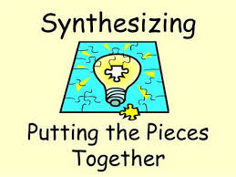
Learning Objective:
AO1 Skills
Select and synthesize evidence from different texts.
Key term:
Synthesize: to combine or put together

Slide 3
In the exam:
You will have one 19th century text and one from this century which will be linked in some way, possibly by their topic.
At least one of the questions will want you to synthesize information from the two texts.
This means that must read both texts carefully, find and then combine the information required in your answer.

Slide 4
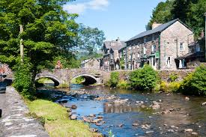
Our texts
The texts we will be using tell the legend of how a town in Snowdonia called Beddgelert got its name. Extract 1 is taken from a book called Wild Wales written by the English author George Borrow in 1862. Extract 2 is from the Beddgelert Tourism webpage.

Slide 5
Extract 1

Slide 6
Read extract one.
Activity 1
Use the context of the extract and your own knowledge to work out the meanings of the following words.
Besmeared
Paroxysm
Indignation
Forthwith
Transfixed
Hastened
Expired
Covered/smeared with
Sudden attack
Anger/annoyance
Immediately
become motionless with horror
be quick
died

Slide 7
Extract 2

Slide 8
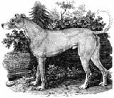
Now read both extracts.
Activity 2.
You will now put together information on the three main characters in the story. Copy and complete the table below. Select more than one quotation for each character to provide a range of details.
Character | Quotations from extract 1 | Quotations from extract 2
The wolf | “in quest of prey” “the monster”
The dog as the Prince returns from hunting/expedition. |  | “the truant, stained and smeared with blood”
The feelings of the Prince as he finds out Gelert did not kill the baby.

Slide 9
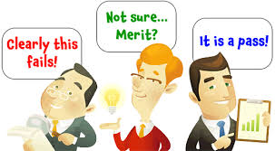
Question and Mark Scheme
Explain what you learn about Gelert (the dog) in both texts. [4]
Mark | Criteria
0 | Nothing worthy of credit.
1 | Some selection of relevant detail from both texts.
2 | Selects a range of relevant detail from both texts.
3 | Synthesizes with some understanding a range of relevant detail from both texts.
4 | Synthesizes with clear understanding and provides an overview drawn from a range of relevant detail from both texts.
“relevant detail” means you must select points about the dog.
Avoid repeating yourself; if both texts say the same thing, use “Both texts suggest ….
Select quotations from both texts, even if what you learn about the dog is the same.
Say which text your ideas/ quotations are from.
Cover enough points from both texts to show a good understanding of the similarities and differences in what is said about the dog.

Slide 10
Question and Mark Scheme
Explain what you learn about Gelert (the dog) in both texts. [4]
TOP ANSWERS - A*
Answers in the top mark band “provide an overview”; this means they take a step back from the detail and consider the bigger picture of the texts. An overview works like the headline of an article or the summary of the weather forecast, giving the main points either before or after all the details have been considered. If there is a main difference to notice, commenting on it would show you can “synthesize with clear understanding”

Slide 11
Example student response

