Slide 1
Do Now
Where, and what, might this path lead to?

Slide 2
Learning outcomes
To describe the ways Egeus is presented in the extract
To explain why Shakespeare shows Egeus in these ways in the extract
To evaluate how Shakespeare uses language to present Egeus in the extract
Learning Content

Slide 3
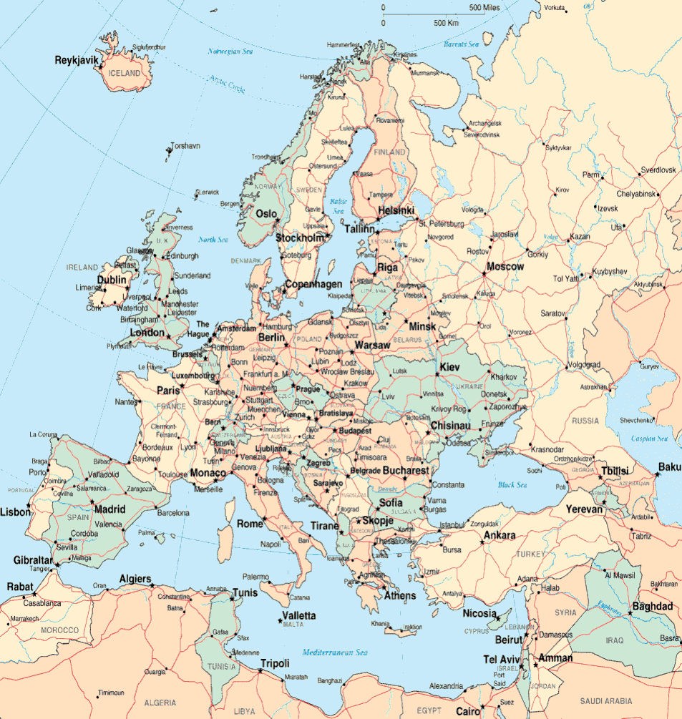
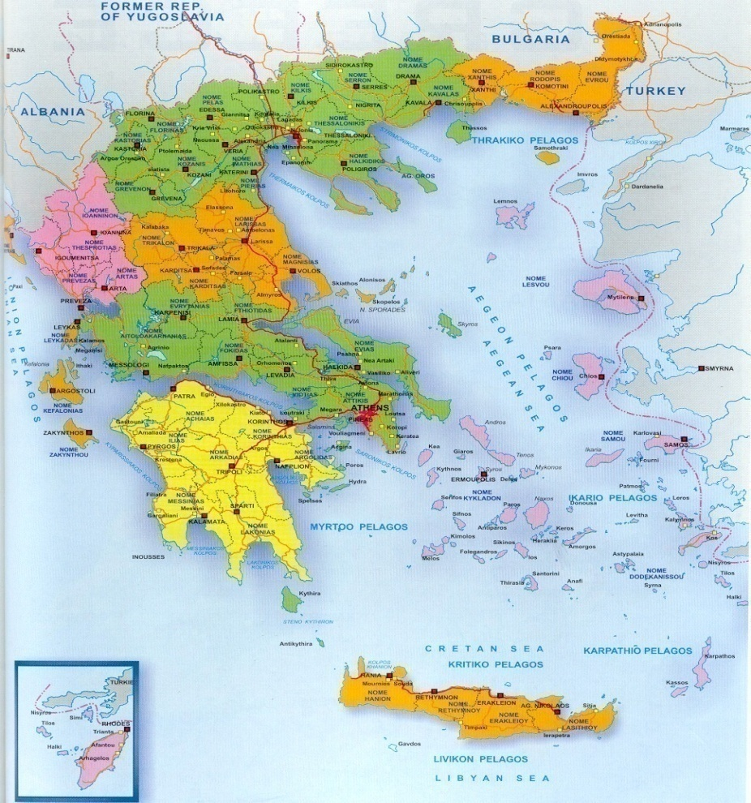
The Beginning of the Play: In Athens
The first scene of the play opens in Athens in Greece.
Europe
Greece and Athens
Context
ATHENS

Slide 4
The Beginning of the Play: In Athens
“Why would Shakespeare set his plays in a different country?”
Hook
What was happening in the 14th and 15th Centuries?
2 minutes to jot down your thoughts and share.

Slide 5
Act I Scene I
Athens is a joyous city that is awaiting the wedding of its
Duke to Hippolyta. Everyone is celebrating…except
The play opens with Theseus and Hippolyta
briefly discussing their wedding.
Context
An angry Egeus enters with his daughter Hermia and
two young men called Demetrius and Lysander.
All exit apart from Hermia and Lysander.
Hermia’s friend Helena enters. They discuss her
love for Demetrius. She is jealous of Hermia.

Slide 6
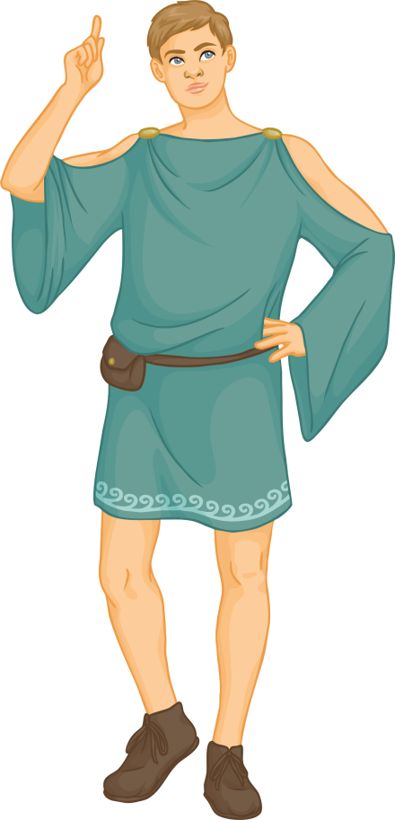
Opening scene
As we follow the events of the opening scene, you should make a note of characters in your books, like a cast list in a theatre programme.
Each time you encounter a new character, you should record:
their name;
their relationship to other characters;
personality traits;
any other key details.
Reading & thinking Task
Challenge: What themes are shown in the opening scene?

Slide 7
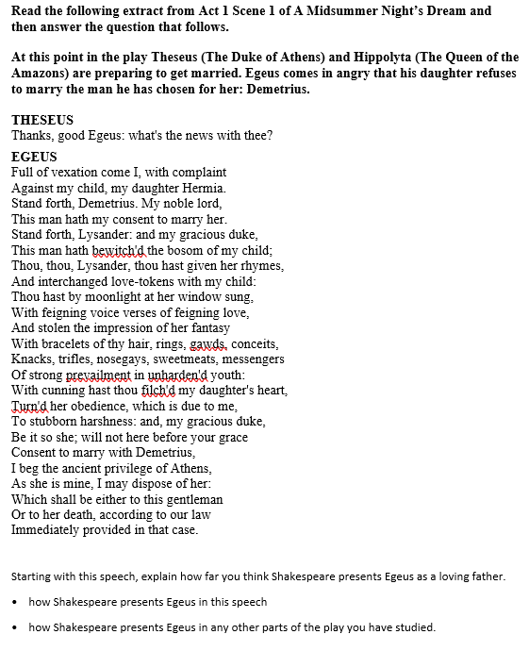
HA-A Midsummer Night’s Dream
Challenge: Match up the adjectives to the quotes and then explain the choices you made.
Extra Challenge: Look at the adjectives to describe Egeus below. Try to match adjective to a quote from your assessment extract. Explain your interpretations.
Mega Challenge: Find quotes from the text that a modern audience may find very negative and also to find quotes that people from the Elizabethan period that would find very positive. Explain your choices.
Unlocking vocabulary
Hurt
Disgusted
Unhappy
Shocked
Desperate
Determined
Angry
Unreasonable
Devoted
Caring
Loving
Aggressive
Evil

Slide 8
Aggressive
Full of vexation come I, with complaint Against my child, my daughter Hermia.
Disgusted
Stand forth, Lysander: and my gracious duke, This man hath bewitch'd the bosom of my child;.
Hurt
Shocked
Thou, thou, Lysander, thou hast given her rhymes, And interchanged love-tokens with my child:
Angry
Unlocking vocabulary
Determined
And stolen the impression of her fantasy
With cunning hast thou filch'd my daughter's heart, Turn'd her obedience, which is due to me, To stubborn harshness:
Which shall be either to this gentleman Or to her death, according to our law Immediately provided in that case.
Challenge: Match up the adjectives to the quotes and then explain the choices you made.

Slide 9
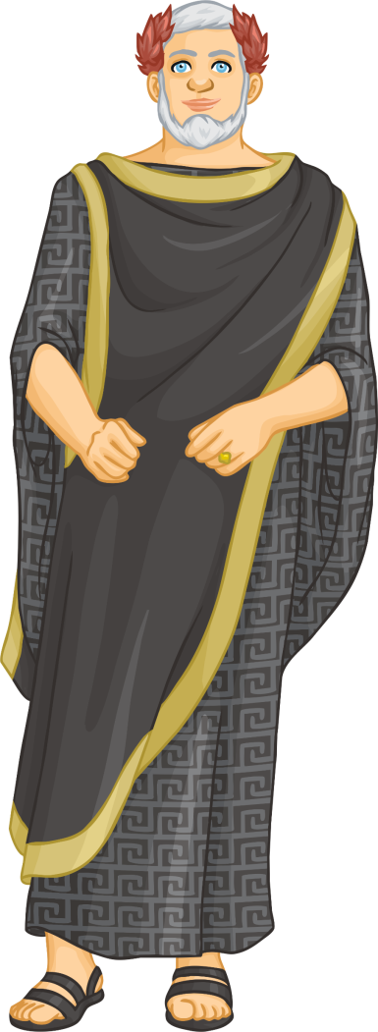
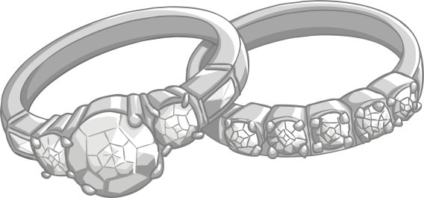
Athens
Checking understanding
In this palace lives the ruler of Athens, Duke Theseus.
On one side of Athens is a wood, and on the other side is a palace. Our story begins in the palace.
Theseus has recently been at war with Queen Hippolyta, a very strong and powerful lady who rules nearby lands. Having finally made peace, they are now to be married.
Imagine we are going back in time, hundreds of years, to Athens, Greece…

Slide 10
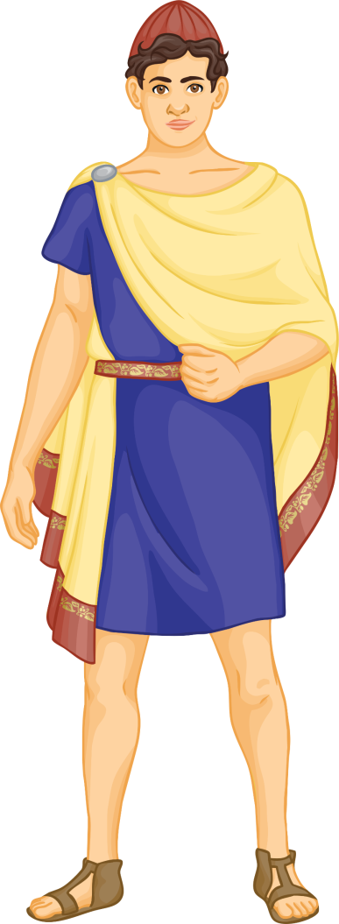
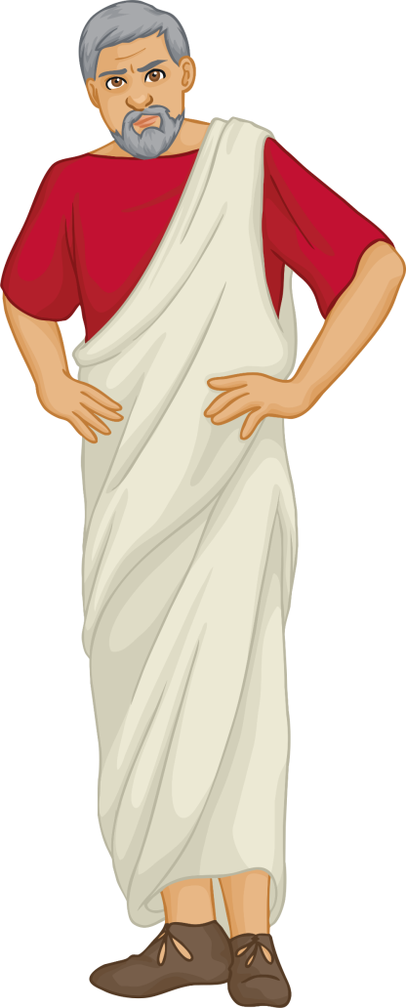
Athens
Checking understanding
Egeus has brought his daughter Hermia to the meeting.
They have been having a heated argument. Hermia is a sweet, beautiful girl, but she can also be extremely stubborn.
Inside the palace, important meetings are taking place in preparation for the wedding.
In the middle of a royal meeting, a good friend of Duke Theseus bursts in, ‘full of vexation’! His name is Egeus.
Their disagreement is over a young man who Hermia is in love with.
His name is Lysander and he is very romantic, constantly bestowing gifts upon his beloved Hermia.

Slide 11
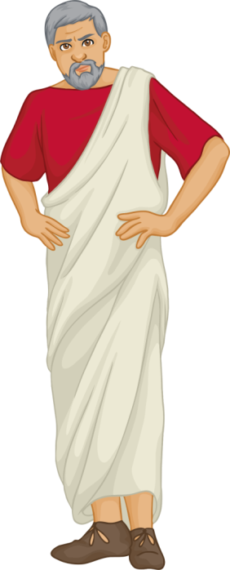
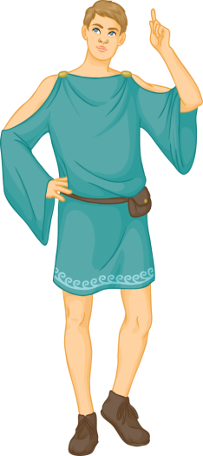
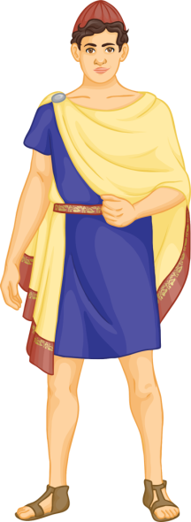
What’s the Problem?
Egeus has in mind for Hermia another man, named Demetrius. Though Demetrius is a jolly nice chap who also dotes on Hermia, she is firmly in love with Lysander. However, since the law is on Egeus’ side, he has brought her before the Duke so that he may decide what becomes of these lovers.
Checking understanding
There is one further complication… Hermia’s best friend is Helena. They have grown up together and share all their secrets.
In ancient Athens, the law states that a father owns his daughter, and that she should do whatever he dictates!

Slide 12
THESEUS
Thanks, good Egeus: what's the news with thee?
EGEUS
Full of vexation come I, with complaint Against my child, my daughter Hermia. Stand forth, Demetrius. My noble lord, This man hath my consent to marry her. Stand forth, Lysander: and my gracious duke, This man hath bewitch'd the bosom of my child; Thou, thou, Lysander, thou hast given her rhymes, And interchanged love-tokens with my child: Thou hast by moonlight at her window sung, With feigning voice verses of feigning love, And stolen the impression of her fantasy With bracelets of thy hair, rings, gawds, conceits, Knacks, trifles, nosegays, sweetmeats, messengers Of strong prevailment in unharden'd youth: With cunning hast thou filch'd my daughter's heart, Turn'd her obedience, which is due to me, To stubborn harshness: and, my gracious duke, Be it so she; will not here before your grace Consent to marry with Demetrius, I beg the ancient privilege of Athens, As she is mine, I may dispose of her: Which shall be either to this gentleman Or to her death, according to our law Immediately provided in that case.
Egeus is full of vexation or frustration with his daughter because she won’t marry Demetrius – the man he has chosen for her. This could show he is loving as he wants her to marry a suitable husband. It was normal for parents to choose husbands and wives for their children in the Elizabethan period.
Egeus accuses Lysander of ‘bewitching’ his daughter Hermia, which suggests Lysander has put a spell on her or done something unnatural. Egeus calls Hermia ‘my child’ which might show he loves her and cares for her, or might show he is very protective.
Egeus accuses Lysander of using ‘rhymes’ or poems, ‘love-tokens’ or small gifts on Hermia to win her love. ‘Feigning’ means to pretend, so Egeus accuses Lysander of not really loving Hermia.
Reading and thinking
‘Stolen’ implies Lysander is a thief and has stolen Hermia’s heart (which is a ‘fantasy’) with lots of little gifts like sweetmeats and nosegays or little flowers.
With ‘cunning’ or deceit (lying) Lysander has ‘filched’ or stolen Hermia’s heart, according to Egeus. He is also angry that his daughter will not be obedient to him as her father.
Egeus asks Theseus to use his power to either execute Hermia or make her marry the man he has chosen for her – Demetrius.

Slide 13
Blank extract – use for any ability if wish
THESEUS
Thanks, good Egeus: what's the news with thee?
EGEUS
Full of vexation come I, with complaint Against my child, my daughter Hermia. Stand forth, Demetrius. My noble lord, This man hath my consent to marry her. Stand forth, Lysander: and my gracious duke, This man hath bewitch'd the bosom of my child; Thou, thou, Lysander, thou hast given her rhymes, And interchanged love-tokens with my child: Thou hast by moonlight at her window sung, With feigning voice verses of feigning love, And stolen the impression of her fantasy With bracelets of thy hair, rings, gawds, conceits, Knacks, trifles, nosegays, sweetmeats, messengers Of strong prevailment in unharden'd youth: With cunning hast thou filch'd my daughter's heart, Turn'd her obedience, which is due to me, To stubborn harshness: and, my gracious duke, Be it so she; will not here before your grace Consent to marry with Demetrius, I beg the ancient privilege of Athens, As she is mine, I may dispose of her: Which shall be either to this gentleman Or to her death, according to our law Immediately provided in that case.
Reading and thinking

Slide 14
Analyse and annotate Egeus’ speech
Support:
Use the extract with tasks sheet given to you to help you make notes on how Egeus is presented in this extract. Explain your ideas.
Don’t forget:
Egeus is very angry.
Parents had the power over children, in particular who their daughter married.
Women had little education and no power or possessions.
Reading and Thinking
HA: on your extract, highlight , annotate and evaluate and explain the different presentations of Egeus in the extract – be brief but clear. (You will use this to write up your PEA paragraphs)
MA: Annotate the extract and explain how Egeus is presented to the audience in this extract.

Slide 15
Now let’s focus on Egeus’ use of language within the extract
“Thou, thou, Lysander, thou hast given her rhymes, And interchanged love-tokens with my child”
Repetition used to accentuate Egeus’ anger at Lysander for his wooing of Hermia.
Identify the different features being used.
Find the language features used and explain for each how they affect the way the audience views Egeus.
Describe the language features that present Egeus as a loving father and language features used to suggest he may be unreasonable or cruel. Create detailed notes on the use of language within the extract.
Reading and Thinking
Here’s an example

Slide 16
THESEUS
Thanks, good Egeus: what's the news with thee?
EGEUS
Full of vexation come I, with complaint Against my child, my daughter Hermia. Stand forth, Demetrius. My noble lord, This man hath my consent to marry her. Stand forth, Lysander: and my gracious duke, This man hath bewitch'd the bosom of my child; Thou, thou, Lysander, thou hast given her rhymes, And interchanged love-tokens with my child: Thou hast by moonlight at her window sung, With feigning voice verses of feigning love, And stolen the impression of her fantasy With bracelets of thy hair, rings, gawds, conceits, Knacks, trifles, nosegays, sweetmeats, messengers Of strong prevailment in unharden'd youth: With cunning hast thou filch'd my daughter's heart, Turn'd her obedience, which is due to me, To stubborn harshness: and, my gracious duke, Be it so she; will not here before your grace Consent to marry with Demetrius, I beg the ancient privilege of Athens, As she is mine, I may dispose of her: Which shall be either to this gentleman Or to her death, according to our law Immediately provided in that case.
Emotive language used to show Egeus’ desperation, anger and hurt
Hyperbolic verbs used to emphasise Egeus’ disgust at Lysander and his anger at the relationship between Lysander and Hermia. Egeus accuses Lysander of stealing and filching Hermia’s heart, rather than doing it honestly.
Repetition used to accentuate Egeus’ anger at Lysander for his wooing of Hermia. ‘Feigning’ means false or fake, so Egeus accuses Lysander of not really loving Hermia but only pretending.
Egeus lists many small items that he claims Lysander use to woo Hermia.
Egeus uses a positive adjective and flattery to try to persuade the duke to agree to his demand.
Model

Slide 17
LA – MA “Using this speech, explain how far you think Shakespeare presents Egeus as a loving father.”
Egeus is presented as a loving father because… | Egeus is not presented as a loving father because…
He accuses Lysander of ‘feigning’ love, so he may just be protecting his daughter. | He is willing to see his daughter die rather than let her marry Lysander.
Check understanding
Create your table in your exercise book and fill it in with as many ideas as possible.
Bonus Challenge: Try to add specific quotes to your answer to support your ideas.

Slide 18
Now use the rest of the time to complete your notes and planning for your PEA paragraph
Based on this speech, explain how far you think Shakespeare presents Egeus as a loving father.
• how Shakespeare presents Egeus in this speech
Mastery

Slide 19
Plenary: End of the Scene
Where, and what, might this path lead to? Has your view changed?
Upon learning of their fate, Hermia and Lysander hatch a plan to run away to his aunt’s house, through the woods.
Plenary
Hermia confides in Helena their plans, and Helena in turn tells Demetrius.
The scene ends with all four young lovers running off into the woods: Hermia and Lysander, followed by Demetrius, followed by Helena.

