Slide 1
Do Now
Where, and what, might this path lead to?

Slide 2
Learning outcomes
To describe the ways Egeus is presented in the extract
To explain why Shakespeare shows Egeus in these ways in the extract
To evaluate how Shakespeare uses language to present Egeus in the extract
Learning Content

Slide 3
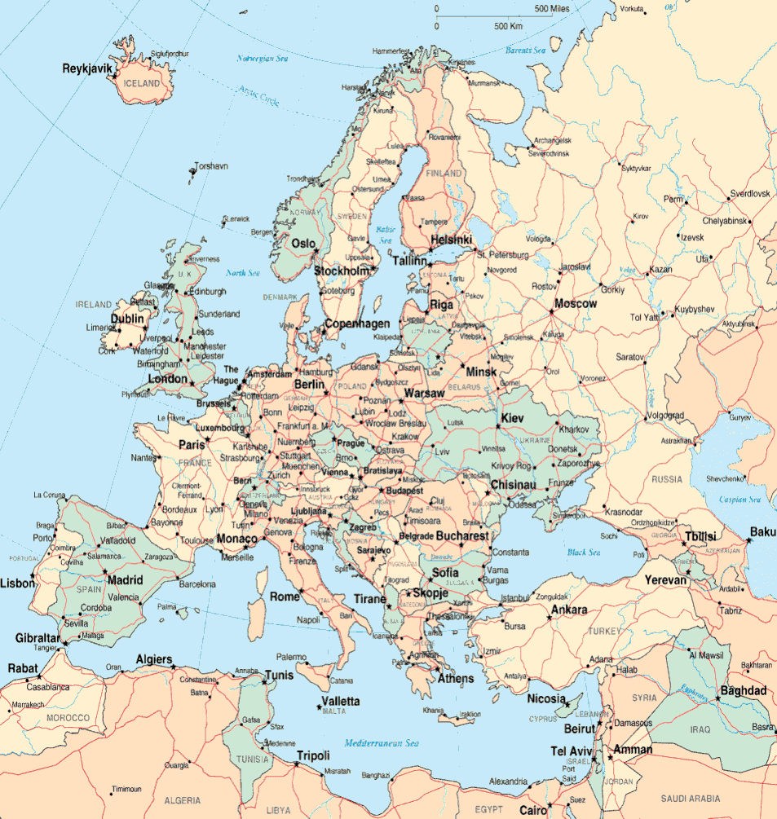
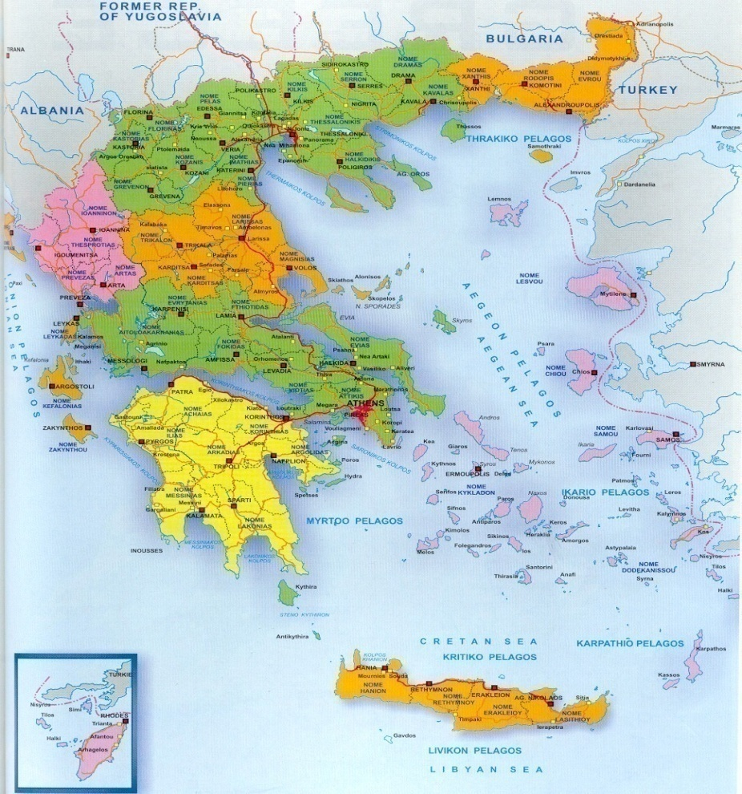
The Beginning of the Play: In Athens
The first scene of the play opens in Athens in Greece.
Europe
Greece and Athens
Context
ATHENS

Slide 4
Act I Scene I
Athens is a joyous city that is awaiting the wedding of its
Duke to Hippolyta. Everyone is celebrating…except
The play opens with Theseus and Hippolyta
briefly discussing their wedding.
Context
An angry Egeus enters with his daughter Hermia and
two young men called Demetrius and Lysander.
All exit apart from Hermia and Lysander.
Hermia’s friend Helena enters. They discuss her
love for Demetrius. She is jealous of Hermia.

Slide 5
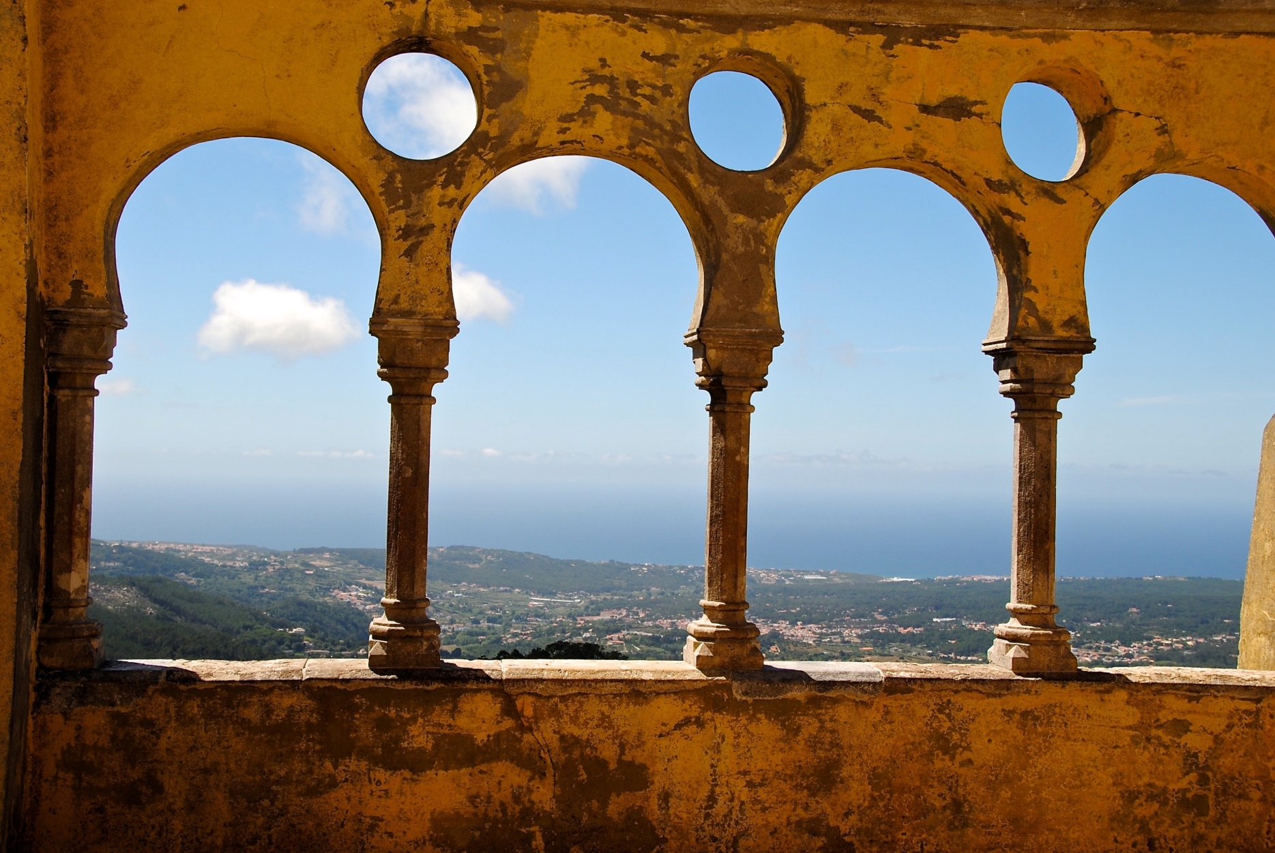
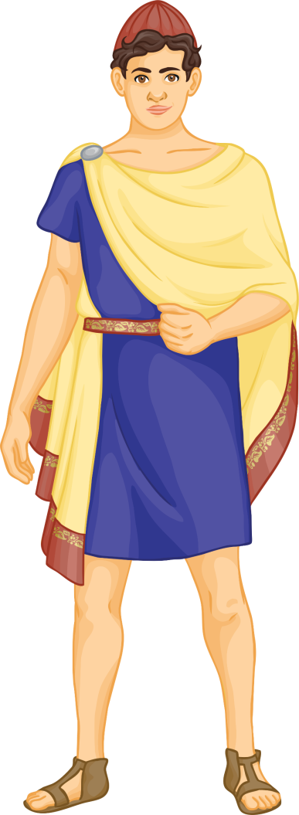
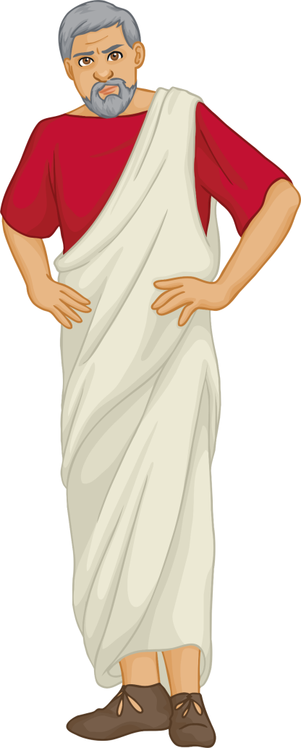
Athens
Checking understanding
Egeus has brought his daughter Hermia to the meeting.
They have been having a heated argument. Hermia is a sweet, beautiful girl, but she can also be extremely stubborn.
Inside the palace, important meetings are taking place in preparation for the wedding.
In the middle of a royal meeting, a good friend of Duke Theseus bursts in, ‘full of vexation’! His name is Egeus.
Their disagreement is over a young man who Hermia is in love with.
His name is Lysander and he is very romantic, constantly bestowing gifts upon his beloved Hermia.

Slide 6
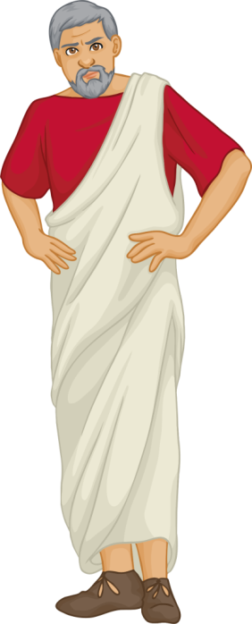
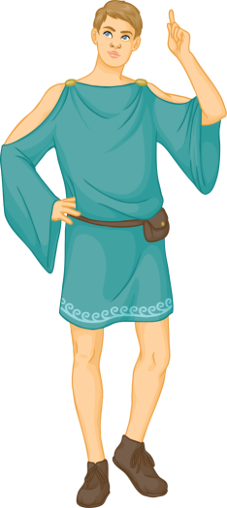
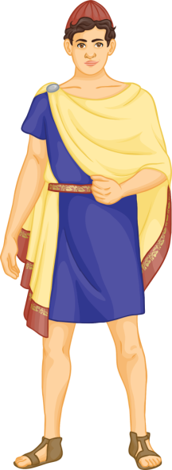
What’s the Problem?
Egeus has in mind for Hermia another man, named Demetrius. Though Demetrius is a jolly nice chap who also dotes on Hermia, she is firmly in love with Lysander. However, since the law is on Egeus’ side, he has brought her before the Duke so that he may decide what becomes of these lovers.
Checking understanding
There is one further complication… Hermia’s best friend is Helena. They have grown up together and share all their secrets.
In ancient Athens, the law states that a father owns his daughter, and that she should do whatever he dictates!

Slide 7
Blank extract – use for any ability if wish
THESEUS
Thanks, good Egeus: what's the news with thee?
EGEUS
Full of vexation come I, with complaint Against my child, my daughter Hermia. Stand forth, Demetrius. My noble lord, This man hath my consent to marry her. Stand forth, Lysander: and my gracious duke, This man hath bewitch'd the bosom of my child; Thou, thou, Lysander, thou hast given her rhymes, And interchanged love-tokens with my child: Thou hast by moonlight at her window sung, With feigning voice verses of feigning love, And stolen the impression of her fantasy With bracelets of thy hair, rings, gawds, conceits, Knacks, trifles, nosegays, sweetmeats, messengers Of strong prevailment in unharden'd youth: With cunning hast thou filch'd my daughter's heart, Turn'd her obedience, which is due to me, To stubborn harshness: and, my gracious duke, Be it so she; will not here before your grace Consent to marry with Demetrius, I beg the ancient privilege of Athens, As she is mine, I may dispose of her: Which shall be either to this gentleman Or to her death, according to our law Immediately provided in that case.
Reading and thinking

Slide 8
Analyse and annotate Egeus’ speech
Use the extract with tasks sheet given to you to help you make notes on how Egeus is presented in this extract. Explain your ideas.
Reading and Thinking

Slide 9
Now let’s focus on Egeus’ use of language within the extract
“Thou, thou, Lysander, thou hast given her rhymes, And interchanged love-tokens with my child”
Repetition used to accentuate Egeus’ anger at Lysander for his wooing of Hermia.
Identify the different features being used.
Find the language features used and explain for each how they affect the way the audience views Egeus.
Describe the language features that present Egeus as a loving father and language features used to suggest he may be unreasonable or cruel. Create detailed notes on the use of language within the extract.
Reading and Thinking
Here’s an example

Slide 10
THESEUS
Thanks, good Egeus: what's the news with thee?
EGEUS
Full of vexation come I, with complaint Against my child, my daughter Hermia. Stand forth, Demetrius. My noble lord, This man hath my consent to marry her. Stand forth, Lysander: and my gracious duke, This man hath bewitch'd the bosom of my child; Thou, thou, Lysander, thou hast given her rhymes, And interchanged love-tokens with my child: Thou hast by moonlight at her window sung, With feigning voice verses of feigning love, And stolen the impression of her fantasy With bracelets of thy hair, rings, gawds, conceits, Knacks, trifles, nosegays, sweetmeats, messengers Of strong prevailment in unharden'd youth: With cunning hast thou filch'd my daughter's heart, Turn'd her obedience, which is due to me, To stubborn harshness: and, my gracious duke, Be it so she; will not here before your grace Consent to marry with Demetrius, I beg the ancient privilege of Athens, As she is mine, I may dispose of her: Which shall be either to this gentleman Or to her death, according to our law Immediately provided in that case.
Emotive language used to show Egeus’ desperation, anger and hurt
Hyperbolic verbs used to emphasise Egeus’ disgust at Lysander and his anger at the relationship between Lysander and Hermia. Egeus accuses Lysander of stealing and filching Hermia’s heart, rather than doing it honestly.
Repetition used to accentuate Egeus’ anger at Lysander for his wooing of Hermia. ‘Feigning’ means false or fake, so Egeus accuses Lysander of not really loving Hermia but only pretending.
Egeus lists many small items that he claims Lysander use to woo Hermia.
Egeus uses a positive adjective and flattery to try to persuade the duke to agree to his demand.
Model

Slide 11
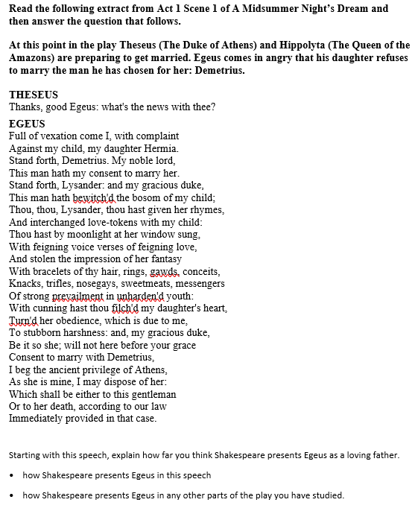
Now use the rest of the time to complete your notes and planning for your PEA paragraph
Based on this speech, explain how far you think Shakespeare presents Egeus as a loving father.
• how Shakespeare presents Egeus in this speech
Mastery

Slide 12
Plenary: End of the Scene
Where, and what, might this path lead to? Has your view changed?
Upon learning of their fate, Hermia and Lysander hatch a plan to run away to his aunt’s house, through the woods.
Plenary
Hermia confides in Helena their plans, and Helena in turn tells Demetrius.
The scene ends with all four young lovers running off into the woods: Hermia and Lysander, followed by Demetrius, followed by Helena.

