Slide 1
KS4 Knowledge Organiser for
English Literature: Eduqas Poetry Anthology
Name
Tutor group
English Teacher
Contents:
How to use your knowledge organiser
The Manhunt and Sonnet 43
London and The Soldier
She Walks in Beauty and Living Space
As Imperceptibly as Grief and Cozy Apologia
Valentine and A Wife in London
Death of a Naturalist and Hawk Roosting
To Autumn and Afternoons
Dulce et Decorum Est and Ozymandias
Mametz Wood and Excerpt from The Prelude
What the titles tell us
Key Terms
New Terminology

Slide 2
How to use your knowledge organiser
Ideas to use
This booklet has all the most important knowledge that you need for each of the poems in your poetry anthology; you need to know these well in order to apply your knowledge to an exam question.
A really good way of revising and learning the poems is to self- quiz on them as part of your revision schedule.
What is self-quizzing? When you have studied the poetry aspect of the course, you need to keep the information fresh in your brain. Schedule time into your homework and revision timetable to revisit the poems and then practise the suggested exercises to see how much you can recall, what knowledge you have retained and which elements you still need to revise.
Dual coding
Draw everything you remember from the poem in picture form or come up with images that capture ideas and themes.
Concept map
Turn the information on the poem into a mind map for each of the sections. Add images and quotes.
Write a quiz and answer
Construct quiz questions from the material in the knowledge organiser and answer these yourself.
Summarise the poem
In your own words write a 200 word summary of each poem; where you can embed short quotations.
Storyboarding
Show you remember the poem’s story by making a storyboard of the events.
Construct a paragraph
Write a paragraph that explains a key theme or element of context from the text and underline the key words you have used.
Knowledge Organiser : Poetry
Ideas to use
1. Look, cover, write, check and correct
Read part of the organiser carefully, cover it up, write down all that you remember then check what you have missed and add this in.
Key terms and definitions
Write out the key terms given for each poem, close your KO and look at the poem. Write out an example from the poem of each term.
1

Slide 3
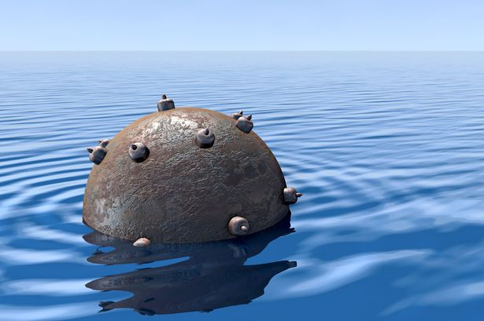
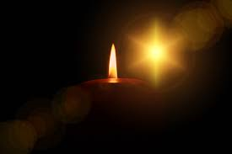
2. The poems
The Manhunt by Simon Armitage: The one about the scarred soldier. “frozen river” “foetus of metal “unexploded mine” |  | 2. Sonnet 43 by Elizabeth Barrett Browning The gushy one about all the different ways of loving someone. “depth and breadth and height/My soul can reach “I love thee freely” “I shall but love thee better after death.”
Content: The wife of a soldier gets to know her husband again after he returns home injured from the war. Her husband is physically scarred by the injuries he sustained in the war, but he also has deeply buried psychological scars as result of his traumatic experiences. The poem traces his physical scars and explores deeper into the “unexploded mine” of PTSD. Physically, they can remain close, but there is a gap between them now emotionally as he struggles to let her in. |  | Content: In this poem, the persona expresses her intense love for her lover, counting all the different ways she loves him. She loves him so deeply that she sees their love as spiritual and sacred. She offers her love freely and without restraint, and at times with a deeply felt passion that she refers to as if was a replacement for her childhood belief and faith. She feels so strongly, that she hopes God will see the purity of their love and allow it to survive beyond death.
Context: The Manhunt is a contemporary poem and was originally aired as part of a Channel 4 documentary, Forgotten Heroes: The Not Dead. In the film, the poem is read by Laura, the wife of Eddie Beddoes, who is the subject of the poem. He served as a peace-keeper in Bosnia before being discharged due to injury and depression. Armitage wrote the poem after interviewing veterans returning from war and as a means of exploring the psychological impact on those who survived intense trauma. |  | Context: The poem is autobiographical. Browning, wrote the poem as part of a series of sonnets for her lover Robert Browning, which she only showed him after their marriage. Elizabeth’s father had forbidden their relationship, but they continued it in secret and eventually married. Browning thought they were so good that she should publish them; however, they were deeply intimate and this was a bit much for a prudish Victorian audience especially as they were written by a woman. Therefore, they were published as translations of a Portuguese poet and called Sonnets from the Portuguese.
Form: The poem is written in couplet –long stanzas, which have lines of varying length, from Laura’s perspective. At the start, the couplets rhyme, but the rhyme breaks down making the poem feel disjointed and conveys the theme of brokenness. It may reflect their struggle to reconnect and how she will have to learn who her husband now is. | Structure: Each couplet introduces a different injury and the reader explores the body and mind of the soldier alongside his wife, experiencing the process at the same time. The use of enjambment mimics the way she traces the injuries that run continuously across his body and explores the damage done. It demonstrates the slow progress she is carefully making. | Form: This poem is a Petrarchan sonnet. It is written in iambic pentameter and has a strong and specific rhyme scheme which conveys a sense of certainty about her love. It is written in the first person creating an intimate tone. Usually a sonnet has an octave (8 lines) which poses a problem and a sestet (6 lines) which answer the problem. This sonnet does not, implying the perfectibility of her love. | Structure: The poem is direct and passionate in its tone and outlines the different ways she loves him. The first 8 lines imply that her love is so great it is almost divine. The last 6 lines show that her love will last an entire lifetime and beyond death. The enjambment reflects the magnitude of her love and its expansive nature. Whereas, the exclamations and caesura imply her passion and ecstasy.
Language Features: The soldier’s body is described by using adjectives of damage to show how broken war has left him. Parts of the body and mind are described using metaphors suggesting his is compiled of broken objects and that part of his humanity has been erased. The verbs express her tenderness and caution in how she approaches him. The final metaphor of the “unexploded mine” refers to the tension and stress his memories cause which he has not come to terms with yet. |  | Language Features: The persona shows the strength of her love through hyperbole and spatial references to imply the scale of her feelings. Throughout the poem religious imagery is applied to demonstrate that her love is spiritual and unconditional like her love of God. It is beyond the physical. The repetition of “I love thee,” known as an anaphora, conveys the intensely personal and direct nature of her feelings – there is utter conviction about how she feels.
Key Themes: War and its lasting effects Love and relationships Pain and suffering Loss and change | Good to compare with: Dulce, Mametz Wood A Wife in London London As Imperceptibly a Grief | Key Themes: Deep and lasting love that is unselfish Faith and worship Hope beyond death | Good to compare with: The Soldier Cozy Apologia A Wife in London Valentine / She Walks in Beauty
English Literature Paper 1: Poetry Anthology
2

Slide 4
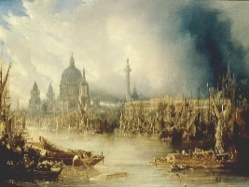
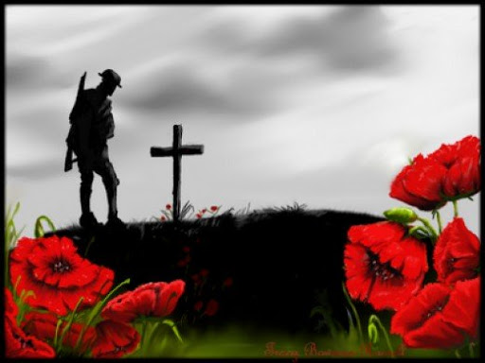
3. London by William Blake The one that describes London and not in a good way. “Marks of weakness , marks of woe” “the mind-forg’d manacles” “Every black’ning Church appalls’ |  | 4. The Soldier by Rupert Brooke The one about dying unselfishly for your country. “there’s some corner of a foreign field/ That is for ever England” “A pulse in the eternal mind” “hearts at peace, under an English heaven.”
Content: The persona observes the state of London as he walks through the streets. He says that everywhere he goes that the people he sees are affected by misery and despair. The misery seems relentless and no one can escape it – not even the young and innocent. It is as if their minds are imprisoned by desolation and unhappiness. He comments that those in power (like the Church, the monarchy, and the most wealthy) seem to be responsible and don’t care about the poverty and destitution that riddles the city like a contagious disease, ruining lives and hope for all. |  | Content: In this poem, the persona, a soldier heading to war, talks about the possibility of dying in a foreign country. He claims that this should not be an occasion for sadness, but that by dying he will have made “a corner of a foreign field” a small part of England. He personifies England as his mother, who gave birth to him and raised him to become the person he is. He feels that he owes his life to her and therefore unselfishly sacrifices his life. He believes dying will be comforting and that he is only giving back the things that England gave to him and his memory and sacrifice will live on after death.
Context: William Blake came from a humble background, but was able to attend art school and became an engraver. He is viewed as an early Romantic poet and had radical political views, influenced by the French Revolution where the monarchy was overthrown by the people of France. His most famous work is Songs of Innocence and Experience. London comes from Songs of Experience, which focus on the negative aspects of life. In this poem, he illustrates the effects of modernity on people and nature, through the discussion of dangerous industrial conditions, child labour, prostitution and poverty. |  | Context: The poem is idealistic. Rupert Brooke was a young, untested soldier, who had attended public school and was Cambridge educated. Athletic and called “the handsomest young man in England,” he was part of the Bloomsbury group of authors and becoming known for his poetry. He wrote this poem at the start of the First World War as part of a series of sonnets and Winston Churchill admired its selfless patriotism. Brooke wrote idealistically about the war. He had not seen action and was never to. After embarking for war, he contracted blood-poisoning from a mosquito bite and died on French hospital ship. The poem has become a symbol for a lost generation of youth.
Form: The poem is a dramatic monologue written in the first person. The persona speaks passionately about the horror of modern London. The ABAB rhyme scheme and strict iambic tetrameter, constrained to four stanzas of four lines (or quatrains) is relentless. It reflects the unforgiving nature of life and routine in the capital which has become inescapable, and emphasises the unbroken misery he sees. | Structure: The first 2 stanzas focus on the people he sees and hears, before he shifts in stanza 3 to criticise the institutions he blames. The final stanza refocuses on the people, in particular the corruption of the innocent and young. Blake uses enjambment in stanza 1 to show how everyone is linked by misery, and repetition in both stanza 1 and 2 to emphasise that no one is unaffected. | Form: This poem is a sonnet, traditionally used for love poetry. Rather than a person, this sonnet expresses Brooke’s love and devotion to his country. Written in the first person, it follows an unwavering iambic pentameter and clear rhyme scheme, that demonstrates the persona’s commitment to England. It is characterised as Georgian poetry with motifs of nature, youth and innocence. | Structure: The first 8 lines, or octave, focus on how England enriched his life and he owes it to her. Whereas, the last 6 lines, or sestet, reflect on how his death is meaningful, and reciprocal. It will bring him peace, and England security. Usually, there is conflict or debate between the two parts of a sonnet, but in The Soldier there is only harmony. The structure of the poem embodies the harmonious relationship between man and country.
Language Features: Emotive language is used powerfully throughout the poem to create a negative semantic field of horror and misery. Repetition emphasises that no one is able to escape the pain and suffering. Alliteration is used effectively to emphasise the horror and mental suffering that leaves the mind manacled. Contrast and oxymorons serve to stress how the innocent are blighted by corruption. |  | Language Features: England is personified through the extended metaphor of a mother who has nurtured a son who is willing to die to protect her, embodying ideas of heroic sacrifice. Natural imagery is used extensively to express his love of the English countryside and creates a Romantic, idealised idea of war without pain or suffering. Religious imagery reveals his sense of faith and belief that his sacrifice will be immortalised by God.
Key Themes: Sense of place Pain and suffering Criticism of power and authority | Good to compare with: Living Space The Manhunt Dulce Ozymandias | Key Themes: Deep and lasting love (for his country) that is unselfish / Nature and Place Faith, belief and worship Attitudes to war and patriotism | Good to compare with: Sonnet 43 A Wife in London Living Space Dulce, Mametz Wood, The Manhunt
English Literature Paper 1: Poetry Anthology
3

Slide 5
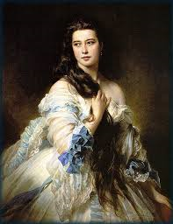
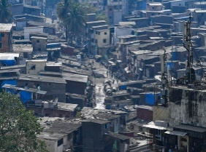
5. She Walks in Beauty by Lord Byron The one about the really beautiful woman. “She walks in beauty, like the night” “all that’s best of dark and bright” “A mind at peace… A heart whose love is innocent.” |  | 6. Living Space by Imtiaz Dharker The one about cramped and vulnerable living conditions in Mumbai. “There are just not enough straight lines.” “Nails clutch at open seams.” “fragile curves of white” “the bright, thin walls of faith.”
Content: The persona describes a woman he’s seen, taking her individual body parts in turn. He thinks she’s incredibly beautiful and uses images of dark and light to emphasise how perfect she is. He suggests that her appearance reflects her inner life and personality which shines through. To begin with, he describes her like a ‘cloudless’ and ‘starry’ night creating a sense of mystery and exoticism. To him, her dark hair is perfect and any different it would be ‘impaired.’ He imagines her thoughts to be pure and describes her expression as ‘soft’ and ‘eloquent.’ It’s all his subjective impression though. |  | Content: The poem opens by describing an building or some sort of construction that is badly built, crooked and barely held together. It is then revealed that this is someone’s home – although we are never told whose home it is. The persona notices that in this precarious building is a basket of fragile, white eggs, bright with light and representing hope and faith despite the exposure and vulnerability of their lives.
Context: Lord Byron was an English Romantic poet described as, “mad, bad and dangerous to know.” However, this poem is more restrained and lyrical in nature. It comes from a series of poems called Hebrew Melodies (religious pieces set to music) which reflects the almost sacred adoration within the poem. The poem was said to be inspired by Mrs Anne Wilmot, wife of Byron’s first cousin. He was struck by her beauty when he saw her at party, and the next morning the poem was written. Like many Romantic poets, he appreciated beauty and to him she epitomises aesthetic beauty. The poem is an emotive tribute to her perfection. |  | Context: Imtiaz Dharker was born in Pakistan, raised in Glasgow and now lives in Britain and India. Her poetry often explores life in India and the difficult conditions in which the poorest live. This poem describes a typical dwelling place in the over-crowded slums of Mumbai (although she doesn’t state this explicitly – so it could be any ramshackle dwelling). On the one hand, the poem highlights the precariousness of such homes. More significantly, however, it praises them as an expression of the miraculousness of life, seeing this living space as evidence of human resourcefulness and determination.
Form: The poem is lyrical in tone and nature , focusing on abstract ideas of beauty and innocence. It is written in iambic tetrameter and has a unwavering ABABAB rhyme scheme, perhaps expressing the conviction of the speaker’s thoughts. It is written in the third person, talking only about the woman, and implicitly conveying the persona’s adoration, but possibly objectifying her as no more than a vessel of beauty. | Structure: The poem is split in three stanzas of equal length and is remarkably short for Byron, capturing the intensity of the moment. The poem begins by focusing on the woman’s physical/external beauty, describing different aspects in turn; however, it concludes by considering it is her inner goodness which is outwardly manifested. Each stanza is one sentence, giving a sense of fluidity and reflecting her effortless grace, poise and elegance. | Form: The poem has an irregular form using stanzas and lines of different lengths, mirroring the random construction and chaos of the building and the precarious nature of life. There is no rhyme or rhythm either – perhaps reflecting the disorder of the ‘living space’ described. It looks disjointed on the page, with lines sticking out and others short and broken, just like the building it describes. | Structure: The poem is split into two parts. The first stanza describes a building under stress and the caesuras emphasise how loosely connected the different parts are. Even the nails “clutch” desperately. The word “miraculous” shifts the tone and, once we know that this is someone’s home, the tone becomes one of wonder. The last two stanzas are one enjambed sentence, that shows how such fragile structures sustain life and give hope.
Language Features: Contrast is used throughout the poem to show how the woman is a perfect balance of opposites. This is achieved through antithesis and repeated structures like “one ray” and “one shade.” Imagery of light and dark is used to emphasise her innocence and radiant purity, which shines through. Sensual language of the body is balanced against the moral language of goodness. |  | Language Features: Language of disorder, such as the verb “clutch” or “thrust off” emphasise the instability of the building, and personify its desperation to stay upright. The key symbolism is the egg – this symbolises faith and new life. Placing them in this vulnerable position is a leap of faith that reveals courage and a belief in a better future. Contrast between light and dark that conveys the edge of danger in which they live as opposed to their innocence in this situation.
Key Themes: Love and adoration of a person Faith and worship Beauty and goodness (of a thing rather than nature.) | Good to compare with: Sonnet 43 Valentine Cozy Apologia | Key Themes: Sense of place Faith, belief and worship Innocence and goodness versus danger and darkness | Good to compare with: London The Soldier, Sonnet 43 Some aspects of The Prelude (place)
English Literature Paper 1: Poetry Anthology
4

Slide 6
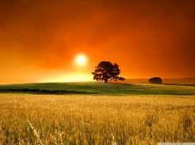
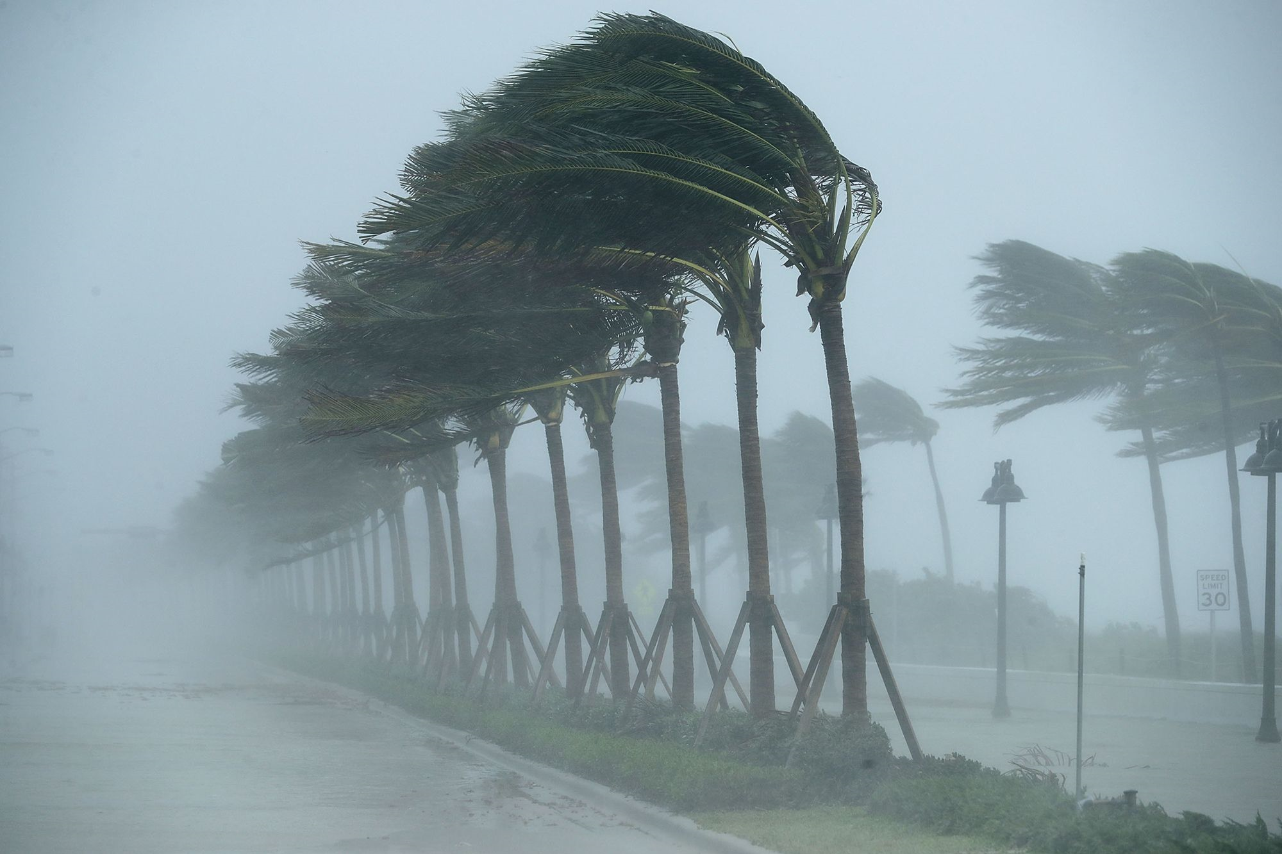
7. As Imperceptibly as Grief by Emily Dickinson The one where she’s quietly sad about the end of summer or love – who knows. Your guess is as good as mine! “As imperceptibly as Grief/ The summer lapsed away” “harrowing Grace” “The Dusk drew earlier in -/ The morning foreign shone- ” “Our Summer made her light escape / Into the Beautiful.” |  | 8. Cozy Apologia by Rita Dove The one where she apologises for her ordinary love as a hurricane approaches. “I could pick anything and think of you” “with furrowed brow/ and chain mail glinting” “thin as liquorice and as chewy” “When has the ordinary ever been news?”
Content: On the surface, the poem describes how summer comes to an end so gradually you don’t notice that is has ended. A bit like how you stop grieving for someone and move on from your loss. Summer and grief end subtly and that can leave you feeling another loss. The poem may be also about the loss of love or “Our Summer” and how love draws to a close and you have to move on into another season of your life that can be both difficult yet beautiful. It is full of contradictory emotions. |  | Content: The persona describes how, as a hurricane approaches, she takes refuge in her study and thinks about her partner. She is reminded of him in the everyday objects around her, but also views him more traditionally as her knight in shining armour. She reflects on how modern life is rushed and emotionless, but she has an opportunity to reflect. She thinks about her past, ‘worthless’ relationships and compares them to the ordinary contentment she feels with her partner. She feels a little guilty about it.
Context: Emily Dickinson was barely known as a poet in her lifetime and led a very reclusive life. After her death, her sister discovered a box containing volumes of her poetry and now nearly 2000 poems exist. Her writing is often very unconventional and the ideas can be very open-ended. One interpretation of the poem is that the loss expressed within it reflects her unrequited love for Charles Wadsworth, an older, married preacher. They spent some, short-lived precious time together, but he moved far away and she became a recluse. The loss at the heart of the poem may reflect her sense of betrayal and heartbreak. |  | Context: Set against the arrival of Hurricane Floyd, a powerful storm which hit the east coast of the USA in 1999, this factual, real-life context supports the idea this is an autobiographical poem and that Dove is talking about her feelings for her husband. It seems to be an affectionate tribute to him. The poem notes details of a couple's domestic life as writers, 'Twin desks, computers, hardwood floors,’ which she is somewhat apologetic for. An apologia is a defence or explanation of something. Her poem seems to be a apology for the domestic comfort and ordinary contentment she feels, as others face danger in the path of the hurricane, but she relishes this moment to be with her husband.
Form: The poem is one stanza of one sentence. It has no discernible rhyme or rhythm. The lines are often short and frequently connected by hyphens, creating pauses and giving the poem a tone of melancholy reflection. The disjointed nature of the poem perhaps reflects her own disjointed thoughts and feelings that she is coming to terms with. As a result, the ideas feel confused and mixed, just like her emotions. | Structure: The poem is a series of metaphors that reveal the persona’s feelings about the way summer fades away gradually. She compares it to the end of grief, twilight, a stolen afternoon, dusk, a bird without a wing and a boat without a keel – at the end it is a woman escaping. This is a mixed metaphor and perhaps shows how difficult it is to express the feelings of loss she experiences and that no one idea is adequate. | Form: The poem is written in free verse creating a conversational tone. The number of syllables in each line varies reflecting the persona’s exploratory train of thought. The first stanza uses regular rhyming couplets which conforms to the traditional presentation of the their love and intimacy. In the second stanza, the rhyme scheme is disrupted as she thinks of past relationships she regrets, with a return to an ABAB rhyme scheme as domestic harmony is restored. | Structure: The poem begins with a personal, first person description of the speaker’s feelings and her partner and is dedicated to him with “ – for Fred.” This stanza is contrasted with the following one, in which she reflects on previous, disappointing relationships. The final stanza returns to the present where she explores their ordinary, domestic lives that will never make the headlines, but are precious “stolen” moments of intimacy.
Language Features: The language of time is a recurring theme in the poem. The different stages of time might reflect the natural process of grief that eases as time passes. Contradictory images (juxtaposition and oxymorons) abound in the text, such as “harrowing Grace.” The contrasts show the pain of loss versus hope for the future expressed in the final line. Imagery of light and dark conveys the sadness and despair against optimism and joy. |  | Language Features: Idealised imagery is used to present her traditional feelings for her husband through the metaphor of the knight. There is a sense of humorous exaggeration about her words. Everyday images and ordinary language is used throughout to show that despite their love being “short of the Divine,” it’s still precious and comforting to her in the presence of danger. Negative imagery is used specifically in the second stanza to highlight the worthlessness of her earlier relationships in contrast to the meaningfulness of her present one.
Key Themes: Death and loss / pain and suffering Passage of time Nature and change | Good to compare with: The Soldier, A Wife in London Afternoons To Autumn | Key Themes: Love and relationships Adoration of a person Sense of place and belonging with someone | Good to compare with: Valentine, She Walks in Beauty, Sonnet 43 Afternoons The Manhunt
English Literature Paper 1: Poetry Anthology
5

Slide 7
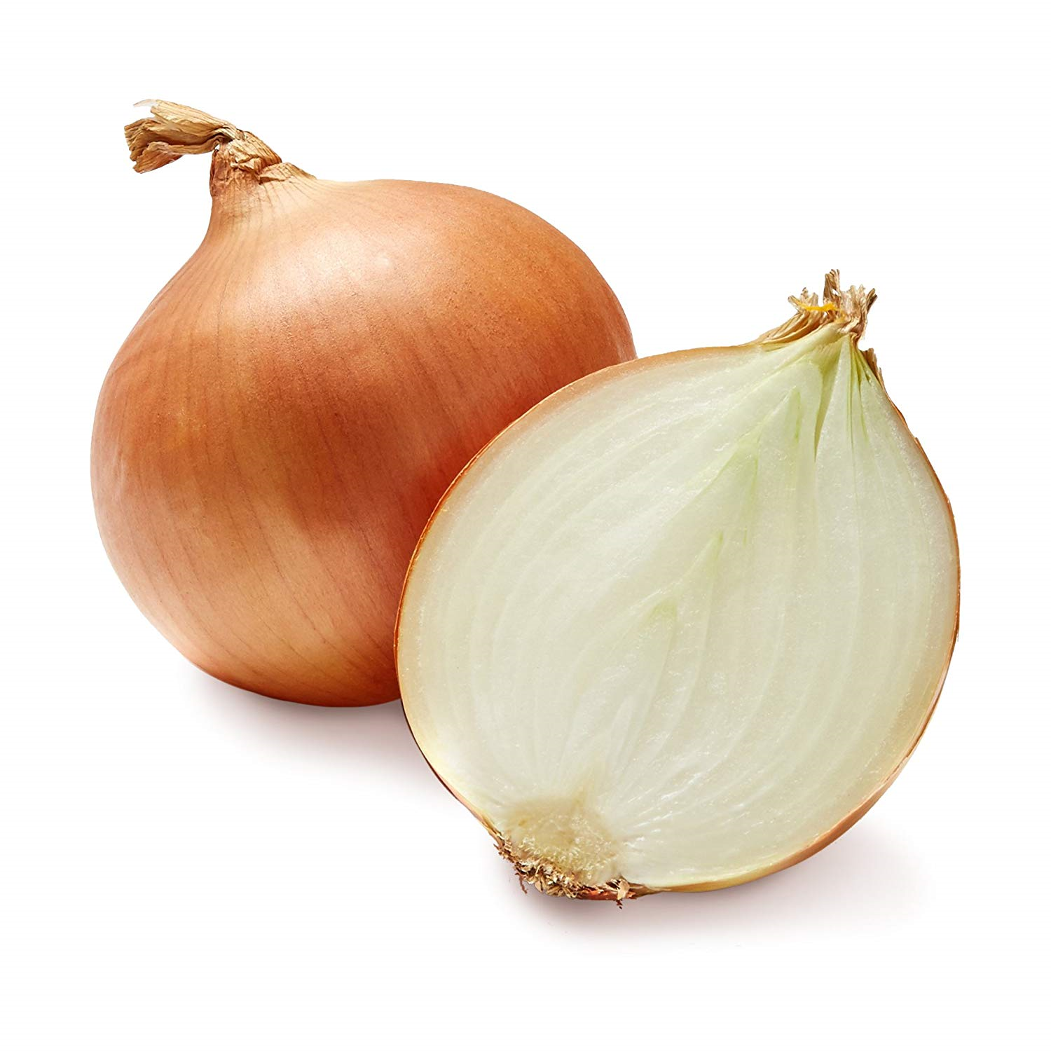
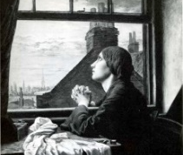
9. Valentine by Carol Ann Duffy The one where she gives him an onion! Honestly. “It is a moon wrapped in brown paper” “It will blind you with tears” “Its fierce kiss will stay on your lips” “cling to your fingers, / Cling to your knife.” |  | 10. A Wife in London by Thomas Hardy The one with the tragic telegram and the ironic letter. “She sits in tawny vapour” “The street lamp glimmers cold” “He –has fallen - in the far South Land…” “His hand, whom the worm now knows”
Content: The persona in the poem gives their lover an unconventional Valentine’s Day gift of an onion, rejecting the clichés normally associated with the day such as red roses. They explore why the onion is a more suitable and realistic expression of their love: it is amoon, it is promises light and hope, it can make you cry, it is powerful and intense and its scent can linger on you indefinitely. Ultimately, it highlights the negative as well as the positive effects of a deep and loving relationship. The forceful presentation of this gift, and the final word choice, also suggests this is a relationship which is cruel, domineering and menacing. |  | Content: The poem opens with a description of a wife sitting at home alone in London, against the backdrop of fog and misery which enfolds her. A sharp knock at the door brings her to her senses, and a messenger delivers a telegram with the tragic news that her husband, who is at war in a distant country, has been killed. The poem moves to the following day. Here a letter is delivered to her from her husband who wrote it before he died. He talks with enthusiasm of his hopes for coming home and their future together. The joy and optimism with which he speaks serves to emphasise the terrible waste of his life and the wife’s desolation and sadness.
Context: Duffy wrote the poem in response to a challenge from a radio presenter who asked her to write an original poem for Valentine’s Day. The poem challenges the stereotypical view of a Valentine’s gift when the speaker presents their lover with the metaphorical onion. This is called a conceit and is reminiscent of metaphysical poets like John Donne, who used unusual or ordinary objects to explore ideas about love. Duffy’s own love life was fairly unconventional. At a young age, she embarked on a torrid love affair with the poet Adrian Henri many years her senior. Her poem clearly captures the deterioration of love over time and the challenges, complexities and disappointments lovers can face. |  | Context: In the poem, Hardy speaks as an observer and chooses to focus on those left behind at home at times of war. The war he is speaking about is the Boer War – a series of campaigns fought against the Boers (or Dutch) over territory in the south of Africa. The war was a distant one and one many thought was unnecessary and wasteful of life, as many men died needlessly of diseases like enteric fever. He uses the isolation of the wife to emphasise her helplessness in the face of her separation from her husband – she could be any one of any number of wives left behind – and employs the letter “page full” of hope to show the futility of war and how many died in their prime.
Form: Duffy’s poem is marked by it deliberate rejection of traditional love poetry forms such as the sonnet. It is written in the first person, in stanzas of irregular length, some of which are just one line. The poem lacks rhyme and rhythm and has a very disjointed feel to it. The single word lines make it seem forceful and aggressive in tone. | Structure: The poem is a list of the ways that the onion represents love. This is an extended metaphor that gradually reveals the deterioration of love over time from something hopeful to something threatening. The tone starts playful and optimistic, becoming forceful and hostile at the end. Single word lines such as “Lethal” emphasise this. Repetition throughout adds an element of coercion. | Form: The persona in the poem is an observer who watches in a detached manner contributing to he helpless and melancholy tone. The irregular rhythm and dashes create pauses and reflect the disbelief of the wife at the news. There is an asymmetrical rhyme scheme (ABBAB) which is broken once in the half rhyme of “smartly” and “shortly” – reflecting the wife’s struggle to absorb the news. | Structure: Hardy deliberately divides the poem into two opposing halves – The Tragedy and The Irony. The first 2 stanzas accentuate the wife’s loneliness trapped in the web of London’s fog and build to climax of anticipation with the tragic news. The second 2 stanzas juxtapose the news of the husband’s death with his joyful prose, fresh and firm. Hardy does this to show how war can crush hope and joy.
Language Features: The extended metaphor of the onion explore the layers of love from the first intimate days through to a more negative end. Direct address is used repeatedly in the poem. At times, this creates an honest personal tone, but through the use of imperative verbs is also commanding and forceful. Negative/ threatening language, which is unusual for a love poem, creates a dark undertone, hinting at the possessive and dangerous side to love. |  | Language Features: Hardy uses visual imagery and the pathetic fallacy of the fog to distil the wife’s isolation and grief. The fog encloses her and foreshadows the grip of death into which she will fall, and imagery of light offers no warmth, hope or consolation. The contrast of the opening imagery with the husband’s joyful language, punctuated by powerful alliteration, creates a deep sense of irony and loss. The graphic imagery of his “hand” once “fresh” and “firm” now intimately acquainted with the worm focuses on his physical decay and the horror of war.
Key Themes: Love and relationships Negative emotions Obsessive feelings | Good to compare with: Sonnet 43/ Cozy Apologia/ Afternoons London and Dulce She Walks in Beauty | Key Themes: Love and relationships Pain and suffering – Death and Loss The impact of war on the individual | Good to compare with: The Manhunt As Imperceptibly as Grief Dulce/ Mametz Wood
English Literature Paper 1: Poetry Anthology
6

Slide 8
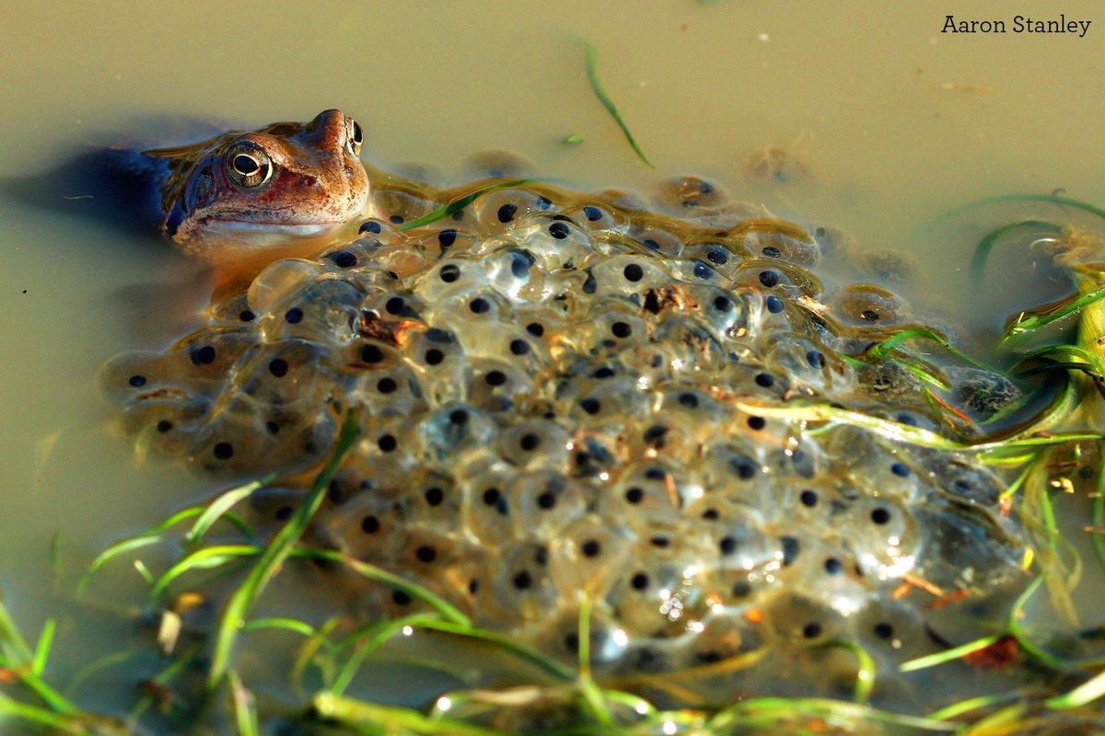
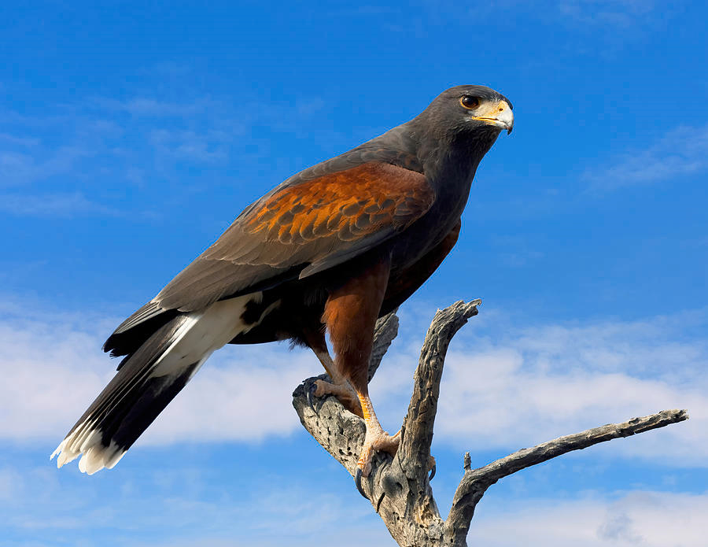
11. Death of a Naturalist By Seamus Heaney The one with the sticky frogspawn. “Bubbles gargled delicately” “warm thick slobber of frogspawn that grew like clotted water” “The air was thick with a bass chorus” “Poised like mud grenades… the great slime kings” |  | 12. Hawk Roosting by Ted Hughes The one with the hawk (that might not be a hawk) in a tree. “in sleep rehearse perfect kills” “I hold Creation in my foot” “I kill where I please because it is all mine” “My eye has permitted no change”
Content: The opening stanza focuses on the persona’s memory of collecting frog spawn as a child from a flax dam. It fascinated him and he writes about his childhood wonderment at the “warm slick slobber” and how he filled jam jars with it, took it home and took it to school where his teacher taught the class about frogs. In the second stanza the tone changes, and the persona describes how “one hot day” the dam was invaded by angry frogs whose croaking filled the air. This frightened and sickened him so much that he ran away in fear. |  | Content: The persona in the poem is the voice of a hawk that boasts of its power and perfection in a God like manner. It describes how the hawk relishes and admires its own ability to kill, and feels like it holds dominion over its environment – even challenging the power of its creator. The hawk rejects the rule of society and refuses to debate or question its own actions. It allows nothing to change and rules through brutality and fear.
Context: Seamus Heaney was a famous Irish poet and much of his work was heavily influenced by observations of the natural world as he came from a farming community. In this poem, he follows the subject matter of many Romantic poets like Wordsworth who use nature to show the transition from childhood innocence to adulthood and experience. The first stanza shows the wonder of nature, whereas the second demonstrates a more adult perspective that is alert to the danger and darkness within the natural world. Heaney’s strong Roman Catholic upbringing, might imply that the poem is also about sexual maturity, with the initial naïve description of the mammy and daddy frogs, contrasted with the repulsive images later, inherently reflecting the Church’s taboo attitude to sex and reproduction, and the guilt associated with it. |  | Context: Ted Hughes was a British born poet who made his name as a nature poet, especially poetry about animals. In this poem, he presents nature red in tooth and claw – the hawk is violently murderous, brutal and sees itself as the pinnacle of creation, top of the food chain. It has a visceral, predatory efficiency and doesn’t see the need to compromise on this. However, some critics interpreted the poem as an allegory for human nature and argue that the hawk symbolises a murderous tyrant who rules through violence and fear. It represents the dictator’s extreme arrogance or hubris and the innate savagery of man. Hughes denied this interpretation.
Form: The poem is written in the first person and blank verse (no rhyme) which makes it sound conversational and personal. The iambic pentameter is not always secure with it often over-spilling into 11 syllables, perhaps reflecting the richness of nature and unpredictability of change. Many of lines run into one another (enjambment) conveying the persona’s enthusiasm and nature’s inability to be constrained. | Structure: The poem is split deliberately into two stanzas that recall contrasting incidents. The first stanza focuses mainly on the persona’s childish wonderment and secure relationship with nature. At times, there is some negative language which foreshadows the change at the end. The second stanza shifts in tone and shows a fractured relationship with nature. It feels like a sudden shift or volta from before, and nature is now unfamiliar and threatening. | Form: The poem is a dramatic monologue from the perspective of the hawk. The audience is silent and the poet neither celebrates nor condemns the hawk’s action in the poem. The first person voice gives the hawk authority and it commands the poem without debate or interruption. There is no rhyme in the poem so it has no lyrical quality – it is cold, harsh and blunt. Each stanza always has four lines (a quatrain), reflecting the decisive, controlling nature of the hawk. | Structure:. The poem begins with the hawk perched high in the tree, untroubled and considering its position in the animal hierarchy. It is relaxed and sure of its position of power and rehearses killing in its sleeps. It develops to consider it own perfection and how it one foot took the whole of creation to make and now it holds Creation or God in its foot. It is supremely confident and asserts that its rights are beyond debate. It ends on an assured statement of complete future control.
Language Features: Heaney uses synaesthesia – this is combing all 5 senses at once. The wealth of sensory imagery conveys the richness and abundance of nature. Contrast is used to reveal the troubled relationship that develops with nature. Imagery of life and beauty contrasts with imagery of decay, repulsion and death to show this change. Military imagery and personification weaponise the frogs, contributing the threatening and harmful presentation of the natural world. |  | Language Features: Brutal and violent imagery dominates the poem and conveys the destructive power of the hawk. It rejects subtly or duplicity and favours direct and violent tactics emphasising the darkly predatorial side of nature/humankind. The language of power is present in the use of the first person pronouns “I” conveying the hawks egotism and sense of possession in the repetition of “my.” The language it uses is formal and complex, presenting it as coldly intelligent and defiant of society’s morals. The end-stopped lines contribute to its uncompromising nature.
Key Themes: Nature Change and transformation Death and decay | Good to compare with: To Autumn/ Hawk Roosting The Prelude/ Afternoons Dulce and Mametz Wood | Key Themes: Nature Power and authority Death and violence | Good to compare with: Death of a Naturalist/ The Prelude Ozymandias Dulce
English Literature Paper 1: Poetry Anthology
7

Slide 9
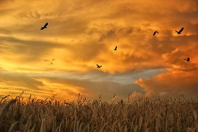
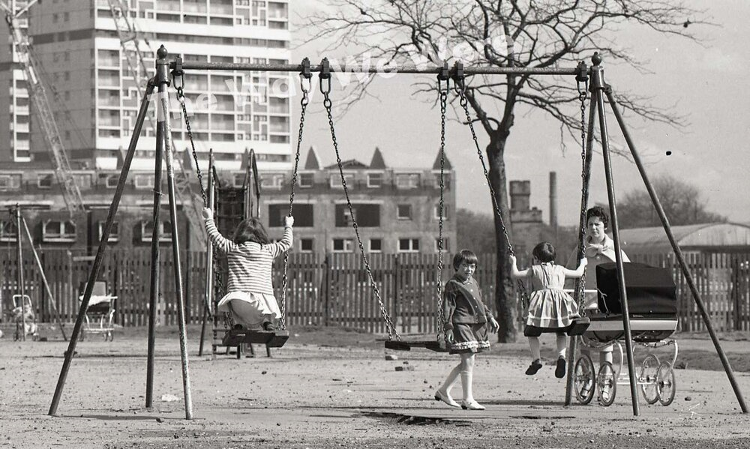
13. To Autumn by John Keats The one that personifies the season of Autumn as a goddess. “Seasons of mists and mellow fruitfulness” “fill all fruit with ripeness to the core” “Thou watchest the last oozings hours by hours,” “gathering swallows twitter in the skies.” |  | Afternoons by Phillip Larkin The one with the estate, playground and unhappy mothers. “Summer is fading” “hollows of afternoons” “An estateful of washing” “pushing them to the side of their own lives”
Content: The persona in the poem directly addresses Autumn as if it were a person. It begins by describing the plentiful nature of Autumn as everything ripens for harvest and the warm days seem endless. They then imagine Autumn as a goddess, who can be found around where the farm labourers are working – often watchful or drowsily sleepy. Finally, they comment on the sounds of Autumn, and how the season draws to a close and the swallows gather to leave for a warmer climate and are replaced in winter by the robin. |  | Content: The poem in observational. The persona describes an ordinary, everyday scene that could be anywhere, as children are sent out to play and the mothers watch. Their husbands are mentioned, but it is ambiguous as to whether they are actually present. The observer paints a picture of the mothers’ routine and static life and how their lives have changed with domestication and their children's expectations of them. Their identity has been pushed aside, and it seems that their children will fall into the same cycle.
Context: As a late Romantic poet, Keats relished the beauty of nature and uses this poem to express nature’s bounty in sight, sound and smell. Keats was a liberal in his political beliefs and rejected urban sophistication, the wealthy and the upper classes. He presents nature as free to us all and even the goddess he describes in an ordinary peasant woman not a powerful deity. He was also very ill. He had nursed his brother, Tom, through consumption and watched him die, and now had the same disease. He was a trained doctor and knew he was dying. The poem captures this presentiment of death and Keats’ hope for an easy passing in the last stanza. He died at the age of 25. |  | Context: Larkin was a post- War poet and a foremost member of The Movement poets, who wrote with irony and honesty about a society shadowed by WWII and the austerity that followed it. Larkin spoke bleak truths about life – this isn’t feel good poetry. Afternoons looks at the emptiness of modern life in the big estates that had sprung up in Britain in the post war years. He empathises with the young mothers who have a lack of control and agency in their lives. Their summer has faded, they have become mothers a young age, their life is dominated by domestic chores and they can only watch as the same cycle starts for their children – pretty pessimistic stuff.
Form: To Autumn is an ode – an poem written in praise of something. It directly addresses Autumn with the term “thou” or you, which we call an apostrophe. It is written in iambic pentameter and each stanza initially has an ABAB rhyme scheme, but then this varies, perhaps reflecting the variety in nature. Keats mainly wrote Odes with 10 lines per stanza; this one has 11 reinforcing the abundance of nature. | Structure: In each stanza Keats introduces an aspect of nature then expands on it. The first stanza seems to start on a misty morning and focuses on the ripeness of Autumn. The second stanza seems to progress to a sleepy afternoon as the season begins to wane and draw to a close. The final stanza refers to the evening and the dying of the season as winter approaches. It captures the passage of time and journey towards death. | Form: The poem in split into three stanzas of equal length perhaps implying the routine/ constricted life they lead. There is no rhythm to the poem, so it has no life or energy as there is no pulse to keep the lines ticking over. This emphasises how static and sterile their life has become. End-stopped lines such as, “Their beauty has thickened.” or “Summer is fading:” give a sense of inevitability that their lives have come to stop with motherhood. | Structure: The speaker starts by establishing the time and setting first to create a melancholy, elegiac tone. He then focuses on the women’s lives, now describing their domestic setting and how the wind is symbolically ruining their past hopes. It ends by commenting on how this routine will continue, that they have thickened with age and that they have been pushed aside – probably by the gender expectations of the time.
Language Features: The language of excess shows how Autumn can produce a plentiful harvest, but hints that is just beyond the point of perfection and is too much- perhaps hinting that it is on the brink of decay/death. The second stanza uses personification – Autumn is a humble goddess who has worked hard and now beginning to relax as the season passes. Sensory language, especially sound, is used in the last stanza to create the song of Autumn – this is quite melancholy, and the swallows at the end symbolise death but the promise of new life, as migration is temporary. The end is quite elegiac. |  | Language Features: Domestic imagery dominates the poem reinforcing the gender roles of the women and their uninspiring, drab lives. They have lost their spark and settled into a passive lifestyle. The language of time – the reference to summer fading suggests they are past their prime and “hollow afternoons” implies an empty, early middle age. They have absent husbands “behind them,” and “before them” is only ruin. The symbolism of the wind is important – it represents the wind of change that has blown through their lives. They are stuck between a hopeless future and an empty present. Throughout the language is plain, direct and unelaborated – like their lives.
Key Themes: Nature – its excess and beauty Death and Loss The passing of time and change | Good to compare with: The Prelude As Imperceptibly as Grief Afternoons | Key Themes: Love and relationships The passing of time Loss and change | Good to compare with: Cozy Apologia/ Valentine As Imperceptibly as Grief/ To Autumn A Wife in London /London
English Literature Paper 1: Poetry Anthology
8

Slide 10
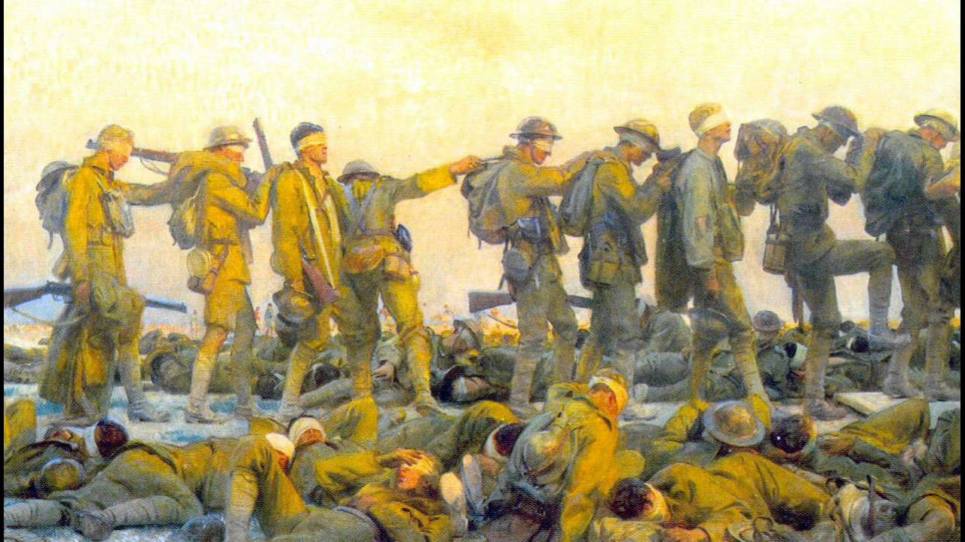
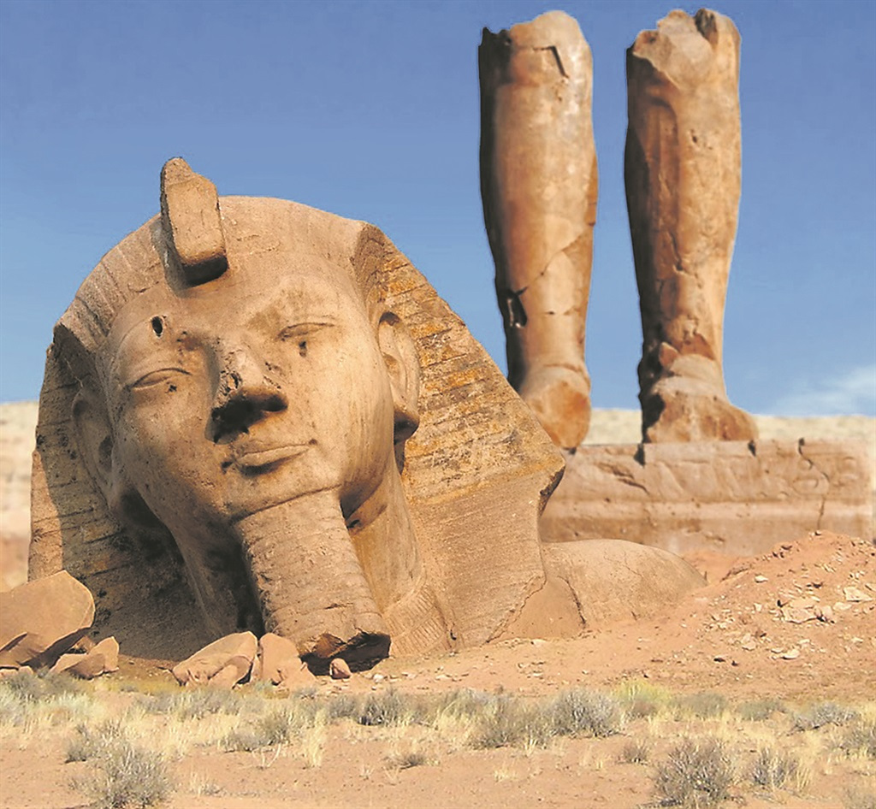
15. Dulce et Decorum Est by Wilfred Owen The famous one about the horrific effects of a gas attack. “Bent double like old beggars… coughing like hags” “All went lame; all blind” “As under a green sea, I saw him drowning” “Obscene as cancer” |  | 16. Ozymandias by Percy Bysshe Shelley The one with the ruined statue in the desert not a dessert. “Two vast and trunkless legs of stone/ Stand in the desert” “shattered visage” “sneer of cold command” “colossal wreck… lone and level sands stretch far away”
Content: The persona describes the suffering of the exhausted soldiers, which he is one of, as they march away from battle back to their rest camp. They are broken, injured and so tired they appear drunk. Suddenly, the shout of “Gas!” rings out. A chlorine gas shell has been dropped and the soldiers scrabble to get their gas masks on. One soldier is unable to and flounders toward the persona choking on gas. The persona recounts how in all his dreams he still sees the man’s face plunging towards him. He directly asks the reader if he had seen young men die in such an obscene way could they ever say to others that it is sweet and fitting to die for your country. He calls this a lie. |  | Content: The narrator of the poem recounts a time when he met a traveller who told him a tale of a ruined statue that lies in the middle of a desert. He recounts how it had no body to it and all that was left was its colossal legs and the broken remains of its head and face. It was a statue of an ancient king called Ozymandias who was arrogant – something the sculptor had captured in its face. On the base of the statue was the phrase, “Look on my works, ye Mighty, and despair!” as a boast of his power. Ironically, the statue is now wrecked and the desert swirls around it. The power of man is finite and boasts are empty; whereas, nature has survived and continues to do so.
Context: 2nd Lt Wilfred Owen was a decorated soldier, who won the highest honour of the Military Cross for bravery in the front line of battle in the First World War. Unlike, Brooke he experienced the horror and depravity of battle first hand and felt that his one duty as a poet was to tell the “truth.” He wasn’t unpatriotic, in fact after treatment for shell shock (PTSD) he returned to the front, but was sadly killed in action on 4th Nov 1918, 7 days before the war ended. The Latin phrase in his poem means It is sweet and fitting to die for your country. It was often displayed in military training camps to inspire trainee soldiers to greater patriotism. Owen criticises this as a lie told by the establishment which he finds disgraceful. |  | Context: Shelley was also a Romantic poet and radical thinker, like Blake, Keats, and Byron he rejected the power, corruption and oppression of governments and was an atheist. He wrote a famous poem called The Mask of Anarchy condemning the British Government for massacring their own people who were protesting at Peterloo. The character of Ozymandias is probably the Egyptian Pharaoh, Ramses II and is used to symbolise autocratic political power and the hubris (arrogance) of man. It is written as a warning to tyrants that, however powerful they think the are, the powers of time and nature are stronger and legacies of cruelty will not last – it is a message of hope to the oppressed.
Form: The poem has some regular and irregular features. The regular ABAB rhyme scheme reflects the relentless trudge and suffering of the soldiers plight; however the stanzas are of irregular length and the iambic pentameter falters at times, perhaps showing the unpredictability of war or the soldiers exhaustion. It can seem disjointed, fragmented and confusing – like war. | Structure: It is written in the first person and is almost certainly autobiographical in nature. It starts with a past tense description of the long trudge of the soldiers back to rest camp, and develops to the panic of the gas attack. It then flashes forward to the present and the horrific dreams the persona still has of the incident. It ends with a graphic description of the soldier’s death on the back of cart and questions the honesty and integrity of those who spread the “old lie” to the young. | Form: The poem is a sonnet, but its not filled with love. It doesn’t follow the regular rhyme scheme of a sonnet, and although there is a semblance of order to it, it falters on words like “frowns” implying that power isn’t perfect and that all human structures, even poetry, can fail or be deconstructed by others. The iambic pentameter breaks at line 10, but is brought under control immediately just like nature constrains man over time and art is more powerful than tyranny. | Structure: The poem has three voices: the narrator, the traveller and Ozymandias. The traveller’s voice dominates and at the start establishes the size and magnitude of the statue but also it’s decay and disrepair. The voice of Ozymandias then briefly interrupts for two lines to assert some authority from the grave. However, the poem ends with a description of the huge and empty desert, emphasising the irony of the words. Nature is literally the great leveller and punisher.
Language Features: (there are almost too many) Similes are used extensively by Owen to describe the condition of the men and the experience of the gas attack. Graphically violent imagery to describe the soldier’s hideous death, including powerful adjectives and verbs convey the brutal, shocking reality of war. Direct address – “My friend” challenges the reader, authorities and other poets (including Jessie Pope) to consider the falsehood they pedal to youth of Britain. |  | Language Features: Language of scale/size is used throughout to represent the arrogance of the ruler and the superiority of nature in reality. Irony demonstrates the temporary nature of political power and Shelley’s own belief that it was possible to overturn social and political power just as the statue is overturned. Language of command and imperative verbs display the arrogance of man and their vainglorious assertions that come to nothing.
Key Themes: War and its impact Pain, suffering, death, loss and PTSD Negative Emotions | Good to compare with: Mametz Wood The Manhunt London | Key Themes: Power of nature/ time Criticism of power and authority Arrogance of man | Good to compare with: Hawk Roosting London The Prelude (nature)
English Literature Paper 1: Poetry Anthology
9

Slide 11
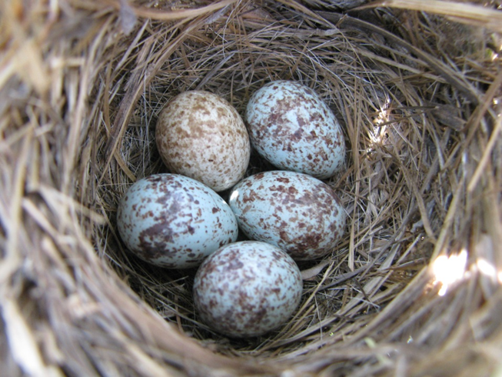
17. Mametz Wood by Owen Sheers The one where a mass grave of dead soldiers is unearthed. “the wasted young” “blown and broken bird’s egg of a skull” “a wound working a foreign body to the surface of the skin” |  | 18. Excerpt from The Prelude by William Wordsworth The one where he remembers ice skating on frozen lake as a child. “It was a time of rapture” “through the darkness and cold we flew” “The orange sky of evening died away.”
Content: The persona in the poem describes that how even now the farmers in France are still finding the remains of soldiers who died on the battlefields of the First World War in the earth as they plough. The remains seem to be near a place called Mametz Wood where a particularly brutal battle, that cost many lives, took place. The narrator references how they were commanded to walk into battle and face the devastating machine guns. The poem moves to the present and the discovery of a mass grave of soldiers that has just been discovered and recounts how they are linked arm in arm and how their mouths seem to be open as if they are mid song. |  | Content: This excerpt, taken from a much longer poem, is written from the perspective of an adult looking back on his childhood nostalgically. They recall a winter’s evening when they were ice-skating on a frozen lake with friends. They are called home, but ignore the summons as they are having so much fun and continue their wild game of chase across the ice. At then end, the narrator reflects on how innocent and connected to nature they were, but as an adult how they have changed and are more strongly aware of the darker and more dangerous aspects of the world and nature as they have matured.
Context: Mametz Wood was written in 2005 by British poet Owen Sheers. Mametz is a village in Northern France; the woodland nearby was the site of an especially bloody battle during World War I, in which around 4,000 men from the British Army's Welsh Regiment were killed. Sheers's poem is set many years later, and considers the way that, even a century after the conflict, the land around Mametz Wood is still filled with fragments of the dead soldiers' bodies. The poem is thus a consideration of the horrors of war, its lasting effects, the fragility of life, and the time it takes nature to heal from such atrocities. It is a commemorative and elegiac in tone. |  | Context: Wordsworth was an early Romantic poet, who grew up in the idyllic setting of the Lake District, where this poem in set. The excerpt comes from a much longer autobiographical poem called The Prelude, in which he describes all the experiences that shaped him to becoming a poet. Wordsworth felt strongly that nature was an important influence in his life – he called it The Great Universal Teacher. Children are presented as having a powerful and natural affinity with nature in their innocence. However, Wordsworth also believed nature had a darker side that inspired awe and wonder – he called this the Sublime – powerful moments of the sublime could open your mind to deeper more philosophical thoughts.
Form: The poem is written in tercets (3 line stanzas) that seem a little less robust than a quatrain, perhaps hinting at the delicate balance between life, death and nature. Sheers chooses to write in the 3rd person, which creates a sense of distance and detachment. He uses enjambment within and between stanzas, which could reflect the slow unearthing and passing of time as the pieces are dug up. It creates a reflective tone. | Structure: The first 3 stanzas focus on the “years” after the war and how farmers found the fragile remains of the “wasted young” leading the narrator to reflect on their death at the mercy of machine guns. The 4th stanza brings us to the present day and how “even now” the earth is still healing from the horror. The final 3 stanzas are written “this morning” and create a sense of immediacy around the horrific discovery of a mass grave – a reminder that this war is forever present in our history. | Form: The poem is written in the first person and is focused on a specific memory. It is written in blank verse and mainly in iambic pentameter. This makes it sound natural and unforced as if it is a personal and intimate conversation with the reader. The steady rhythm creates the impression that memory is clear and certain, and the enjambment creates a spontaneity to the memory and a sense of joy. | Structure: There are two main sections to the excerpt. The main focus is on the memory of ice-skating, which is recalled with vivid and exhilarating detail. The tone is carefree and one of wild abandonment and is punctuated with caesuras and lists which convey the energetic excitement of the children. At line 16 there is a volta or change, where the older voice reflects on nature that as a child went “unnoticed” – this introduces a more serious tone and mature understanding of the more threatening aspects of nature and the world.
Language Features: The earth is personified as a “sentinel” who guards the remains of the soldiers and ensures they do not slip from memory. It is also described as wounded, suggesting how it still needs to heal from the horror of war. Images of brokenness and fragility such as the symbolism of the “bird’s egg” emphasise the fragility of life but also how war can dehumanise those who fight in it. Graphic imagery is used to describe the mass grave to suggest the horrific manner of their death, but is contrasted with the metaphor of the “mosaic” emphasising their beauty and delicacy. |  | Language Features: The poet uses powerful verbs such as “wheel’d” and “flew” to create the speed and movement of youthful energy that is present in the poem. Animalistic imagery is present throughout – the narrator compares himself to a horse and the children to hounds and a hare. This implies their wild and untamed nature and close connection to nature. Sibilance (the s sound) is used to recreate the speed and pace of the ice-skating. Towards the end more negative diction such as “melancholy,” “alien” and “died” is introduced which adds a sombre tone to the piece.
Key Themes: Attitudes to war/ death and loss The passage of time/ the past Nature | Good to compare with: Dulce/ The Soldier The Manhunt/ A Wife in London To Autumn | Key Themes: The passage of time/past Innocence v experience Nature | Good to compare with: Death of a Naturalist To Autumn/ Ozymandias Afternoons
English Literature Paper 1: Poetry Anthology
10

Slide 12
3. What the title tells us.
Title | Explanation | Title | Explanation
1. The Manhunt | The title is a pun or play on words. A manhunt is an organised search for a criminal. In this case, it’s the wife’s search for the man she knew and her relentless, yet tender, exploration of his inner trauma that leads to a new understanding of him. | 10. A Wife in London | The most important word here is the indefinite article “A” – this could be any wife in London at the time. It emphasises the universality of this experience for women, who were alone and separated from their husbands who were thousands of miles away at war. In this poem, the impact of war on women left behind is central.
2. Sonnet 43 – How Do I Love Thee? | A simple title – the fact that it’s number 43 shows the depth of her feeling for her husband. The use of the word “how” is important because she’s not asking why she loves him. Her love for him is uncontested, she is more concerned with exploring the power and nature of their bond rather than questioning it. | 11. Death of a Naturalist | The title seems really dramatic – we expect a death or some kind of murder. But it’s a lot less gruesome than this. The “naturalist” of the title is the innocent or natural child who blithely collects frogspawn. As he becomes more aware of the world and matures into adolescence, this innocence dies and is replaced by tainted experience.
3. London | London is the central character of the poem. The capital symbolises modernity and the material heart of the nation. In this poem, it is representative of all that is wrong with mankind – greed, prostitution, corruption and enslavement to commerce. | 12. Hawk Roosting | The title can be read literally or metaphorically. Perhaps it is just a bird of prey viewing its territory, confident of its power. However, metaphorically a hawk is someone who favours war and aggression, therefore it could represent a dictator. The fact that they are “roosting” suggests that they are relaxed and unconflicted about their violent actions. The feel unassailable and omnipotent.
4. The Soldier | The title mythologises the common soldier, making him seen heroic and symbolic of bravery and valour. He epitomises the common man, who gave his life willingly for his country. The use of the definite article “the” stresses the central importance of the average soldier in war and is used to inspire personal patriotism. | 13. To Autumn | The is a poem written directly “to” the season, revealing Keats admiration of it. “Autumn” also represents maturity before the point of death, so the title is symbolic of Keats own awareness that his life has reached fruition and death is not in the too distant future.
5. She Walks in Beauty | The main character is nameless and therefore we could argue that she is objectified and subject to the male gaze rather than being a real presentation of a woman. The emphasis on “beauty” could imply that the narrator purely judges her on her outward appearance rather than really understanding her inner life. | 14. Afternoons | The fact that it is afternoon creates a sense of melancholy and of time passing in this poem. The women are no longer children at the dawn of their life, and their midday, noon or prime has passed. They are thickening with age. You get the impression that their best days are behind them and it’s all downhill from here.
6. Living Space | At first, the title seems impersonal – a living space is not really a home. But if you read the word “living” as an adjective, you begin to understand that this tiny space, where life shouldn’t really exist, is alive with life and faith. A place to grow and thrive in like the egg. | 15. Dulce et Decorum Est | A Latin phrase meaning that it is “sweet and fitting to die for your country,” that was used to inspire patriotism. It is used ironically by Owen and challenged as a “lie” used to manipulate young soldiers into believing death in battle was glorious. Therefore, the title is undermined by the graphic horror of the poem.
7. As Imperceptibly as Grief | Dickinson didn’t really give titles to her poems, so this title is a best guess. “Imperceptibly” suggests that the loss of summer can go unnoticed but this is juxtaposed with “grief” – a deeply felt emotion – suggesting that it can be a quietly painful process. | 16. Ozymandias | The title just goes to show that names mean very little in the big scheme of things. Who was Ozymandias? ( Possibly Ramses II) But his name, just like his power, has been forgotten. The title suggests that we should remember him, but the poem proves that time and nature are more powerful than human power.
8. Cozy Apologia | Dove uses the latin phrase “apologia” – a formal defence of one’s actions – to defend the quiet and “cozy” domesticity of her relationship with her husband. But is it really a defence or a paean ( a song of praise) for the ordinary? I’m not sure she’s that apologetic. The ordinary can be extraordinary. She questions what we truly value about love. | 17. Mametz Wood | This was the scene of a violent and bloody battle of The First World War, but how many of you had heard of it? The title therefore situates the poem in a scene of horror and commemorates the battle. It is written in memoriam to the soldiers. The omission of the qualifying “The Battle of” suggests the restorative power of nature to heal the wounds and destruction of war.
9. Valentine | The title is ironic . The reader expects a love poem that is traditional and romantic. Instead, Duffy rejects the clichéd symbols of love and gives us an anti- Valentine poem that challenges traditional romantic stereotypes and undermines the platitudes of Valentine’s Day. | 18. Excerpt from The Prelude | What can we say about this? Well a prelude means an introduction or runup to the main event; therefore, this poem simply explores Wordsworth’s formative years and how nature heavily influenced and shaped his understanding of the world as an adult.
English Literature Paper 1: Poetry Anthology
11

Slide 13
6. Key Terminology.
Term | Example | Term | Example
alliteration: repetition of the same letter or sound at the start of consecutive words | London: “Mind forged manacles” | oxymoron: a figure of speech in which apparently contradictory terms appear in conjunction | As Imperceptibly as Grief: “harrowing Grace”
anaphora: the repetition of a word or phrase at the beginning of successive clauses | Sonnet 43: “I love thee” | pathetic fallacy: to give human feelings and responses to inanimate things, especially the weather | A Wife in London: “She sit in tawny vapour… webby fold”
caesura: a pause or break the middle of a line of poetry | Sonnet 43: “Smiles, tears of all my life!- and if God choose.” | personification: to give something non-human or abstract human characteristics and form | Death of a Naturalist: “The great slime kings… gathered there for vengeance.
contrast: placing ideas or words that are strikingly different close together for effect | She Walks in Beauty “And all that’s best of dark and bright.” | repetition: repeating something that has already been written | London: “Every…”
couplet: a pair of successive lines of verse, typically rhyming and of the same length | The Manhunt: “and feel the hurt of his grazed heart.” | rhyme: correspondence of sound between words or the endings of words, especially at the end of lines | Look at poems such as The Solider or London for strong and regular rhyme schemes used for effect.
end-stopped line: a line in verse which ends with punctuation, to show that phrase has ended | Valentine: “I give you an onion.” | rhythm: the beat or cadence of a poem | Look at poems such as She walks in Beauty or The Prelude for use of iambic tetrameter or iambic pentameter.
enjambment: the continuation of a sentence without a pause beyond the end of a line, couplet, or stanza | Living Space: “………. Beams/ Balance crookedly” | sibilance: the repeated use of the “s” sound close together | The Prelude: “All shod with steel. We hiss’d along the polish’d ice”
hyperbole: exaggerated statements or claims said for effect | Sonnet 43: “I love thee to the depth, breadth and height” | simile: a direct comparison between two thing using as or like | Dulce et Decorum Est: “Bent double like old beggars”
imagery: visually descriptive or figurative language, such as similes or metaphors | Cozy Apologia: “chain mail glinting” “shooting arrows” | sonnet: a 14 line poem typically on the subject of love | Sonnet 43, The Solider and Ozymandias all use this form for different purposes.
irony: using language that normally signifies the opposite of what it means | Dulce et Decorum Est: “Dulce et decorum est pro patria mori” | stanza: a verse of poetry made up of poetic lines | All of the poem uses stanzas for differing effects. Ensure you know why.
juxtaposition: two things being seen or placed close together with contrasting effect | Living Space: “dark edge” “gathering light” “bright thin” | symbolism: using a symbol or object to represent an abstract idea or concept | Afternoons: “the wind/ Is ruining their courting places” Also think of the use of eggs in MW and LS.
metaphor: a comparison between two things where one thing is said to be another for effect | Mametz Wood: “a broken mosaic of bone” | synaesthesia: the blending of the different senses in a piece of poetry | Death of a Naturalist: “strong gauze of sound around the smell.”
English Literature Paper 1: Poetry Anthology
12

Slide 14
7. New Terms: Make a note of any new terminology you have been taught, record from which poem and an example.
Term | Example | Term | Example
English Literature Paper 1: Poetry Anthology
13

