Slide 1
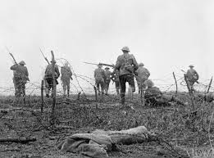
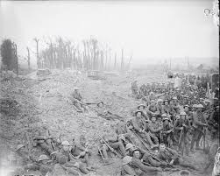
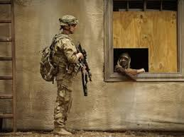
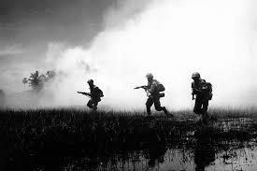
‘War Poems’
Dulce st Decorum Est
LO: To develop poetry analysis skills. ST: I can understand writers’ methods and use subject terminology.
Learning Objective:
AO2: Analyse the language, form and structure used by a writer to create meanings and effects, using relevant subject terminology where appropriate.

Slide 2
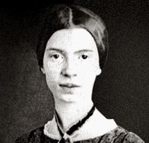
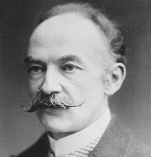
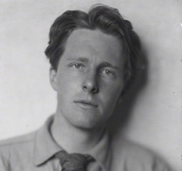
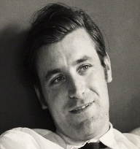
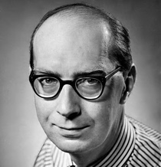
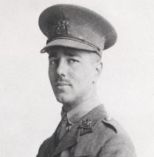
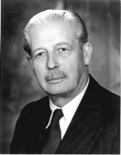
Starter: read Dulce et decorum Est
Emily Dickinson was strongly influenced by the Romantic poets that came before her. Although her poetry is written in an era of Realism, it has a lot of features that were typical of Romanticism.
The Boer Wars were proclaimed a great victory for the British but, in the words of the imperial poet Rudyard Kipling, the British Empire was taught "no end of a lesson".55,000 British soldiers died in the Second Boer War (1899-1902) alone.
Rupert Brooke caught the optimism of the opening months of the war with his wartime poems, published after his death, which expressed an idealism about war that contrasts strongly with poetry published later in the conflict. His poetry was used as propaganda by the British.
As Imperceptibly as Grief – Dickinson (1865-ish)
A Wife in London – Hardy (1899)
The Soldier – Brooke (1914)
AO1 In Emily Dickinson’s poem “As imperceptibly as Grief,” Dickinson uses beautiful words to show her complete distress. Dickinson wrote about “Summer” as if Summer is a symbolism for happiness. Dickenson writes this poem to represent her own emotions and struggles. Her words provide a sense of beauty in the darkness.
AO2 Dickinson’s isolation is emphasised through her personification of Summer. The personification runs throughout, and creates a genuine sense of abandonment and isolation, as it makes its ‘escape’. The alliterative ‘dusk drew’ adds to the sense that darkness is creeping in, as the figurative depiction of Autumn reflects her lack of comfort with her own isolation. The enjambment mirrors the waning of the summer sun, slowly dissipating.
AO3 Dickinson was a recluse, who spent a lot of her time on her own. Her isolation from the world was made clear in her poetry, and a lot of her poems were sad/ melancholic. She was familiar with death as a child, as she lost several close friends to illness, whilst she was at school. Dickinson admired the Romantic poets and loved botany.
AO1 The poem describes a wife receiving news of her husband who has died in a battle. It is a poem about grief and love. There is an ominous atmosphere; the reader knows that something bad is going to happen. Ironically, after she has learned that he is dead, she receives a letter from her husband in which he speaks of his excitement of when he will next see her and the things which they will do together.
AO2 The ironic tragedy of the poem is established through the clear structure, forcing our sympathy with the wife. The caesura reflects the wife’s shock, whilst we also feel genuine sorrow through her euphemistic and personified denial of the situation. The sharp, harsh, onomatopoeic nature of the message’s arrival contrasts with the melancholic presentation of life during the war (evident through the pathetic fallacy /references to fog)
AO3 Hardy was very critical of Victorian society and his poems criticised the social constraints of life at the time. Written about the Second Boer War, which began in 1899, Hardy used the poem as a commentary on the frivolity of the conflict. The Second Boer War was a military embarrassment, with many people viewing the whole war as pointless and unnecessary.
AO1 The Soldier encapsulates the feeling of patriotism that was evident in British society at the start of WW1. It expresses the belief that it is an honourable thing to die for your country, and Brooke is prepared to die in battle. England is a key theme in the poem and the speaker clearly loves his country. It is worth noting that Brooke never saw the reality of battle – he died on his way to fight.
AO2 Written in quasi-sonnet form, The Soldier’s romanticised attitude towards war is compounded by the personification of England as a maternal figure. The infallibility of mother England creates a positive and patriotic tone, in line with romantic views of war. The repetition of lexemes associated with ‘England’ serve to add to the overwhelming influence of the nation.
AO3 Brooke's poem reflects optimistic pre-war (WW1) perspective and is an important counterpoint to much World War I poetry. (The poems of Wilfred Owen et al., often emphasize the senselessness of the Great War and the tragic deaths many young soldiers suffered.) As such, it gives us some great insight into how people can romanticise war when they haven't yet experienced it.
Emily Dickinson was a textbook recluse. She spoke to visitors through doors, gave treats to local children by lowering a basket from a second-story window and listened to her father's funeral from the privacy of her bedroom. She didn't leave the family property for the last two decades of her life. Of her nearly 1,800 poems, fewer than a dozen were published while Dickinson was alive.
World War I began in 1914, after the assassination of Archduke Franz Ferdinand, and lasted until 1918. During the conflict, Germany, Austria-Hungary, Bulgaria and the Ottoman Empire (the Central Powers) fought against Great Britain, France, Russia, Italy, Romania, Japan and the United States (the Allied Powers). Thanks to new military technologies and the horrors of trench warfare, World War I saw unprecedented levels of carnage and destruction. By the time the war was over and the Allied Powers claimed victory, more than 16 million people—soldiers and civilians alike—were dead.
Key quotes ‘The summer lapsed away.’
‘Sequestered afternoon.’
‘courteous yet harrowing grace.’
‘As guest that would be gone.’
‘Our summer made her light escape into the beautiful.’
Main Themes:
Nature, Change, Death, Fragility, Freedom, Time, Loss,
Comparisons:
Time passing – To Autumn, Afternoons,
The natural world – To Autumn, Prelude, DoaN
Key quotes ‘he-has fallen- in the far South Land.’
‘the fog hangs thicker.’
‘His hand, whom the worm now knows.’
‘page-full of his hoped return.’
‘Flashed news in her hand.’
Main Themes:
War, Love, Change, Death, Women, Fragility, Memories, Relationships, Time,
Comparisons:
London life – London
Relationships – Manhunt
War – DeDe, Soldier, Mametz
Key quotes ’in some corner of a foreign field That is forever England’.
’A dust whom England bore, shaped, made aware’.
’A pulse in the Eternal mind’
’breathing English air’
’In hearts at peace, under an English heaven’
Main Themes:
War, Love, Death, Patriotism, Identity, Faith
Comparisons:
Impact of war – DeDe, AWiL.
Pride – Ozy, DeDe,
Patriotism - DeDe
Both Afternoons and AIAG are explore the theme of change being inescapable. Neither poet presents change positively.
In February 2005, the Canadian ornithologist Louis Lefebvre announced a method of measuring avian "IQ" in terms of their innovation in feeding habits. Hawks were named among the most intelligent birds based on his scale.
‘Deprivation is for me what daffodils were for Wordsworth.’- Larkin
‘Man hands on misery to man. It deepens like a coastal shelf. Get out as early as you can, and don't have any kids yourself.’ - Larkin
Hawk Roosting – Hughes (1960)
Afternoons – Larkin (1959)
Dulce et Decorum Est – Owen (1917)
After a mustard gas attack, you would see red spots forming on your skin that quickly turned into painful blisters. If you underwent a direct attack and inhaled mustard gas, it wouldn't take long to feel pain and swelling in your nose and throat as the blisters developed, sealing your airway.
AO1 The poem is written from the first person narrative of a hawk, who feels on top of the world. It discusses power. The poem uses a lot of imagery related to death and evolution. The hawk will not allow anything or anyone to stand in his way. We could interpret the poem as literally being about a hawk, or the hawk could be a metaphor for a dictator.
AO2 A personified, first person, view into the life of a hawk. His arrogance and omnipotence is suggested through his aggressive use of language and metaphorical references to death, which he thinks he controls. The personification of the sun (behind him) and earth (beneath him), adds to his authority and control. Nothing will change, like the regular four line stanzas.
AO3
Hughes fascinated by animals. Studied Anthropology – the behaviour of humans within past and present societies.
Hawk was a Nazi symbol, and politicians are described as ‘hawkish’ –aggressive towards other countries. Hughes probably used the hawk as a metaphor for the way some leaders arrogantly abuse their power like Hitler.
Do humans just act on animal-instincts? Anti-religion too possibly.
AO1
Afternoons is a very melancholy poem, about the inevitability of change and the passing of youth. The poem talks about the challenges of growing up and having children. The poem discusses parenthood – how priorities have changed and there are responsibilities to face. The couples in the poem have been replaced by younger couples who go to their old ‘courting places.’
AO2 The end of youth (and happiness) is explored rather melancholically through Larkin’s figurative expression, as the reality of the mother’s lives lurk behind them. The homonym ‘lying’ presents a turning point as the mother’s realise their own youth is over. They are metaphorically being ‘pushed’ to the side of their own lives, by the weight of expectation.
AO3 Larkin was an observational poem, who didn’t like change or children, saying they ‘diluted’ a person. The poem focuses on the unsatisfactory nature of all of our lives, in that we’ll all have to grow up and eventually realise we’ve lost our youth. The poem is not specific to life at the time (1959), although it’s ironic that life was viewed as ‘good’ then.
AO1 Recounting his first hand experiences of fighting in WW1. He describes the dreadful conditions of the battlefront and gruesomely depicts the death of a fellow soldier from a gas attack. It is an unflinchingly honest portrayal of war, opposite to pro-war, patriotic ideas of the time. Owen makes use of rhyme, mostly on alternate line endings. Irregular structure reflects life as a soldier.
AO2 Graphic depictions of violence, as well as onomatopoeic lexemes and a change in voice, place the reader on the (albeit figuratively described) battlefield, with Owen. The repetition of shocking verbs represent the inescapable reality of war, which challenge the traditional presentation of war. The Latin phrase at the end reflects the ‘dead’ ideology that war is honourable.
AO3 Owen fought and died in WW1 and portrayed war as violent and realistic. This challenged the previously ‘romantic’ depiction of war in poetry. His graphic depictions of violence, death and despair were difficult to ignore, and his poetry helped to emphasise the reality of war to the population ‘at home’. If inhaled, the mustard gas, described in the poem, led to a long and agonising death.
"The poem of mine usually cited for violence is the one about the Hawk Roosting, this drowsy hawk sitting in a wood and talking to itself. That bird is accused of being a fascist... the symbol of some horrible genocidal dictator. Actually what I had in mind was that in this hawk Nature was thinking. Simply Nature."
Ted Hughes, London Magazine, January 1971
Owen was initially enthusiastic about the war but soon changed his mind when he went to the frontline. His optimism turned to horror during his time in the trenches. He was sent home with shellshock but went back to the frontline when he recovered. He died in conflict a week before the end of the war.
Harold Macmillan’s famous declaration that “most of our people have never had it so good” came in July 1957 at a time when the country was riding high on the post-war economic boom.
Key quotes ‘I sit at the top of the wood.’
‘Rehearse perfect kills and eat.’
‘Now I hold creation in my foot.’
‘I kill where I please
‘The allotment of death.’
‘I am going to keep things like this.’
Main Themes:
Nature, Change, Death, Power, Identity, Faith,
Comparisons:
Power and control – Ozy
The natural world – To Autumn, Afternoons, DoaN
Key quotes ‘Summer is fading’
‘young mothers assemble.’
‘Our Wedding’ lying near the television.’
‘expect to be taken home’
‘something is pushing them to the side.’
Main Themes:
Nature, Change, Childhood, Women, Memories, Freedom, Time, Identity,
Comparisons:
Time passing – To Autumn, AIAG
Loss of innocence - DoaN
Jessie Pope was an English pro-war poet. Wilfred Owen dedicated his 1917 poem Dulce et Decorum Est to Pope, whose literary reputation has faded into relative obscurity as the horror of war was realised.
Key quotes ’Bent double, like old beggars under sacks’
’Men marched asleep’
’Gas! Gas! Quick, boys!’
’if you could hear, at every jolt, the blood Come gargling from the froth-corrupted lungs..’
’The old lie: Dulce et Decorum Est Pro patria mori.’
Main Themes:
War, Death, Power, Fragility, Patriotism, Injustice
Comparisons:
Effect of war – Mametz Wood, Manhunt,
Patriotism – The Soldier
Harold Macmillan, British PM from 1957-1963
Hughes denies it but is the hawk a personified representation of a dictator like Hitler?
Colour key: Love and relationships / Welfare and conditions / Attitude to nature / Natural change / Powerful figures / The effect of war / Attitude to war
Challenge: which other poems is it similar to?

Slide 3
Key Words:
Antiquated
glorified
Assonance
Simile
Metaphor
What do you think the poet’s view of war is from the title of the poem?
Dulce et Decorum Est
‘It is sweet and proper’
Learning Objective:
AO2: Analyse the language, form and structure used by a writer to create meanings and effects, using relevant subject terminology where appropriate.
Notes:
Talk about the positive and negative connotations of the Latin words.
TALK THROUGH KEY WORDS

Slide 4
Answer:
What, how, why?
Learning Objective:
AO2: Analyse the language, form and structure used by a writer to create meanings and effects, using relevant subject terminology where appropriate.

Slide 5
Key Words:
Antiquated
glorified
Assonance
Simile
Metaphor
"Dulce et Decorum Est" by Wilfred Own
Bent double, like old beggars under sacks,
Knock-kneed, coughing like hags, we cursed through sludge,
Till on the haunting flares we turned our backs,
And towards our distant rest began to trudge.
Men marched asleep. Many had lost their boots,
But limped on, blood-shod. All went lame; all blind;
Drunk with fatigue; deaf even to the hoots
Of gas-shells dropping softly behind.
Gas! GAS! Quick, boys!—An ecstasy of fumbling
Fitting the clumsy helmets just in time,
But someone still was yelling out and stumbling
And flound’ring like a man in fire or lime.—
Dim through the misty panes and thick green light,
As under a green sea, I saw him drowning.
In all my dreams before my helpless sight,
He plunges at me, guttering, choking, drowning.
If in some smothering dreams, you too could pace
Behind the wagon that we flung him in,
And watch the white eyes writhing in his face,
His hanging face, like a devil’s sick of sin;
If you could hear, at every jolt, the blood
Come gargling from the froth-corrupted lungs,
Obscene as cancer, bitter as the cud
Of vile, incurable sores on innocent tongues,—
My friend, you would not tell with such high zest
To children ardent for some desperate glory,
The old Lie: Dulce et decorum est
Pro patria mori.
Start with the title, Dulce et Decorum Est
Let’s read our poem Dulce et Decorum Est by Wilfred Owen
What are your initial thoughts?
Make notes on the poem
Learning Objective:
AO2: Analyse the language, form and structure used by a writer to create meanings and effects, using relevant subject terminology where appropriate.

Slide 6
Answer all the questions by annotating the poem
Structure | How is the piece organised on the page? Think punctuation? | Can you identify the topic of each stanza? | Are the stanzas equal or unequal?
 | How many stanzas/verses? | Is there rhythm/repetition/enjambment? | What is the line length/rhyme scheme?
"Dulce et Decorum Est" by Wilfred Own
Bent double, like old beggars under sacks,
Knock-kneed, coughing like hags, we cursed through sludge,
Till on the haunting flares we turned our backs,
And towards our distant rest began to trudge.
Men marched asleep. Many had lost their boots,
But limped on, blood-shod. All went lame; all blind;
Drunk with fatigue; deaf even to the hoots
Of gas-shells dropping softly behind.
Gas! GAS! Quick, boys!—An ecstasy of fumbling
Fitting the clumsy helmets just in time,
But someone still was yelling out and stumbling
And flound’ring like a man in fire or lime.—
Dim through the misty panes and thick green light,
As under a green sea, I saw him drowning.
In all my dreams before my helpless sight,
He plunges at me, guttering, choking, drowning.
If in some smothering dreams, you too could pace
Behind the wagon that we flung him in,
And watch the white eyes writhing in his face,
His hanging face, like a devil’s sick of sin;
If you could hear, at every jolt, the blood
Come gargling from the froth-corrupted lungs,
Obscene as cancer, bitter as the cud
Of vile, incurable sores on innocent tongues,—
My friend, you would not tell with such high zest
To children ardent for some desperate glory,
The old Lie: Dulce et decorum est
Pro patria mori.
Effect
What effect on the reader is the poet aiming to achieve? (How is it intended to make you think/feel?)
What opinion is conveyed by the poet?
What is the purpose of the poet’s choice of language/opinion/theme?
Meaning
What is the poem about?
Can you discover more than one meaning of the poem?
What ideas and themes is the poet portraying?
What is the poet’s point of view?
Language | Which words has the poet used to convey meaning? | What are the connotations of the language used? Is there more than one meaning of the word/phrase? | Has the poet used figurative language? (onomatopoeia, alliteration, assonance…) | How has the poet used language to infer meaning?
Imagery | Which images are conveyed to the reader? | Does the poem contain metaphors, similes or personification? | Why do you think the poet has included the images in the poem?
Notes:
Check understanding of the use of colon and commas. Tell students it deals with the antiquated notions of war – a contrast between the realities and the glorified notion of what it’s like to serve. Immersed in war from the start.

Slide 7
Research the poem on google and add more notes
Dulce et Decorum Est" by Wilfred Own
Bent double, like old beggars under sacks,
Knock-kneed, coughing like hags, we cursed through sludge,
Till on the haunting flares we turned our backs,
And towards our distant rest began to trudge.
Men marched asleep. Many had lost their boots,
But limped on, blood-shod. All went lame; all blind;
Drunk with fatigue; deaf even to the hoots
Of gas-shells dropping softly behind.
Gas! GAS! Quick, boys!—An ecstasy of fumbling
Fitting the clumsy helmets just in time,
But someone still was yelling out and stumbling
And flound’ring like a man in fire or lime.—
Dim through the misty panes and thick green light,
As under a green sea, I saw him drowning.

Slide 8
In all my dreams before my helpless sight,
He plunges at me, guttering, choking, drowning.
If in some smothering dreams, you too could pace
Behind the wagon that we flung him in,
And watch the white eyes writhing in his face,
His hanging face, like a devil’s sick of sin;
If you could hear, at every jolt, the blood
Come gargling from the froth-corrupted lungs,
Obscene as cancer, bitter as the cud
Of vile, incurable sores on innocent tongues,—
My friend, you would not tell with such high zest
To children ardent for some desperate glory,
The old Lie: Dulce et decorum est
Pro patria mori.
Notes:
“It is sweet and proper to die for one’s country”

Slide 9
Key Words:
Antiquated
glorified
Assonance
Simile
Metaphor
Context
https://www.youtube.com/watch?v=4w3pFJB9F7M
Wilfred Owen was killed in action on 4 November 1918 exactly one week (almost to the hour) before the signing of the Armistice, which ended the First World War.
His mother received the telegram informing her of his death on Armistice Day, as the church bells were ringing out in celebration.
This poem has such detailed imagery, even by today's standards, it is still thought of as an unforgettable, harsh criticism of World War I with the use of its intense tone, it truly gives the reader an insight of what the feeling of being on the front line would have been like.
Owen is recounting his first hand experiences of fighting in WW1 in this poem.
He describes the dreadful conditions of the battlefront and gruesomely depicts the death of a fellow soldier from a gas attack.
It is an unflinchingly honest portrayal of war, opposite to pro-war, patriotic ideas of the time.
Be proactive take your own notes!
Learning Objective:
AO2: Analyse the language, form and structure used by a writer to create meanings and effects, using relevant subject terminology where appropriate.

Slide 10
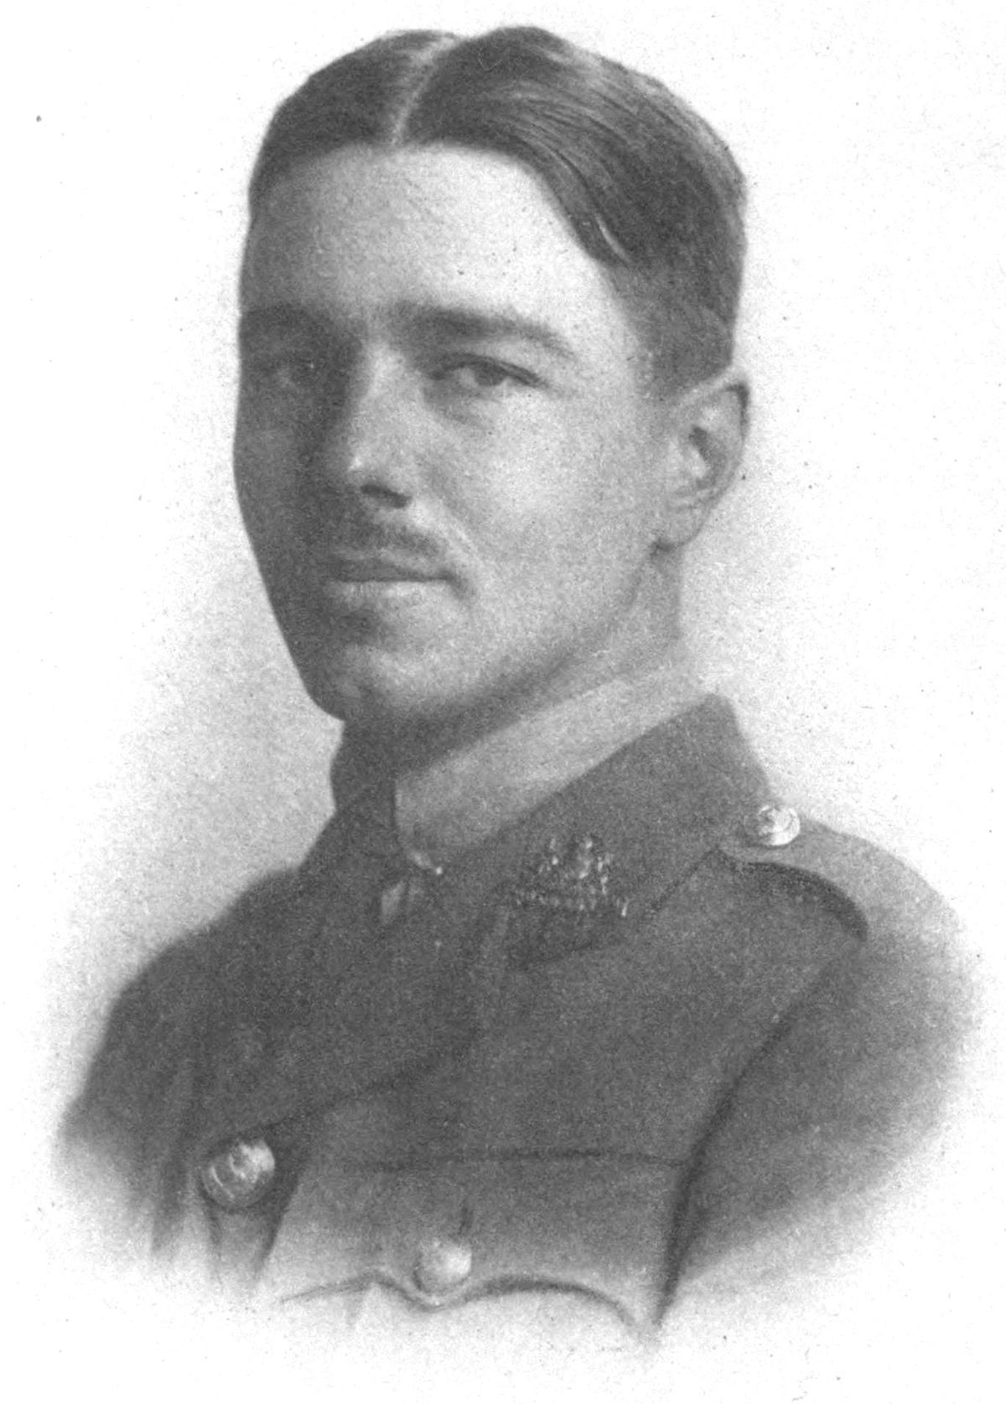
The Poet: Wilfred Owen
Wilfred Owen was born in 1893 in Shropshire.
In 1915 enlisted in the army.
He left for the western front early in January 1917.
After experiencing heavy fighting, he was diagnosed with shellshock. He was evacuated to England and arrived at Craiglockhart War Hospital near Edinburgh in June.
There he met the poet Siegfried Sassoon, who already had a reputation as a poet and shared Owen's views. Sassoon agreed to look over Owen's poems.
He returned to France in August 1918 and in October was awarded the Military Cross for bravery.
On 4 November 1918 he was killed.The news of his death reached his parents on 11 November, Armistice Day. He was 25.

Slide 11
Key Words:
Antiquated
glorified
Assonance
Simile
Metaphor
Structure
The first stanza has a slow, turgid (boring) pace due to the first sentence layering clause on top of clause. This creates a turgid tone, reflecting the soldiers’ feeling that the march will never end.
The second stanza is fast paced through one word sentences and exclamation marks. This reflects the sense of panic as the gas attack unfolds.
The pace slows again in the final stanza to reflect the feeling that war is never ending. Owen uses the second person (“you”, “my friend”) to address the reader personally, creating an uncomfortable and accusatory tone. These final lines are clearly aimed at those in command
Be proactive take your own notes!
Learning Objective:
AO2: Analyse the language, form and structure used by a writer to create meanings and effects, using relevant subject terminology where appropriate.

Slide 12
Answer all the questions. Use google if needed
What effect does the repetition of of the pre-determiner ‘all’ have? And the metaphor ‘drunk with fatigue’?
What do the these similies suggest? What type of language is this? Do they sound like heroes?The simile suggests the soldiers are...
Bent double, like old beggars under sacks,
Knock-kneed, coughing like hags, we cursed through sludge,
Till on the haunting flares we turned our backs,
And towards our distant rest began to trudge.
Men marched asleep. Many had lost their boots,
But limped on, blood-shod. All went lame; all blind;
Drunk with fatigue; deaf even to the hoots
Of gas-shells dropping softly behind.
Assonace is like a background rumbling of explosions.
What does the verb ‘trudge’ suggest?
What does the adjective ‘haunting’ suggest ?

Slide 13
What does this exclamatory phrase create? What does ‘boys’ tell us?
Gas! GAS! Quick, boys!—An ecstasy of fumbling
Fitting the clumsy helmets just in time,
But someone still was yelling out and stumbling
And flound’ring like a man in fire or lime.—
Dim through the misty panes and thick green light,
As under a green sea, I saw him drowning.
What do the verbs ‘yelling’ and ‘stumbling’ imply?
How does ‘misty panes’ add to the traumatic scene? What is the effect of the metaphor describing the gas?
What does the adjective ‘clumsy’ imply?
What does the metaphor suggest? How could the verb ‘drowning’ be both literal and metaphorical?

Slide 14
What does the fact he sees this in his dreams suggest?
In all my dreams before my helpless sight,
He plunges at me, guttering, choking, drowning.
What effect does the listing of the visceral verbs have?
Guttering, describes the tears streaming down the face – a symptom of inhaling toxic gas.

Slide 15
What impact does the use of the 2nd person pronoun have?
What is the impact of the grotesque imagery? What does the alliteration do?
If in some smothering dreams, you too could pace
Behind the wagon that we flung him in,
And watch the white eyes writhing in his face,
His hanging face, like a devil’s sick of sin;
If you could hear, at every jolt, the blood
Come gargling from the froth-corrupted lungs,
Obscene as cancer, bitter as the cud
Of vile, incurable sores on innocent tongues,—
My friend, you would not tell with such high zest
To children ardent for some desperate glory,
The old Lie: Dulce et decorum est
Pro patria mori.
Owen is aiming this sarcastic reference to Jesse Pope who glorified war.
‘It is sweet and proper to die for one’s country’ - why does he refer to this as the ‘old Lie’?
Does this poem have an anti-war tone? Why?

Slide 16
Key Words:
Antiquated
glorified
Assonance
Simile
Metaphor
Task: How does Wilfred Owen create tone and mood in "Dulce et Decorum Est?“
Refer to the text – included quotations
Write as:
P
E
E
D
Learning Objective:
AO2: Analyse the language, form and structure used by a writer to create meanings and effects, using relevant subject terminology where appropriate.

Slide 17
Model PETER
Wilfred Owen creates a brutal tone in the poem. The speaker describes a dying man as the ‘blood come[s] gargling from the froth-corrupted lungs’. The onomatopoeic verb ‘gargling’, along with the grotesque imagery, highlights the brutality and violence of war by making it so vivid and inescapable for the reader. Events like this would have been traumatic for the dying man as well as those who witnessed it. Owen himself suffered from Shell Shock so would have realised the long-lasting impact of war personally. Therefore Owen clearly creates a savage and harsh tone throughout the poem presenting war as brutal for everyone involved. As a result of the horrific imagery, readers may feel horrified by the reality of war and the intense trauma they endured from the gas attacks.
.

Slide 18
WAGOLL PETER
Wilfred Owen creates a brutal tone in the poem. The speaker describes a dying man as the ‘blood come[s] gargling from the froth-corrupted lungs’. The onomatopoeic verb ‘gargling’, along with the grotesque imagery, highlights the brutality and violence of war by making it so vivid and inescapable for the reader. Events like this would have been traumatic for the dying man as well as those who witnessed it. Owen himself suffered from Shell Shock so would have realised the long-lasting impact of war personally. Moreover, Owen hints at more brutality in ‘men marched asleep’ and ‘drunk with fatigue’. The alliteration and metaphor highlight the sheer exhaustion the men suffered whilst attempting to continue their fight and protect their motherland. On the other hand, it shows the atrocious expectations of the soldiers from their leaders. As a result of the horrific imagery, readers may feel horrified by the reality of war and the intense trauma they endured from the gas attacks.
.
Wilfred Owen creates a brutal tone in the poem. The speaker describes a dying man as the ‘blood come[s] gargling from the froth-corrupted lungs’. The onomatopoeic verb ‘gargling’, along with the grotesque imagery, highlights the brutality and violence of war by making it so vivid and inescapable for the reader. Events like this would have been traumatic for the dying man as well as those who witnessed it. Owen himself suffered from Shell Shock so would have realised the long-lasting impact of war personally. Therefore Owen clearly creates a savage and harsh tone throughout the poem presenting war as brutal for everyone involved. As a result of the horrific imagery, readers may feel horrified by the reality of war and the intense trauma they endured from the gas attacks.
.

Slide 19
Model PETER
Wilfred Owen creates a brutal tone in the poem. The speaker describes a dying man as the ‘blood come[s] gargling from the froth-corrupted lungs’. The onomatopoeic verb ‘gargling’, along with the grotesque imagery, highlights the brutality and violence of war by making it so vivid and inescapable for the reader. Events like this would have been traumatic for the dying man as well as those who witnessed it. Owen himself suffered from Shell Shock so would have realised the long-lasting impact of war personally. Therefore Owen clearly creates a savage and harsh tone throughout the poem presenting war as brutal for everyone involved. As a result of the horrific imagery, readers may feel horrified by the reality of war and the intense trauma they endured from the gas attacks.
.

