Slide 1
What is wrong with these sentences? Correct them.
Can I have a drink? said Lucy.
Although I was cold.
The castle which was built in 1230 looked derelict.
Is this Roberts calculator
“I really dont want to do this maths test” complained Eddie
Do Now

Slide 2
Look at the text: A Conversation About Rain
Complete the following
Highlight complex sentence structures.
Underline character appearance
Circle character actions and body language.
How has the writer developed the description around this conversation?
Reading Activity

Slide 3
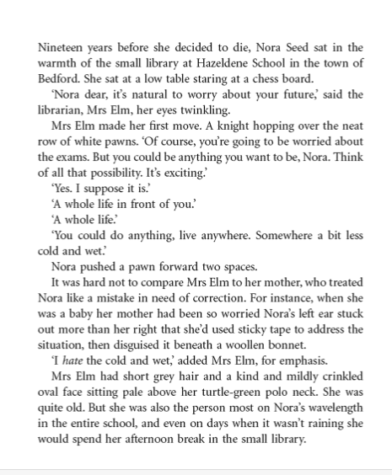
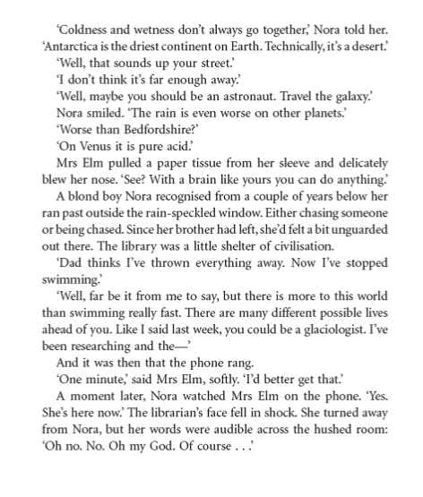
Reading Activity

Slide 4
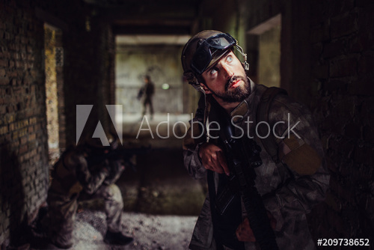
Pick one of the pictures – create a conversation between the characters.
Focus:
Complex sentence structures.
Character appearance
Character actions and body language.
Mastery

Slide 5
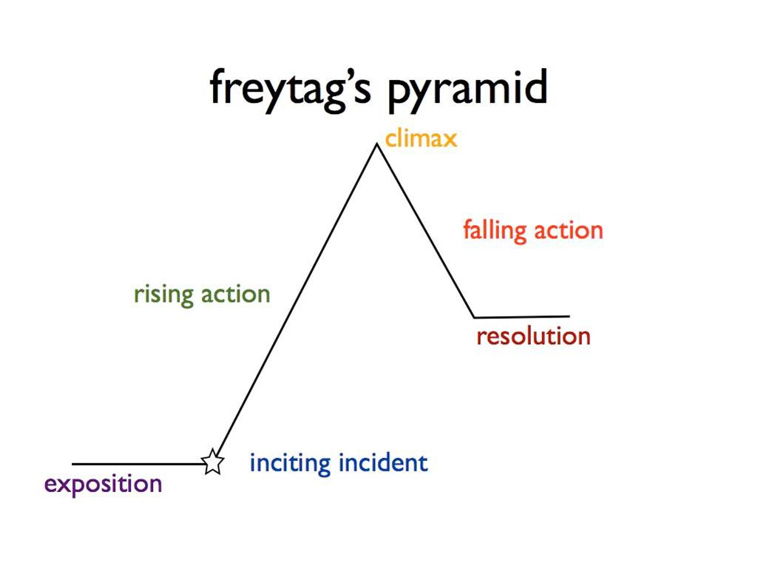
Planning Narratives: Graph to plot your narrative
Mastery

Slide 6
Use the graph to plan narratives for the following:
A time you felt nervous
A favourite memory
A time you felt sad
An embarrassing moment
REMEMBER: These do not have to be based on REAL events.
Mastery

Slide 7
Example Exam Questions: How could you adapt your narrative plans if you had to select one of these titles?
Making a difference
The Choice
Write about a time when you were at a children’s party.
Write a story which begins: ‘I didn’t know if I had the courage to do this.’
Mastery

Slide 8
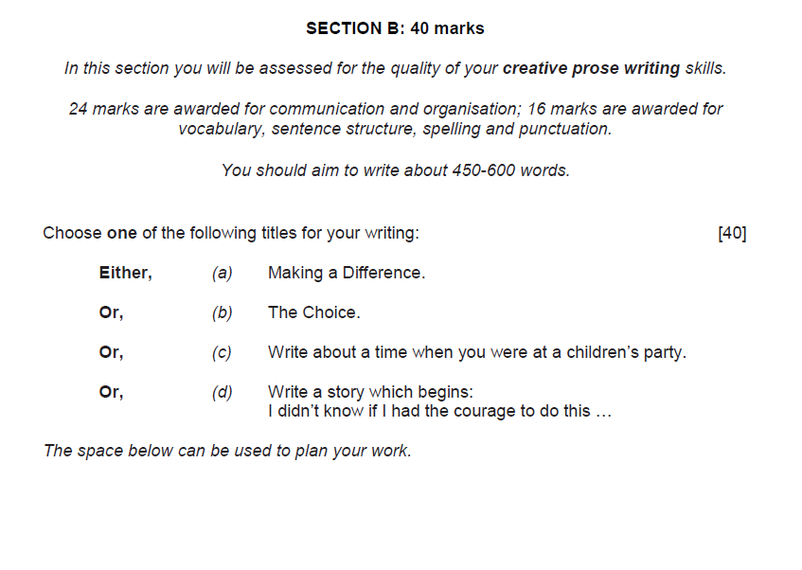
Exam Practice

