Slide 1
Lesson 1 & 2 GCSE Descriptive Writing
Lesson 1 – preparation and development of descriptive writing skills.
Follow the ppts – complete tasks as shown – copy out some examples.
Lesson 2 – Planning and writing your own descriptive piece.
Complete the Review sheet and bring this and your written work to class and glue into your books for assessment.
Learning Objectives:
Using appropriate sensory imagery and writers’ techniques to describe effectively

Slide 2
GCSE Descriptive Writing
Learning Objectives:
Using appropriate sensory imagery and writers’ techniques to describe effectively

Slide 3
Rule no.1 : Showing not telling!!!
It was a dull day and I was feeling glum
He was careless and free
He strolled into the room lazily
I felt so excited, I could hardly contain myself
The room was empty
It was foggy and drizzling outside
THESE ARE ALL TELLING A STORY, NOT DESCRIBING
If you can ask yourself ‘how?’ after the sentence then it is narrative, not descriptive.

Slide 4
Telling sentences
Showing sentences
It was a dull day and he was feeling glum
She was careless and free
He strolled into the room lazily
The girls felt so excited, they could hardly contain themselves
The room was empty
It was foggy
The sky was painted with darkening shades of grey as he slumped , dragging his feet.
She jauntily bounded down the street with the wind in her hair
His heels scuffed the floor as he pushed his body into the room.
Giggles and screams emanated from the girls as they flailed their arms in rapture.
The door opened with a resounding echo that seemed to fill the house
Yellow smog rubbed itself up against the rows of windows, cooling to a greying condensation.

Slide 5
More examples...
The pizza was delicious.
Steam rising up off the melted cheese made my mouth water. The first bite, my teeth sinking into the cheese through the tomato sauce and into the moist crust, made me chew and swallow rapidly. Even the cheese and tomato sauce, sticking to my fingertips, begged to be licked.
He is angry.
Sitting at his desk, his jaw tightened. His eyes flashed heat waves at me. The words erupted from his mouth, "I want to talk to you after class." The final hiss in his voice warned me about his feelings.
The morning was beautiful.
Behind the mountains, the sun peaked brightly, ready to start a new day. The blue sky remained silent yet showed signs of sadness. The wind whispered through the trees as the cheerful sun rose. The birds sang gently by my window as if they wanted to wake me up.
The coffee was enjoyable.
She cradled the mug in both hands and leaned her head over it in the rising steam. Pursing her lips, she blew softly over the clouded surface and let her eyelids drop. Her shoulders rose slightly as she breathed in, and she hummed with her head low. I lifted the tiny porcelain pitcher and poured a brief rotating arch of white into the black depths of my own cup. She opened her eyes, and we looked at each other across the table without speaking.

Slide 6
How can you ‘show’ these facts about these characters?
He was very tired and had lived a long life
She was very stuck – up and always judged everybody
He had been injured many years ago from a fractured knee
She was very excitable and was always full of energy
He did not care for celebrations and felt bitter about the cake that was presented to him
REMEMBER:
- Use an adverb to describe their movements (e.g. Hastily, clumsily...)
- Describe PHYSICAL features
- Use similes/metaphors/ other comparisons to the person
- Always ask yourself ‘how’ and answer it by showing images of the person and details of their appearance which reveals their personality

Slide 7
Rule no. 2 – Writing using the 3rd person
First person sentence
Third person sentence
DO NOT write from the perspective of yourself e.g. I, you
You must take the perspective of a human camera that does not personally belong to the scene e.g. ‘there was’ ‘it was’ ‘could be seen’ ‘could be heard’
I could see a myriad of flowers bursting with vibrance.
The man stamped past me, angrily.
You could hear the waves roaring against the cliffs in the distance.
His eyes bore into me like deep, dark cavernous pits
They reminded me of a herd of elephants
A myriad of flowers were bursting with vibrance.
The man stamped towards the door, angrily

Slide 8

Rule no. 3 - Sensory Writing
Describe a car journey.
What might you see, touch,
smell, taste and
hear?

Slide 9
seen
- Like a fiery red fist, the Ferrari Testarossa punched its way past our ageing Ford Fiesta...
touched
- the open window allowed a cool spring breeze to caress my cheeks...
smelt
- an ancient jalopy of a school bus spluttered along in front of us spewing out nauseous black clouds of exhaust...
tasted
- the bitter taste of the travel sickness pill still clung to back of my throat...
heard
- the screeching siren of an ambulance forced us to pull in and wait till it passed...

Slide 10
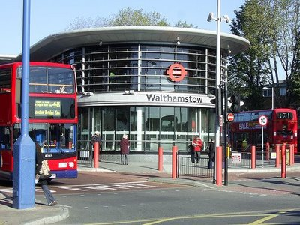
Your turn
Describe the scene in a busy
bus station.
What might you see, touch,
smell, taste and hear?
hear?
Remember – DO NOT say ‘I heard’ ‘I saw’ ‘It felt like’ – this is first person and also very boring.

Slide 11
Rule no. 4 – stop using boring describing words!
BORING, NOT PRECISE, NOT APPROPRIATE AND DOES NOT CREATE AN IMAGE
Bright
Miserable
White as snow
Clear as day
Smart
Smile like the sun
Fresh
Gloomy
Dark
Gleaming
Shadowy
Tiny
Tall
Broad

Slide 12
Try this instead...
Bright
Miserable
White as snow
Clear as day
Smart
Smile like the sun
Fresh
Gloomy
Dark
Gleaming
Shadowy
Tiny
Tall
Broad
Irridescent/radiant/glowing
sagging/used teabag
Peaked meringues/ alpine smile
Transparent/ colourless
Starched/ elegant/ majestic/ robust
Spread warmth/sparkling jewels

Slide 13
What makes this description of setting so good?
It was a town of red brick, or of brick that would have been red if the smoke and ashes had allowed it; but as matters stood it was a town of unnatural red and black like the painted face of a savage. It was a town of machinery and tall chimneys, out of which interminable serpents of smoke trailed themselves for ever and ever, and never got uncoiled. It had a black canal in it, and a river that ran purple with ill-smelling dye, arid vast piles of building full of windows where there was a rattling and a trembling all day long, and where the piston of the steam-engine worked monotonously up and down, like the head of an elephant in a state of melancholy madness.

Slide 14
What makes this description so good? Visual imagery - colours
It was a town of red brick, or of brick that would have been red if the smoke and ashes had allowed it; but as matters stood it was a town of unnatural red and black like the painted face of a savage. It was a town of machinery and tall chimneys, out of which interminable serpents of smoke trailed themselves for ever and ever, and never got uncoiled. It had a black canal in it, and a river that ran purple with ill-smelling dye, arid vast piles of building full of windows where there was a rattling and a trembling all day long, and where the piston of the steam-engine worked monotonously up and down, like the head of an elephant in a state of melancholy madness.

Slide 15
What makes this description so good? Visual imagery: Details of sights & quantities, size adjectives
It was a town of red brick, or of brick that would have been red if the smoke and ashes had allowed it; but as matters stood it was a town of unnatural red and black like the painted face of a savage. It was a town of machinery and tall chimneys, out of which interminable serpents of smoke trailed themselves for ever and ever, and never got uncoiled. It had a black canal in it, and a river that ran purple with ill-smelling dye, arid vast piles of building full of windows where there was a rattling and a trembling all day long, and where the piston of the steam-engine worked monotonously up and down, like the head of an elephant in a state of melancholy madness.

Slide 16
What makes this description of so good? Sound / Movement imagery
It was a town of red brick, or of brick that would have been red if the smoke and ashes had allowed it; but as matters stood it was a town of unnatural red and black like the painted face of a savage. It was a town of machinery and tall chimneys, out of which interminable serpents of smoke trailed themselves for ever and ever, and never got uncoiled. It had a black canal in it, and a river that ran purple with ill-smelling dye, arid vast piles of building full of windows where there was a rattling and a trembling all day long, and where the piston of the steam-engine worked monotonously up and down, like the head of an elephant in a state of melancholy madness.

Slide 17
What makes this description so good? Scent imagery
It was a town of red brick, or of brick that would have been red if the smoke and ashes had allowed it; but as matters stood it was a town of unnatural red and black like the painted face of a savage. It was a town of machinery and tall chimneys, out of which interminable serpents of smoke trailed themselves for ever and ever, and never got uncoiled. It had a black canal in it, and a river that ran purple with ill-smelling dye, arid vast piles of building full of windows where there was a rattling and a trembling all day long, and where the piston of the steam-engine worked monotonously up and down, like the head of an elephant in a state of melancholy madness.

Slide 18
What makes this description so good? Ambitious vocabulary
It was a town of red brick, or of brick that would have been red if the smoke and ashes had allowed it; but as matters stood it was a town of unnatural red and black like the painted face of a savage. It was a town of machinery and tall chimneys, out of which interminable serpents of smoke trailed themselves for ever and ever, and never got uncoiled. It had a black canal in it, and a river that ran purple with ill-smelling dye, arid vast piles of building full of windows where there was a rattling and a trembling all day long, and where the piston of the steam-engine worked monotonously up and down, like the head of an elephant in a state of melancholy madness.

Slide 19
What makes this description so good? Complex sentences
It was a town of red brick, or of brick that would have been red if the smoke and ashes had allowed it; but as matters stood it was a town of unnatural red and black like the painted face of a savage. It was a town of machinery and tall chimneys, out of which interminable serpents of smoke trailed themselves for ever and ever, and never got uncoiled. “It had a black canal in it, and a river that ran purple with ill-smelling dye, arid vast piles of building full of windows where there was a rattling and a trembling all day long, and where the piston of the steam-engine worked monotonously up and down, like the head of an elephant in a state of melancholy madness”.

Slide 20
What makes this description good? Devices such as similes & metaphors
It was a town of red brick, or of brick that would have been red if the smoke and ashes had allowed it; but as matters stood it was a town of unnatural red and black like the painted face of a savage. It was a town of machinery and tall chimneys, out of which interminable serpents of smoke trailed themselves for ever and ever, and never got uncoiled. It had a black canal in it, and a river that ran purple with ill-smelling dye, arid vast piles of building full of windows where there was a rattling and a trembling all day long, and where the piston of the steam-engine worked monotonously up and down, like the head of an elephant in a state of melancholy madness.

Slide 21
What makes this description so good? Spelling, punctuation & grammar is correct!
It was a town of red brick, or of brick that would have been red if the smoke and ashes had allowed it; but as matters stood it was a town of unnatural red and black like the painted face of a savage. It was a town of machinery and tall chimneys, out of which interminable serpents of smoke trailed themselves for ever and ever, and never got uncoiled. It had a black canal in it, and a river that ran purple with ill-smelling dye, arid vast piles of building full of windows where there was a rattling and a trembling all day long, and where the piston of the steam-engine worked monotonously up and down, like the head of an elephant in a state of melancholy madness.

Slide 22
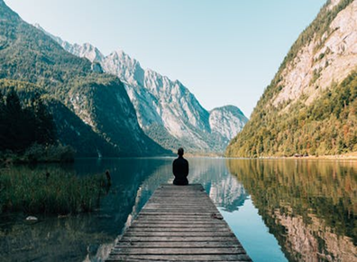
Lesson 2 Writing Task
Based on the image, plan and write a description based on the image. Aim for 3 paragraphs.
Go into detail – zoom in. Use the examples given in the previous lesson.
Make sure you include:
The senses – focus on ONE aspect and describe in great detail.
Colours – see previous ppts/lessons
Techniques- adjectives, adverbs, metaphors simile etc
VARY your Vocabulary, sentence structures, punctuation for effect.
Self edit for: Sp & G

Slide 23
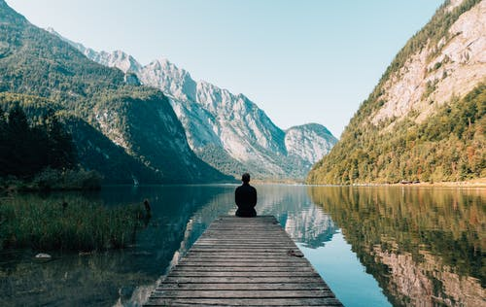
Lesson 2 Writing Task
Write down all the vocabulary which comes to mind when you see this image. (Big picture – zoom out)
Colours:
Senses:
Techniques:
Adjectives:

Slide 24
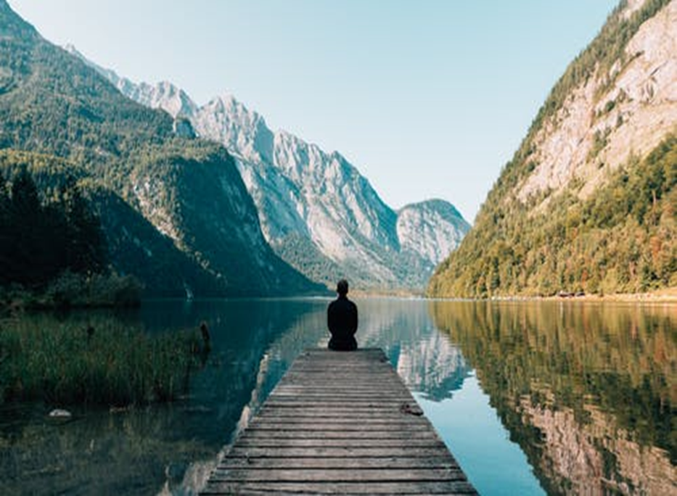
Lesson 2 Writing Task- planning and preparing
Based on the image, plan and write a description based on the image.
Vocabulary, sentence structures, punctuation for effect.
(You may copy or print off larger table on next slide)
What are you going to ‘zoom in’ on?
What sentence types will you include? | Punctuation types:
Vocabulary: | Zoom in:

Slide 25
Print or copy: planning and preparing
Based on the image, plan and write a description based on the image.
Vocabulary, sentence structures, punctuation for effect.
What sentence types will you include? | Punctuation types:
Vocabulary: | Zoom in :

Slide 26
Lesson 2 Writing Task
You are now ready to write your description.
Aim for a minimum of 3 paragraphs – focus in on ONE specific aspect(zoom in) as well as the picture as a whole (zoom out).
Suggested order:
Paragraph 1 – Big picture, overview of what you see/hear/touch relevant techniques and sentence structures.
Paragraph 2 – Zoom in on chosen aspect: techniques, adjectives etc
Paragraph 3 – Zoom out again focus on foreground or background for instance – include any techniques/vocabulary not yet used.
Make sure you include:
The senses – focus on ONE aspect and describe in great detail.
Colours – see previous ppts/lessons
Techniques- adjectives, adverbs, metaphors simile etc
VARY your Vocabulary, sentence structures, punctuation for effect.
Self edit for: Sp & G

