Slide 1
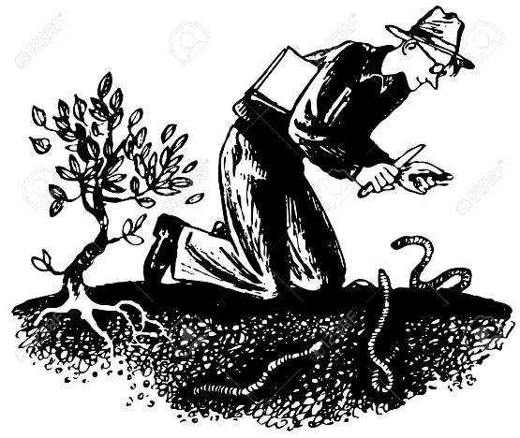
Death of a naturalist Seamus heaney
Annotate your anthology with a definition of the word naturalist:- someone who studies and enjoys nature.
Big question:.

Slide 2
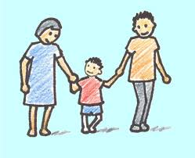
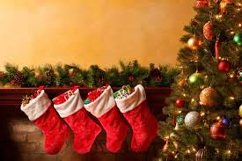
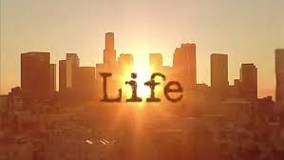
Think of examples of when your attitude to something has changed as you have got older
E.g.

Slide 3
What would you expect a nature poem to be like?
Content
Mood
Atmosphere
Types of vocabulary

Slide 4
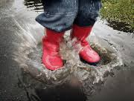
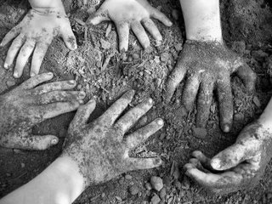
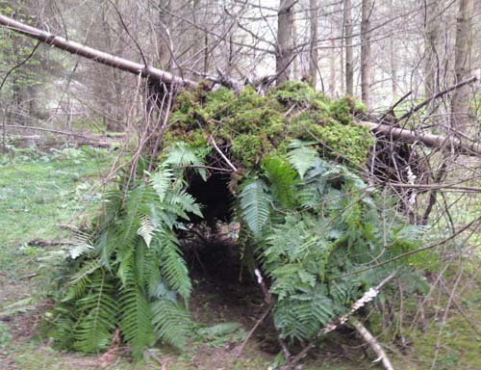
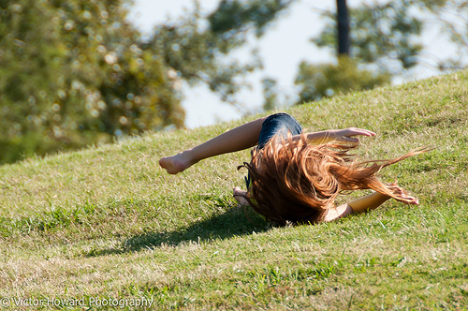

Slide 5
Use 3 colours to annotate the different imagery below.
Unpleasant – but fun
Unpleasant and threatening
Military imagery
Notes:
OPTIONAL game of SPLAT (2 students are up the front. They compete to guess the word by whacking the board-word first. They then, for a bonus point, give their opinion on what the object was).

Slide 6
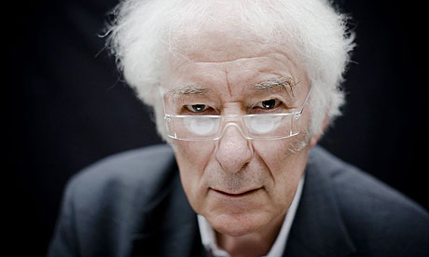
Seamus heaney
Resident expert?
a song of praise or triumph
Irish poet (1939 – 2013). First book of poetry Death of a Naturalist contained “vivid portraits” of natural life.
Born on a farm, became a schoolteacher, then a writer. He won the Nobel Prize for Literature in 1995.
“Heaney's work is often a paean to the beauty and depth of nature.”
Notes:
Quotes from http://www.biography.com/people/seamus-heaney-9332875#acclaimed-poet

Slide 7
Death of a naturalist
Does anyone die in the poem?
In what sense can there be a death?
Metaphorical death of a potential naturalist.
Notes:
https://www.youtube.com/watch?v=sgsaB4NRSak (Heaney Reads)

Slide 8
All year the flax-dam festered in the heart
Of the townland; green and heavy headed
Flax had rotted there, weighted down by huge sods.
Daily it sweltered in the punishing sun.
Bubbles gargled delicately, bluebottles
Wove a strong gauze of sound around the smell.
There were dragon-flies, spotted butterflies,
But best of all was the warm thick slobber
Of frogspawn that grew like clotted water
In the shade of the banks. Here, every spring
I would fill jampotfuls of the jellied
Specks to range on window-sills at home,
On shelves at school, and wait and watch until
The fattening dots burst into nimble-
Swimming tadpoles. Miss Walls would tell us how
The daddy frog was called a bullfrog
And how he croaked and how the mammy frog
Laid hundreds of little eggs and this was
Frogspawn. You could tell the weather by frogs too
For they were yellow in the sun and brown
In rain.
How are the disgusting parts of nature emphasised?
How does the speaker show his familiarity with nature.

Slide 9
All year the flax-dam festered in the heart
Of the townland; green and heavy headed
Flax had rotted there, weighted down by huge sods.
Daily it sweltered in the punishing sun.
Bubbles gargled delicately, bluebottles
Wove a strong gauze of sound around the smell.
There were dragon-flies, spotted butterflies,
But best of all was the warm thick slobber
Of frogspawn that grew like clotted water
In the shade of the banks. Here, every spring
I would fill jampotfuls of the jellied
Specks to range on window-sills at home,
On shelves at school, and wait and watch until
The fattening dots burst into nimble-
Swimming tadpoles. Miss Walls would tell us how
The daddy frog was called a bullfrog
And how he croaked and how the mammy frog
Laid hundreds of little eggs and this was
Frogspawn. You could tell the weather by frogs too
For they were yellow in the sun and brown
In rain.
Wonder/enthusiasm
Techniques used?
Impression Created?
Semantic field: threat
Soundscape (onomatopoeia)
Alliteration (w)
Notes:
Wordsworth’s idea: Fair seed time had my soul and I grew up Fostered alike by beauty and by fear.
Wordsworth presents, in natural terms, the idea of a plant being nurtured from a seed and links this to his personal growth through childhood and beyond. He carefully signals, though, that he experienced both “beauty” and “fear”. In the same way, Heaney writes about being entranced by the variegated beauty of nature as well as its frightening dimension.
http://www.sheerpoetry.co.uk/gcse/seamus-heaney/notes-on-selected-poems/death-of-a-naturalist

Slide 10
Then one hot day when fields were rank
With cowdung in the grass the angry frogs
Invaded the flax-dam; I ducked through hedges
To a coarse croaking that I had not heard
Before. The air was thick with a bass chorus.
Right down the dam gross-bellied frogs were cocked
On sods; their loose necks pulsed like sails. Some hopped:
The slap and plop were obscene threats. Some sat
Poised like mud grenades, their blunt heads farting.
I sickened, turned, and ran. The great slime kings
Were gathered there for vengeance and I knew
That if I dipped my hand the spawn would clutch it.
Why a “bass” chorus?
Why are they seeking vengeance?
What word emphasises a change in tone?
Add to our semantic field of threat.
How does this contrast to the beginning?

