Slide 1
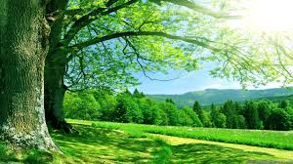
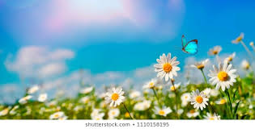
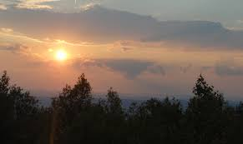
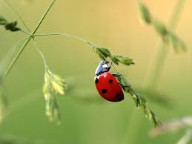
‘Nature Poems’
Death of a Naturalist
by Seamus Heaney
LO: To analyse the poem and understand the use of language and structure for meaning. ST: I can understand writers’ methods and use subject terminology.
Learning Objective:
AO2: Analyse the language, form and structure used by a writer to create meanings and effects, using relevant subject terminology where appropriate.

Slide 2
Key Words:
Naturalist
Flax dam
Sods
Fascination/ Disgust
Consider what a naturalist is.
Consider what nature means to you.
Do things that you found fascinating as a child hold no interest for you now?
What does this tell us about aging?
Learning Objective:
AO2: Analyse the language, form and structure used by a writer to create meanings and effects, using relevant subject terminology where appropriate.
Notes:
Sophistry = subtle false arguments used to deceive someone.
Fascist = Fascism is a form of far-right, authoritarian ultranationalism characterized by dictatorial power, forcible suppression of opposition, and strong regimentation

Slide 3
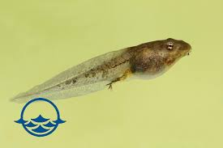
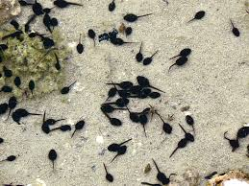
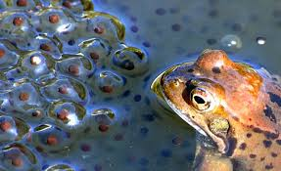
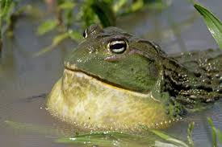
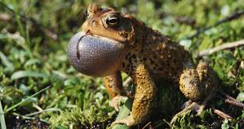
Look at the images below and think about what they represent.

Slide 4
Key Words:
Naturalist
Flax dam
Sods
Fascination/ Disgust
All year the flax-dam festered in the heart
Of the townland; green and heavy headed
Flax had rotted there, weighted down by huge sods.
Daily it sweltered in the punishing sun.
Bubbles gargled delicately, bluebottles
Wove a strong gauze of sound around the smell.
There were dragonflies, spotted butterflies,
But best of all was the warm thick slobber
Of frogspawn that grew like clotted water
In the shade of the banks. Here, every spring
I would fill jampotfuls of the jellied
Specks to range on window sills at home,
On shelves at school, and wait and watch until
The fattening dots burst, into nimble
Swimming tadpoles. Miss Walls would tell us how
The daddy frog was called a bullfrog
And how he croaked and how the mammy frog
Laid hundreds of little eggs and this was
Frogspawn. You could tell the weather by frogs too
For they were yellow in the sun and brown
In rain.
Then one hot day when fields were rank
With cowdung in the grass the angry frogs
Invaded the flax-dam; I ducked through hedges
To a coarse croaking that I had not heard
Before. The air was thick with a bass chorus.
Right down the dam gross bellied frogs were cocked
On sods; their loose necks pulsed like sails. Some hopped:
The slap and plop were obscene threats. Some sat
Poised like mud grenades, their blunt heads farting.
I sickened, turned, and ran. The great slime kings
Were gathered there for vengeance and I knew
That if I dipped my hand the spawn would clutch it.
Start with the title Death of a Naturalist
Let’s read the poem by Seamus Heaney
What are your initial thoughts?
Learning Objective:
AO2: Analyse the language, form and structure used by a writer to create meanings and effects, using relevant subject terminology where appropriate.

Slide 5
Key Words:
Naturalist
Flax dam
Sods
Fascination/ Disgust
Let’s have some feedback
Learning Objective:
AO2: Analyse the language, form and structure used by a writer to create meanings and effects, using relevant subject terminology where appropriate.

Slide 6
All year the flax-dam festered in the heart
Of the townland; green and heavy headed
Flax had rotted there, weighted down by huge sods.
Daily it sweltered in the punishing sun.
Bubbles gargled delicately, bluebottles
Wove a strong gauze of sound around the smell.
There were dragonflies, spotted butterflies,
But best of all was the warm thick slobber
Of frogspawn that grew like clotted water
In the shade of the banks. Here, every spring
I would fill jampotfuls of the jellied
Specks to range on window sills at home,
On shelves at school, and wait and watch until
The fattening dots burst, into nimble
Swimming tadpoles. Miss Walls would tell us how
The daddy frog was called a bullfrog
And how he croaked and how the mammy frog
Laid hundreds of little eggs and this was
Frogspawn. You could tell the weather by frogs too
For they were yellow in the sun and brown
In rain.
Then one hot day when fields were rank
With cowdung in the grass the angry frogs
Invaded the flax-dam; I ducked through hedges
To a coarse croaking that I had not heard
Before. The air was thick with a bass chorus.
Right down the dam gross bellied frogs were cocked
On sods; their loose necks pulsed like sails. Some hopped:
The slap and plop were obscene threats. Some sat
Poised like mud grenades, their blunt heads farting.
I sickened, turned, and ran. The great slime kings
Were gathered there for vengeance and I knew
That if I dipped my hand the spawn would clutch it.
What are your initial thoughts? What is it all about?

Slide 7
Tense? Narration?
What does this language of decay suggest?
Personification brings the dam to life
All year the flax-dam festered in the heart
Of the townland; green and heavy headed
Flax had rotted there, weighted down by huge sods.
Daily it sweltered in the punishing sun.
What does this suggest about nature ?
How is the sun described? What technique is used?
Notes:
Tense = past Narration = 1st person Sun seems oppressive uses personification

Slide 8
What does the oxymoron suggest about the narrator?
What does this language show?
Bubbles gargled delicately, bluebottles
Wove a strong gauze of sound around the smell.
There were dragonflies, spotted butterflies,
But best of all was the warm thick slobber
Of frogspawn that grew like clotted water
In the shade of the banks. Here, every spring
I would fill jampotfuls of the jellied
Specks to range on window sills at home,
Find the use of sensory description.
Juxtaposition of beauty and disgust – why?
What is the effect of the word clotted?
What does the use of alliteration show?
Notes:
Oxymoron shows narrators childish enthusiasm. Sensory description uses sound, smell touch Juxtaposition = focus on setting
alliteration of jampotsfull and jellied shows stickiness sensory description

Slide 9
What does the enjambment show?
On shelves at school, and wait and watch until
The fattening dots burst, into nimble
Swimming tadpoles. Miss Walls would tell us how
The daddy frog was called a bullfrog
And how he croaked and how the mammy frog
Laid hundreds of little eggs and this was
Frogspawn. You could tell the weather by frogs too
For they were yellow in the sun and brown
In rain.
What type of language is this?
The use of simple conjunctions ‘and’ is repetitive to show speaker’s youth.
How can you tell the narrator wants to share his interest with others?
What is the purpose of the last line?
Notes:
Enjambment = emphasise the narrators excitement daddy/mammy = childlike innocence?
Last line is short / it makes the stanza end abruptly to show a turning point in the poem or VOLTA.

Slide 10
Setting of Stanza 2 echoes stanza 1 – emphasises nature hasn’t changed BUT the narrator’s opinion has
How are the frogs made to seem?
Then one hot day when fields were rank
With cowdung in the grass the angry frogs
Invaded the flax-dam; I ducked through hedges
To a coarse croaking that I had not heard
Before. The air was thick with a bass chorus.
Military language?
What does this refer to? What is it an example of?
What is the effect of the alliteration?
Notes:
Alliteration mimics the sound of croaking bass is the deep pitch of the bullfrogs – sensory description
Frogs seem threatening

Slide 11
Unusual simile?
Military language?
Right down the dam gross bellied frogs were cocked
On sods; their loose necks pulsed like sails. Some hopped:
The slap and plop were obscene threats. Some sat
Poised like mud grenades, their blunt heads farting.
I sickened, turned, and ran. The great slime kings
Were gathered there for vengeance and I knew
That if I dipped my hand the spawn would clutch it.
Why the use of onomatopoeia?
Personification – frogs have authority?
The shortest sentence! Emphasises what?
Which word suggests the frogs want revenge?
How does the poem end?
Notes:
Military – cocked like a gun/trigger
Simile frogs are about to explode shortest sentence emphasises speed of narrators reaction to frogs – list of verbs contrast with descriptive nature
Ends with a nightmarish image – reinforces how much the speaker’s views have changed.

Slide 12
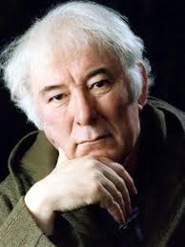
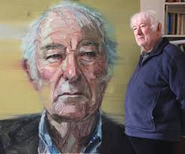
Seamus Heaney
*Seamus Heaney was born in Northern Ireland in 1939, the eldest of nine children.
*His father was a farmer in rural County Derry and much of Heaney's poetry is about the countryside and farm life of his childhood.
*At the age of 12, Heaney won a scholarship to the boarding school of St Columb's College in the city of Derry, forty miles from his rural home.

Slide 13
Death of a Naturalist describes the exploits of a young Heaney collecting frogspawn. He remembers being fascinated by the frogspawn and recollects his teacher telling him all about frogs in school. However, in the second half of the poem, when the boy returns to the ‘flax-dam’, he feels threatened and disgusted by the frogs and flees. His interest in nature has died, hence the title of the poem ‘Death of a Naturalist’. The two verses could stand for innocence and experience.
Context
Be proactive take your own notes!
Learning Objective:
AO2: Analyse the language, form and structure used by a writer to create meanings and effects, using relevant subject terminology where appropriate.
Notes:
Could it mean the end of the school holidays? Coming back to a new change of year/school/teachers/ does that make you sad.
The loss of good weather? Etc.

Slide 14
Nature Change Transformation Sense of place Links well with ‘The Prelude’ and ‘To Autumn’
Themes
Be proactive take your own notes!
Learning Objective:
AO2: Analyse the language, form and structure used by a writer to create meanings and effects, using relevant subject terminology where appropriate.
Notes:
Could it mean the end of the school holidays? Coming back to a new change of year/school/teachers/ does that make you sad.
The loss of good weather? Etc.

Slide 15
Written in a first person narrative. It is written in blank verse which makes the poem sound like a conversation. No rhyme scheme – suggests that change is not always predictable.
Form
Be proactive take your own notes!
Learning Objective:
AO2: Analyse the language, form and structure used by a writer to create meanings and effects, using relevant subject terminology where appropriate.
Notes:
Could it mean the end of the school holidays? Coming back to a new change of year/school/teachers/ does that make you sad.
The loss of good weather? Etc.

Slide 16
* Two stanzas – each one presenting a different attitude towards nature. * References to decay in stanza 1 foreshadow a change in attitude. * Childish enthusiasm towards nature in stanza 1 makes relationship seem secure. * Volta is used in stanza 2 to show change. The relationship with nature becomes troubled –it is presented as unfamiliar and threatening. * The tone is of fascination in stanza 1 and disgust in stanza 2 * The use of senses lets the reader be immersed in the poem to focus their attention on the setting. * Juxtaposition is used to contrast life and death – the speaker’s interest in living creatures comes to an end. *Military language is used to create a threatening atmosphere – innocence has been lost – nature can be seen as something dark and potentially harmful.
Structure and tone
Be proactive take your own notes!
Learning Objective:
AO2: Analyse the language, form and structure used by a writer to create meanings and effects, using relevant subject terminology where appropriate.

Slide 17
Key Words:
Naturalist
Flax dam
Sods
Fascination/ Disgust
How does the poet use sensory description to create a contrast between the frogspawn and the frogs?
Use Point, Evidence, Analyse (method and meaning) , Link
Learning Objective:
AO2: Analyse the language, form and structure used by a writer to create meanings and effects, using relevant subject terminology where appropriate.

Slide 18
Structure | How is the piece organised on the page? | Can you identify the topic of each stanza? | Are the stanzas equal or unequal?
 | How many stanzas/verses? | Is there rhythm/repetition/enjambment? | What is the line length/rhyme scheme?
Effect
What effect on the reader is the poet aiming to achieve? (How is it intended to make you think/feel?)
What opinion is conveyed by the poet?
What is the purpose of the poet’s choice of language/opinion/theme?
All year the flax-dam festered in the heart
Of the townland; green and heavy headed
Flax had rotted there, weighted down by huge sods.
Daily it sweltered in the punishing sun.
Bubbles gargled delicately, bluebottles
Wove a strong gauze of sound around the smell.
There were dragonflies, spotted butterflies,
But best of all was the warm thick slobber
Of frogspawn that grew like clotted water
In the shade of the banks. Here, every spring
I would fill jampotfuls of the jellied
Specks to range on window sills at home,
On shelves at school, and wait and watch until
The fattening dots burst, into nimble
Swimming tadpoles. Miss Walls would tell us how
The daddy frog was called a bullfrog
And how he croaked and how the mammy frog
Laid hundreds of little eggs and this was
Frogspawn. You could tell the weather by frogs too
For they were yellow in the sun and brown
In rain.
Then one hot day when fields were rank
With cowdung in the grass the angry frogs
Invaded the flax-dam; I ducked through hedges
To a coarse croaking that I had not heard
Before. The air was thick with a bass chorus.
Right down the dam gross bellied frogs were cocked
On sods; their loose necks pulsed like sails. Some hopped:
The slap and plop were obscene threats. Some sat
Poised like mud grenades, their blunt heads farting.
I sickened, turned, and ran. The great slime kings
Were gathered there for vengeance and I knew
That if I dipped my hand the spawn would clutch it.
Meaning
What is the poem about?
Can you discover more than one meaning of the poem?
What ideas and themes is the poet portraying?
What is the poet’s point of view?
Language | Which words has the poet used to convey meaning? | What are the connotations of the language used? Is there more than one meaning of the word/phrase? | Has the poet used figurative language? (onomatopoeia, alliteration, assonance…) | How has the poet used language to infer meaning?
Imagery | Which images are conveyed to the reader? | Does the poem contain metaphors, similes or personification? | Why do you think the poet has included the images in the poem?

Slide 19
Death of a Naturalist
Consider the line, ‘if I dropped my hand the spawn would clutch it.’ Do you think the violent depiction of nature is imagined by the child or real? Argue both sides of the question. | Heaney was born and raised in Ireland. Where do we see hints of this within the poem? | How does the mood change in the second stanza? (If you have complete the verb task, this should help!) | Explore imagery that depicts decay/excrement. Why might the chid focus on the negative aspects of nature?
Select eight verbs from the poem ( choose from across the entire poem). What emotions do they depict in the speaker? | How is the fascination and curiosity of being a child created within the first stanza? | Which feelings of your own early childhood might Heaney want you to recognise in this poem? | After reading the poem, why do you suppose Heaney chose to entitle it ‘the Death of….’? What is lost or dies?
Heaney was interested in rural life and nature, along with its impact on human life. How is this relevant to the poem? | Consider the personification of the, ‘angry frogs,’ giving ‘obscene threats.’ Why does the speaker think them angry? | The poem does not use a rhyme scheme. Why might this be? Give two reasons. CHALLENGE: why the use of iambic pentameter? | How is the repeated fricative consonant (‘ax’ in ‘flax’ create a sense of foreboding?
Meaning | Context | Structure | Language

Slide 20
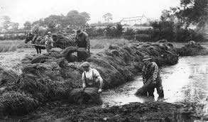
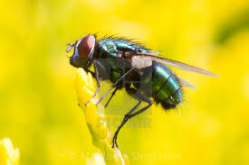
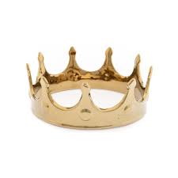
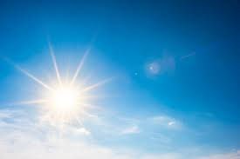
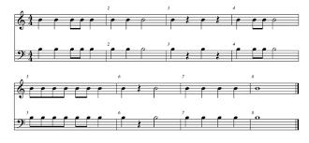
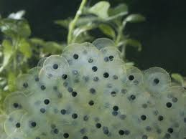
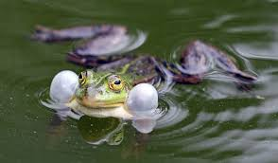
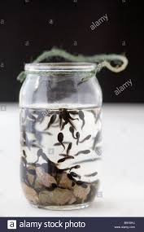
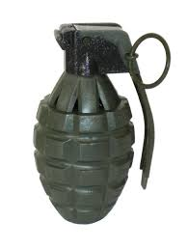
‘Death of a Naturalist’ by Seamus Heaney Images Task –
Step1. Choose quotations in the poem that match these images.
Step 2. Identify language techniques and word types in at least SIX of these quotations.
THEN answer this question: “How does Heaney use imagery and language to create the feelings of change and transformation in the poem?

