Slide 1
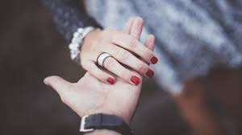
‘Love Poems’
Cozy Apologia
LO: To develop poetry analysis skills. ST: I can understand writers’ methods and use subject terminology.
Learning Objective:
AO2: Analyse the language, form and structure used by a writer to create meanings and effects, using relevant subject terminology where appropriate.

Slide 2
Key Words:
Apologia: a text written in defence of something
Exudes: oozes out
Aerie: the nest of a bird of prey, usually built up high
Cliché: anything that has become trite or commonplace through overuse.
Colloquial: used in ordinary or familiar conversation; not formal
How do ordinary objects make you think of others?
What makes you feel safe or protected?
How would an approaching hurricane make you feel? Vulnerable? Scared? Content? Grateful?
Learning Objective:
AO2: Analyse the language, form and structure used by a writer to create meanings and effects, using relevant subject terminology where appropriate.

Slide 3
Key Words:
Apologia
Aerie
Cliché
Colloquial
Start with the title, Cozy Apologia
Let’s read the poem by Rita Dove
What are your initial thoughts?
Challenge:
Can you spot any feelings or attitudes in the poem?
Learning Objective:
AO2: Analyse the language, form and structure used by a writer to create meanings and effects, using relevant subject terminology where appropriate.
Notes:
Attitude/ feelings =love , safety, apology

Slide 4
Key Words:
Apologia
Aerie
Cliché
Colloquial
Let’s have some feedback!
Learning Objective:
AO2: Analyse the language, form and structure used by a writer to create meanings and effects, using relevant subject terminology where appropriate.

Slide 5
Structure | How is the piece organised on the page? | Can you identify the topic of each stanza? | Are the stanzas equal or unequal?
 | How many stanzas/verses? | Is there rhythm/repetition/enjambment? | What is the line length/rhyme scheme?
Effect
What effect on the reader is the poet aiming to achieve? (How is it intended to make you think/feel?)
What opinion is conveyed by the poet?
What is the purpose of the poet’s choice of language/opinion/theme?
Meaning
What is the poem about?
Can you discover more than one meaning of the poem?
What ideas and themes is the poet portraying?
What is the poet’s point of view?
Language | Which words has the poet used to convey meaning? | What are the connotations of the language used? Is there more than one meaning of the word/phrase? | Has the poet used figurative language? (onomatopoeia, alliteration, assonance…) | How has the poet used language to infer meaning?
Imagery | Which images are conveyed to the reader? | Does the poem contain metaphors, similes or personification? | Why do you think the poet has included the images in the poem?

Slide 6
What does the pronoun ‘anything’ suggest?
I could pick anything and think of you— This lamp, the wind-still rain, the glossy blue My pen exudes, drying matte, upon the page. I could choose any hero, any cause or age And, sure as shooting arrows to the heart, Astride a dappled mare, legs braced as far apart As standing in silver stirrups will allow— There you'll be, with furrowed brow And chain mail glinting, to set me free: One eye smiling, the other firm upon the enemy.
What effect does the cliched love imagery?
What is the effect of the listing?
What is the effect of the medieval imagery?
What is the effect of the repetition?

Slide 7
What effect does the use of business language have?
What effect does the cliched love imagery?
This post-postmodern age is all business: compact disks And faxes, a do-it-now-and-take-no-risks Event. Today a hurricane is nudging up the coast, Oddly male: Big Bad Floyd, who brings a host Of daydreams: awkward reminiscences Of teenage crushes on worthless boys Whose only talent was to kiss you senseless. They all had sissy names—Marcel, Percy, Dewey; Were thin as licorice and as chewy, Sweet with a dark and hollow center. Floyd's
How does this make the hurricane sound?
Why does the rhyme scheme end at this point? What is the effect of the caesurae and enjambment?
What does the simile suggest?

Slide 8
What are these objects symbolic of?
What is the effect of the rhetorical question?
Cussing up a storm. You're bunkered in your Aerie, I'm perched in mine (Twin desks, computers, hardwood floors): We're content, but fall short of the Divine. Still, it's embarrassing, this happiness— Who's satisfied simply with what's good for us, When has the ordinary ever been news? And yet, because nothing else will do To keep me from melancholy (call it blues), I fill this stolen time with you.
What is the effect of religious imagery?
What does the end of the poem suggest about their love?

Slide 9
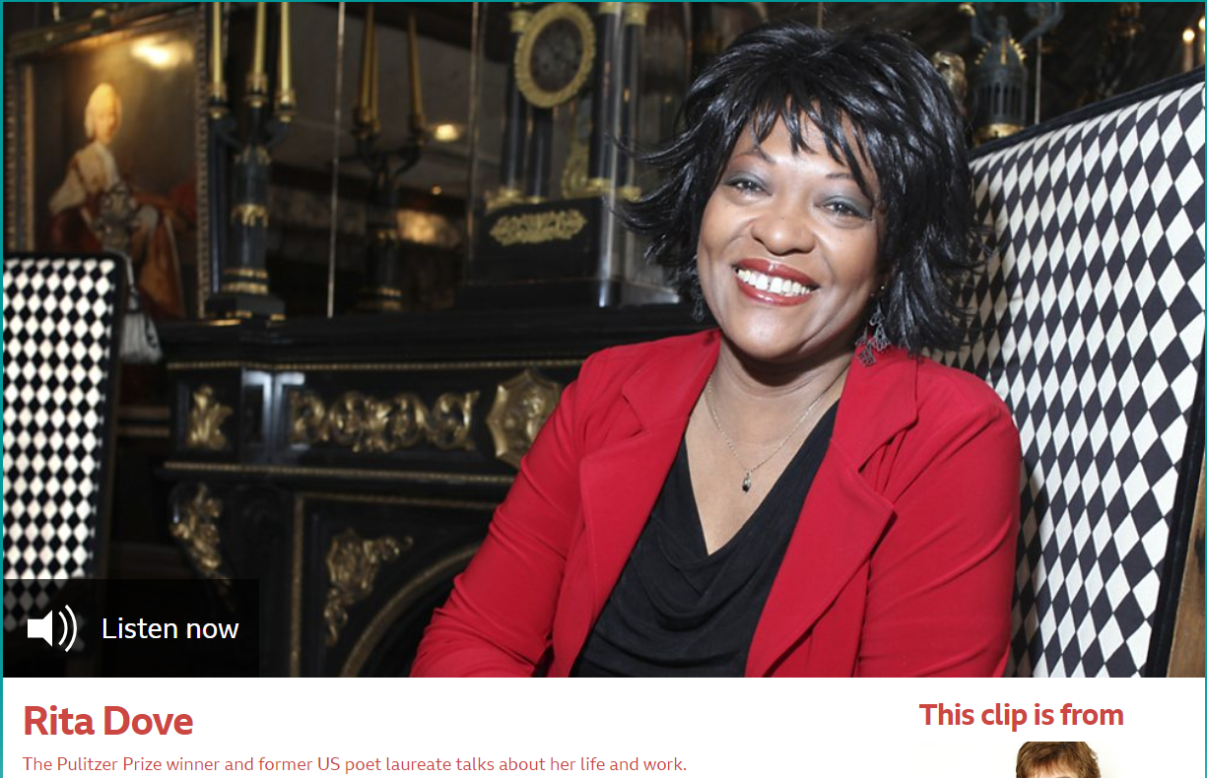
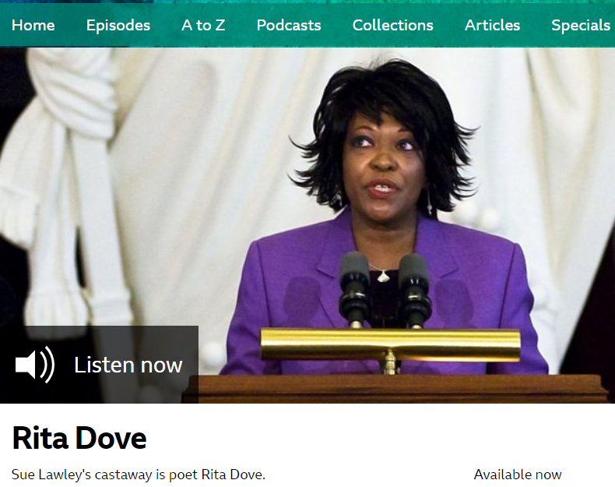
The poet: Rita Dove
Rita Dove is considered to be one of America’s greatest living poets. From 1993 to 1995, she served as Poet Laureate and was the first African-American to have been appointed to the position. She is also the second African American to receive the Pulitzer Prize for Poetry, in 1987.
She is married to the writer Fred Viebahn to whom Cozy Apologia is an affectionate tribute. The poem is set against the arrival of Hurricane Floyd, a powerful storm which, in 1999, hit the east coast of America.
Learning Objective:
AO3: Demonstrate understanding of the significance and influence of the contexts in which literary texts are written and received.
Learning Objective:
AO2: Analyse the language, form and structure used by a writer to create meanings and effects, using relevant subject terminology where appropriate.
Notes:
Two bbc programs on Rita Dove – can be used as a link for students to engage with in their own time/homework.

Slide 10
Context
Waiting for Hurricane Floyd to hit, the speaker of the poem has prepared herself and her house and has taken shelter in the safety of her study. The storm disrupts the fast paced routine of working life and gives her time to daydream. With time on her hands, she finds herself thinking about her partner.
Everything the speaker looks at, from the rain outside to the ink on the page, reminds her of ‘Fred’. To amuse herself she pictures him as a knight in shining armour, protecting her. We learn that Fred is very different, to the 'worthless' boys she had dated in her youth.
In the final stanza she is slightly embarrassed by how content their cosy, ordinary lives have made them. The word 'apologia' means 'a defence’ so the poem could be called 'A Defence of Cosiness'.
Learning Objective:
AO3: Demonstrate understanding of the significance and influence of the contexts in which literary texts are written and received.
Learning Objective:
AO2: Analyse the language, form and structure used by a writer to create meanings and effects, using relevant subject terminology where appropriate.

Slide 11
Form
The poem takes the form of a first-person narrative. A free verse to make it sound conversational. It appears to be autobiographical as it is dedicated to her husband, Fred, and it describes the home of a writer.
It has a wandering conversational structure and doesn’t stick to any particular rhythm or rhyme scheme.
The number of syllables in each line differs and although the first stanza uses regular rhyming couplets this rhyme scheme is disrupted in the middle of the second stanza – possibly to mirror the disorder brought by the arrival of the hurricane.
In the final stanza, in the poem’s final four lines, a new ABAB rhyme scheme is established.
Be proactive take your own notes!
Learning Objective:
AO2: Analyse the language, form and structure used by a writer to create meanings and effects, using relevant subject terminology where appropriate.

Slide 12
Structure and tone
The poem begins with a description of the speaker’s feelings for her partner and ends by reflecting on their happy ordinary relationship.
The poem is composed of three 10-line stanzas. Stanza one is made up of five rhyming couplets, but this rhyme scheme breaks down in stanza two and by stanza three, a new rhyme scheme has emerged. Perhaps this disruption represents the chaos that the hurricane threatens.
There are four stresses in most lines, but some lines have five. Again, there is no clear or rigid pattern and the stresses do not always fall in a strict rhythm. This creates the impression of a relaxed, informal but thoughtful voice, wandering from idea to idea like a train of thought.
The tone is shown through the feelings and attitudes of love, safety and apology.
Be proactive take your own notes!
Learning Objective:
AO2: Analyse the language, form and structure used by a writer to create meanings and effects, using relevant subject terminology where appropriate.

Slide 13
Language and imagery
Dove dedicates the poem to her husband Fred and compares him to a number of everyday objects, ‘This lamp, the wind-still rain, the glossy blue / My pen exudes’. Such imagery contrasts with the type of images traditionally found in love poetry. The clichéd images of romantic love are mocked by the poet: ‘Astride a dappled mare, legs braced as far apart / As standing in silver stirrups will allow’. Here Dove gently pokes fun at her partner which suggests that he isn’t anything like the romantic hero found in fairy tales. As she waits for the hurricane to strike she muses on her past. ‘Big Bad Floyd who brings a host / Of daydreams: awkward reminiscences / Of teenage crushes on worthless boys’ Here Dove uses humour to make the storm seem less threatening. Floyd reminds her of old boyfriends from her teenage years. The boys are described as ‘thin as licorice and as chewy, / Sweet with a dark and hollow center’ suggesting that they were nice boys but the relationships lacked substance.
Be proactive take your own notes!
Learning Objective:
AO2: Analyse the language, form and structure used by a writer to create meanings and effects, using relevant subject terminology where appropriate.

Slide 14
Language and imagery: Look at the imagery used in the poem. What does each image convey?
Images | What the image conveys
I could pick anything and think of you— This lamp, the wind-still rain, the glossy blue My pen exudes | These ordinary household objects are very different to the type of imagery traditionally used in love poetry
Astride a dappled mare, legs braced as far apart As standing in silver stirrups will allow— There you'll be
Today a hurricane is nudging up the coast, Oddly male: Big Bad Floyd
Marcel, Percy, Dewey; Were thin as licorice and as chewy, Sweet with a dark and hollow center
You're bunkered in your Aerie, I'm perched in mine (Twin desks, computers, hardwood floors): We're content, but fall short of the Divine.
Be proactive take your own notes!
Learning Objective:
AO2: Analyse the language, form and structure used by a writer to create meanings and effects, using relevant subject terminology where appropriate.

Slide 15
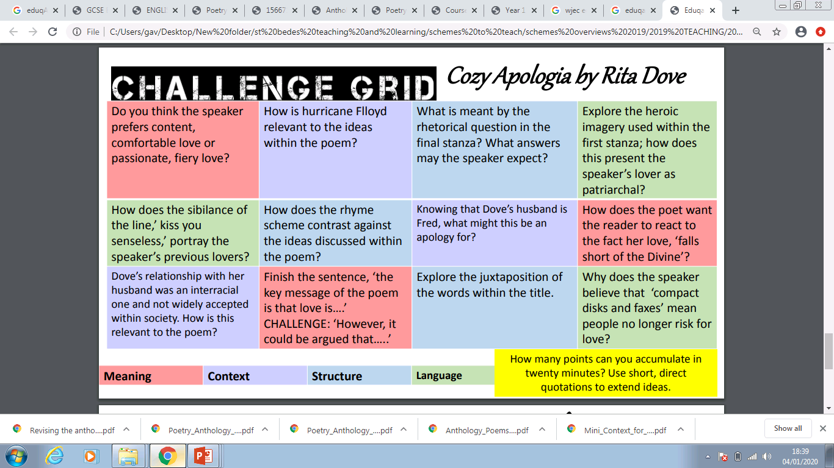

Slide 16
Writing up a Paragraph
P
Dove presents the hurricane as something almost gentle and amusing.
‘Today a hurricane is nudging up the coast’
‘Floyd’s cussing up a storm’
Here Dove uses colloquial language very effectively. Describing the hurricane as ‘nudging up the coast’ makes it sound almost gentle and comparing it to a person swearing makes it seem more humorous than dangerous.
The reader is surprised by this image of the hurricane. Usually associated with devastation and death, we don’t expect a tropical storm to be presented like this. This is probably because the speaker is well prepared. She feels cosy, safe and protected, as the hurricane approaches.
E
T
E
R

Slide 17
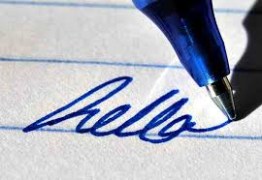
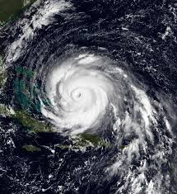
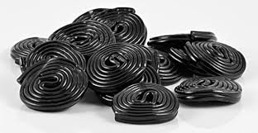
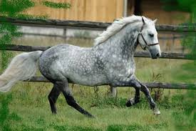
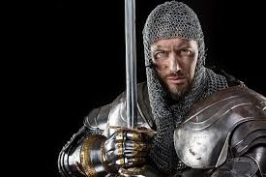
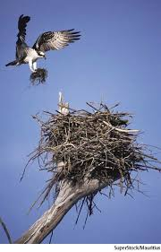
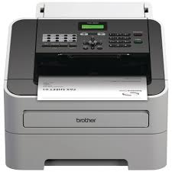
‘Cozy Apologia’ by Rita Dove Images Task –
Step1. Choose quotations in the poem that match these images.
Step 2. Identify language techniques and word types in at least SIX of these quotations.
THEN answer this question: “How does Dove use poetic devices to show her love and relationship with her husband in poem?
Notes:
Love, Honesty Danger

