Slide 1
Lesson 16: Contemporary & Future Literature
LO: To consider how literature may develop in the future.

Slide 2
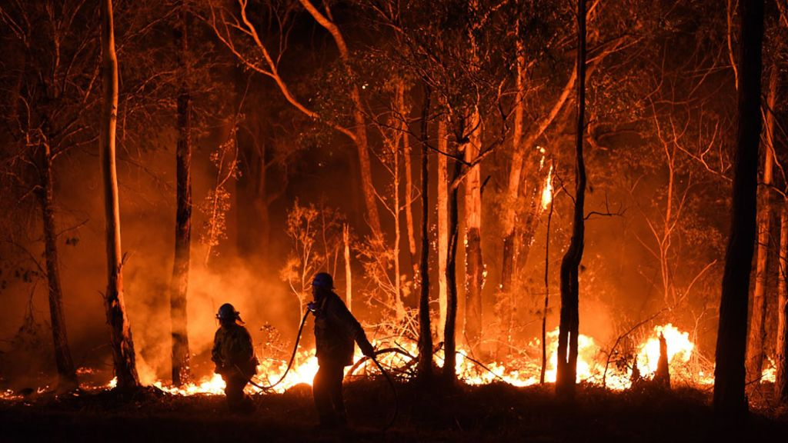
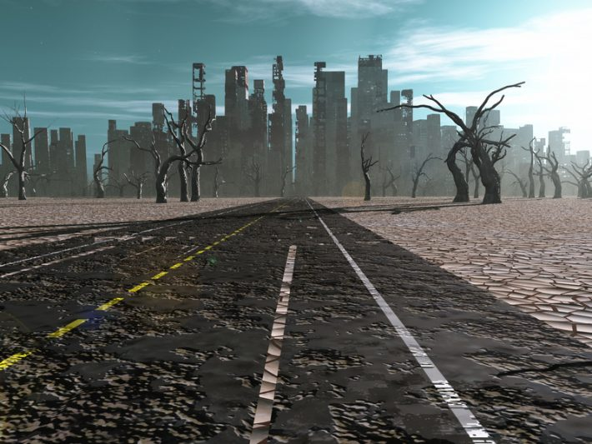
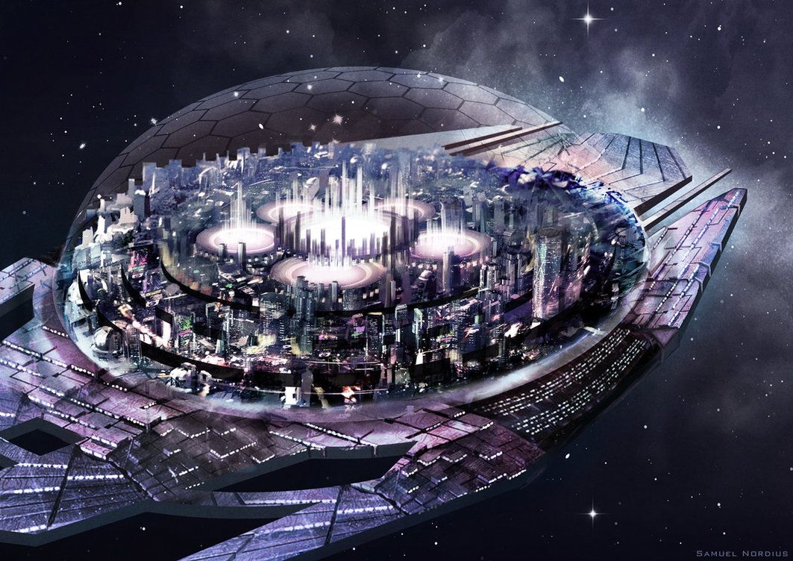
Starter:
Select one of the pictures to create a short description.
Do Now
LO: To consider how literature may develop in the future.

Slide 3
LTM REFRESH: Can you create your own definitions for some of the vocabulary we have used in this topic?
Allusion
Orator
Satire
Tiresome
Picturesque
Democracy
Unlocking Vocabulary
LO: To consider how literature may develop in the future.

Slide 4
LTM REFRESH: Check your answers
Allusion: A figure of speech that makes a reference to a place, person, or event.
Orator: A public speaker, especially one who is eloquent or skilled.
Satire: A humorous way of criticizing people or ideas to show that they have faults or are wrong.
Tiresome: Causing one to feel bored or annoyed.
Picturesque: Visually attractive, especially in a quaint or charming way.
Democracy: A country in which power is held by elected representatives.
Answers
LO: To consider how literature may develop in the future.

Slide 5
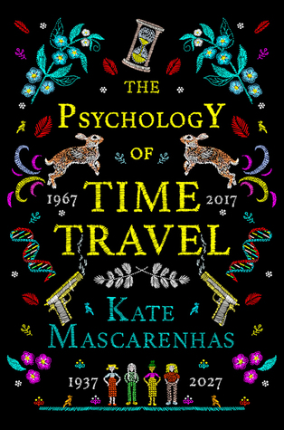
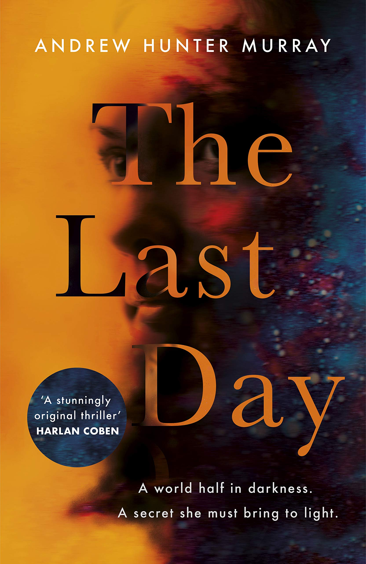
Paired Discussion: What do you think these recent novels are about?
Discussion Activity
LO: To consider how literature may develop in the future.

Slide 6
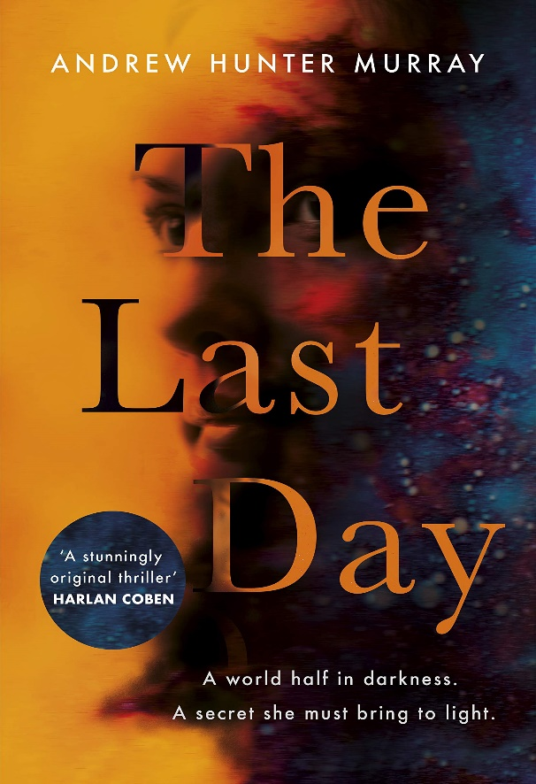
Which time period we have already studied links most closely to these contemporary novels?
Set in a Swiss forest in an isolated hotel, Jon, a historian attending a conference, is caught up when the world goes BOOM! Nuclear war has broken out, most of the world's major cities are lost, communication is scratchy and transport non-existent. Jon takes it on himself to record what has happened, from his point of view, and we are reading his journal.
What similarities does today’s society have with Post-WW2?
Discussion Activity
The gravity from a passing asteroid slows down the Earth's rotation until it finally comes to a complete stop. As you can imagine, this is a catastrophe. One half of the world is plunged into eternal darkness and the other half is constantly baking under the sun's intense heat. Only a small part of Earth's land is habitable.
When four female scientists create the world's first-time machine in 1967, they had no idea how they would alter the world (or themselves). These women were known as pioneers, each with her own specialty to assist each other in the development of the time machine. Fifty years later, time travel is a big business with thousands of people working in the industry.
LO: To consider how literature may develop in the future.

Slide 7
What contemporary issues could influence literature today and in the near future?
Checking Understanding
LO: To consider how literature may develop in the future.
Notes:
Could consider climate change, advances in technology, Covid-19, war, space exploration etc.

Slide 8
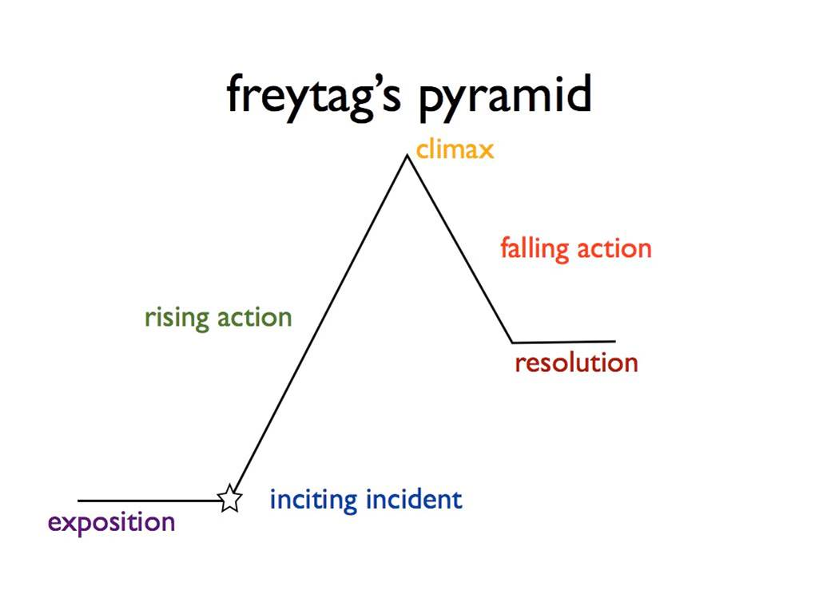
Contemporary issues in literature
Select one of the issues/themes we have discussed.
Create a plan for a narrative which would explore the issue/theme.
Mastery
LO: To consider how literature may develop in the future.
Notes:
Less able students may want to use the blurbs from one of the three novels to base their plan on.

Slide 9
Creating Your Narrative World
Look at the examples of opening pages from ‘Nineteen Eighty-Four’ and ‘The Last Day’.
How do they provide the reader with information about their settings?
It was a bright cold day in April, and the clocks were striking thirteen. Winston Smith, his chin nuzzled into his breast in an effort to escape the vile wind, slipped quickly through the glass doors of Victory Mansions, though not quickly enough to prevent a swirl of gritty dust from entering along with him.
The hallway smelt of boiled cabbage and old rag mats. At one end of it a coloured poster, too large for indoor display, had been tacked to the wall. It depicted simply an enormous face, more than a metre wide: the face of a man of about forty-five, with a heavy black moustache and ruggedly handsome features. Winston made for the stairs. It was no use trying the lift. Even at the best of times it was seldom working, and at present the electric current was cut off during daylight hours. It was part of the economy drive in preparation for HateWeek. The flat was seven flights up, and Winston, who was thirty-nine and had a varicose ulcer above his right ankle, went slowly, resting several times on the way. On each landing, opposite the lift shaft, the poster with the enormous face gazed from the wall. It was one of those pictures which are so contrived that the eyes follow you about when you move. BIG BROTHER IS WATCHING YOU, the caption beneath it ran.
Reading Activity
LO: To consider how literature may develop in the future.
Notes:
Model first with the first section of 1984.

Slide 10
Create the exposition for your narrative. Remember to create a clear sense of your world.
Writing Activity
LO: To consider how literature may develop in the future.

Slide 11
In your exposition, Highlight anything which provides information to the reader about how your imagined world is different to our own.
Checking Understanding
LO: To consider how literature may develop in the future.
Notes:
This could be done in pairs/peer assessment instead.

