Slide 1
Chapter 5 - Heroes by Robert Cormier
LO: To explore Cormier’s use of foreshadowing in chapter 5.
ST: I can develop my understanding of the author’s craft.

Slide 2
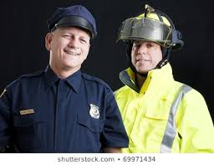
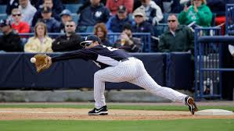
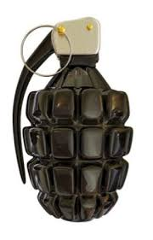
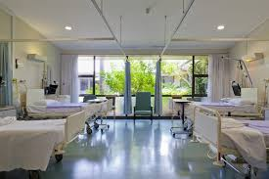
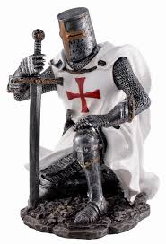
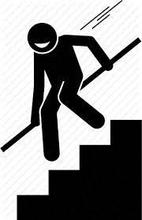
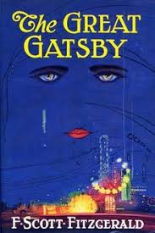
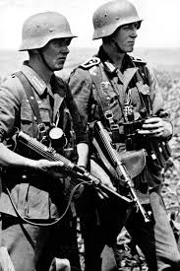
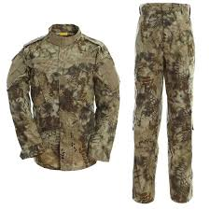
Make a connection with an image below and what we have read so far.

Slide 3
Starter: What are the connotations of ‘wreck’?
‘Wreck’
Let’s read chapter 5.

Slide 4
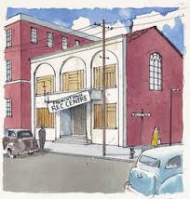
Task: Summarise the ‘Wreck’ centre’s history in no more than 25 words. What does the violent history suggest about the place?

Slide 5
Task: Re-read the description of the wreck centre. What does the language suggest? How does it foreshadow events to come?
In the next few days the men worked frantically, scraping and painting, replacing doors and windows, tarring the roof. But the work was haphazard. Workers dropped hammers, spilled paint, stumbled over each other and occasionally pulled brown paper bags from their pockets and took quick gulps from hidden bottles…
When the workers finally completed the job , the building still looked unfinished. The white paint didn't completely cover the dark patches of mildew on the clapboards and the shutters sagged next to the windows.
Underline or highlight the negative words. Add your own annotations/ ideas that tell me why.

Slide 6
Underline or highlight the negative words. Add your own annotations/ ideas that tell me why.
In the next few days the men worked frantically, scraping and painting, replacing doors and windows, tarring the roof. But the work was haphazard. Workers dropped hammers, spilled paint, stumbled over each other and occasionally pulled brown paper bags from their pockets and took quick gulps from hidden bottles…
When the workers finally completed the job , the building still looked unfinished. The white paint didn't completely cover the dark patches of mildew on the clapboards and the shutters sagged next to the windows.

Slide 7
Underline or highlight the negative words. Add your own annotations/ ideas that tell me why.
In the next few days the men worked frantically, scraping and painting, replacing doors and windows, tarring the roof. But the work was haphazard. Workers dropped hammers, spilled paint, stumbled over each other and occasionally pulled brown paper bags from their pockets and took quick gulps from hidden bottles…
When the workers finally completed the job , the building still looked unfinished. The white paint didn't completely cover the dark patches of mildew on the clapboards and the shutters sagged next to the windows.

Slide 8
Using your annotations write a PETER paragraph : How does Cormier use foreshadowing in his description of the Wreck Centre?
Cormier describes the Wreck Centre’s repairs as … For example the words …It hints at … The clever use of … gives a reader a sense of … This foreshadows …

Slide 9
Task: How is Francis portrayed as a young boy in Chapter 5? What do we learn about his early life? Mind map your ideas and support each one with a quote from the chapter.
Francis

Slide 10
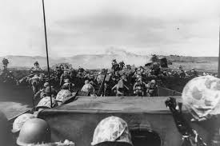
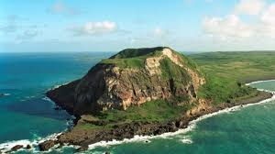
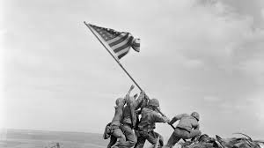
Plenary: Imagine you are Francis and you could speak to Joey LeBlanc today. What would you say to him?
The Battle of Iwo Jima (19 February – 26 March 1945) was a major battle in which the United States Marine Corps and Navy landed on and eventually captured the island of Iwo Jima from the Imperial Japanese Army (IJA) during World War II.

