Slide 1
Chapter 4 - Heroes by Robert Cormier
LO: To explore the key theme of heroism.
ST: I can develop my understanding of the author’s craft.

Slide 2
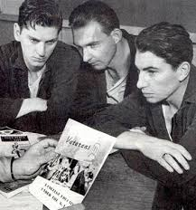
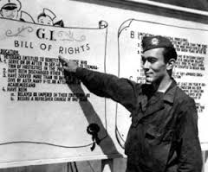
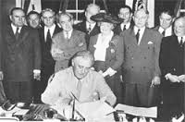
Read chapter 4.
Why is the Wreck Centre so important to Francis?
What was the GI Bill?
Why was Arthur Rivier famous in Frenchtown before the war?
The legislation provided a range of benefits for returning World War II veterans, including funding for college, home loans and unemployment insurance.
GI = ‘Government issue’

Slide 3
Before and After
In chapter four Francis meets an old friend, Arthur Rivier. How has Arthur changed since the war?
Before the war | After the war
‘a star first baseman for the Frenchtown Tigers.’ | ‘His eyes are bleary and bloodshot’
Why do you think Cormier includes this character?
What could his story represent?

Slide 4
Heroism
In the novel Cormier presents different types of heroes. Francis is a decorated war hero and Arthur was a sporting hero before the war. However in chapter four Francis says that he is not the hero that others think he is. Answer fully
What does he mean by this?
What does this reveal about Francis’s self esteem?
Why doesn’t Francis join in the drinking and conversation?
What is the topic of conversation in the St Jude club?
What are Francis’s plans for the future?
What could this suggest?

