Slide 1
Chapter 1 - Heroes by Robert Cormier
LO: To explore the characterisation of Francis.
ST: I can comment on the writer’s craft.

Slide 2
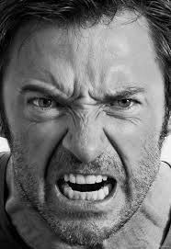
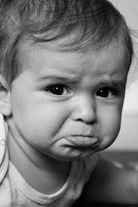
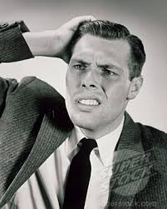
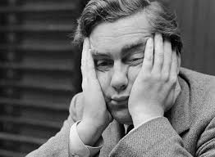
Starter: What does your face mean to you?
What emotions are being shown in the following images?
So what conclusion can we make about the importance of our face?

Slide 3
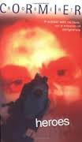
Task: Let’s read the first page of the novel.
What is your initial reaction?

Slide 4
How does the writer use language to describe Francis and evoke empathy from a reader? Look at your handout and highlight /annotate ideas.
My name is Francis Joseph Cassavant and I have just returned to Frenchtown in Monument and the war is over and I have no face.
Oh, I have eyes because I can see and ear-drums because I can hear but no ears to speak of, just bits of dangling flesh. But that’s fine, like Dr Abrams says, because it’s sight and hearing that count and I was not handsome to begin with. He was joking, of course. He was always trying to make me laugh.
If anything bothers me, it’s my nose. Or, rather, the absence of my nose. My nostrils are like two small caves and they sometimes get blocked and I have to breathe through my mouth. This dries up my throat and makes it hard for me to swallow. I also become hoarse and cough a lot. My teeth are gone but my jaw is intact and my gums are firm so it’s possible for me to wear dentures. In the past few weeks, my gums began to shrink, however, and the dentures have become loose and they click when I talk and slip around inside my mouth.
I have no eyebrows, but eyebrows are minor, really. I do have cheeks. Sort of. I mean, the skin that forms my cheeks was grafted from my thighs and has taken a long time to heal. My thighs sting when my pants rub against them. Dr Abrams says that all my skin will heal in time and my cheeks will someday be as smooth as a baby’s arse. That’s the way he pronounced it: arse. In the meantime, he said, don’t expect anybody to select you for a dance when it’s the Girls’ Choice at the Canteen.

Slide 5
How does the writer use language to describe Francis and evoke empathy from a reader?
EXAMPLE OF CHOSEN QUOTATIONS
A face gives identity, a reader would find this shocking.
My name is Francis Joseph Cassavant and I have just returned to Frenchtown in Monument and the war is over and I have no face.
Oh, I have eyes because I can see and ear-drums because I can hear but no ears to speak of, just bits of dangling flesh. But that’s fine, like Dr Abrams says, because it’s sight and hearing that count and I was not handsome to begin with. He was joking, of course. He was always trying to make me laugh.
If anything bothers me, it’s my nose. Or, rather, the absence of my nose. My nostrils are like two small caves and they sometimes get blocked and I have to breathe through my mouth. This dries up my throat and makes it hard for me to swallow. I also become hoarse and cough a lot. My teeth are gone but my jaw is intact and my gums are firm so it’s possible for me to wear dentures. In the past few weeks, my gums began to shrink, however, and the dentures have become loose and they click when I talk and slip around inside my mouth.
I have no eyebrows, but eyebrows are minor, really. I do have cheeks. Sort of. I mean, the skin that forms my cheeks was grafted from my thighs and has taken a long time to heal. My thighs sting when my pants rub against them. Dr Abrams says that all my skin will heal in time and my cheeks will someday be as smooth as a baby’s arse. That’s the way he pronounced it: arse. In the meantime, he said, don’t expect anybody to select you for a dance when it’s the Girls’ Choice at the Canteen.
The powerful verb, ‘dangling’ helps to give a vivid picture, it is emotive language.
The use of a simile adds further imagery to the young soldier’s injuries. What connotations are there for the word cave? Is it scary? If someone has caved in have they given up/in?
The sentence forms are simple/short. ‘sort of’ is a vague term he is applying to his own statement – does he believe he has cheeks? The words are also emotive, a reader learns the reality of his feelings towards his injuries – he is unsure.

Slide 6
How does the writer use language to describe Francis and evoke empathy from a reader?
EXAMPLE OF CHOSEN QUOTATIONS
A face gives identity, a reader would find this shocking.
My name is Francis Joseph Cassavant and I have just returned to Frenchtown in Monument and the war is over and I have no face.
Oh, I have eyes because I can see and ear-drums because I can hear but no ears to speak of, just bits of dangling flesh. But that’s fine, like Dr Abrams says, because it’s sight and hearing that count and I was not handsome to begin with. He was joking, of course. He was always trying to make me laugh.
If anything bothers me, it’s my nose. Or, rather, the absence of my nose. My nostrils are like two small caves and they sometimes get blocked and I have to breathe through my mouth. This dries up my throat and makes it hard for me to swallow. I also become hoarse and cough a lot. My teeth are gone but my jaw is intact and my gums are firm so it’s possible for me to wear dentures. In the past few weeks, my gums began to shrink, however, and the dentures have become loose and they click when I talk and slip around inside my mouth.
I have no eyebrows, but eyebrows are minor, really. I do have cheeks. Sort of. I mean, the skin that forms my cheeks was grafted from my thighs and has taken a long time to heal. My thighs sting when my pants rub against them. Dr Abrams says that all my skin will heal in time and my cheeks will someday be as smooth as a baby’s arse. That’s the way he pronounced it: arse. In the meantime, he said, don’t expect anybody to select you for a dance when it’s the Girls’ Choice at the Canteen.
The powerful verb, ‘dangling’ helps to give a vivid picture, it is emotive language.
The use of a simile adds further imagery to the young soldier’s injuries. What connotations are there for the word cave? Is it scary? If someone has caved in have they given up/in?
The sentence forms are simple/short. ‘sort of’ is a vague term he is applying to his own statement – does he believe he has cheeks? The words are also emotive, a reader learns the reality of his feelings towards his injuries – he is unsure.

Slide 7
SELF ASSESS YOUR PARAGRAPHS!
Use the colour pencils to colour over each of your sentences – are you hitting each part of the PETER structure?
If NOT – what element of the structure are you missing?

Slide 8
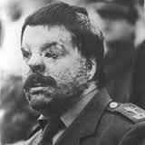
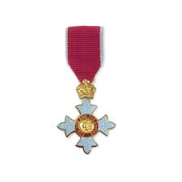
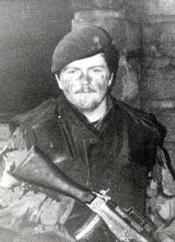
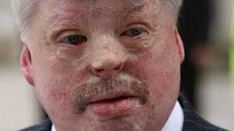
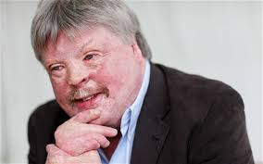
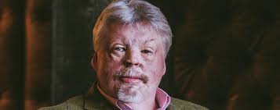
A Real War Hero – Simon Weston CBE https://www.youtube.com/watch?v=lDznh9Ck5Js
On 8 June 1982, he was boarded with other members of his regiment on RFA Sir Galahad in Port Pleasant near Fitzroy, just off the Falkland Islands. It was bombed and set on fire by the Argentine Skyhawk fighters during the Bluff Cove Air Attacks. His ship was carrying ammunition as well as phosphorus bombs and thousands of gallons of diesel and petrol. Out of his platoon of 30 men, 22 were killed. The Welsh Guards lost a total of 48 men killed and 97 wounded aboard the Sir Galahad.
Weston survived with 46% burns, following which his face was barely recognisable. Weston endured years of reconstructive surgery, including over 70 major operations or surgical procedures. Skin from his shoulders was used to make eyelids and his nose was grafted on in a later operation

Slide 9
Task 2: let’s finish the chapter.
What do we find out about the setting of the novel?
Examine Cormier’s description of Frenchtown. Write down a list of things you discover about when and where the story is set.

Slide 10
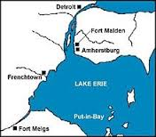
Frenchtown
Frenchtown is based on Leominster in Massachusetts, Robert Cormier’s home town.
The main action takes place in 1945 after the end of World War Two, however much of the narrative is told through flashbacks (or analepsis) to events in 1940 and 1941.

Slide 11
Chapter One
Extension Questions
Why do you think so many physical details are mentioned in the first page?
Why doesn’t the doctor have much success in developing Francis’s sense of humour (page 2)?
‘I knew that my mission was about to begin’ (page 5) marks a beginning. Up to this point, how has the writer suggested details from Francis’s past life?
4. In the section beginning ‘Later, I light a candle in St Jude’s Church’ (page 5), the writer introduces the other time periods in the book. How does he do this?
5. In this first chapter, what is revealed about Francis’s feelings about Larry and Nicole?
6. What is suggested in the first chapter about the events in the rest of the book?

