Slide 1
LO: to be able to avoid common errors and use correct spelling.
L4 I can write with generally correct spellings with occasional errors with function words. |  | L5 I can write with correct spellings, including function words. |  | L6 I can write with correct spellings, even uncommon, ambitious words and those with complex spelling patterns.
two
were
wear
to
too
where
We’re
Notes:
Common errors – two/too/to and where/were/we’re /wear.

Slide 2
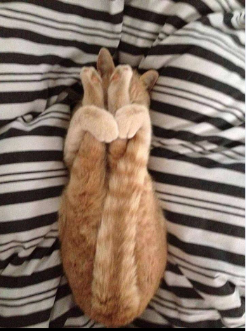
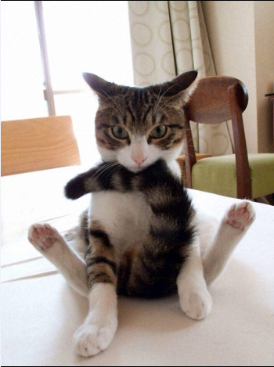
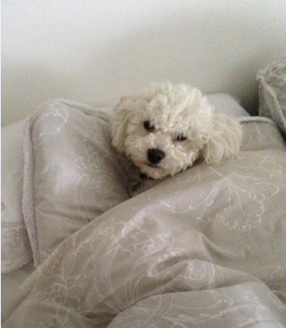
Two, too and to – structured input
1) Two is the number 2, as in ‘two cats and one dog.’
Two, too and to have the same sound, so they can easily be confused.
Notes:
STRUCTURED INPUT

Slide 3
Two, too and to – structured input
Too means ‘an excessively large or small amount of something.’
Too also means ‘as well’.
You’ve given me too much sauce!
Too few people turned up to make it worthwhile.
This means a larger amount than I wanted.
This means a smaller number than we wanted.
Polly is coming too.
Have you seen it, too.
Notes:
STRUCTURED INPUT

Slide 4
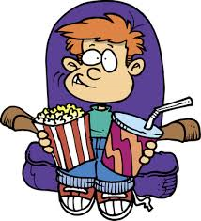
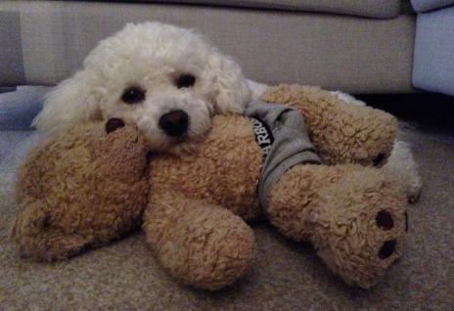
Two, too and to – structured input
To is used in all cases where two and too do not apply. You can often recognise it because, when you say it, it sounds shorter
than two or too.
I would like to go to the cinema.
I want to cuddle my teddy bear!

Slide 5
Two, too and to – structured output
Choose whether it is correct to put two, too or to in the blank spaces in the sentences below:
1) I went running with ___ of my friends yesterday, but we were ___ tired ___ get all of the way around the track.
2) We are pleased ___ receive the money, but it’s a case of
___ little ___ late.
3) If you’re both coming ___ tennis practice ___, we’re going __ need ___ extra spaces in the car.
Andy wasn’t ___ impressed when he discovered what Jo had done ___ his bike.
two
too
to
to
too
too
to
too
to
two
too
to

Slide 6
Where, were, we’re, wear– structured input
Where, were, we’re and wear do not all sound the same when spoken, but it is still easy to mix them up.
Where -
Where is used in questions, and means ‘in which place?’
Where also links the different parts of a sentence and shows how the words around it are connected to each other:
Where are you?
Where did you put my books?
This is the spot where the accident happened.
Notes:
Common errors – two/too/to and where/were/we’re /wear.

Slide 7
Where, were, we’re, wear– structured input
Were -
Were is part of the verb be:
We’re -
We’re is the shortened form of ‘we are’:
Present | Past
I am | I was
You are | You were
You were going into the shop when I saw you.
What were you going to buy?
We are just good friends.
We’re just good friends.
We are going to win this time.
We’re going to win this time.
Notes:
Common errors – two/too/to and where/were/we’re /wear.

Slide 8
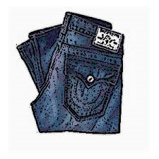
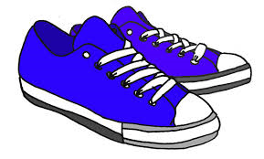
Where, were, we’re, wear– structured input
Wear: Wear means to have on an item of clothing:
Wear can also mean to damage or erode by friction:
I am going to wear my new jeans on Saturday.
Take your shoes off so that the carpet doesn’t wear away.

Slide 9
Where, were, we’re, wear – structured output
Choose whether it is correct to put where, were we’re or wear in the blank spaces in the sentences below:
1) ____ going to visit Aunty Jean on Sunday.
2) _____ _____ you when I called last night?
3) The sharks ____ gathering as soon as they saw ____ the boat was.
4) I don’t know _____ ____ going to put all these toys that ____ in the loft.
5) Don’t ____ your new shorts to rugby training, you’ll ____ a hole in them.
6) ____ you not in school on the day when we ____ told _____ our form has to sit in assembly?
We’re
Where
were
were
where
where
we’re
were
wear
wear
Were
were
where

Slide 10
Quiz
Questions 1 to 3 are about two, too and to.
True or false? - ‘two’ has a shorter sound when said aloud than ‘too’ or ‘to’.
2) Complete the missing word in the sentence below with two, too or to.
It is ___ hot outside; remember your sun cream!
3) Is the use of to correct or incorrect in the following sentence:
Are you coming to Leeds on Saturday?

Slide 11
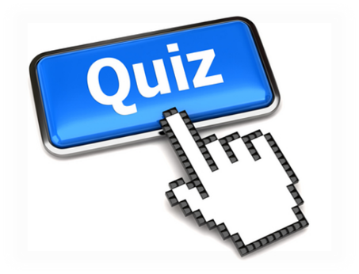
Quiz
Questions 4 to 6 are about where, were, we’re and wear.
4) True or false – the words we’re and were mean the same thing.
5)Fill in the gaps below using where, were, we’re or wear correctly: What are you going to ____ tomorrow night? ____ going to Meadowhall later because it’s ____ all of the good shops are.
Of the three sentences below, which uses where, were, or we’re incorrectly:
We’re you late for school this morning?
Where are you going to sit on the coach?
How were you feeling yesterday?

Slide 12
Quiz
Questions 7 to 10 check what you can remember from the last 5 weeks of grammar lessons!
7) True or false? – Whose means the same as who is.
8) love, dreams, anger and passion are all what type of nouns?
9) Fill in the gaps below with ‘your’ or ‘you’re’ : ______ going to get an A* with the amount of effort ______ putting into _____ work!
10) Which of the following words is not a preposition? behind above alongside under table

Slide 13
Answers
1) false
2) too
3) correct
4) false
5) wear, we’re, where
6) a
7) false
8) abstract
9) You’re you’re, your
10) table

