Slide 1
LO: to be able to avoid common errors and use correct spelling.

Slide 2
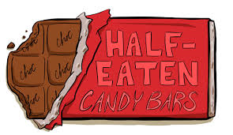
Who’s and whose – structured input
1) Who’s is the shortened form of ‘who is’ or ‘who has’.
It’s easy to confuse who’s and whose.
Who’s going to watch the fireworks?
Who is going to watch the fireworks?
Who’s eaten all of the chocolate?
Who has eaten all of the chocolate?
Notes:
STRUCTURED INPUT

Slide 3
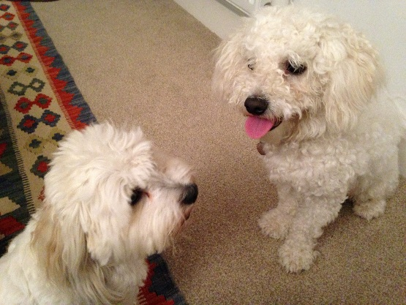
Who’s and whose – structured input
1) Whose is a way of saying ‘belonging to whom.’
Whose book is this?
The neighbours couldn’t decide whose dog was the cutest.
This means ‘to whom does this book belong?’’
You can test that you’ve used ‘whose’ correctly by replacing it with ‘who is’ or ‘who has’. In this sentence, neither of those make sense, so ‘whose’ is correct.
Notes:
STRUCTURED INPUT

Slide 4
Who’s and whose – structured output
Choose whether it is correct to put who’s or whose in the blank spaces in the sentences below:
1) I don’t know __________ bag it is.
2) I bet it’s Dave __________ behind all of this.
3) I’m not sure _________ list you’ve got. _________on it?
__________ walked into the kitchen and left their muddy shoes on?
5) __________ planner has been left on the table here?
whose
who’s
whose
Who’s
Who’s
Whose

Slide 5
There, their and they’re – structured input
There, their and they’re are often used incorrectly as they sound the same. When you are writing or checking your work, you must look hard at every example of these words and ask yourself: ‘Have I used the correct spelling?’
There -
‘There’ means ‘in that place’:
‘There’ is also used as part of a statement:
The sports centre is over there.
There’s the ball.
Your brother is still there.
She went there with her friend.
There is a wasp in the classroom.

Slide 6
There, their and they’re – structured input
Their -
‘Their’ means ‘belonging to or connected with them.’
That’s their train.
(the train they want to take)
Their house is bigger than ours.
(the house they live in)

Slide 7
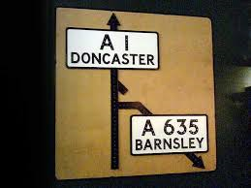
There, their and they’re – structured input
They’re -
They’re is a shortened form of ‘they are’:
They are walking into Doncaster.
They’re walking into Doncaster.
If they are playing basketball, I’ll play too.
If they’re playing basketball, I’ll play too.

Slide 8
There, their and they’re – structured output
Look carefully at each blank in these sentences and decide whether the right word for the blank is there, their or they’re.
1) I want you to be ______when they arrive with _____ friends.
2) ______the biggest-selling band this year, and _____ new album is already at number one.
3) ________ bags are over _____ by the door, and _____ getting in people’s way.
We don’t know _____ names, but _____ are fifteen in the group.
5) _____ won’t be time for them to visit _____ friends: _____ tied up all week with the project.
there
their
They’re
their
Their
there
they’re
their
there
There
their
they’re

Slide 9
Quiz
Questions 1 to 3 are about who’s and whose.
True or false - who’s is a way of saying ‘belonging to whom.’
2) Complete the missing word in the sentence below with who’s or whose
_______ remembered to bring their PE kit today?
3) Is the use of who’s correct or incorrect in the following sentence:
Who’s football is this?

Slide 10
Quiz
Questions 4 to 6 are about there, their and they’re.
4) True or false – there is used to mean ‘belonging to or connected to them’.
5)Fill in the gaps below using there, their or they’re correctly: ______ shirts are covered in mud and _____ going to get in trouble when the head teacher sees!
Of the three sentences below, which uses there, their or they’re incorrectly:
There are 30 students in this class.
They’re going to be late home because they missed the bus.
Their running quickly to avoid the rain.

Slide 11
Quiz
Questions 7 to 10 check what you can remember from the last 4 weeks of grammar lessons!
7) Which of the following words is a verb:
-are -clock -football -chocolate
8) Hedgehog, balloon, nurse, window, trumpet are all what kind of nouns?
9) What type of words ‘give information about where and when something is/happens.’ (This word starts with a ‘p’)
10) Add ‘your’ or ‘you’re’ correctly to the sentence below:
I am going to get _____ dog and _____ going to walk him with me.

Slide 12
Answers
1) false
2) who’s
3) incorrect
4) false
5) their, they’re
6) c
7) are
8) common
9) prepositions
10) your, you’re

