Slide 1
English Language Paper 2
Prison Texts
Q5 and Q6

Slide 2
Question 5 (1st compare question)
How many marks?
4 marks
How many points should you make?
2
How are each of the points evidenced?
quote and explanation from each
extract for each point
What do you need to avoid?
terminology
lengthy explorations

Slide 3
To answer the following questions you will need to use both texts.
A5. Using information from both texts, explain how the unknown can make children scared in prison.
this question wants you to synthesize information from 2 texts.
this means you must read both texts carefully, find and then combine the information required in your answer.
you should take 5/6 minutes for this question.
make 2 points with a quote from both extracts on each.
identify basic similarities and differences.

Slide 4
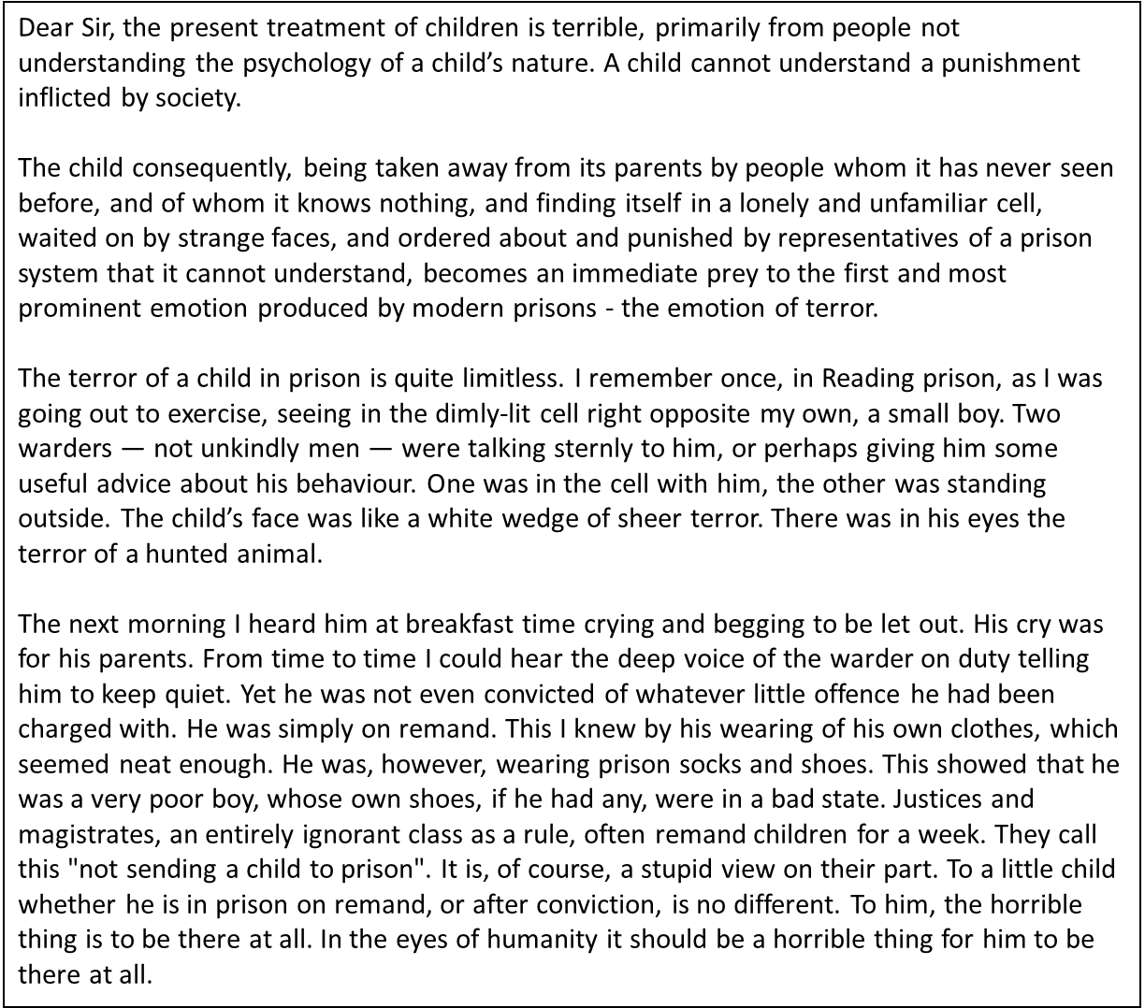
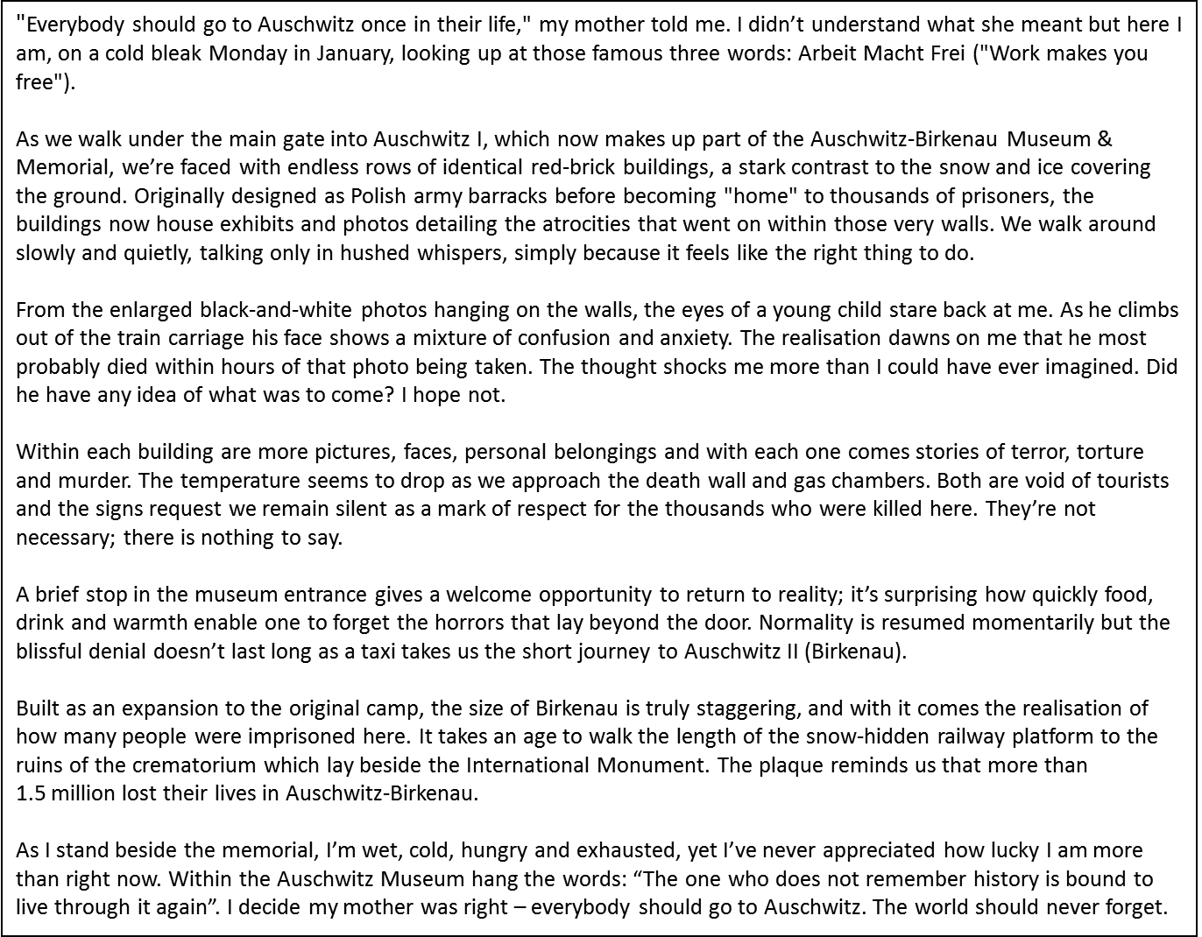
You will have already read both texts in the exam so you’ll be familiar with them.

Slide 5
you can say both texts are the similar or different.
be clear which text you are talking about!
terminology is not needed!
Use adverbials to get higher marks: similarly, likewise, on the other hand, in contrast
Similar or different:
ideas talked about
point of view
language
structure

Slide 6
Track though both texts for key parts about the question e.g. the unknown making children scared in prison. Highlight key points.
"Everybody should go to Auschwitz once in their life," my mother told me. I didn’t understand what she meant but here I am, on a cold bleak Monday in January, looking up at those famous three words: Arbeit Macht Frei ("Work makes you free").
As we walk under the main gate into Auschwitz I, which now makes up part of the Auschwitz-Birkenau Museum & Memorial, we’re faced with endless rows of identical red-brick buildings, a stark contrast to the snow and ice covering the ground. Originally designed as Polish army barracks before becoming "home" to thousands of prisoners, the buildings now house exhibits and photos detailing the atrocities that went on within those very walls. We walk around slowly and quietly, talking only in hushed whispers, simply because it feels like the right thing to do.
From the enlarged black-and-white photos hanging on the walls, the eyes of a young child stare back at me. As he climbs out of the train carriage his face shows a mixture of confusion and anxiety. The realisation dawns on me that he most probably died within hours of that photo being taken. The thought shocks me more than I could have ever imagined. Did he have any idea of what was to come? I hope not.
Within each building are more pictures, faces, personal belongings and with each one comes stories of terror, torture and murder. The temperature seems to drop as we approach the death wall and gas chambers. Both are void of tourists and the signs request we remain silent as a mark of respect for the thousands who were killed here. They’re not necessary; there is nothing to say.
A brief stop in the museum entrance gives a welcome opportunity to return to reality; it’s surprising how quickly food, drink and warmth enable one to forget the horrors that lay beyond the door. Normality is resumed momentarily but the blissful denial doesn’t last long as a taxi takes us the short journey to Auschwitz II (Birkenau).
Built as an expansion to the original camp, the size of Birkenau is truly staggering, and with it comes the realisation of how many people were imprisoned here. It takes an age to walk the length of the snow-hidden railway platform to the ruins of the crematorium which lay beside the International Monument. The plaque reminds us that more than 1.5 million lost their lives in Auschwitz-Birkenau.
As I stand beside the memorial, I’m wet, cold, hungry and exhausted, yet I’ve never appreciated how lucky I am more than right now. Within the Auschwitz Museum hang the words: “The one who does not remember history is bound to live through it again”. I decide my mother was right – everybody should go to Auschwitz. The world should never forget.
Dear Sir, the present treatment of children is terrible, primarily from people not understanding the psychology of a child’s nature. A child cannot understand a punishment inflicted by society.
The child consequently, being taken away from its parents by people whom it has never seen before, and of whom it knows nothing, and finding itself in a lonely and unfamiliar cell, waited on by strange faces, and ordered about and punished by representatives of a prison system that it cannot understand, becomes an immediate prey to the first and most prominent emotion produced by modern prisons - the emotion of terror.
The terror of a child in prison is quite limitless. I remember once, in Reading prison, as I was going out to exercise, seeing in the dimly-lit cell right opposite my own, a small boy. Two warders — not unkindly men — were talking sternly to him, or perhaps giving him some useful advice about his behaviour. One was in the cell with him, the other was standing outside. The child’s face was like a white wedge of sheer terror. There was in his eyes the terror of a hunted animal.
The next morning I heard him at breakfast time crying and begging to be let out. His cry was for his parents. From time to time I could hear the deep voice of the warder on duty telling him to keep quiet. Yet he was not even convicted of whatever little offence he had been charged with. He was simply on remand. This I knew by his wearing of his own clothes, which seemed neat enough. He was, however, wearing prison socks and shoes. This showed that he was a very poor boy, whose own shoes, if he had any, were in a bad state. Justices and magistrates, an entirely ignorant class as a rule, often remand children for a week. They call this "not sending a child to prison". It is, of course, a stupid view on their part. To a little child whether he is in prison on remand, or after conviction, is no different. To him, the horrible thing is to be there at all. In the eyes of humanity it should be a horrible thing for him to be there at all.

Slide 7
Structure Your Answer
Overview (as a whole) - both texts say… quote from extract 1… quote from extract 2… | Both writers say that the unknown is prison is scary for children. Giles says the young boy’s face “shows a mixture of confusion and anxiety”. Likewise, Wilde says “The terror of a child in prison is quite limitless.”
Point 2 – both texts say… quote from extract 1… quote from extract 2… | Both texts have a different version of the ‘unknown’. Giles questions “Did he have any idea of what was to come?”, showing it is a true unknown that the boy faces. Whereas Wilde specifies precise unknowns that can create terror: “and finding itself in a lonely and unfamiliar cell”.
Summary sentence (no quotes) | In summary, both Giles and Wilde agree that the unknown creates terror in a child, However, Wilde is able to give very specific examples of what induces terror, whereas Giles cannot be sure what the boy knew.

Slide 8
Question 6
How many marks?
10 marks
How many points/quotes should you make?
5 comparisons between the two texts
What are the marks given for?
quotes from each extract to support points of comparison
analysis of the effect on the reader
What do you need to avoid?
Only talking about 1 text
waffling!

Slide 9
A6 Both of these texts are about the treatment of people in prison.
Compare:
the treatment of people in both texts
How Giles and Wilde get their feelings about this treatment across to the reader [10]
10 marks – 13-15 minutes
make 5 points with a quote from both extracts on each
you can say both texts are the similar or different
be clear which text you are talking about (use their names)
don’t worry if you feel you might be repeating points you’ve already written in past questions

Slide 10
What is the examiner looking for?
Q.6 – Comparing and synthesising information from two texts (10 marks
Marks | Criteria
0 marks | Nothing worthy of credit
1-2 marks | Can identify a basic similarity/difference – may only refer to one text or not identify which text
3-4 marks | Can identify some similarities and differences – refers to BOTH texts.
5-6 marks | Can identify some similarities and differences – refers to BOTH texts. Starts to talk about writer’s method
7-8 marks | Can make detailed comparisons with valid comments on how writers explore the subject.
9-10 marks | Can make sustained and detailed comparisons, showing clear understanding of how the writers explore the subject.

Slide 11
Language of Comparison
In pairs, create a list of phrases that can be used to show how two things are similar and how two things are different.
Same | Different

Slide 12
Language of Comparison
In pairs, create a list of phrases that can be used to show how two things are similar and how two things are different.
Same | Different
Likewise Similarly Also …too As well as And Both | But However Whereas On the other hand Yet In contrast

Slide 13
Language of Comparison
Look at the following slides – make four sentences for each slide.
Two sentences showing a similarity between the pictures.
Two sentences showing a difference between the pictures.
Make sure that you use the linking words from the previous slide.

Slide 14
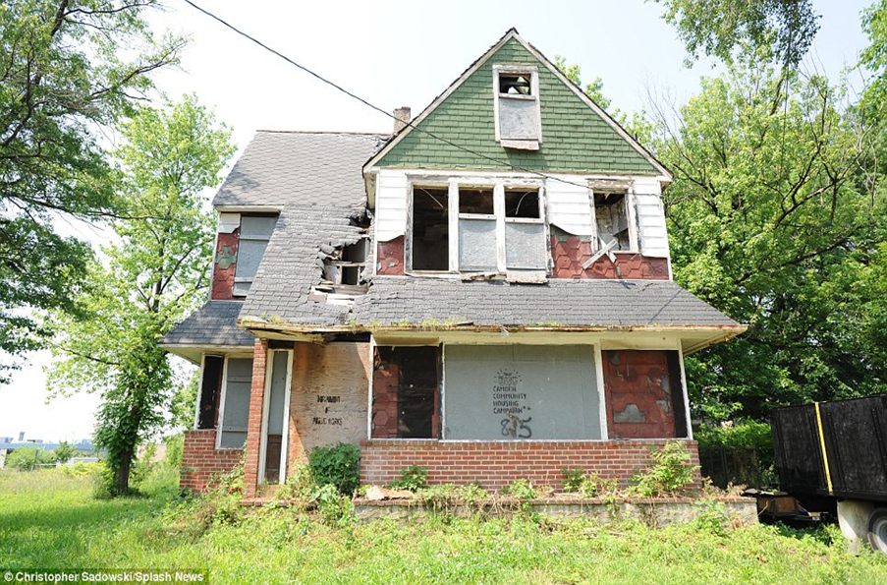
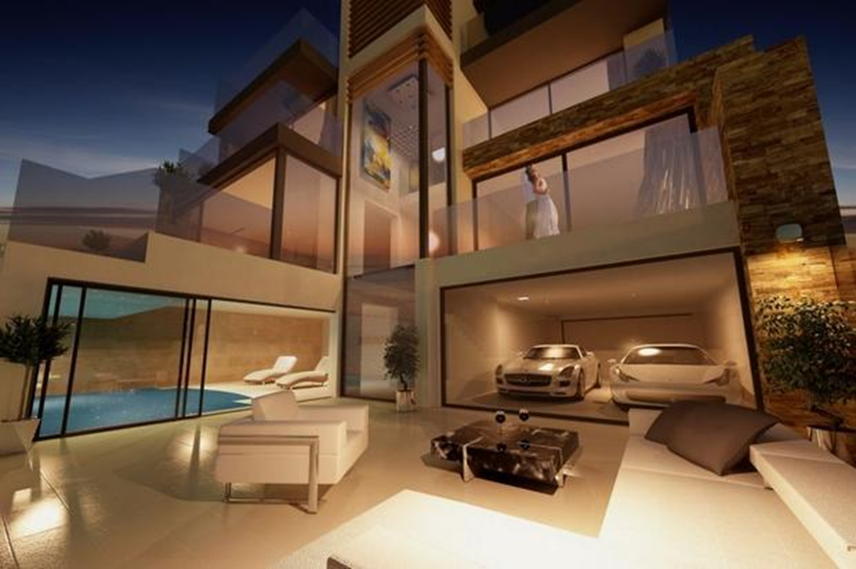
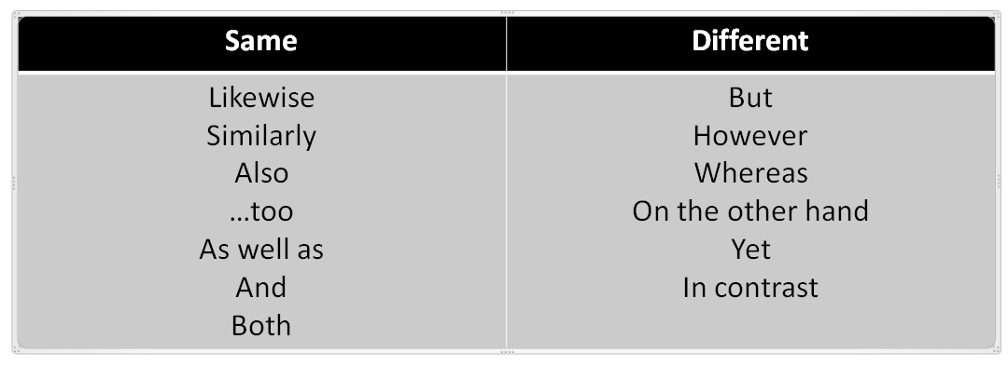
Two sentences showing a similarity between the pictures.
Two sentences showing a difference between the pictures.

Slide 15
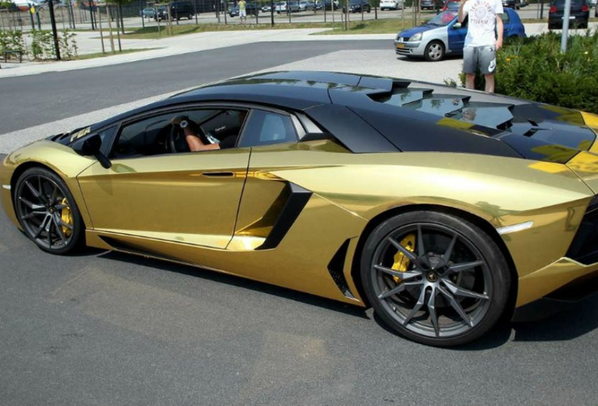
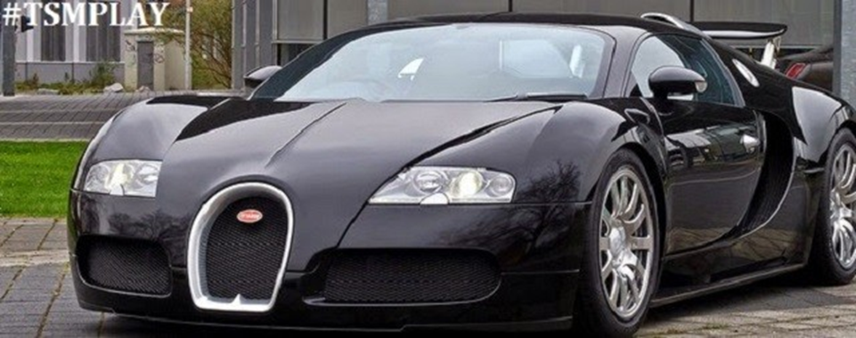
Two sentences showing a similarity between the pictures.
Two sentences showing a difference between the pictures.

Slide 16
You will be given a particular area to focus on. Highlight the topic on both extracts - do both texts use them in the same way?
How:
adjectives
individual examples
strong phrases
structure
first person narrator
sentence length

Slide 17
Go through each text and highlight what they each say about the treatment of people in prison.
Then, use a different colour highlighter to pick out techniques that are used. Here are some of the things you can look for (you may not find all of them):
Simile
Metaphor
Strong adjectives
Powerful nouns
Triples
Varied sentence length for effect
Rhetorical question
Direct speech
1st/2nd/3rd person
Ellipsis

Slide 18
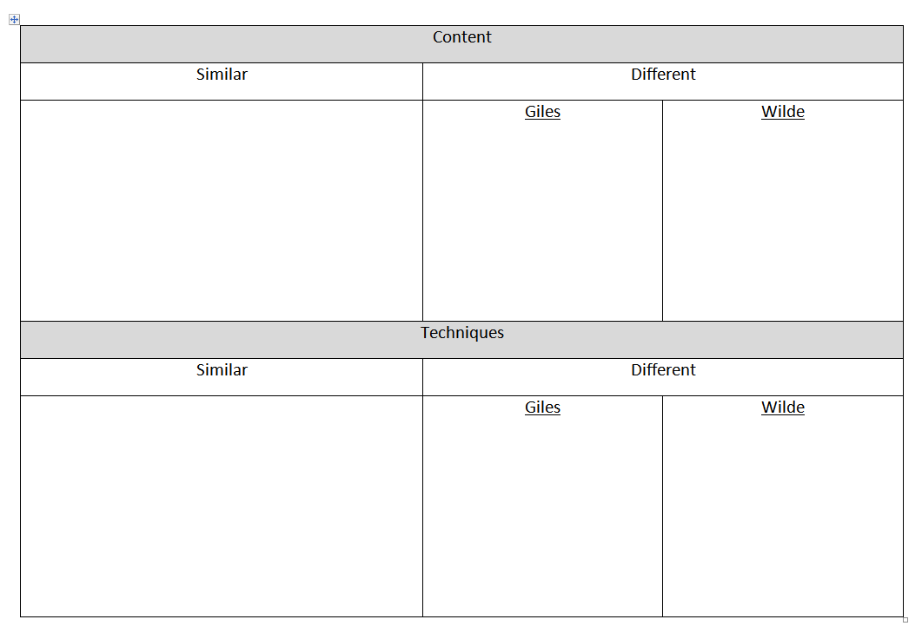
Complete the table and get ready to feed back:

Slide 19
Content
Similar | Different
Both tell about a young – unidentified - boy Both have very strong emotions about the subject matter Both have attended the prisons in person Both writing a message to readers (though intended audiences are different) | Giles doesn’t mention who was behind the prison Feels sorrowful and reflective | Wilde Specifically refers to the justices and magistrates as stupid Feels angry
Techniques
Similar | Different
Both told in 1st person Both use single sentence statements Both use triples Both use strong adjectives | Giles Rhetorical question Semi colons | Wilde Simile Long sentences

Slide 20
Similarities | Differences
Both tell about a young boy Both show strong emotions Both are writing with a message Both have visited the prisons involved Both use sentence length for effect Both use triples Both use first person Both use powerful adjectives and nouns | Wilde addresses the people behind the prison whilst Giles doesn’t mention them Both feel strong emotions but Giles is sorrowful whilst Wilde is angry Wilde uses a simile whilst Giles uses rhetorical questions Giles uses more complex punctuation whilst Wilde lets his sentences run on
NOTE: you need to match the differences up so you can talk about the 2 texts in comparison

Slide 21
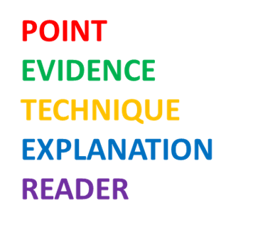
Structure your Answer - Similarities
Both writers use short sentences for effect. After Giles has asked her rhetorical question, she answers with “I hope not.” The brevity of the sentence helps to focus the emotion felt by the writer to a pinpoint, and the reader would also agree with her desire that the young boy in the photo wasn’t aware of the fate that awaited him. Similarly, Wilde uses “A child cannot understand a punishment inflicted by society.” This sums up Wilde’s entire argument. As it is placed in his opening paragraph, this means that the reader is fully informed of his intent in writing from the beginning. Like Giles’ short sentence, it focuses the attention of the reader.
Remember to use linking adverbials such as:
similarly
likewise
also

Slide 22
Structure your Answer - Differences
Remember to use contrasting adverbials such as:
however
whereas
on the other hand
yet
in contrast
Giles uses a rhetorical question for effect: “Did he have any idea of what was to come?”. She highlights that this young boy was heading to a terrible fate and, though he is long dead, she still shows concern for him in this moment. By asking a question, Giles makes the reader also consider this boy and his situation. However, Wilde doesn’t use rhetorical questions because he is keen to push his own message without pausing for the reader to consider how they feel. Instead, he uses similes to make the reader think a certain way: “The child’s face was like a white wedge of sheer terror”. The use of ‘white’ shows how scared the boy was as all the blood has drained from his face. ‘Sheer’ highlights the extremity of this fear.
Try to link the differences together – why are they different?
Now write 4 paragraphs of your own. Write about 2 similarities and 2 differences.

