Slide 1
English Language Paper 2
A letter written by Oscar Wilde
Q3 and Q4

Slide 2
Question 3 (2nd extract)
How many marks?
a, b, c, 1 mark each – 3 marks total
What should you write?
full sentences
What do you need to remember?
specific details
What do you need to avoid?
quotes
terminology
single words (instead of sentences)
Q3 is very much like Q1 but will be on the 19th century text.

Slide 3
Dear Sir, the present treatment of children is terrible, primarily from people not understanding the psychology of a child’s nature. A child cannot understand a punishment inflicted by society.
The child consequently, being taken away from its parents by people whom it has never seen before, and of whom it knows nothing, and finding itself in a lonely and unfamiliar cell, waited on by strange faces, and ordered about and punished by representatives of a prison system that it cannot understand, becomes an immediate prey to the first and most prominent emotion produced by modern prisons - the emotion of terror.
The terror of a child in prison is quite limitless. I remember once, in Reading prison, as I was going out to exercise, seeing in the dimly-lit cell right opposite my own, a small boy. Two warders — not unkindly men — were talking sternly to him, or perhaps giving him some useful advice about his behaviour. One was in the cell with him, the other was standing outside. The child’s face was like a white wedge of sheer terror. There was in his eyes the terror of a hunted animal.
The next morning I heard him at breakfast time crying and begging to be let out. His cry was for his parents. From time to time I could hear the deep voice of the warder on duty telling him to keep quiet. Yet he was not even convicted of whatever little offence he had been charged with. He was simply on remand. This I knew by his wearing of his own clothes, which seemed neat enough. He was, however, wearing prison socks and shoes. This showed that he was a very poor boy, whose own shoes, if he had any, were in a bad state. Justices and magistrates, an entirely ignorant class as a rule, often remand children for a week. They call this "not sending a child to prison". It is, of course, a stupid view on their part. To a little child whether he is in prison on remand, or after conviction, is no different. To him, the horrible thing is to be there at all. In the eyes of humanity it should be a horrible thing for him to be there at all.
A3. (a) Why is the current treatment of children terrible?
(b)When did Wilde hear the boy crying in prison?
(c) How did Wilde know the boy was only on remand?

Slide 4
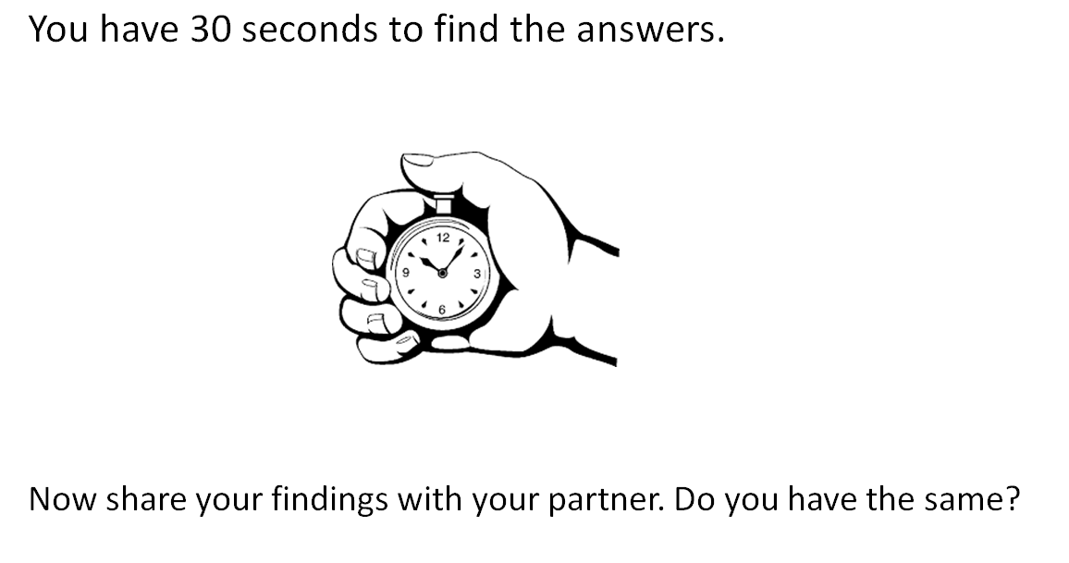

Slide 5
Dear Sir, the present treatment of children is terrible, primarily from people not understanding the psychology of a child’s nature. A child cannot understand a punishment inflicted by society.
The child consequently, being taken away from its parents by people whom it has never seen before, and of whom it knows nothing, and finding itself in a lonely and unfamiliar cell, waited on by strange faces, and ordered about and punished by representatives of a prison system that it cannot understand, becomes an immediate prey to the first and most prominent emotion produced by modern prisons - the emotion of terror.
The terror of a child in prison is quite limitless. I remember once, in Reading prison, as I was going out to exercise, seeing in the dimly-lit cell right opposite my own, a small boy. Two warders — not unkindly men — were talking sternly to him, or perhaps giving him some useful advice about his behaviour. One was in the cell with him, the other was standing outside. The child’s face was like a white wedge of sheer terror. There was in his eyes the terror of a hunted animal.
The next morning I heard him at breakfast time crying and begging to be let out. His cry was for his parents. From time to time I could hear the deep voice of the warder on duty telling him to keep quiet. Yet he was not even convicted of whatever little offence he had been charged with. He was simply on remand. This I knew by his wearing of his own clothes, which seemed neat enough. He was, however, wearing prison socks and shoes. This showed that he was a very poor boy, whose own shoes, if he had any, were in a bad state. Justices and magistrates, an entirely ignorant class as a rule, often remand children for a week. They call this "not sending a child to prison". It is, of course, a stupid view on their part. To a little child whether he is in prison on remand, or after conviction, is no different. To him, the horrible thing is to be there at all. In the eyes of humanity it should be a horrible thing for him to be there at all.
A3. (a) Why is the current treatment of children terrible?
A child can’t understand why they are being punished by society.
(b)When did Wilde hear the boy crying in prison?
He heard him at breakfast time.
(c) How did Wilde know the boy was only on remand?
The boy was wearing his own clothes.

Slide 6
A4. How well do you think Wilde’s letter captures his feelings about the treatment of children in prison?
You should comment on:
• what his feelings are about the treatment of children
• how well you think his letter makes his feelings clear [10]

Slide 7
Question 4
How many marks?
10 marks
How many points/quotes should you make?
6-8 points with quotes
What are the marks given for?
clear points related to quote
quotes to support points
terminology for how the writer presents impression
giving your opinion/reaction to the text in some way
What do you need to avoid?
Waffling!
Q4 is very much like Q2 (how) but you need to give your own opinion.

Slide 8
what his feelings are about the treatment of children
Paragraph | Main Topics | Scott’s Feelings/Opinions
1 | A child’s understanding of punishment | He is angered by the treatment of children: “the present treatment of children is terrible”
2 | The events/conditions that can create terror in a child. | He believes that children are treated badly: “ordered about and punished by representatives of a prison system that it cannot understand”
3
4

Slide 9
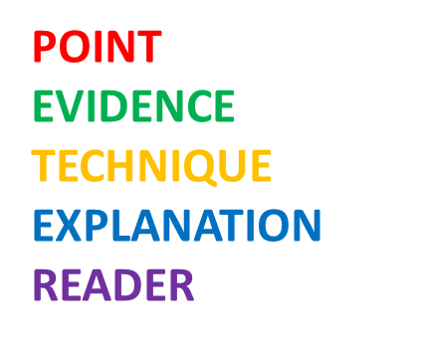
A4. How well do you think Wilde’s letter captures his feelings about the treatment of children in prison?
You should comment on:
• what his feelings are about the treatment of children
• how well you think his letter makes his feelings clear [10]
I think Wilde makes it clear that the treatment of children in prison angers him: “ordered about and punished by representatives of a prison system that it cannot understand” The use of the verbs ‘ordered about’ and ‘punished’ shows his feelings that these children are the subjects of a system they “don’t understand”. It makes the reader feel that they have no control over anything. In addition, the noun phrase “representatives of a prison system” makes the people in charge of them seem anonymous and therefore perhaps unaccountable for what happens to the children.
Write 7 more paragraphs, making sure you take quotations from across the whole extract.
You have 12 minutes.

