Slide 1
English Language Paper 2
Just Back: Memories of Auschwitz
Q1 and Q2

Slide 2
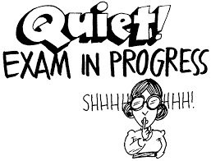
Paper 2 Non Fiction
2 hours – 80 marks
30% of the whole GCSE.
Non Fiction Reading Exam - 1 hour – 40 marks
You will do this in the same exam as writing letters, speeches, reviews etc.
You have 2 extracts to read.
You will have one extract from 21st century non-fiction (2000-2018) and one from the 19th century (1800-1899).
They will be on the same theme e.g. food, survival, music etc.

Slide 3
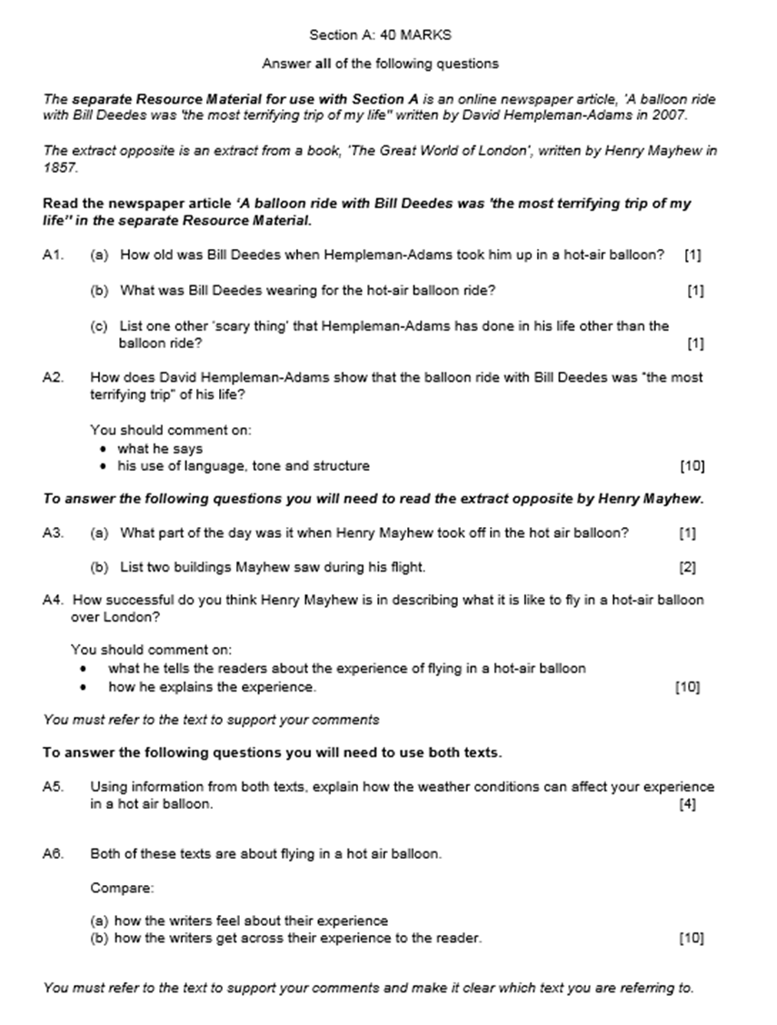
21st century, Q1 and Q2
19th century, Q3 and Q4
Both, Q5 and Q6

Slide 4
What are the main differences to the Paper 1 reading exam?
There are two documents to read
You will be using non fiction texts
You are given no specific line guidance eg read lines 12-36
There are 6 questions instead of 5

Slide 5
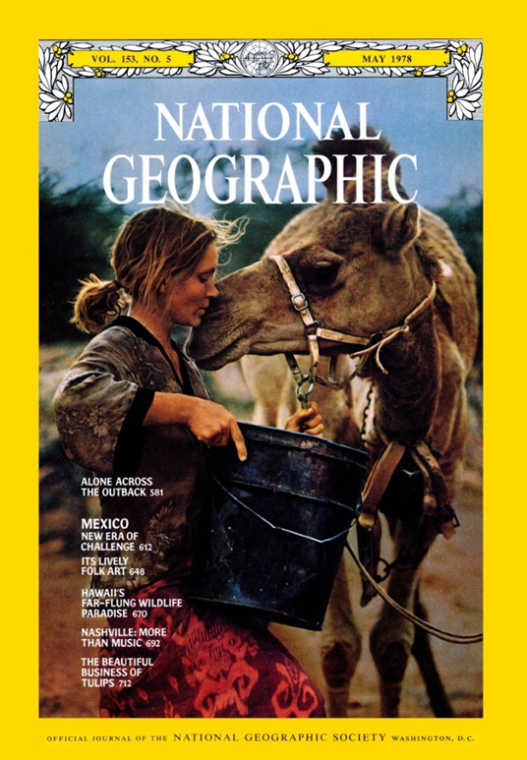
Reminder – what is non fiction?

Slide 6
Non Fiction - writing that is informative or factual rather than fictional.
Non-fiction texts:
adverts
reviews
diaries
newspaper articles
leaflets
magazine articles

Slide 7
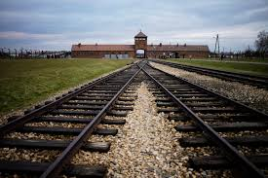
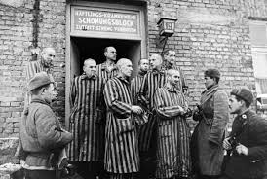
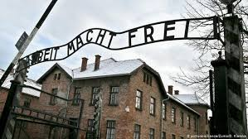
Auschwitz was the largest of the German Nazi concentration camps and extermination centres.
Over 1.1 million men, women and children lost their lives here.
The first exhibition in the barracks opened in 1947. Today, millions of people visit the museum every year in order to remember the horror that took place.

Slide 8
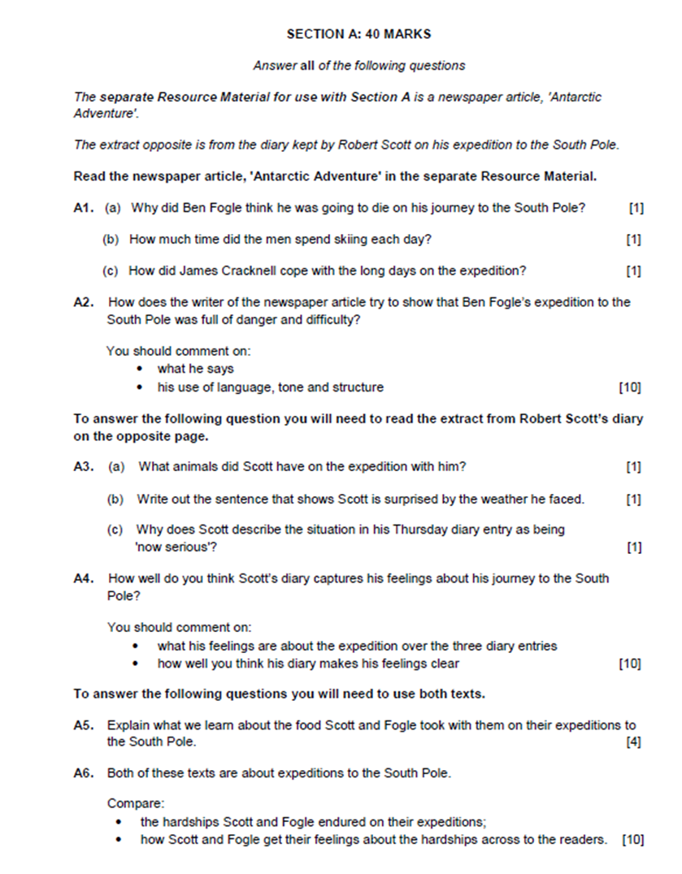
Question 1
How many marks?
a, b, c, 1 mark each – 3 marks total
What should you write?
full sentences
What do you need to remember?
specific details
What do you need to avoid?
quotes
terminology
single words (instead of sentences)
The question is testing your ability to identify information & ideas in a text.
You need to identify the key words in the question and scan through the text to find them.

Slide 9
"Everybody should go to Auschwitz once in their life," my mother told me. I didn’t understand what she meant but here I am, on a cold bleak Monday in January, looking up at those famous three words: Arbeit Macht Frei ("Work makes you free").
As we walk under the main gate into Auschwitz I, which now makes up part of the Auschwitz-Birkenau Museum & Memorial, we’re faced with endless rows of identical red-brick buildings, a stark contrast to the snow and ice covering the ground. Originally designed as Polish army barracks before becoming "home" to thousands of prisoners, the buildings now house exhibits and photos detailing the atrocities that went on within those very walls. We walk around slowly and quietly, talking only in hushed whispers, simply because it feels like the right thing to do.
From the enlarged black-and-white photos hanging on the walls, the eyes of a young child stare back at me. As he climbs out of the train carriage his face shows a mixture of confusion and anxiety. The realisation dawns on me that he most probably died within hours of that photo being taken. The thought shocks me more than I could have ever imagined. Did he have any idea of what was to come? I hope not.
Within each building are more pictures, faces, personal belongings and with each one comes stories of terror, torture and murder. The temperature seems to drop as we approach the death wall and gas chambers. Both are void of tourists and the signs request we remain silent as a mark of respect for the thousands who were killed here. They’re not necessary; there is nothing to say.
A brief stop in the museum entrance gives a welcome opportunity to return to reality; it’s surprising how quickly food, drink and warmth enable one to forget the horrors that lay beyond the door. Normality is resumed momentarily but the blissful denial doesn’t last long as a taxi takes us the short journey to Auschwitz II (Birkenau).
Built as an expansion to the original camp, the size of Birkenau is truly staggering, and with it comes the realisation of how many people were imprisoned here. It takes an age to walk the length of the snow-hidden railway platform to the ruins of the crematorium which lay beside the International Monument. The plaque reminds us that more than 1.5 million lost their lives in Auschwitz-Birkenau.
As I stand beside the memorial, I’m wet, cold, hungry and exhausted, yet I’ve never appreciated how lucky I am more than right now. Within the Auschwitz Museum hang the words: “The one who does not remember history is bound to live through it again”. I decide my mother was right – everybody should go to Auschwitz. The world should never forget.
1a) What was Auschwitz originally built as?
1b) What are visitors asked to do to show respect for those who were killed?
1c) Name one thing that enables Katie to forget the horrors of the museum.

Slide 10
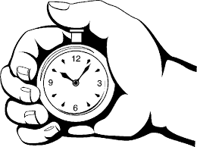
You have 30 seconds to find the answers.
Now share your findings with your partner. Do you have the same?

Slide 11
"Everybody should go to Auschwitz once in their life," my mother told me. I didn’t understand what she meant but here I am, on a cold bleak Monday in January, looking up at those famous three words: Arbeit Macht Frei ("Work makes you free").
As we walk under the main gate into Auschwitz I, which now makes up part of the Auschwitz-Birkenau Museum & Memorial, we’re faced with endless rows of identical red-brick buildings, a stark contrast to the snow and ice covering the ground. Originally designed as Polish army barracks before becoming "home" to thousands of prisoners, the buildings now house exhibits and photos detailing the atrocities that went on within those very walls. We walk around slowly and quietly, talking only in hushed whispers, simply because it feels like the right thing to do.
From the enlarged black-and-white photos hanging on the walls, the eyes of a young child stare back at me. As he climbs out of the train carriage his face shows a mixture of confusion and anxiety. The realisation dawns on me that he most probably died within hours of that photo being taken. The thought shocks me more than I could have ever imagined. Did he have any idea of what was to come? I hope not.
Within each building are more pictures, faces, personal belongings and with each one comes stories of terror, torture and murder. The temperature seems to drop as we approach the death wall and gas chambers. Both are void of tourists and the signs request we remain silent as a mark of respect for the thousands who were killed here. They’re not necessary; there is nothing to say.
A brief stop in the museum entrance gives a welcome opportunity to return to reality; it’s surprising how quickly food, drink and warmth enable one to forget the horrors that lay beyond the door. Normality is resumed momentarily but the blissful denial doesn’t last long as a taxi takes us the short journey to Auschwitz II (Birkenau).
Built as an expansion to the original camp, the size of Birkenau is truly staggering, and with it comes the realisation of how many people were imprisoned here. It takes an age to walk the length of the snow-hidden railway platform to the ruins of the crematorium which lay beside the International Monument. The plaque reminds us that more than 1.5 million lost their lives in Auschwitz-Birkenau.
As I stand beside the memorial, I’m wet, cold, hungry and exhausted, yet I’ve never appreciated how lucky I am more than right now. Within the Auschwitz Museum hang the words: “The one who does not remember history is bound to live through it again”. I decide my mother was right – everybody should go to Auschwitz. The world should never forget.
1a) What was Auschwitz originally built as?
It was originally designed as Polish army barracks.
1b) What are visitors asked to do to show respect for those who were killed?
Visitors are asked to remain silent.
1c) Name one thing that enables Katie to forget the horrors of the museum.
Food
Or
Drink
Or
Warmth

Slide 12
English Language Paper 2
Just Back: Memories of Auschwitz

Slide 13
Q2 How does the writer show Auschwitz to be a terrible place?
You should comment on:
what she says
her use of language, tone and structure
CONTENT – What does she say makes it sound sad, scary or horrific?
METHOD – How does she say it?

Slide 14
Beat the clock!
Find an example of each of the following in the extract:
Verb
Noun
Question mark
Short sentence
Semi colon
Triple
From the enlarged black-and-white photos hanging on the walls, the eyes of a young child stare back at me. As he climbs out of the train carriage his face shows a mixture of confusion and anxiety. The realisation dawns on me that he most probably died within hours of that photo being taken. The thought shocks me more than I could have ever imagined. Did he have any idea of what was to come? I hope not.
Within each building are more pictures, faces, personal belongings and with each one comes stories of terror, torture and murder. The temperature seems to drop as we approach the death wall and gas chambers. Both are void of tourists and the signs request we remain silent as a mark of respect for the thousands who were killed here. They’re not necessary; there is nothing to say.

Slide 15
Beat the clock!
Find an example of each of the following in the extract:
Verb
Noun
Question mark
Short sentence
Semi colon
Triple
From the enlarged black-and-white photos hanging on the walls, the eyes of a young child stare back at me. As he climbs out of the train carriage his face shows a mixture of confusion and anxiety. The realisation dawns on me that he most probably died within hours of that photo being taken. The thought shocks me more than I could have ever imagined. Did he have any idea of what was to come? I hope not.
Within each building are more pictures, faces, personal belongings and with each one comes stories of terror, torture and murder. The temperature seems to drop as we approach the death wall and gas chambers. Both are void of tourists and the signs request we remain silent as a mark of respect for the thousands who were killed here. They’re not necessary; there is nothing to say.

Slide 16
Question 2
How many marks?
10 marks
How many points/quotes should you make?
6-8 points with quotes
(13-15 minutes)
What are the marks given for?
clear points related to quote
quotes to support points
terminology for how the writer presents impression
What do you need to avoid?
waffling!
Remember to use quotes from the beginning, middle and end of the extract.

Slide 17
adjectives
verbs
word choice
adverbs
DAFOREST
exaggeration (doesn’t need to be hyperbole)
how it starts/ends
punctuation
sensory language
figurative language (similes, metaphor, personification, onomatopoeia etc.)
Go through the extract and highlight any of these that you find.
You have 4 minutes

Slide 18
Why might he not know what was happening?
Who is he?
“Did he have any idea of what was to come? I hope not.”
What’s the effect of this short sentence?
What was to come?
What’s the effect of the question mark on the reader?

Slide 19
Q2 How does the writer show Auschwitz to be a terrible place?
You should comment on:
what she says
her use of language, tone and structure
The writer uses the example of a small boy from a photograph to highlight the horror of Auschwitz: “Did he have any idea of what was to come? I hope not.” The rhetorical question makes the reader think about how the small boy was likely killed soon after the photo was taken. The short sentence ‘I hope not’ is simple but shows how the writer hopes that the boy’s innocence lasted as long as possible.
Write up
Write 7 more short paragraphs of your own to answer the question.
You have 10 minutes.
POINT
EVIDENCE
TECHNIQUE
EXPLANATION
READER

Slide 20
Summary:
Focus on what happens nd how the language used supports this.
Start sentences with phrases such as, ‘The writer uses...’
You must use correct subject terminology (but it doesn’t have to be in every paragraph)
Explain the effect on the reader.
Use as many examples/quotations as possible.

