Slide 1
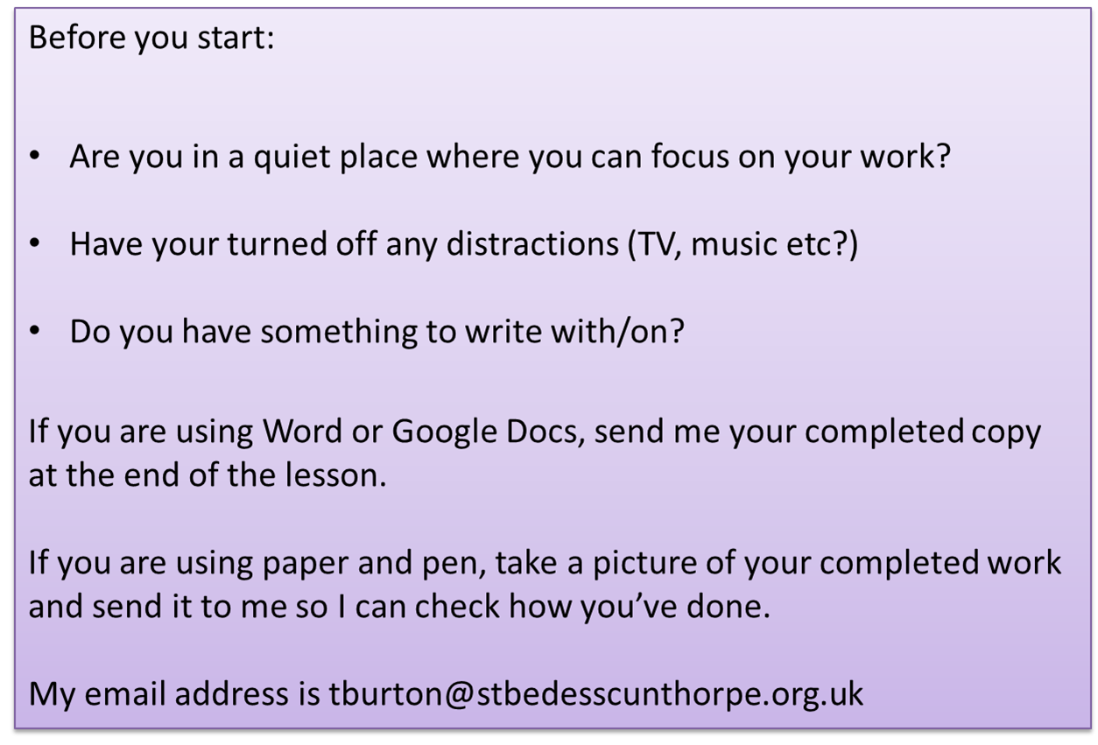

Slide 2
Language Paper 2 – nonfiction
Q How does the writer show that the life of an athlete is difficult?

Slide 3
How to analyse
non-fiction
Identify three ADJECTIVES and explain/analyse why the writer has used these and explain their intended effect on the reader.
Identify three VERBS and explain/analyse why the writer has used these and their intended effect on the reader.
What is the writer’s ATTITUDE towards what they are writing about? Find evidence to support your opinion.
Does the writer use authority or argument in their writing? Find quotations to support this.
My alarm sounds at 4.30 am every day except Sundays- the one day in which I can rest. Although I am not hungry at such an early hour, I know I have to eat in order to have energy for the gruelling swim session at 5.45 am. Breakfast consists of a banana and a protein drink. It is my first breakfast. My second comes when we are out of the pool, and consists of fruit and porridge.
I have a tough schedule. I begin in the pool for two hours. Although the coach is motivational and encouraging, he is also strict and will not accept excuses. For these two hours we are pushed beyond our normal limits with timed laps and races. Although I am friends with the other swimmers, there is often an element of competition between us as we all fight for first place and personal bests.
After the first pool session, we take a two hour break to replenish our energy, and then begin a two hour session in the gym. We work with a personal trainer who monitors our progress in both cardiovascular and strength training. It is important that we finish the session with intense stretches and massage as swimmers use every muscle in the body, and without proper cool downs, the muscles can tear and strain.
How is the extract structured? Is there a difference between the ideas or events described at the beginning and at the end of the extract? Is there a shift in viewpoint/tone/focus?
What is the writer’s primary FOCUS in the text? People? Places? Ideas? Why have they focused on this and what is its effect on the reader?
Identify some use of FIGURATIVE language (metaphor, simile, personification). Analyse why the writer has used this and explain its effect on the reader.
What REGISTER does the writer use? Is it formal, colloquial, serious, sarcastic or something else? Why have they used this register?
Find TWO different sentences whose structure you find interesting. What sort of sentences are they? Simple, complex, compound? How does the structure of the sentence help to convey the writer’s meaning?
Identify 3 METHODS used by the writer to help convey their point of view. Analyse their effects.

Slide 4
How to analyse
non-fiction
Identify three ADJECTIVES and explain/analyse why the writer has used these and explain their intended effect on the reader.
Identify three VERBS and explain/analyse why the writer has used these and their intended effect on the reader.
What is the writer’s ATTITUDE towards what they are writing about? Find evidence to support your opinion.
Does the writer use authority or argument in their writing? Find quotations to support this.
My alarm sounds at 4.30 am every day except Sundays- the one day in which I can rest. Although I am not hungry at such an early hour, I know I have to eat in order to have energy for the gruelling swim session at 5.45 am. Breakfast consists of a banana and a protein drink. It is my first breakfast. My second comes when we are out of the pool, and consists of fruit and porridge.
I have a tough schedule. I begin in the pool for two hours. Although the coach is motivational and encouraging, he is also strict and will not accept excuses. For these two hours we are pushed beyond our normal limits with timed laps and races. Although I am friends with the other swimmers, there is often an element of competition between us as we all fight for first place and personal bests.
After the first pool session, we take a two hour break to replenish our energy, and then begin a two hour session in the gym. We work with a personal trainer who monitors our progress in both cardiovascular and strength training. It is important that we finish the session with intense stretches and massage as swimmers use every muscle in the body, and without proper cool downs, the muscles can tear and strain.
How is the extract structured? Is there a difference between the ideas or events described at the beginning and at the end of the extract? Is there a shift in viewpoint/tone/focus?
What is the writer’s primary FOCUS in the text? People? Places? Ideas? Why have they focused on this and what is its effect on the reader?
Identify some use of FIGURATIVE language (metaphor, simile, personification). Analyse why the writer has used this and explain its effect on the reader.
What REGISTER does the writer use? Is it formal, colloquial, serious, sarcastic or something else? Why have they used this register?
Find TWO different sentences whose structure you find interesting. What sort of sentences are they? Simple, complex, compound? How does the structure of the sentence help to convey the writer’s meaning?
Identify 3 METHODS used by the writer to help convey their point of view. Analyse their effects.

Slide 5
How to analyse
non-fiction
Identify three ADJECTIVES and explain/analyse why the writer has used these and explain their intended effect on the reader.
Identify three VERBS and explain/analyse why the writer has used these and their intended effect on the reader.
What is the writer’s ATTITUDE towards what they are writing about? Find evidence to support your opinion.
Does the writer use authority or argument in their writing? Find quotations to support this.
My alarm sounds at 4.30 am every day except Sundays- the one day in which I can rest. Although I am not hungry at such an early hour, I know I have to eat in order to have energy for the gruelling swim session at 5.45 am. Breakfast consists of a banana and a protein drink. It is my first breakfast. My second comes when we are out of the pool, and consists of fruit and porridge.
I have a tough schedule. I begin in the pool for two hours. Although the coach is motivational and encouraging, he is also strict and will not accept excuses. For these two hours we are pushed beyond our normal limits with timed laps and races. Although I am friends with the other swimmers, there is often an element of competition between us as we all fight for first place and personal bests.
After the first pool session, we take a two hour break to replenish our energy, and then begin a two hour session in the gym. We work with a personal trainer who monitors our progress in both cardiovascular and strength training. It is important that we finish the session with intense stretches and massage as swimmers use every muscle in the body, and without proper cool downs, the muscles can tear and strain.
How is the extract structured? Is there a difference between the ideas or events described at the beginning and at the end of the extract? Is there a shift in viewpoint/tone/focus?
What is the writer’s primary FOCUS in the text? People? Places? Ideas? Why have they focused on this and what is its effect on the reader?
Identify some use of FIGURATIVE language (metaphor, simile, personification). Analyse why the writer has used this and explain its effect on the reader.
What REGISTER does the writer use? Is it formal, colloquial, serious, sarcastic or something else? Why have they used this register?
Find TWO different sentences whose structure you find interesting. What sort of sentences are they? Simple, complex, compound? How does the structure of the sentence help to convey the writer’s meaning?
Identify 3 METHODS used by the writer to help convey their point of view. Analyse their effects.

Slide 6
How to analyse
non-fiction
Identify three ADJECTIVES and explain/analyse why the writer has used these and explain their intended effect on the reader.
Identify three VERBS and explain/analyse why the writer has used these and their intended effect on the reader.
What is the writer’s ATTITUDE towards what they are writing about? Find evidence to support your opinion.
Does the writer use authority or argument in their writing? Find quotations to support this.
My alarm sounds at 4.30 am every day except Sundays- the one day in which I can rest. Although I am not hungry at such an early hour, I know I have to eat in order to have energy for the gruelling swim session at 5.45 am. Breakfast consists of a banana and a protein drink. It is my first breakfast. My second comes when we are out of the pool, and consists of fruit and porridge.
I have a tough schedule. I begin in the pool for two hours. Although the coach is motivational and encouraging, he is also strict and will not accept excuses. For these two hours we are pushed beyond our normal limits with timed laps and races. Although I am friends with the other swimmers, there is often an element of competition between us as we all fight for first place and personal bests.
After the first pool session, we take a two hour break to replenish our energy, and then begin a two hour session in the gym. We work with a personal trainer who monitors our progress in both cardiovascular and strength training. It is important that we finish the session with intense stretches and massage as swimmers use every muscle in the body, and without proper cool downs, the muscles can tear and strain.
How is the extract structured? Is there a difference between the ideas or events described at the beginning and at the end of the extract? Is there a shift in viewpoint/tone/focus?
What is the writer’s primary FOCUS in the text? People? Places? Ideas? Why have they focused on this and what is its effect on the reader?
Identify some use of FIGURATIVE language (metaphor, simile, personification). Analyse why the writer has used this and explain its effect on the reader.
What REGISTER does the writer use? Is it formal, colloquial, serious, sarcastic or something else? Why have they used this register?
Find TWO different sentences whose structure you find interesting. What sort of sentences are they? Simple, complex, compound? How does the structure of the sentence help to convey the writer’s meaning?
Identify 3 METHODS used by the writer to help convey their point of view. Analyse their effects.

Slide 7
How to analyse
non-fiction
Identify three ADJECTIVES and explain/analyse why the writer has used these and explain their intended effect on the reader.
Identify three VERBS and explain/analyse why the writer has used these and their intended effect on the reader.
What is the writer’s ATTITUDE towards what they are writing about? Find evidence to support your opinion.
Once we are finished in the gym, I go home for a sleep- I am often exhausted after such intense training, even after starting at such a young age! I began professional swimming at high school. Mum would have to drive me to pool training sessions both before and after school every day. I would do my homework in the car and often crash out in bed as soon as I came home. There were many sacrifices made by both myself and my family, and there was never a promise of success. Even now, as a professional athlete, there are no luxuries. My life revolves around training and competition.
Life as a professional athlete is structured. You have to monitor what you eat, how much you sleep, and how many hours you train. I try to get eight hours sleep a night; however, there is often a lot of travelling as you move between competitions, which makes it difficult to keep to your normal routines. And of course, there are some days when all you want to do is sleep and eat burger and chips!
It has never crossed my mind to give up swimming as I love the sport so much. Competitions are exciting and there is no greater feeling than winning a race, or achieving a personal best. Although it is tough, the retiring age of an athlete is young, so I know I should make the most of it while I can.
Does the writer use authority or argument in their writing? Find quotations to support this.
How is the extract structured? Is there a difference between the ideas or events described at the beginning and at the end of the extract? Is there a shift in viewpoint/tone/focus?
What is the writer’s primary FOCUS in the text? People? Places? Ideas? Why have they focused on this and what is its effect on the reader?
Identify some use of FIGURATIVE language (metaphor, simile, personification). Analyse why the writer has used this and explain its effect on the reader.
What REGISTER does the writer use? Is it formal, colloquial, serious, sarcastic or something else? Why have they used this register?
Find TWO different sentences whose structure you find interesting. What sort of sentences are they? Simple, complex, compound? How does the structure of the sentence help to convey the writer’s meaning?
Identify 3 METHODS used by the writer to help convey their point of view. Analyse their effects.

Slide 8
How to analyse
non-fiction
Identify three ADJECTIVES and explain/analyse why the writer has used these and explain their intended effect on the reader.
Identify three VERBS and explain/analyse why the writer has used these and their intended effect on the reader.
What is the writer’s ATTITUDE towards what they are writing about? Find evidence to support your opinion.
Once we are finished in the gym, I go home for a sleep- I am often exhausted after such intense training, even after starting at such a young age! I began professional swimming at high school. Mum would have to drive me to pool training sessions both before and after school every day. I would do my homework in the car and often crash out in bed as soon as I came home. There were many sacrifices made by both myself and my family, and there was never a promise of success. Even now, as a professional athlete, there are no luxuries. My life revolves around training and competition.
Life as a professional athlete is structured. You have to monitor what you eat, how much you sleep, and how many hours you train. I try to get eight hours sleep a night; however, there is often a lot of travelling as you move between competitions, which makes it difficult to keep to your normal routines. And of course, there are some days when all you want to do is sleep and eat burger and chips!
It has never crossed my mind to give up swimming as I love the sport so much. Competitions are exciting and there is no greater feeling than winning a race, or achieving a personal best. Although it is tough, the retiring age of an athlete is young, so I know I should make the most of it while I can.
Does the writer use authority or argument in their writing? Find quotations to support this.
How is the extract structured? Is there a difference between the ideas or events described at the beginning and at the end of the extract? Is there a shift in viewpoint/tone/focus?
What is the writer’s primary FOCUS in the text? People? Places? Ideas? Why have they focused on this and what is its effect on the reader?
Identify some use of FIGURATIVE language (metaphor, simile, personification). Analyse why the writer has used this and explain its effect on the reader.
What REGISTER does the writer use? Is it formal, colloquial, serious, sarcastic or something else? Why have they used this register?
Find TWO different sentences whose structure you find interesting. What sort of sentences are they? Simple, complex, compound? How does the structure of the sentence help to convey the writer’s meaning?
Identify 3 METHODS used by the writer to help convey their point of view. Analyse their effects.

Slide 9
How to analyse
non-fiction
Identify three ADJECTIVES and explain/analyse why the writer has used these and explain their intended effect on the reader.
Identify three VERBS and explain/analyse why the writer has used these and their intended effect on the reader.
What is the writer’s ATTITUDE towards what they are writing about? Find evidence to support your opinion.
Does the writer use authority or argument in their writing? Find quotations to support this.
My alarm sounds at 4.30 am every day except Sundays- the one day in which I can rest. Although I am not hungry at such an early hour, I know I have to eat in order to have energy for the gruelling swim session at 5.45 am. Breakfast consists of a banana and a protein drink. It is my first breakfast. My second comes when we are out of the pool, and consists of fruit and porridge.
I have a tough schedule. I begin in the pool for two hours. Although the coach is motivational and encouraging, he is also strict and will not accept excuses. For these two hours we are pushed beyond our normal limits with timed laps and races. Although I am friends with the other swimmers, there is often an element of competition between us as we all fight for first place and personal bests.
After the first pool session, we take a two hour break to replenish our energy, and then begin a two hour session in the gym. We work with a personal trainer who monitors our progress in both cardiovascular and strength training. It is important that we finish the session with intense stretches and massage as swimmers use every muscle in the body, and without proper cool downs, the muscles can tear and strain.
How is the extract structured? Is there a difference between the ideas or events described at the beginning and at the end of the extract? Is there a shift in viewpoint/tone/focus?
What is the writer’s primary FOCUS in the text? People? Places? Ideas? Why have they focused on this and what is its effect on the reader?
Identify some use of FIGURATIVE language (metaphor, simile, personification). Analyse why the writer has used this and explain its effect on the reader.
What REGISTER does the writer use? Is it formal, colloquial, serious, sarcastic or something else? Why have they used this register?
Find TWO different sentences whose structure you find interesting. What sort of sentences are they? Simple, complex, compound? How does the structure of the sentence help to convey the writer’s meaning?
Identify 3 METHODS used by the writer to help convey their point of view. Analyse their effects.

Slide 10
“the gruelling swim session”
strong adjective that shows how much effort is needed
“we all fight for first place”
powerful verb which highlights how competitive professional athletics is
“My alarm sounds at 4.30 am every day except Sundays”
very early time which shows dedication. Also six days a week which shows how non-stop this life is.
Now look at your notes from when you analysed slide 7. Choose three quotations and write them up briefly as I have here. This will form the basis of your PETER paragraphs.

Slide 11
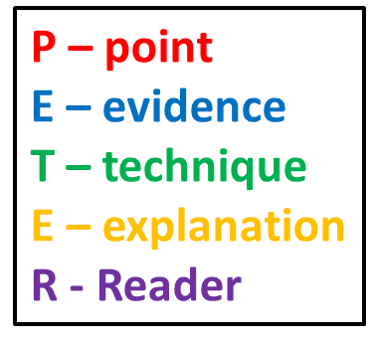
Writing your response
The writer shows the difficulty of professional sport by using a powerful verb in “we all fight for first place”. The word ‘fight’ shows how competitive the sport is and that the competitors always have to try and be the best, even though only one of them can succeed. This verb also suggests a violent struggle which makes us think the writer is taking part in a battle rather than a sport.
Task: Using your annotations write three of your own P.E.T.E.R paragraphs answering the question:
How does the writer show that the life of an athlete is difficult?

