Slide 1
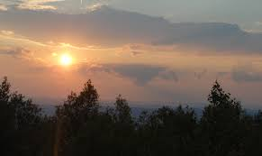
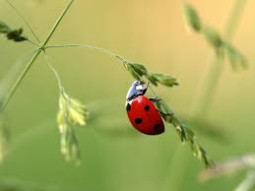
‘Nature Poems’
As Imperceptibly as Grief
LO: To develop poetry analysis skills. ST: I can understand writers’ methods and use subject terminology.
Learning Objective:
AO2: Analyse the language, form and structure used by a writer to create meanings and effects, using relevant subject terminology where appropriate.

Slide 2
Key Words:
Imperceptible – so gradual that it’s hard to detect
Perfidy – deceit/dishonesty
Distilled – concentrated
Sequestered – hidden away
Keel – the wood/ metal that allow a boat to balance
Consider what summer means to you.
Consider what grief means to you.
Is there a connection between the two?
Learning Objective:
AO2: Analyse the language, form and structure used by a writer to create meanings and effects, using relevant subject terminology where appropriate.
Notes:
Could it mean the end of the school holidays? Coming back to a new change of year/school/teachers/ does that make you sad.
The loss of good weather? Etc.

Slide 3
Key Words:
Imperceptible
Perfidy
Distilled
Sequestered
Keel
As imperceptibly as Grief
The Summer lapsed away —
Too imperceptible at last
To seem like Perfidy —
A Quietness distilled
As Twilight long begun,
Or Nature spending with herself
Sequestered Afternoon —
The Dusk drew earlier in —
The Morning foreign shone —
A courteous, yet harrowing Grace,
As Guest that would be gone —
And thus, without a Wing
Or service of a Keel
Our Summer made her light escape
Into the Beautiful.
Start with the title, As imperceptibly as Grief
Let’s read the poem by Emily Dickinson.
What are your initial thoughts?
Learning Objective:
AO2: Analyse the language, form and structure used by a writer to create meanings and effects, using relevant subject terminology where appropriate.
Notes:
Could it mean the end of the school holidays? Coming back to a new change of year/school/teachers/ does that make you sad.
The loss of good weather? Etc.

Slide 4
Key Words:
Imperceptible
Perfidy
Distilled
Sequestered
Keel
Let’s Have some feedback
Learning Objective:
AO2: Analyse the language, form and structure used by a writer to create meanings and effects, using relevant subject terminology where appropriate.
Notes:
Could it mean the end of the school holidays? Coming back to a new change of year/school/teachers/ does that make you sad.
The loss of good weather? Etc.

Slide 5
As Imperceptibly as Grief
As imperceptibly as Grief
The Summer lapsed away —
Too imperceptible at last
To seem like Perfidy —
A Quietness distilled
As Twilight long begun,
Or Nature spending with herself
Sequestered Afternoon —
The Dusk drew earlier in —
The Morning foreign shone —
A courteous, yet harrowing Grace,
As Guest that would be gone —
And thus, without a Wing
Or service of a Keel
Our Summer made her light escape
Into the Beautiful.
Emily Dickinson
What are your initial thoughts? What is it all about?
Teacher-of-English.com

Slide 6
What do the poem’s short lines give a sense of?
What does the narrator establish in the first two lines?
As imperceptibly as Grief
The Summer lapsed away —
Too imperceptible at last
To seem like Perfidy —
What do the dashes do?
What tone does the speaker create?
Does the speaker hint at a betrayal by summer?
Notes:
A sense of simplicity.
Establishes the link between grief and summer. Both grief and summer can slip away.

Slide 7
What does the word quietness suggest?
What does the half rhyme of begun/afternoon illustrate?
A Quietness distilled
As Twilight long begun,
Or Nature spending with herself
Sequestered Afternoon —
Where is there light imagery? What does it suggest?
What has been personified?
What is the effect of quietness being ‘distilled’?
Notes:
Quietness – summer and grief are associated with a stillness/ being closed off from the world. BUT it is comforting rather than isloating.
Half rhyme not at peace with her feelings

Slide 8
Where is the theme of death at this point in the poem?
How is morning personified? Is it strange to leave grief behind?
The Dusk drew earlier in —
The Morning foreign shone —
A courteous, yet harrowing Grace,
As Guest that would be gone —
Why has the poet juxtaposed these two words?
What does the writer suggest about time here?
Could there be different stages of grief?
Notes:
Alliteration dusk drew = life and death part of natural cycle
Harrowing grace = something pleasant can be unsettling

Slide 9
What does ‘and thus’ signal?
How does grief and summer leave here?
And thus, without a Wing
Or service of a Keel
Our Summer made her light escape
Into the Beautiful.
Why use the first person plural ‘our’?
Is the end of grief ultimately positive? What is the significance of the only full stop in the poem?
The extended metaphor of escape suggests what has happened to the speakers grief?
Notes:
And thus shift in tone = to acceptance of loss. Able to move on.
Leaves as easily as moving through air or water.

Slide 10
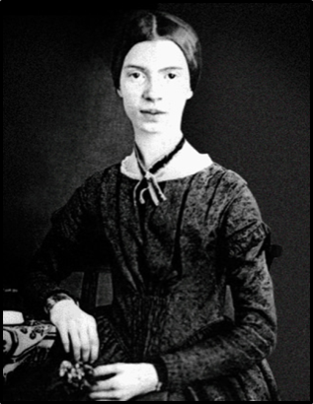
Emily Dickinson
Emily Dickinson is considered to be one of the greatest poets to have come out of the USA. Writing in America in the mid-1800s, Dickinson composed over a thousand poems in her late 20s and early 30s. Yet during her lifetime she made no real attempt to publish her work, choosing instead to share them privately with family and friends.
In the later years of her life Dickinson withdrew from society spending much of her time as a recluse in her Massachusetts home. She never married, and most friendships between her and others depended entirely upon correspondence.
With a few exceptions, her poetry remained virtually unknown until after her death. Her collection of almost 1,800 poems was discovered by her younger sister, Lavinia, after Dickinson died in 1886. It was published four years later but it wasn’t until the 1920s and the emergence of the modernist movement that her work gained critical success.
Teacher-of-English.com

Slide 11
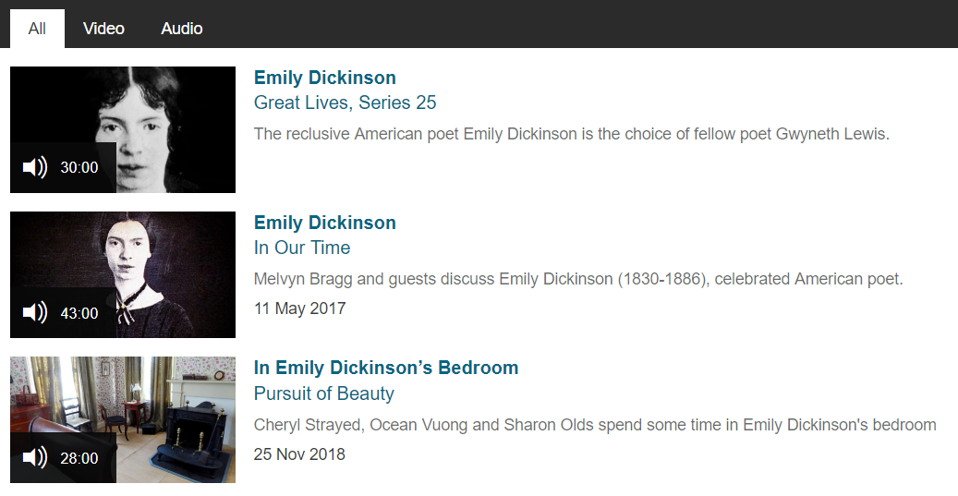
Emily Dickinson
A number of videos about Emily Dickinson can be viewed by clicking the image below.
Teacher-of-English.com

Slide 12
‘As Imperceptibly as Grief’ by Emily Dickinson is about two things – the end of summertime and the end of a period of grieving.
The poem begins by describing the end of summer. Dickinson is sad that summer has come to an end and she comments on how it ends so gradually that you don’t notice when it is over – it’s ‘imperceptible’.
The end of summer represents the end of a grieving process for the speaker. This suggests that the speaker has lost a loved one and that they have grieved for them for a period of time. Eventually, like the summer, the grieving period has come to an end and – also like the summer, it ends so gradually that the speaker barely notices the change happen.
Dickinson suggests that the feeling of grief was a comfort – maybe because it kept a connection between her and her lost loved one. When the grief is over the connection is broken and the speaker is unsettled by this.
Context
Be proactive take your own notes!
Learning Objective:
AO2: Analyse the language, form and structure used by a writer to create meanings and effects, using relevant subject terminology where appropriate.
Notes:
Could it mean the end of the school holidays? Coming back to a new change of year/school/teachers/ does that make you sad.
The loss of good weather? Etc.

Slide 13
The poem is made up of generally short lines which give it a sense of simplicity. It also uses long dashes rather than conventional punctuation. These slow down the poem’s pace to reflect the slowness of the transition from summer to autumn as well as the gradual end of the grieving process. It also gives the poem a sombre and reflective mood. The poem’s rhythm and half-rhymes reflect the pattern of speech, making it sound personal, honest and confessional.
Form
Be proactive take your own notes!
Learning Objective:
AO2: Analyse the language, form and structure used by a writer to create meanings and effects, using relevant subject terminology where appropriate.
Notes:
Could it mean the end of the school holidays? Coming back to a new change of year/school/teachers/ does that make you sad.
The loss of good weather? Etc.

Slide 14
The poet creates a link between summer and grief in the first two lines of the poem and continues it throughout via a series of natural metaphors which convey the speaker’s feelings about the way grief slowly fades away. The poem’s use of half rhymes convey her feelings of discomfort as her grief (which has been a strange source of comfort to her) disappears. The use of just one stanza adds to the sense of slow change as we see a gradual development in feeling and tone as the stanza develops. By the end of the stanza she seems to have finally come to terms with things and the poem finishes on a positive note. There is only one full stop in the poem which is at the very end. This suggests that not only have both summer and grief passed but also that the speaker has finally accepted the change and come to terms with it. Therefore the sorrowful tone that exists for most of the poem is replaced at the very end with one of hope.
Structure and tone
Be proactive take your own notes!
Learning Objective:
AO2: Analyse the language, form and structure used by a writer to create meanings and effects, using relevant subject terminology where appropriate.
Notes:
Could it mean the end of the school holidays? Coming back to a new change of year/school/teachers/ does that make you sad.
The loss of good weather? Etc.

Slide 15
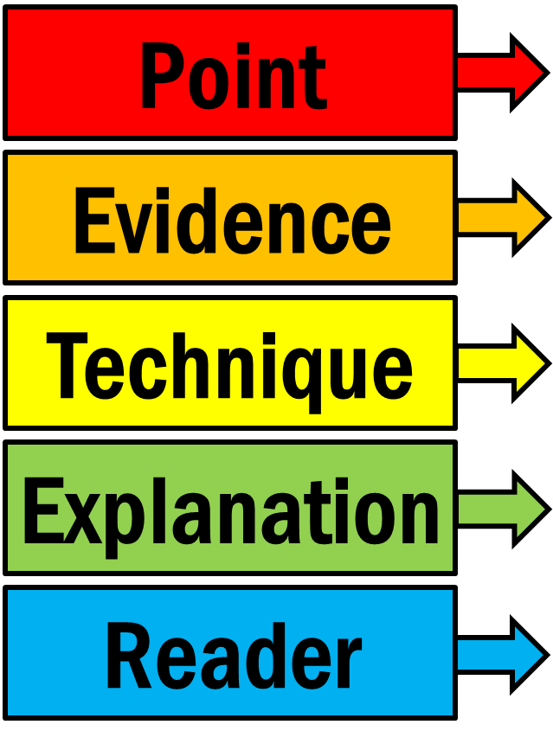
Using P.E.T.E.R.
When writing about poetry, PETER can help.
Has a technique been used in the quotation? Maybe a simile, metaphor or onomatopoeia has been used?
Why has the poet used it? Be clear and detailed
What is the intended effect on the reader?

Slide 16
Putting together a P.E.T.E.R. paragraph
Look at how Dickinson uses language in the poem. Make a point, select a quotation to back up your point, then explain the quote in detail and the effect on the reader. Look at the example below.
Point | Evidence | Technique | Explain | Reader
Dickinson uses a number of contradictory images in the poem. | ‘The Morning foreign shone — / A courteous, yet harrowing Grace’ | personification | Describing the morning as ‘harrowing’ is very unusual – as is the comparison of summer with grief. | The reader is surprised by these images as summer is usually associated with the prime of life – not death - and morning is usually representative of hope and a fresh start. Such contradictory images convey the poet’s sense of loss and discomfort. There is a reluctance in letting go of grief and moving forward. Grief has become a kind of comfort which connects the speaker with the loved one she has lost so when it goes, it’s strange and difficult to come to terms with.
How does Dickinson use poetic devices in ‘As Imperceptibly as Grief’?

Slide 17
Writing up the Paragraph
P
Dickinson uses a number of contradictory images in the poem.
‘The Morning foreign shone — /
A courteous, yet harrowing Grace’
Here Dickinson uses personification very effectively. Describing the morning as ‘harrowing’ is very unusual – as is the comparison of summer with grief.
The reader is surprised by these images as summer is usually associated with the prime of life – not death - and morning is usually representative of hope and a fresh start. Such contradictory images convey the poet’s sense of loss and discomfort. There is a reluctance in letting go of grief and moving forward. Grief has become a kind of comfort which connects the speaker with the loved one she has lost so when it goes, it’s strange and difficult to come to terms with.
E
T
E
R

Slide 19
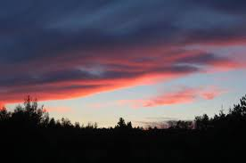
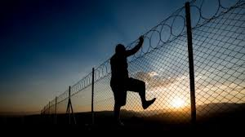
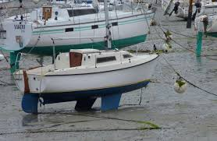
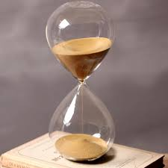
‘As Imperceptibly as Grief’ by Emily Dickinson Images Task –
Step1. Choose quotations in the poem that match these images.
Step 2. Identify language techniques and word types in at least SIX of these quotations.
THEN answer this question: “How does Dickinson use comfort and loss in her poem?
Notes:
Keys guest leaving
Hourglass summer lapsed away

