Slide 1
Prediction
Title: A Midsummer Night’s dream Animated Tales
What do you think this play is about based on the title and the front cover.
Write as mind map or in a paragraph of approximately 30-50 words.
Do Now

Slide 2
Learning outcomes
WHAT: to have an overview of William Shakespeare’s play ‘A Midsummer Night’s Dream
WHY: So as to have an understanding of the play before focussing on the language used by Shakespeare.
Learning Content
.
Love Respect Serve

Slide 3
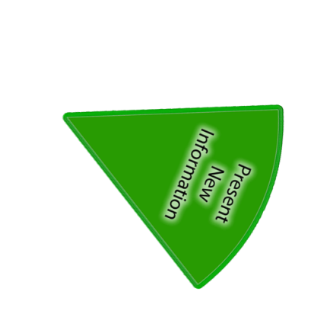
Make notes as you watch
Watch any version of A Midsummer Night’s Dream
Hook
TASKS:
Complete storyboard as you are watching
(see the next slide before starting this).
Complete the tasks as you are watching.

Slide 4
Note the important events and characters in each scene in your storyboard.
Act 1 | Act 2 | Act 3
Act 4 | Act 5 | Characters
Writing task

Slide 5
Review
Check your storyboard with a partner/self.
Fill any gaps.
Take turns to explain what was happening:
A – at the beginning
B -at the end
Checking Understanding

Slide 6
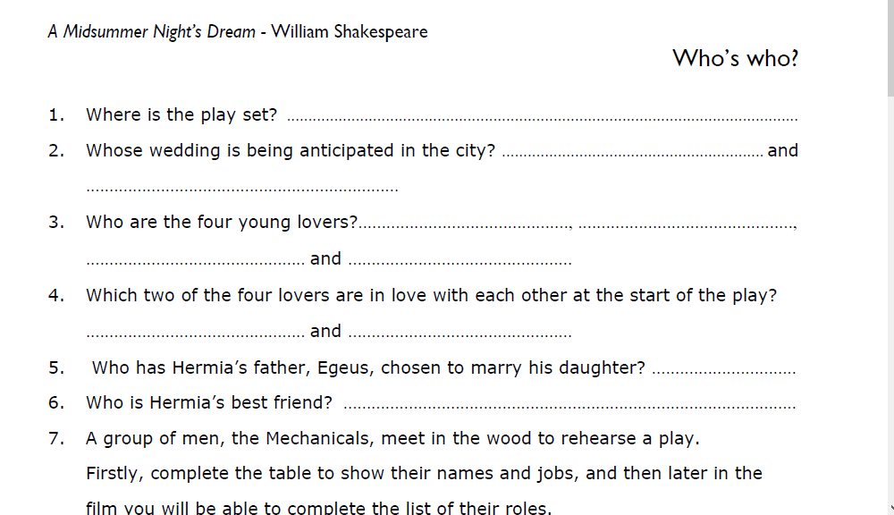
TASK: answer the questions to embed knowledge of the play.
On the sheet you have been given:
Complete the tasks as we watch the film.
Writing task

Slide 7
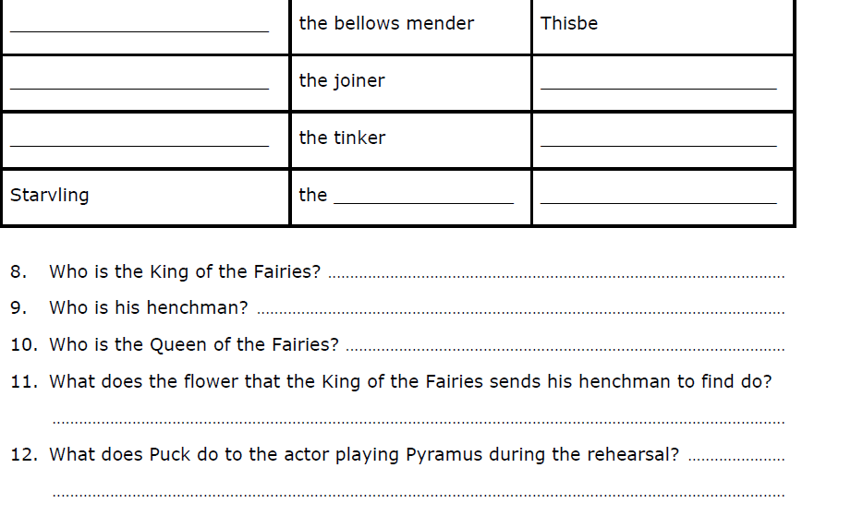
On the sheet you have been given:
Complete the tasks as we watch the film.
Writing task

Slide 8
Review
Check your answers using the next slide and tick if correct.
Correct them in green pen if inaccurate.
Checking Understanding

Slide 9
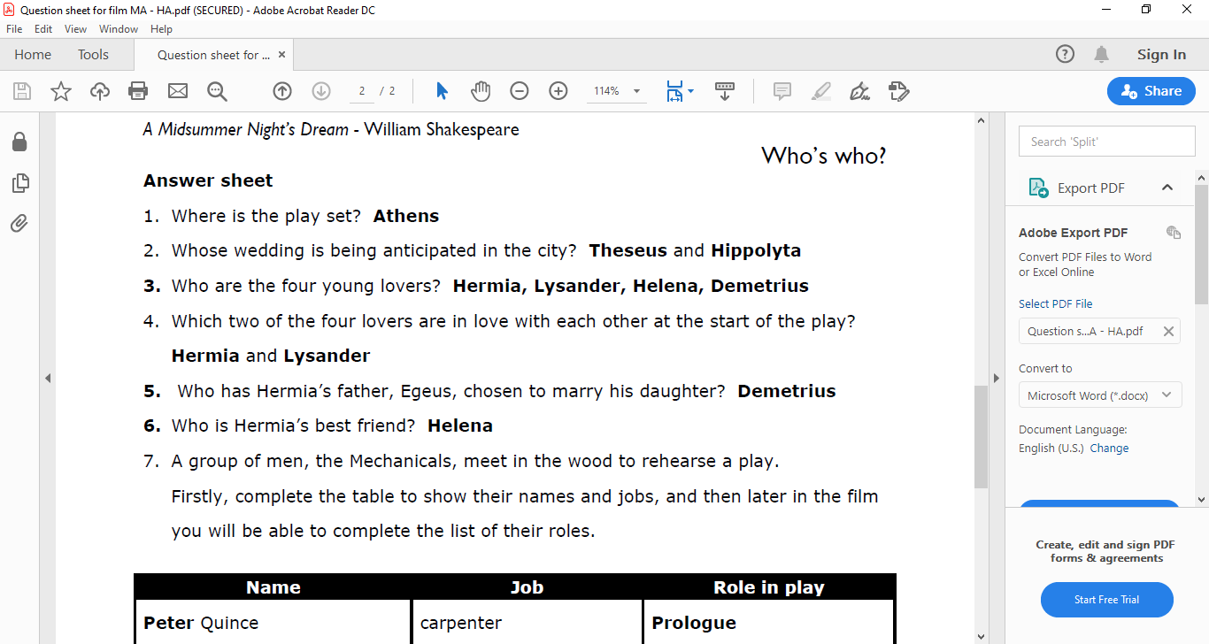
Review
Checking Understanding

Slide 10
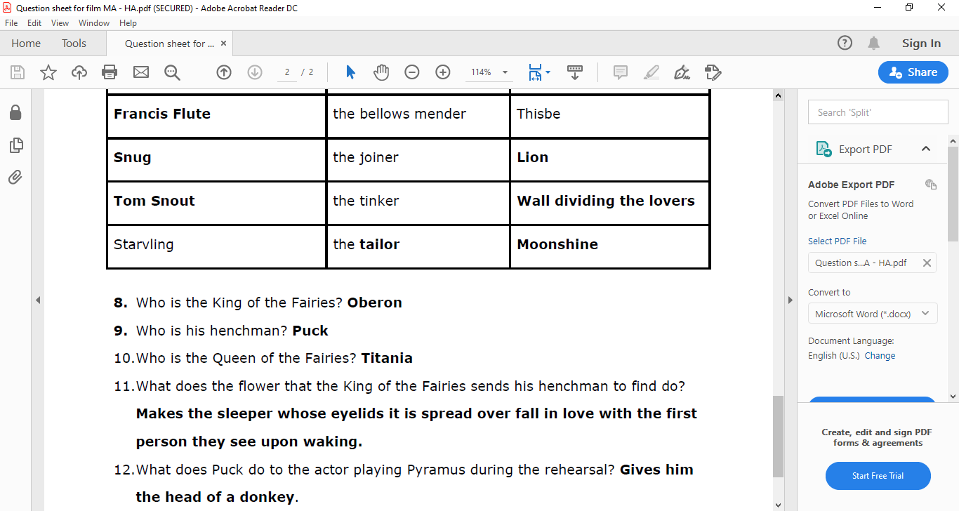
Review
Checking Understanding

