Slide 1
Prediction
Title: A Midsummer Night’s dream Animated Tales
What do you think this play is about based on the title and the front cover.
Write as mind map or in a paragraph of approximately 30-50 words.
Do Now

Slide 2
Note to teacher
For all abilities, teacher decide how/when/if to include animated tales, I found it particularly useful for M – LA to get overview:
L – Medium abilities:
Show the animated tales at the outset to gain an overview of the story.
Use the storyboard.
Medium to High ability:
Complete the task sheet as watching.
Preparation for teacher

Slide 3
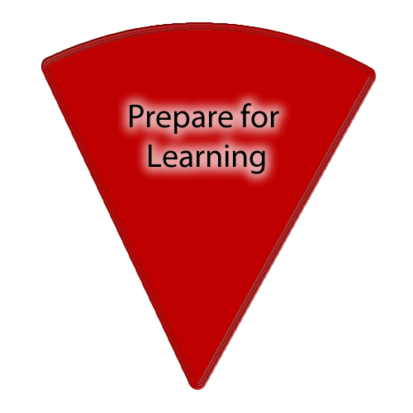
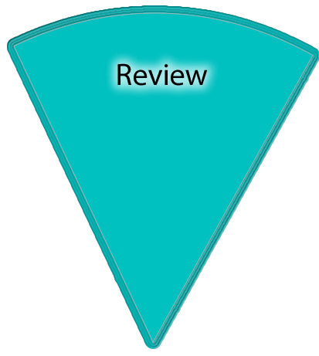
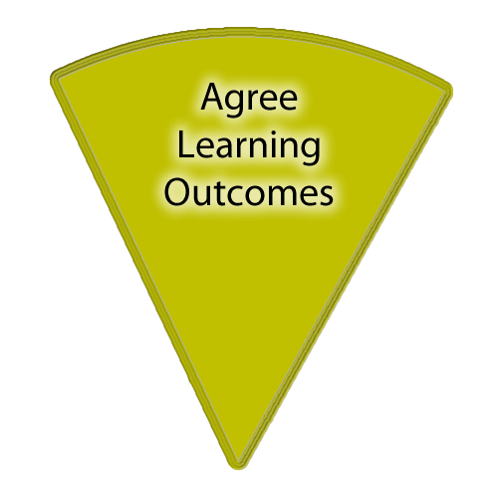
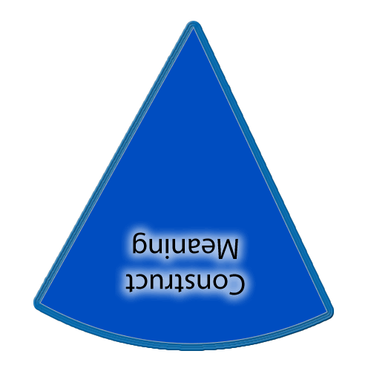
There is also a slide in each of the sections with a set of yellow boxes should you want to display learning outcomes throughout the lesson.
If you want to show on this slide only you can draw a text box and write in it. Alternatively creating a text box in the master view allows for easier duplication.
Copies of the ‘cheeses’ if you want them additionally to what is in the slide masters.
This timer (it’ll show on slideshow mode) can be copied and pasted on to any slide.

Slide 4
Learning outcomes
WHAT: overview of William Shakespeare’s play ‘A Midsummer Night’s Dream?
WHY: So as to have an understanding of the play before focussing on the language used by Shakespeare.
Learning Content
.
Love Respect Serve
Notes:
Teachers explicitly share the purpose of the lesson/s with their students so that the students are in no doubt as to what is expected of them during the lesson. The teacher will:
Make the content, skills and thinking explicit
State clearly what the students will have learned by the end of the lesson
Share the criteria against which the learning will be assessed.
Students will be able to answer the key questions:
What are you learning?:
Why are you learning this?
How will you know if you are doing this well?
WAGOLL:
Success Criteria:

Slide 5
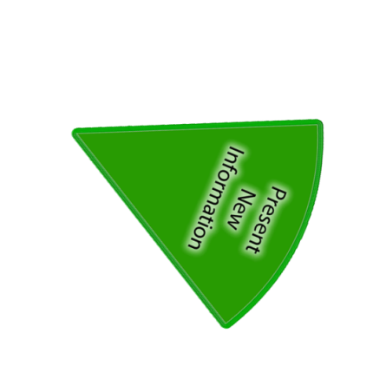
Make notes as you watch
https://www.youtube.com/watch?v=OdmQdAYM9ew
Hook
Complete storyboard as you are watching.
Complete the tasks as you are watching.
Notes:
Now students will be presented with or introduced to the new information that they are required work with. Teachers need to consider what will be the best way to present the information so that it provides for maximum inclusion of the students.

Slide 6
Make notes as you watch
https://www.youtube.com/watch?v=QYknOe7OluE
Trailer of 1999 film with Michelle P and Kevin K
(I have the DVD if full version required and unable to access)
Hook
Notes:
I have not included the film – teacher to decide whether to show all or parts throughout the scheme.

Slide 7
Note the important events and characters in each scene.
Act 1 | Act 2 | Act 3
Act 4 | Act 5 | Characters
Writing task

Slide 8
Review
Check your storyboard with a partner.
Fill any gaps.
Take turns to explain what was happening:
A – at the beginning
B -at the end
Checking Understanding
Notes:
Checking learning: It is likely that this process will feature throughout the lesson, not just at the end.
Reviewing is a critical element in the process of teaching and learning as it is at this point that teachers can challenge the students to make their learning explicit. Although Review is the last of the elements of the cycle to be described, it should not be seen as coming only at the end of a lesson. It is useful to include different review opportunities throughout every lesson so that teachers and students can identify challenges and supports, and strengths and weaknesses. Review is a significant part of developing metacognitive awareness.

Slide 9
On the sheet you have been given:
Complete the tasks as we watch the film.
Writing task
Notes:
MA – HA issue task sheets to students.
Print enough of the answer sheets for them to check.

Slide 10
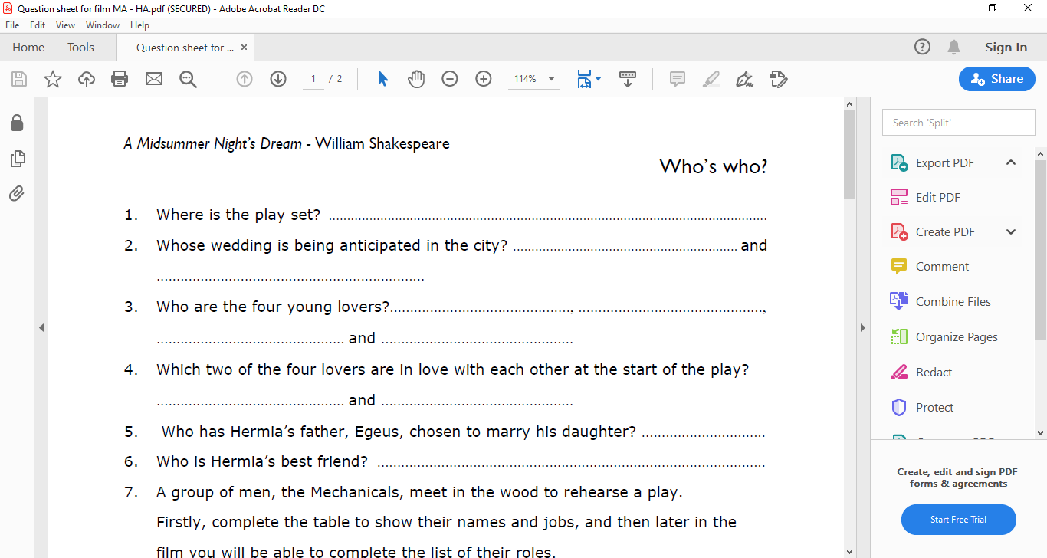
On the sheet you have been given:
Complete the tasks as we watch the film.
Writing task
Notes:
MA – HA issue task sheets to students.
Print enough of the answer sheets for them to check.

Slide 11
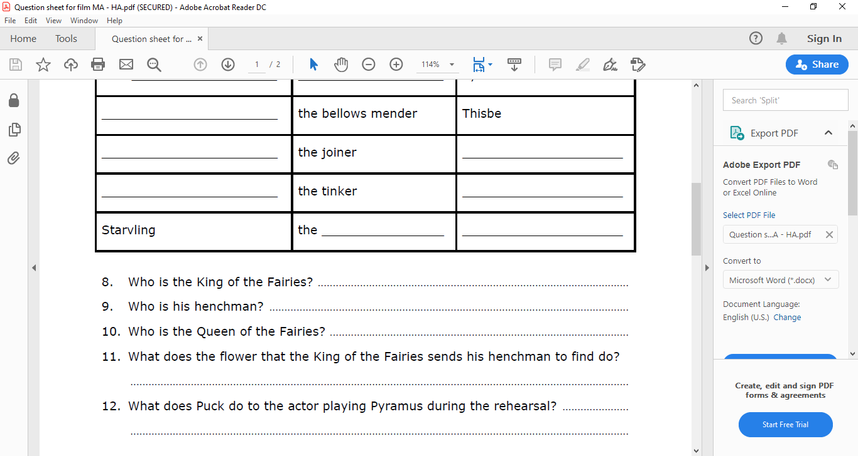
On the sheet you have been given:
Complete the tasks as we watch the film.
Writing task
Notes:
MA – HA issue task sheets to students.
Print enough of the answer sheets for them to check.

Slide 12
Review
Check your answers using the sheet.
Make any amendments.
Take turns to explain what was happening:
A – at the beginning
B -at the end
Checking Understanding
Notes:
Checking learning: It is likely that this process will feature throughout the lesson, not just at the end.
Reviewing is a critical element in the process of teaching and learning as it is at this point that teachers can challenge the students to make their learning explicit. Although Review is the last of the elements of the cycle to be described, it should not be seen as coming only at the end of a lesson. It is useful to include different review opportunities throughout every lesson so that teachers and students can identify challenges and supports, and strengths and weaknesses. Review is a significant part of developing metacognitive awareness.

Slide 13
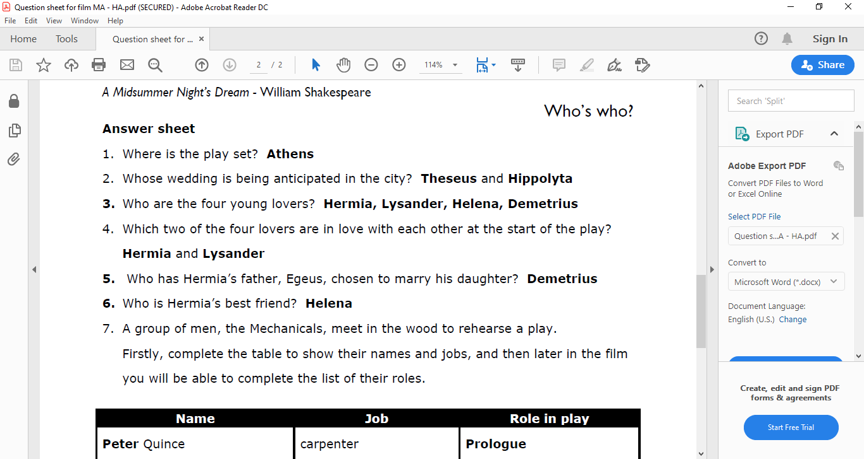
Review
Checking Understanding
Notes:
You may wish to print out for groups/pairs

Slide 14
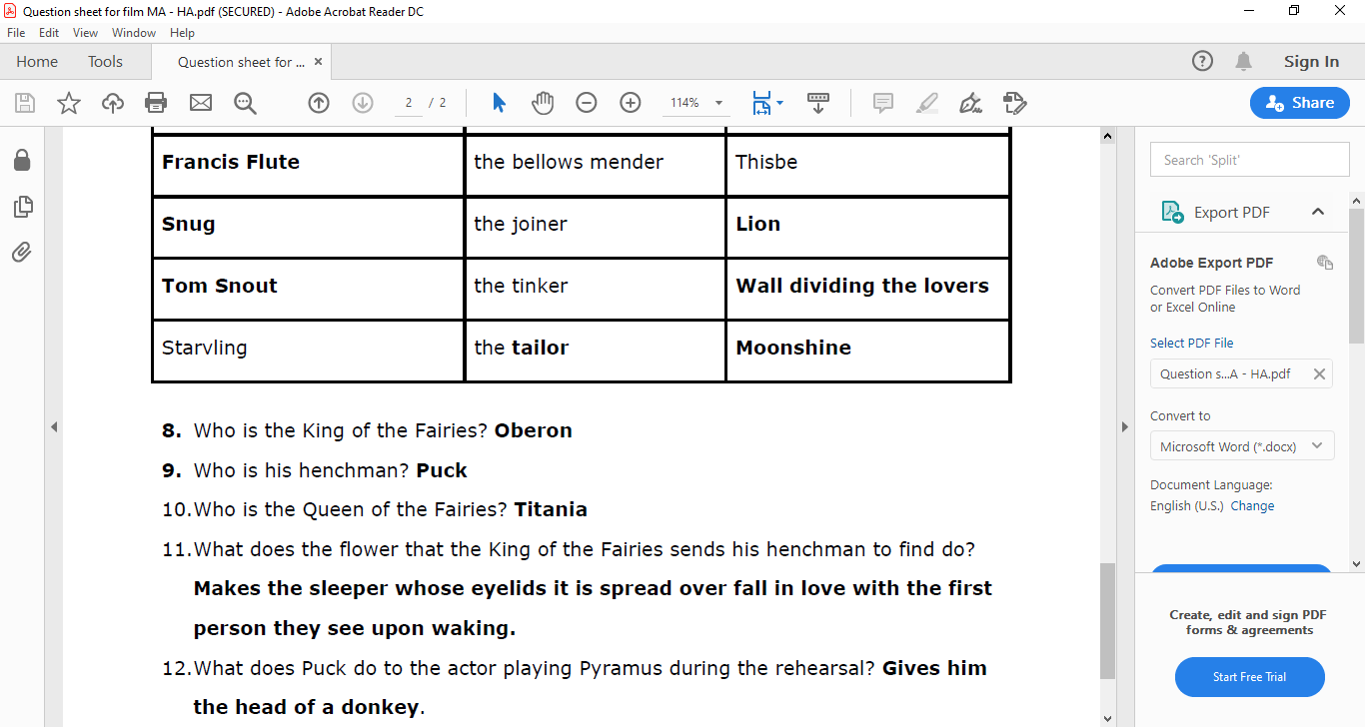
Review
Checking Understanding
Notes:
You may wish to print out for groups/pairs

Slide 15
Challenge and extend
Write a synopsis (Overview) of A Midsummer Night’s dream, focusing on the fact that it is a romantic comedy.
Checking Understanding

Slide 16
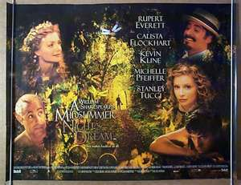
Synopsis
In your overview talk about-
What the play is about.
What genre is the play?
What happens to make the story a romantic comedy?
Checking Understanding

Slide 17
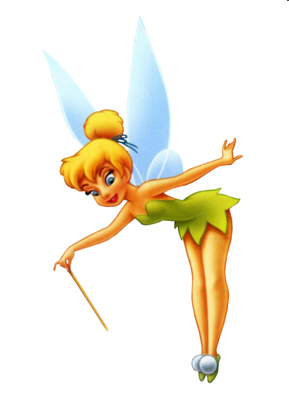
Sentence starters
A Midsummer Night’s Dream is a fantastic experience …
You will …
The theme of ….
Model and Support
The story is based around ….
The genre of a romantic comedy is …
The story is intricate and is about …

Slide 18
Homework
Select an appropriate Homework based on today’ lesson.
Notes:
Checking learning: It is likely that this process will feature throughout the lesson, not just at the end.
Reviewing is a critical element in the process of teaching and learning as it is at this point that teachers can challenge the students to make their learning explicit. Although Review is the last of the elements of the cycle to be described, it should not be seen as coming only at the end of a lesson. It is useful to include different review opportunities throughout every lesson so that teachers and students can identify challenges and supports, and strengths and weaknesses. Review is a significant part of developing metacognitive awareness.

