Slide 1
Scrooge’s Character
Read and annotate the extracts.
What do they show about Scrooge’s character?
Use quotations from the extracts to support your answer.

Slide 2
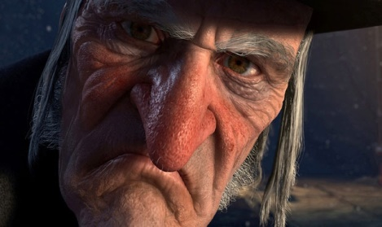
Analyse and link
``Keep it!'' repeated Scrooge's nephew. ``But you don't keep it.''
``Let me leave it alone, then,'' said Scrooge. ``Much good may it do you! Much good it has ever done you!''
``There are many things from which I might have derived good, by which I have not profited, I dare say,'' returned the nephew: ``Christmas among the rest. But I am sure I have always thought of Christmas time, when it has come round -- apart from the veneration due to its sacred name and origin, if anything belonging to it can be apart from that -- as a good time: a kind, forgiving, charitable, pleasant time: the only time I know of, in the long calendar of the year, when men and women seem by one consent to open their shut-up hearts freely, and to think of people below them as if they really were fellow-passengers to the grave, and not another race of creatures bound on other journeys. And therefore, uncle, though it has never put a scrap of gold or silver in my pocket, I believe that it has done me good, and will do me good; and I say, God bless it!''

Slide 3
Analyse and link:
``At this festive season of the year, Mr Scrooge,'' said the gentleman, taking up a pen, ``it is more than usually desirable that we should make some slight provision for the Poor and destitute, who suffer greatly at the present time. Many thousands are in want of common necessaries; hundreds of thousands are in want of common comforts, sir.''
…. What shall I put you down for?''
``Nothing!'' Scrooge replied.
``You wish to be anonymous?''
``I wish to be left alone,'' said Scrooge. ``Since you ask me what I wish, gentlemen, that is my answer. I don't make merry myself at Christmas and I can't afford to make idle people merry. I help to support the establishments I have mentioned: they cost enough: and those who are badly off must go there.''
``Many can't go there; and many would rather die.''
``If they would rather die,'' said Scrooge, ``they had better do it, and decrease the surplus population. Besides -- excuse me -- I don't know that.''
``But you might know it,'' observed the gentleman.
``It's not my business,'' Scrooge returned. ``It's enough for a man to understand his own business, and not to interfere with other people's. Mine occupies me constantly. Good afternoon, gentlemen!''

