Slide 1
An Inspector Calls Revision
Y11

Slide 2
Memory and recall: define the key vocabulary using your knowledge of Y10 and AIC
Word | Definition
Portentous
Socialist
Capitalist
Influential
Provincial
Sermon
Optimistic
Welfare
Disloyal
Patronising
Gaffe
Prejudice
Dismissive
Intimate
Hypocrite
Consciences
Responsibility
Industrialist
Hypocrite
Grandiose
Orthodox
Conceited
Narcissistic
Rapacious
Bourgeois​ie
Omniscient
Authoritative
Antithesis

Slide 3
Self Assess: tick in green pen if correct. If incorrect, then write the correct definition.
Word | Definition
Portentous | pompous, self-important - describes Mr Birling
Socialist | A person who believes a society should be one social group and look after each other, pay for one another and have equal influence.
Capitalist | A person who believes that you gain power and influence through your own work and ownership of property and wealth.
Influential | Someone who has power over others and can influence their decisions.
Provincial | Used to describe the inhabitants of a town or a region, NOT a city (often associated with being narrow minded, not sophisticated)
Optimistic | Looking forward to the future, excited about future possibilities
Welfare | ocial support for all citizens / looking after someone's needs
Patronising | When you talk down to someone as if they are inferior,
Prejudice | A negative opinion not based on fact, but rather the way you view other classes / races etc
Dismissive | Rejecting someone's opinion without paying them attention or respect
Consciences | The inspector may be the voice of all our consciences
Responsibility | Taking accountability for one’s actions
Industrialist | Arthur Birling is a factory owner and a man of business. He could be described as an industrialist
Hypocrite | Someone who speaks as if they were very moral, but really are not
Grandiose | Extravagantly or pretentiously imposing in appearance or style e.g. The description of the Birlings’ residence in the opening stage directions.
Orthodox | Following or conforming to the traditional or generally accepted rules or beliefs of a religion, philosophy, or practice e.g. Acts and behaves how women from middle/upper class did in 1912, e.g. Sheila and her mother leave the room so the men can talk.
Conceited | Excessively proud of oneself. E.g. when Eva used the family name Mrs Birling said ‘She’d impertinently made use of our name’ highlighting how she considers their name to be of great importance.
Narcissistic | Having or showing an excessive interest in or admiration of oneself e.g. Mr Birling remind the family and Gerald he is ‘a hard-headed business man’ he shares his views to the family and talks about his opinions and doesn’t listen to others, especially Eric.
Rapacious | Aggressively greedy or grasping e.g. Mr Birling is concerned about money ‘Lower cost and higher prices’
Bourgeois​ie | Belonging​ ​to​ ​or​ ​characteristic​ ​of​ ​the​ ​middle class,​ ​typically​ ​with​ ​reference​ ​to​ ​its​ ​perceived​ ​materialistic values​ ​or​ ​conventional​ ​attitudes e.g. Eric has been born into a middle class family and has been given a job at his father’s company. It is expected he will take over the company in the future.
Omniscient | Knowing everything e.g. the inspector seems to have a deep knowledge of the whole family and uses this when he questions them.
Authoritative | ommanding and self-confident; likely to be respected and obeyed e.g. in the stage direction he is described as ‘He speaks carefully, weightily and has a disconcerting habit of looking hard at the person he addresses before actually speaking.’ In addition, he controls the room the lighting changes from ‘pink and intimate’ to ‘brighter and harder’ once he arrives.
Antithesis | A person or thing that is the direct opposite of someone or something e.g. the inspector is a socialist and Mr Birling is a capitalist their views and opinions are the antithesis of each other’s.

Slide 4
Characters
Inspector | Priestley’s mouthpiece; advocates social justice
Mr Birling | Businessman, capitalist, against social equality
Mrs Birling | Husband’s social superior, believes in personal responsibility
Sheila | Young girl, comes to change views and pities Eva, feels regret
Eric | Young man, drinks too much, rapes Eva, regrets actions
Gerald | Businessman, engaged to Sheila, politically closest to Birling
Eva | Unseen in play, comes to stand for victims of social injustice
Plot
Act 1 | Sheila and Gerald’s engagement is celebrated
Act 1 | Birling says there will be no war; references Titanic
Act 1 | Inspector arrives; a young girl has committed suicide
Act 1 | Birling threw her out after strike; Sheila had her fired for laughing
Act 2 | Gerald had an affair with Daisy Renton
Act 2 | Mrs Birling refused to give charity to Eva; blames father
Act 3 | Eric’s involvement revealed; possible rape hinted at
Act 3 | Inspector leaves. Gerald returns; met policeman, no Inspector G
Act 3 | Telephone rings; an inspector is coming
TASK: read the knowledge organiser opposite.
Highlight any information you are unfamiliar with.
Key quotations
Birling’s confidence | ‘We’re in for a time of steadily increasing prosperity’
Birling on society | ‘the way some of these cranks talk and write now, you’d think everybody has to look after everybody else’
Sheila’s recognition | ‘but these girls aren’t cheap labour – they’re people’
Sheila’s regret | ‘it’s the only time I’ve ever done anything like that, and I’ll never, never do it again to anybody’
Sheila on the Inspector | ‘we all started like that – so confident, so pleased with ourselves until he began asking us questions’
Sheila on Eric | ‘he’s been steadily drinking too much for the last two years’
Inspector on guilt | ‘I think you did something terribly wrong – and that you’re going to spend the rest of your life regretting it’
Mrs Birling defends herself | ‘she was claiming elaborate fine feelings and scruples that were simply absurd in a girl in her position’
Eric explains | ‘I’m not very clear about it, but afterwards she told me she didn’t want me to go in but that – well, I was in that state when a chap easily turns nasty – and I threatened to make a row’
The Inspector says | ‘but each of you helped to kill her. Remember that’
Inspector’s message | ‘there are millions and millions and millions of Eva Smiths and John Smiths still left with us, with their lives, their hopes and fears, their suffering, and chance of happiness, all intertwined with our lives, with what we think and say and do. We don’t live alone.’
Birling’s confidence | ‘the famous younger generation who know it all’
Theatrical Stagecraft: Dramatic Devices
1. Dramatic irony | the audience knows what the characters don’t
2. Stage directions | Instructions for the actors; often revealing
3. Setting | Constant throughout but subtle changes e.g. lighting
4. Tension | Builds up throughout the play
5. Cliff-hanger | The ending allows the audience to make up their minds
Key concepts and context
1912 | Play is set here; just before WWI and sinking of the Titanic
1945 | Priestley wrote the play then; start of the welfare state and ideals of social equality made real
Social responsibility | Or socialism; we must all look after each other
Capitalism | Business should make money no matter the human cost; we are all responsible only for ourselves
Class | Upper and lower social classes are segregated
Age | Old vs young; new and old ideas counterposed
Attitudes to women | Patriarchal leading to misogyny
Notes:
Characters, plot, context, stagecraft, quotes

Slide 5
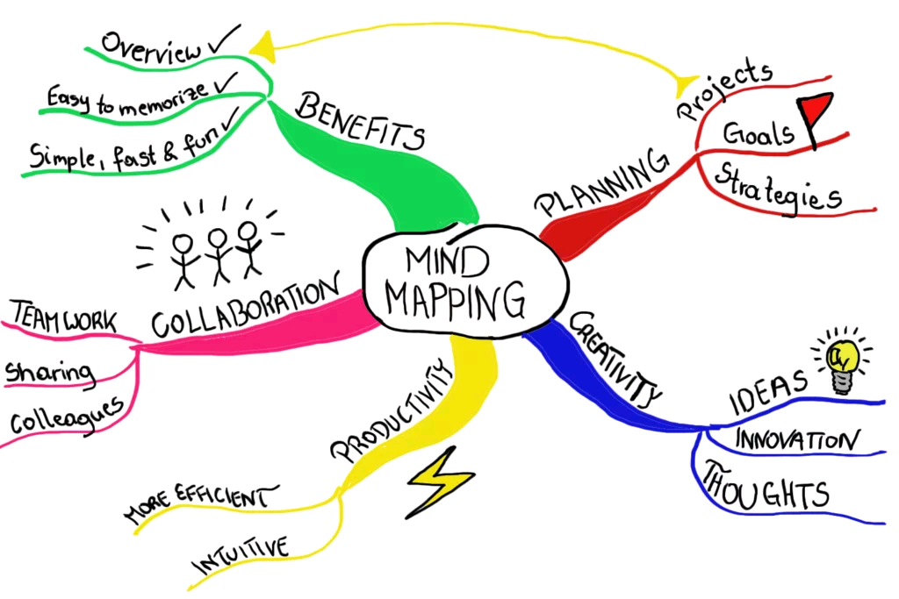
How is Arthur Birling presented throughout the play? Create a mind map of words and quotations from the start to the end of the play

Slide 7
Mr Birling Exam extract
Task:
Highlight quotes from the start to the end of the extract
Annotate quotations using ‘what, how, why’.
Make notes on language, context and Priestley’s message.
Identify 2 quotes from each of the other acts and ‘what, how, why’ them as above. Refer to slide 5 if necessary.
Employ sophisticated vocab when annotating the extract.

Slide 8
Write an exam response
SENTENCE STARTERS
Point:
CLEARLY, Priestley ….
Evidently, Priestley conveys ….
Evidence:
This can be seen in/shown in/ displayed in/revealed in
Technique:
The words/phrases/noun/verb/adjective/adverb/simile ….
Explain:
This suggests/conveys/indicates/reveals/connotes/hints/implies…
Also/moreover/maybe/might/possibly
Reader:
An audience would have …
Ironically, the audience ….
Message:
Priestley was …
Perhaps Priestley’s message was …
The readers would have felt ….
Maybe Priestley was …
Priestley’s mouthpiece …
SUCCESS CRITERIA:
PETER
SUPPORTING QUOTES EMBEDDED WITHIN ANALYSIS
LANGUAGE EXPLORED
ALTERNATIVE MENAINGS CONSIDERED
CONTEXT RELATED TO IT
COMMENT ON PREIESTLEY’S PURPOSE/MESSAGE
EFFECT ON AUDIENCE

