Slide 1
Oberon and Titania
OUTCOME
To design a costume for the king and queen and summarise their quarrel.
KEY WORDS
Changeling
Henchman
Votaress
mortal
Learning objective: To develop an understanding of the characters Oberon and Titania and their quarrel.
THE BIG PICTURE
To develop reading and writing skills through studying ‘A Midsummer Night’s Dream’
Notes:
votaress: a female votary (one who is bound by vows to a religious life); ...

Slide 2
Starter task: let’s read pg.16 line 60 – line 87 & line 118 – line 145
OUTCOME
To design a costume for the king and queen and summarise their quarrel.
KEY WORDS
Changeling
Henchman
Votaress
mortal
What is your first impression of Oberon?
What is your first impression of Titania?
Why are they arguing?
THE BIG PICTURE
To develop reading and writing skills through studying ‘A Midsummer Night’s Dream’
SUMMARISE: Answer in FULL sentences!

Slide 3
Task: What do these quotes tell us about Oberon? Titania?
OUTCOME
To design a costume for the king and queen and summarise their quarrel.
KEY WORDS
Changeling
Henchman
Votaress
mortal
‘Ill met by moonlight proud Titania!’
‘Am not I thy Lord?’
‘What, jealous Oberon? I have forsworn his bed and company’
THE BIG PICTURE
To develop reading and writing skills through studying ‘A Midsummer Night’s Dream’
‘But with thy brawls thou hast disturb’d our sport’

Slide 4
Task: Using your annotations and evidence answer the following question – How is Oberon and Titania presented?
OUTCOME
To design a costume for the king and queen and summarise their quarrel.
Use these sentence starters to help structure your paragraphs.
KEY WORDS
Changeling
Henchman
Votaress
mortal
Oberon is presented as a strong and fierce king for example …
Oberon speaks to his queen in a very …. way. He asks her ….
Titania is presented as …
THE BIG PICTURE
To develop reading and writing skills through studying ‘A Midsummer Night’s Dream’
Write using PEA = Point, Evidence, Analyse
Titania is seen to be …
As an audience we feel…..

Slide 5
Task: Oberon and Titania’s costume.
OUTCOME
To design a costume for the king and queen and summarise their quarrel.
How do you think Oberon/Titania should be dressed? How could you use costume to symbolize Oberon/Titania’s abilities and characters? How would being magical effect the representation of the character? Using the template design the character’s costume.
KEY WORDS
Changeling
Henchman
Votaress
mortal
THE BIG PICTURE
To develop reading and writing skills through studying ‘A Midsummer Night’s Dream’

Slide 6
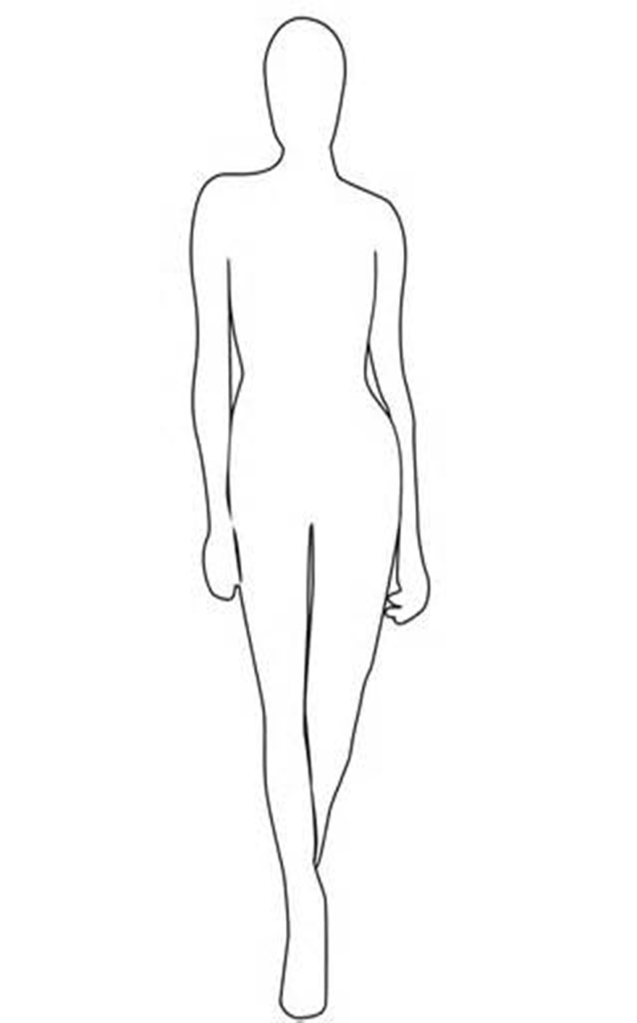
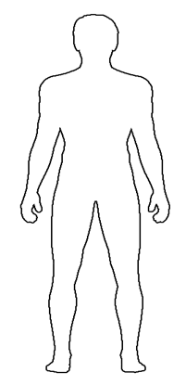
Label your ideas/choices!
OUTCOME
To design a costume for the king and queen and summarise their quarrel.
KEY WORDS
Changeling
Henchman
Votaress
mortal
THE BIG PICTURE
To develop reading and writing skills through studying ‘A Midsummer Night’s Dream’
Explain your costume designs. Write about why you have chosen these costumes and what they show about the charcters.

Slide 7
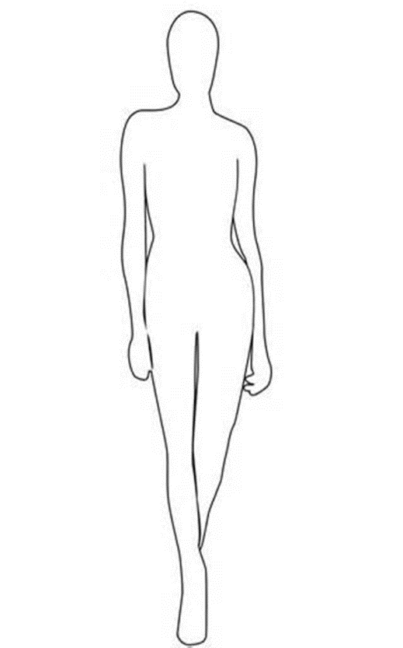
Label your ideas/choices!
OUTCOME
To design a costume for the king and queen and summarise their quarrel.
KEY WORDS
Changeling
Henchman
Votaress
mortal
Quotation search.
Select and write at least 4 quotations from the text for each character.
Explain what these show about the character and why.
THE BIG PICTURE
To develop reading and writing skills through studying ‘A Midsummer Night’s Dream’

Slide 8
Oberon and Titania
OUTCOME
To design a costume for the king and queen and summarise their quarrel.
Why do you think Titania won’t give Oberon the boy?
Do you think she is right? Why? Why not?
Is it unfair that Oberon is demanding the boy? Why? Why not?
What do you think about Oberon’s plan?
KEY WORDS
Changeling
Henchman
Votaress
mortal
THE BIG PICTURE
To develop reading and writing skills through studying ‘A Midsummer Night’s Dream’

