Slide 1
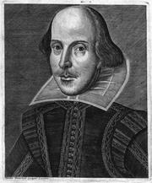
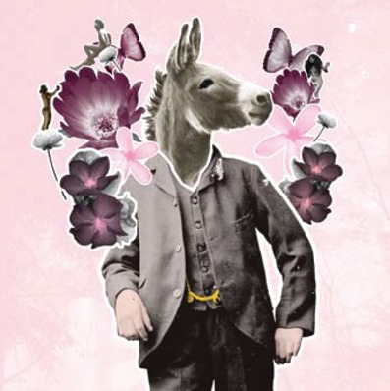
“I quite like donkeys. Not so sure about fairies though…”
Love,Emotions And Conflict
LO: Writing in character using correct spelling, punctuation and grammar
Learning Content
“Are you giggling at me-haw hee-haw?”

Slide 2
The Main Characters in the Play
Egeus
Starter Task
Write down the following character’s names.
Next to the names, explain who they are.
Hermia
Hook
Demetrius
Lysander
Helena

Slide 3
The Main Characters in the Play
The Duke of Athens - Theseus
Egeus
Hermia
Checking Understanding
Demetrius
Lysander
Helena
Nick Bottom
Puck
Oberon

Slide 4
Task: Correctly punctuate-use green pen
1.shakespeare portrays hermia as having dark hair being shorter than her friend helena and being beautiful
2. egeus her father sees hermia as being wilful disobedient and stubborn
many people today can sympathize with her disobedience and her decision to run away from athens in order to marry lysander
to the elizabethans however this disobedient and reckless behaviour would have been a cause for great disapproval
when egeus describes how lysander has ‘stolen’ hermia we see that lysander is very romantic sensitive and determined
lysander is a wealthy young man who is used to being at court and shows no fear of egeus or theseus
Extension
he shows his contempt for demetrius by making fun of him telling him to marry egeus instead of hermia as he has egeus’ love
when he is under the influence of the love-juice his hateful behaviour towards hermia seems cruel
egeus is rather narrow-minded authoritarian and has little sympathy with his daughter
egeus’ decision forces his daughter to elope which then leads to the events in the forest
Do Now
Notes:
Amend on the sheet

Slide 5
Self Assess with green pen: Correct punctuation
1.Shakespeare portrays Hermia as having dark hair, being shorter than her friend Helena and being beautiful.
2.Egeus, her father, sees Hermia as being wilful, disobedient and stubborn.
3. Many people today can sympathize with her disobedience and her decision to run away from Athens in order to marry Lysander.
4.To the Elizabethans, however, this disobedient and reckless behaviour would have been a cause for great disapproval.
5. When Egeus describes how Lysander has ‘stolen’ Hermia, we see that Lysander is very romantic, sensitive and determined.
6. Lysander is a wealthy young man, who is used to being at court and shows no fear of Egeus or Theseus.
Extension
7. He shows his contempt for Demetrius by making fun of him, telling him to marry Egeus instead of Hermia, as he has Egeus’ love.
8. When he is under the influence of the love-juice, his hateful behaviour towards Hermia seems cruel.
9. Egeus is rather narrow-minded, authoritarian and has little sympathy with his daughter.
10. Egeus’ decision forces his daughter to elope, which then leads to the events in the forest.
Do Now

Slide 6
Who loves who?
Hermia
Lysander
X
X
Checking Understanding
Demetrius
Helena
= Real love
= Magic Potion love
X = Cancelled out

Slide 7
Thinking About Act I, Scene I
Answer Task: answer the questions
(1) What dilemma does faces Hermia? Who is involved?
(2) What are Egeus’ reasons behind his instructions?
(3) What are Hermia’s options?
Reading & thinking Task
(4) What would you do if you were in Hermia’s place
during the 1500s?
(5) What would you do in Hermia’s place during 2020?

Slide 8
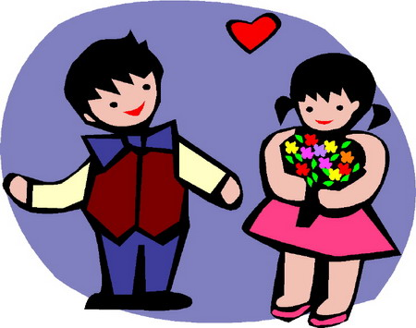
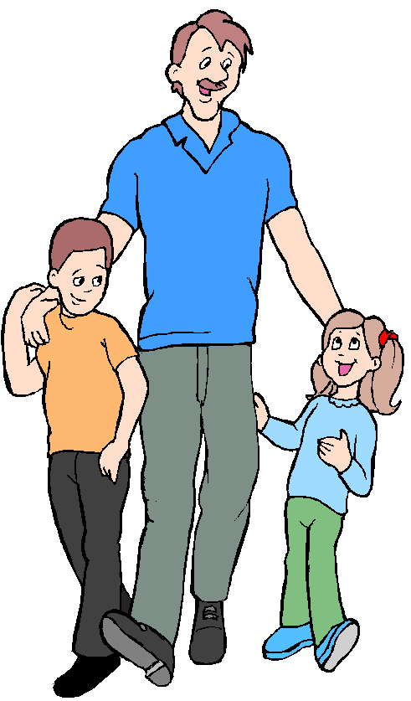
Love and Conflict
The characters are subject to the
difficulties between ‘love’ and ‘conflict’.
Task: answer the questions below
“Explain who is in love in Act 1, Scene 1 of A Midsummer Night’s Dream.”
“Explain the conflict in Act 1, Scene 1 of the play.”
Thinking & discussing
Task: answer the question:
Why do young people in love
sometimes
experience conflict
with their parents or guardians?

Slide 9
Task: Why was Hermia’s refusal to marry Demetrius so unusual? What risks was she taking?
Thinking & discussing
What would be the issues today?

Slide 10
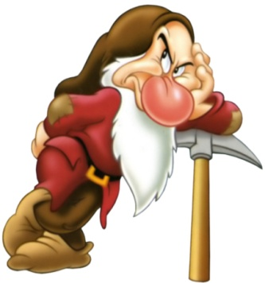
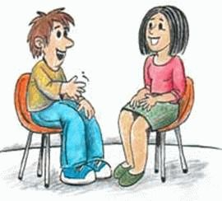
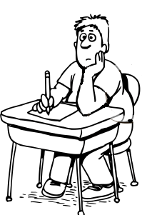
Feelings and Emotions
We all experience feelings and emotions every day.
TASK: list of the different feelings and emotions that we experience.
What events can make us feel these emotions?”
Thinking Task
“I know how I feel about being in school…”
You will see a different face
on each slide.
TASK: note down how you think each of the
people are feeling.
Notes:
This could be done as a quick class task with no need to write anything down. OR, circulate images and write on them.

Slide 11
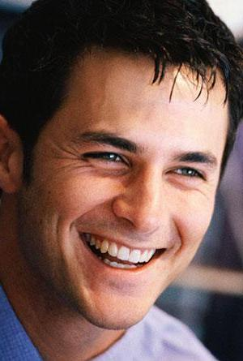

Slide 12
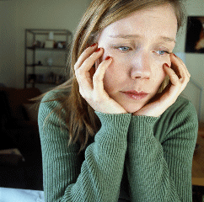

Slide 13
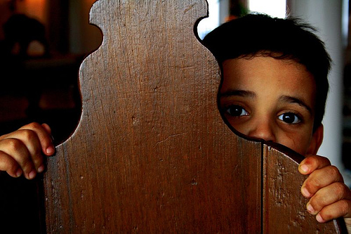

Slide 14
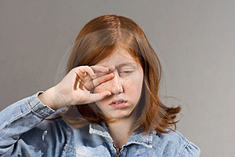

Slide 15
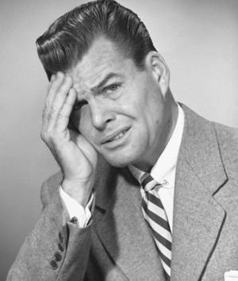

Slide 16
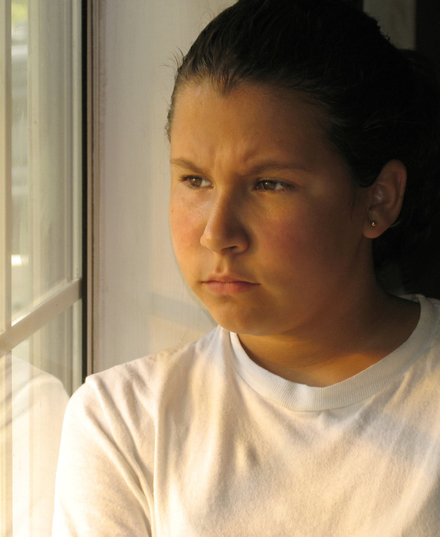

Slide 17
Feelings and Emotions in A Midsummer Night’s Dream
TASK: read to end of Act 1, Sc 1. How is each character feeling at
each stage below?
Hermia’s father tells her that
she must marry Demetrius.
Lysander runs away with Hermia.
Helena tells Demetrius about
Lysander and Hermia’s plans.
Hermia and Helena discuss Demetrius
Reading & thinking Task
Hermia and Lysander discuss
their feelings p11,13
Look at the speech patterns
How does it reflect their emotions?
How does Hermia feel about: her father, Lysander?

Slide 18
Feelings and Emotions
TASK: imagine that you are Hermia, write a diary entry
explaining how you feel about the current situation
What do we need
to include
in a diary entry?
Use the first person
‘I’ and ‘we’.
Present tense.
Explain what has just
happened to you.
Time (day, hour)
Writing task
Hermia tells Helena about
Her and Lysander’s plans.
Describe your feelings.
You must use at least 5 different
feelings and emotions.
Include a message to Egeus,
your father
Try to explain how you think
the other characters might be
feeling at this point in the play.
Varied and accurate: Vocabulary, Sentence structure, spelling, punctuation and grammar.
Future plans, hopes, dreams.

Slide 19
Sentence Starters
In Athens…
Earlier…
Theseus told us…
I can not believe…
This can’t be happening…
It is unfair that…
I have heard…
I don’t believe…
However…
This situation is…
I will follow…
I am feeling…
If only I could…
My head…
My heart…
On this night…
Soon…
They don’t know what they are doing…
When I…
We are…
If Egeus knew…
My next move is…
I can only hope…
Tonight is the night…
I will not rest until…
My imagination runs wild…
The conclusion to this night will be…
Eventually they will…
I want…
I wish…
Wrting support
Notes:
Can print out if necessary

Slide 20
Sentence Starters
In Athens…
Earlier…
Theseus told us…
I can not believe…
This can’t be happening…
It is unfair that…
I have heard…
I don’t believe…
However…
This situation is…
I will follow…
I am feeling…
If only I could…
My head…
My heart…
On this night…
Soon…
They don’t know what they are doing…
When I…
We are…
If Egeus knew…
My next move is…
I can only hope…
Tonight is the night…
I will not rest until…
My imagination runs wild…
The conclusion to this night will be…
Eventually they will…
I want…
I wish…
Notes:
Can print out if necessary

Slide 21
Plenary: Self assessment
Read over your own work and check you have done the following things:
I have written in full, clear sentences
I have spelt the key words correctly
I have used the correct layout
I have written in an appropriate style
It needs to be OBVIOUS it is Hermia’s diary.
Homework: complete and illustrate your diary.
Plenary

