Slide 1
Notes:
To remind ourselves that God is here and that Christ is with us through the second week of Christmastide, let us begin with the sign of the cross…

Slide 2
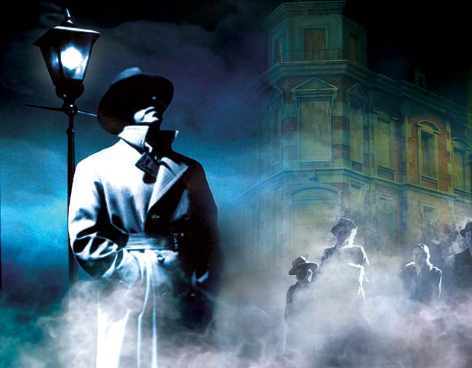
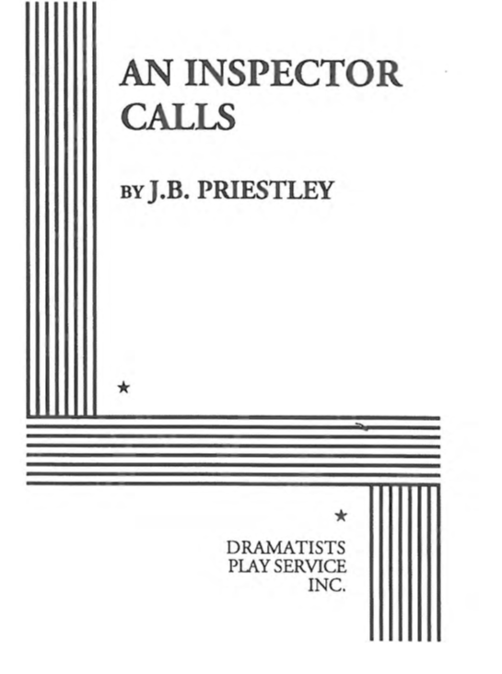
GET READY FOR LEARNING….
Make sure you have:
Opened the shared document:
An Inspector Calls full play PAGE 30
Have your lesson notes from Wednesday
Got pen and paper ready to write.
TODAY’S KEY QUESTIONS:
Can I show an understanding of how Mrs Birling behaves in the play?
Can I make comparisons between Sheila and Mrs Birling?
Can I explain how Priestley presents his beliefs in moral socialism?
Notes:
@SPryke2

Slide 3
LESSON 8: Mrs Birling
TODAY’S KEY QUESTIONS:
Can I show an understanding of how Mrs Birling behaves in the play?
Can I make comparisons between Sheila and Mrs Birling?
Can I explain how Priestley presents his beliefs in moral socialism?
Notes:
@SPryke2

Slide 4
READING: PAGE 30
TODAY’S KEY QUESTIONS:
Can I show an understanding of how Mrs Birling behaves in the play?
Can I make comparisons between Sheila and Mrs Birling?
Can I explain how Priestley presents his beliefs in moral socialism?
Notes:
@SPryke2

Slide 5
READING: PAGE 31
TODAY’S KEY QUESTIONS:
Can I show an understanding of how Mrs Birling behaves in the play?
Can I make comparisons between Sheila and Mrs Birling?
Can I explain how Priestley presents his beliefs in moral socialism?
Notes:
@SPryke2

Slide 6
READING: PAGE 32
TODAY’S KEY QUESTIONS:
Can I show an understanding of how Mrs Birling behaves in the play?
Can I make comparisons between Sheila and Mrs Birling?
Can I explain how Priestley presents his beliefs in moral socialism?
Notes:
@SPryke2

Slide 7
MASTERY: Comparison between Sheila and Mrs Birling
Sheila: quote | What it reveals about her | Mrs Birling: quote | What it reveals about her
(Urgently, cutting in) | Sheila understands the Inspectors motives and tries to influence her mother’s actions. | ‘Girls of that class- ‘ | Social superiority -dismisses Eva and her class
TODAY’S KEY QUESTIONS:
Can I show an understanding of how Mrs Birling behaves in the play?
Can I make comparisons between Sheila and Mrs Birling?
Can I explain how Priestley presents his beliefs in moral socialism?
Notes:
@SPryke2

Slide 8
MASTERY: Answer the following questions in full sentences.
Why does Mrs Birling’s sense of social importance give her a feeling of security?
How does she treat the Inspector?
What has Sheila already realised?
What is JB Priestley’s point? Why repeat ‘offence’? What are the suggested meanings of this word?
How does Mrs Birling react to her son’s drinking?
TODAY’S KEY QUESTIONS:
Can I show an understanding of how Mrs Birling behaves in the play?
Can I make comparisons between Sheila and Mrs Birling?
Can I explain how Priestley presents his beliefs in moral socialism?
Notes:
@SPryke2

Slide 9
How does Priestley present the interaction between the Inspector and Mrs Birling at the start of Act 2?
At the beginning of Act 2, the interaction between the Inspector and Mrs Birling can be described as___________________________
Mrs Birling is seen as ___________________________
She says, “_______________________________”
This shows ___________________________________
The use of “___________” implies _____________
However the Inspector ______________________
“________________________________”
This suggests _________________________________
The use of “_________” can indicate _____________
Priestley wants us to realise ____________________
TODAY’S KEY QUESTIONS:
Can I show an understanding of how Mrs Birling behaves in the play?
Can I make comparisons between Sheila and Mrs Birling?
Can I explain how Priestley presents his beliefs in moral socialism?
Notes:
@SPryke2

Slide 10
MASTERY: Characterisation of the Inspector
Discuss how Priestley presents the Inspector in this section of the play. What mood does the Inspector adopt? How does he manage Mrs Birling? How does he control the situation?
TODAY’S KEY QUESTIONS:
Can I show an understanding of how Gerald behaves in the play?
Can I make comparisons between Sheila and Mrs Birling?
Can I explain how Priestley presents his beliefs in moral socialism?
Notes:
@SPryke2

Slide 11
MASTERY: Characterisation of the Inspector
Priestley creates a moral character/figure in the Inspector
Priestley wants the audience to know how much Eva Smith suffered to elicit the audience’s feelings of sympathy and condemnation
‘We’ll have to share our guilt,’ refers to shared and collective responsibility
The Inspector embodies Priestley’s moral socialism opposed to Birlings individualism and self focus
Priestley is using the play as a vehicle to influence a 1946 audience (only just free from war) to build a new society with the political belief that there is a need for cooperation, community and social justice.
TODAY’S KEY QUESTIONS:
Can I show an understanding of how Gerald behaves in the play?
Can I make comparisons between Sheila and Mrs Birling?
Can I explain how Priestley presents his beliefs in moral socialism?
Notes:
@SPryke2

Slide 12
Notes:
To remind ourselves that God is here and that Christ is with us through the second week of Christmastide, let us begin with the sign of the cross…

