Slide 1
Introduction to the play
Learning Outcomes
Read the opening of the play
Make deductions about the characters and setting.
Key words
Character
Deduce
Stage directions
Learning Objective: To gain knowledge of drama
To be introduced to the characters

Slide 2
Characters:
Learning Outcomes
Read the opening of the play
Make deductions about the characters and setting.
As part of the exam you will be expected to know the characters in and out.
So to help you out here is a bit of information.
Key words
Character
Deduce
Stage directions

Slide 3
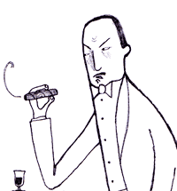
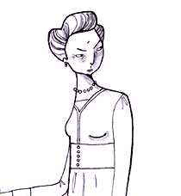
The Birling Family
Learning Outcomes
Read the opening of the play
Make deductions about the characters and setting.
Mr Arthur Birling
"heavy-looking, rather portentous man in his middle fifties but rather provincial in his speech."
Key words
Character
Deduce
Stage directions
Mrs Sybil Birling
"about fifty, a rather cold woman and her husband's social superior."

Slide 4
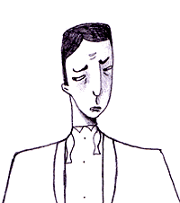
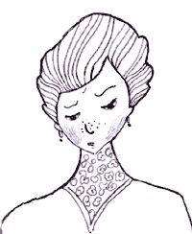
Learning Outcomes
Read the opening of the play
Make deductions about the characters and setting.
Mr Eric Birling
"in his early twenties, not quite at ease, half shy, half assertive."
Key words
Character
Deduce
Stage directions
Miss Sheila Birling
"a pretty girl in her early twenties, very pleased with life and rather excited."

Slide 5
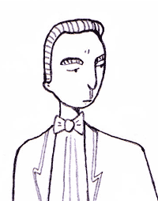
Learning Outcomes
Read the opening of the play
Make deductions about the characters and setting.
Mr Gerald Croft
"an attractive chap about thirty, rather too manly to be a dandy but very much the easy well-bred man-about-town."
Key words
Character
Deduce
Stage directions

Slide 6
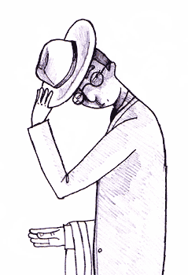
And finally …
Learning Outcomes
Read the opening of the play
Make deductions about the characters and setting.
Inspector Goole
"an impression of massiveness, solidity and purposefulness. He is a man in his fifties, dressed in a plain darkish suit. He speaks carefully, weightily, and has a disconcerting habit of looking hard at the person he addresses before actually speaking."
Key words
Character
Deduce
Stage directions

Slide 7
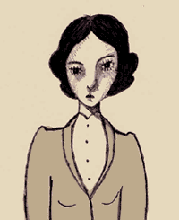
Other Characters:
Learning Outcomes
Read the opening of the play
Make deductions about the characters and setting.
Eva Smith
“very pretty – soft brown hair and big dark eyes.”
Key words
Character
Deduce
Stage directions

Slide 8
Stage Directions
Learning Outcomes
Read the opening of the play
Make deductions about the characters and setting.
Why are stage directions
used?
Why are they important
to a writer?
Key words
Character
Deduce
Stage directions
Why are they important
to an actor/director?

Slide 9
TASK
Learning Outcomes
Read the opening of the play
Make deductions about the characters and setting.
Read the stage directions at the start of the play then complete the table with what you can deduce about the characters.
Key words
Character
Deduce
Stage directions
Character | Stage directions | I deduce that…
Mr Birling
Mrs Birling
Sheila
Eric
Gerald
House

Slide 10
The Importance of Lighting
Learning Objective: To understand the effect of stage directions and lighting

Slide 11
“Looking at the world through rose tinted glasses”
What does this quote mean

Slide 12
Lighting:
Look at in the stage directions for information on the lighting.
Write down any quotations that mention in
3 minutes on the clock!

Slide 13
Quote:
“The lighting should be pink and intimate”
Why do you think that Priestley chose to use pink for the lighting?
Hint! Think back to your starter activity!
2 minutes to write a response

Slide 14
Quote:
“the INSPECTOR arrives, and then it should be brighter and harder.”
Why has Priestley chosen to use this contrasting lighting?
What does it tell us about the character of the Inspector?
What does it foreshadow about the play?
3 minutes to write your response.

Slide 15
What does the lighting tell us about the play?
PETER your response. Using the two quote and your two responses.
5 minutes!

Slide 16
Social Position and Wealth
Learning Outcomes:
Read the opening of the play
Answer four questions to test your knowledge of social class in the play
What does the opening stage directions tell us about the social position and wealth of the family?
Pick out certain quotes to back up your answer!
Key words
Socialism
Capitalism
Class

Slide 17
Lesson Two
Read up to page 11 (before the Inspector comes)

Slide 18
The Dinner Party
Learning Outcomes:
Read the opening of the play
Answer four questions to test your knowledge of social class in the play
Key words
Socialism
Capitalism
Class
Learning Objective: To use inference skills to understand the character of Mr Birling

Slide 19
Discussion
Learning Outcomes:
Read the opening of the play
Answer four questions to test your knowledge of social class in the play
Look at the following stage directions and discuss, in pairs, what this tells us about the theme of class in the play.
Key words
Socialism
Capitalism
Class
Mr Birling is described as “rather provincial in his speech”.
Mrs Birling is “her husband’s social superior.”
Notes:
This should be a 2 minute discussion

Slide 20
Points to note:
Learning Outcomes:
Read the opening of the play
Answer four questions to test your knowledge of social class in the play
It is interesting that Gerald’s parents are not there to celebrate the engagement. Could there be another reason for this apart from the one given by Birling?
Key words
Socialism
Capitalism
Class

Slide 21
Points to note:
Learning Outcomes:
Read the opening of the play
Answer four questions to test your knowledge of social class in the play
Birling says that he thinks Gerald’s parent think that Gerald might have done “better for himself socially” and he tells Gerald that he is expecting a knighthood which would improve the social position of his family.
Key words
Socialism
Capitalism
Class

Slide 22
Reading:
Learning Outcomes:
Read the opening of the play
Answer four questions to test your knowledge of social class in the play
Whilst we are reading think about:
The first impressions of the characters
Their social situation
Their relationship with each other
Key words
Socialism
Capitalism
Class

Slide 23
Summary:
Learning Outcomes:
Read the opening of the play
Answer four questions to test your knowledge of social class in the play
The Birling family and Gerald Croft are enjoying a dinner to celebrate the engagement of Gerald to Sheila.
Mr Birling makes a speech congratulating the engaged couple and expressing the hope that their marriage will lead to closer and more profitable links between the firms owned by the Birling and Croft families.
Gerald presents Sheila with an engagement ring.
The ladies leave the room while the men enjoy port and cigars.
Key words
Socialism
Capitalism
Class

Slide 24
Why is this section important?
Learning Outcomes:
Read the opening of the play
Answer four questions to test your knowledge of social class in the play
It introduces five of the main characters.
It establishes the relationships between those characters.
It demonstrates the wealth and social position of the Birling and Croft families.
It hints at Mr Birling’s attitude to life in general and marriage in particular.
It introduces key ideas about social justice, class distinction and how life will develop in the future.
Key words
Socialism
Capitalism
Class

Slide 25
What are our first impressions of the family?
Learning Outcomes
Read the opening of the play
Make deductions about the characters and setting.
Key words
Character
Deduce
Stage directions
Mr Arthur Birling
Mrs Sybil Birling
Mr Gerald Croft
Mr Eric Birling
Miss Sheila Birling

Slide 26
Close family or contrasting characters?
Learning Outcomes:
Read the opening of the play
Answer four questions to test your knowledge of social class in the play
Look at Sheila and Eric
Mr Birling and Mrs Birling
Key words
Socialism
Capitalism
Class
What does the word contrast mean?
Do any of the characters show contrasting personalities/beliefs?

