Slide 1
A Midsummer Night’s Dream by William Shakespeare
Act 4

Slide 2
Learning Objective:
Examining how language in Act 4 of ‘A Midsummer Night’s Dream’ reveals the reactions of characters to events.
Noting the characters who explain their behaviour by saying they were dreaming or under a spell.
Learning Content

Slide 3
Progress Indicators:
Expected Progress: Understand a character’s reaction to what happened during the night.
Good Progress: Explain why the character has the reaction they do.
Outstanding Progress: Make inferences about the character’s reaction based on their use of language.
Progress

Slide 4
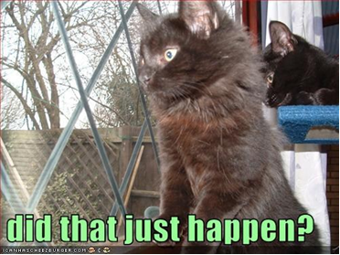
Starter:
Think of a movie or book in which characters have an unusual experience that makes them shake their head and ask, “Did that really happen?”
With a partner, make a list of stories, movies or television shows in which a character wakes up to realise that it was just a dream. Compare your list with another pair.
Do Now

Slide 5
Vocabulary
What part of the play is Act 4?
(Clue there are 5 (sometimes 6) stages of the writing arc)
Use a dictionary to find the meaning of:
Illusion
Surreal
Unlocking vocabulary

Slide 6
Pre-writing discussion
Think back to the starter discussion about dream experiences.
Describe times when you or others have had an experience that others couldn’t or wouldn’t understand.
Discuss Bottom’s reaction when he rejoins his friends. Why does he tell them so little about his experience? Do you think he is simply unwilling to do so, or is he simply unable to express himself clearly? Give reasons for your answer.
Hook

Slide 7
ACT 4 Scene 1 p111/112 Ca/p64-65 Oxford
The couples are awoken by the arrival of the Duke and Hippolyta (along with Egeus who still wishes Hermia to marry Demetrius). Theseus asks the four young lovers to explain how they came to be in the wood
LYSANDER
My lord, I shall reply amazedly,
Half sleep, half waking: but as yet, I swear,
I cannot truly say how I came here;
But, as I think,--for truly would I speak,
And now do I bethink me, so it is,--
I came with Hermia hither: our intent
Was to be gone from Athens, where we
might,
Without the peril of the Athenian law.
Reading and Wrting task

Slide 8
ACT 4 Scene 1 p111/112 Ca/p64-65 Oxford
DEMETRIUS
My lord, fair Helen told me of their
stealth,
Of this their purpose hither to this wood;
And I in fury hither follow'd them,
Fair Helena in fancy following me.
But, my good lord, I wot not by what
power,--
But by some power it is,--my love to
Hermia,
Melted as the snow, seems to me now
As the remembrance of an idle gaud
Which in my childhood I did dote upon;
And all the faith, the virtue of my heart,
The object and the pleasure of mine eye,
Is only Helena. To her, my lord,
Was I betroth'd ere I saw Hermia:
But, like in sickness, did I loathe this food;
But, as in health, come to my natural
taste,
Now I do wish it, love it, long for it,
And will for evermore be true to it.
Reading and Wrting task

Slide 9
Act 4 Sc 1
THESEUS
Fair lovers, you are fortunately met:
Of this discourse we more will hear anon.
Egeus, I will overbear your will;
For in the temple by and by with us
These couples shall eternally be knit:
Away with us to Athens; three and three,
We'll hold a feast in great solemnity.
Come, Hippolyta.
Exeunt THESEUS, HIPPOLYTA, EGEUS, and train
DEMETRIUS
These things seem small and
undistinguishable,
HERMIA
Methinks I see these things with parted
eye,
When every thing seems double.
HELENA
So methinks:
And I have found Demetrius like a jewel,
Mine own, and not mine own.
DEMETRIUS
Are you sure
That we are awake? It seems to me
That yet we sleep, we dream.
Reading and Wrting task

Slide 10
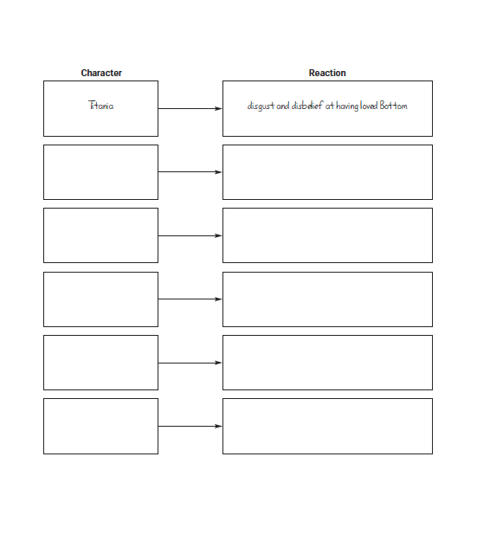
Active Reading Task
In this act, a number of characters wake up. 1. Complete the annotation, questions and tasks on the extract given.
2. Complete the character sheet chart. In each box, write the name of a character then summarise that character’s reaction to what happened during the night.
Reading & thinking Task

Slide 11
Active Reading Task
In this act, a number of characters wake up. Complete the chart. In each box, write the name of a character then summarise that character’s reaction to what happened during the night.
Reading & thinking Task

Slide 13
Pairs or individual
Answer the following questions individually or with a partner. Answers in your exercise book.
How does Titania respond to when Oberon asks for the fairy child this time? What does this reveal about the strength of the love potion.
How do most of the dreamers respond to the dream experience upon waking? Which character is changed permanently by the dream experience?
3. How does Theseus’s current decision regarding Hermia and Lysander contradict his earlier statement?
Checking understanding

Slide 14
1. Read and annotate the extract with any aspects of language and structure that you can find. 2How do most of the dreamers respond to the dream experience upon waking? Which character is changed permanently by the dream experience? 3. How does Theseus’s current decision regarding Hermia and Lysander contradict his earlier statement? What does Egeus still want to happen? When Theseus says ‘Egeus, I will overbear your will;’ what is he saying and doing? What will this mean for the four lovers? Between the four lovers, is this infatuation or real love now? Explain. Challenge: How is the character of ____________________________(insert character of choice from extract) presented in this extract? Write as PEA.
Your tasks
Reading and Wrting task
Notes:
Tasks completed according to ability.

Slide 15
ALL Extension: Compare this Act to Act 3. In which act did the majority of the characters enjoy themselves the most? Which act did you enjoy more? Explain.
Challenge and extensions
L- M ability:
Select any of the four lovers and explain how they feel about each other now. Is it infatuation or real love? Explain include quotations.
M-H ability:
How is the character of ____________________________(insert character of choice from extract) presented in this extract? Write as PEA.
Challenge and extend

Slide 16
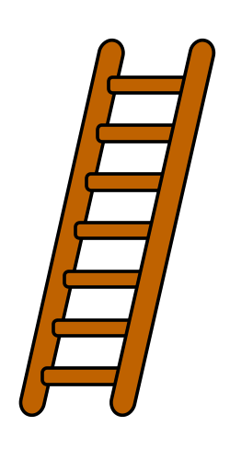
Plenary
Create an
event ladder for act 4.
You have 5 minutes.
Ready?
Plenary
GO!
Notes:
Print out worksheet.

