Slide 1
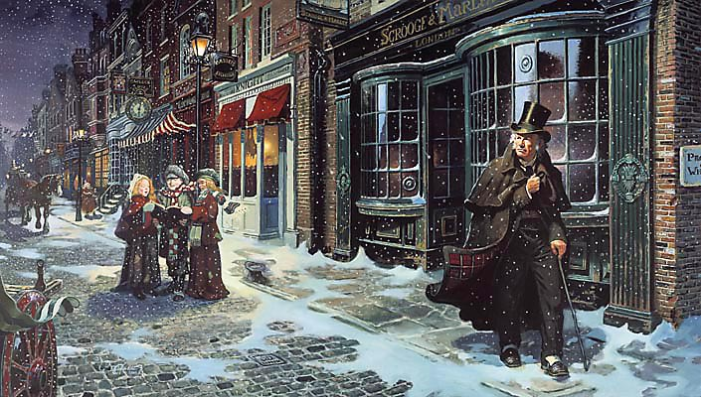
sso
A CHRISTMAS CAROL: REVISION
List all the characters that feature in ‘A Christmas Carol’.
Write down anything you can remember about the context (the historical & social issues) of the novel.
https://www.youtube.com/watch?v=w7V4tXuhbk8&t=4s
Do Now

Slide 2
sso
How does this vocabulary fit into our understanding of ‘A Christmas Carol’?
The Poor Law: The Poor Law was the way that the poor were helped in 1815. The law said that each parish had to look after its own poor. If you were unable to work then you were given some money to help you survive. However, the cost of the Poor Law was increasing every year. By 1830 it cost about £7 million and criticism of the law was mounting.
The ‘Poor Law Amendment Act’: In 1834 the Poor Law Amendment Act was passed by Parliament. This was designed to reduce the cost of looking after the poor as it stopped money going to poor people except in exceptional circumstances. Now if people wanted help they had to go into a workhouse to get it.
Political diatribe: A ‘diatribe’ is a verbal attack on something. ‘A Christmas Carol’ is a political diatribe. Dickens is attacking the politics of the time, saying that the rich was not doing enough to help the poor.
Allegory: ‘A Christmas Carol’ is an example of an allegory. An allegory is a story that can be interpreted to reveal a hidden meaning, usually a moral or political one?
Zeitgeist: With A Christmas Carol, Dickens captured the zeitgeist of the mid-Victorian revival of the Christmas holiday. The Zeitgeist (spirit of the age or spirit of the time) is the dominant set of ideals and beliefs that motivate the actions of the members of a society in a particular period in time.
Unlocking Vocabulary

Slide 3
sso
Answer the revision questions in your books.
Checking Understanding

