Slide 1
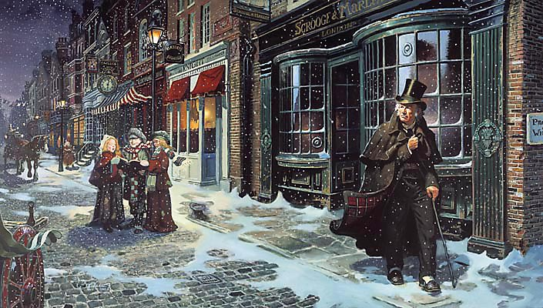
A CHRISTMAS CAROL: REVISION
Write down the missing words from these quotes
I _________ the chains I forged in life.
Hard and ________ as flint.
“Spirit!” said Scrooge, “Show me no ______!”
“I should like to be able to say a word or two to my ______ just now.”
“If these shadows remain unaltered by the _______, the child will die.”
“This boy is ___________. This girl is Want. Beware of them both.”
Do Now

Slide 2
A CHRISTMAS CAROL: REVISION
I wear the chains I forged in life.
Hard and sharp as flint.
“Spirit!” said Scrooge, “Show me no more!”
“I should like to be able to say a word or two to my Clerk just now.”
“If these shadows remain unaltered by the Future the child will die.”
“This boy is Ignorance. This girl is Want. Beware of them both.”
Answers

Slide 3
A CHRISTMAS CAROL: REVISION
Exam Question

Slide 4
A CHRISTMAS CAROL: REVISION
Exam Question

Slide 5
A CHRISTMAS CAROL: REVISION
Mastery

Slide 6
A CHRISTMAS CAROL: REVISION
Introduction: What is your opinion of Scrooge through the text? Can you mention contextual information and what Dickens is saying about the issues of the time?
Mastery

Slide 7
A CHRISTMAS CAROL: REVISION
Mastery
Select three more quotations to discuss from the extract.
This image of isolation is continued when….

Slide 8
A CHRISTMAS CAROL: REVISION
Finish the quotations
Decrease the…
A solitary child neglected by his…
Are there no ….
Spirit! Hear me! I am not the man…
God bless us…
Do Now

Slide 9
A CHRISTMAS CAROL: REVISION
Decrease the surplus population
A solitary child neglected by his friends.
Are there no prisons?
Spirit! Hear me! I am not the man I was
God bless us, Every One!
Answers

Slide 10
A CHRISTMAS CAROL: REVISION
Exam Question

Slide 11
A CHRISTMAS CAROL: REVISION
Write about Scrooge and the way he changes throughout the novel.
The rest of the novella?
Checking Understanding

Slide 12
A CHRISTMAS CAROL: REVISION
How would you criticise this answer?
Mastery

Slide 13
A CHRISTMAS CAROL: REVISION
Let’s improve this section.
Now write three of your own paragraphs.
Mastery

