Slide 1
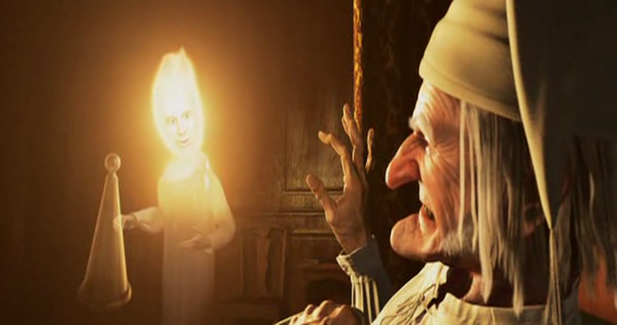
A Christmas Carol
The Ghost of Christmas Past
LO: To explore the Ghost of Christmas Past and the use of light.
ST: I Can develop my critical understanding of motif.
Key words: Authorial intent Theme Moral growth Contrast Paradox Welfare Redemption Juxtaposition Symbolism Contradiction Memory Hope Reclamation

Slide 2
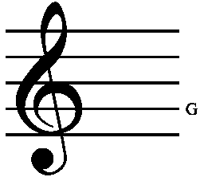
Starter Activity: what is a ‘stave’?
A stave is a set of five parallel lines on which music is written. The lines indicate the pitch of the music.
A stave is to break something by forcing it inwards or piercing it roughly.
Why did Dickens name the chapters of A Christmas Carol staves?
How do these definitions relate to the novella?
Key words: Authorial intent Theme Moral growth Contrast Paradox Welfare Redemption Juxtaposition Symbolism Contradiction Memory Hope Reclamation

Slide 3
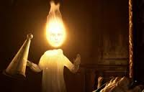
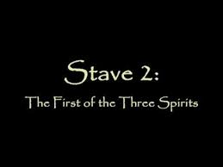
Task : Read the start of Stave 2 page 24 – bottom of page 28.
Key words: Authorial intent Theme Moral growth Contrast Paradox Welfare Redemption Juxtaposition Symbolism Contradiction Memory Hope Reclamation
Notes:
Stave 2 page 29 – 34 my book blue cover

Slide 4
The Ghost of Christmas Past – How does Dickens present the ghost of Christmas past?
How can these contradictions be explained? Like a child but an old man?
Find 3 adjectives, 3 verbs, 2 superlatives, 1 simile
It was a strange figure – like a child: yet not so like a child as like an old man, viewed through some supernatural medium, which gave him the appearance of having receded from view, and being diminished to a child’s proportions. Its hair, which hung about its neck and down its back, was white as if with age; and yet the face had not a wrinkle in it, and the tenderest bloom was on the skin. The arms were long and muscular; the hands the same, as if its hold were of uncommon strength. Its legs and feet, most delicately formed, were, like those upper members, bare. It wore a tunic of the purest white; and round its waist was bound a lustrous belt, the sheen of which was beautiful. It held a branch of fresh green holly in its hand; and, in singular contradiction of that wintry emblem, had its dress trimmed with summer flowers. But the strangest thing about it was, that from the crown of its head there sprung a bright clear jet of light, by which all this was visible; and which was doubtless the occasion of its using, in its duller moments, a great extinguisher for a cap, which it now held under its arm.
Which physical properties represent Scrooge’s memories?
Holly : refers to forgetting the past as well as a symbol for winter
Annotate your extract!
Key words: Authorial intent Theme Moral growth Contrast Paradox Welfare Redemption Juxtaposition Symbolism Contradiction Memory Hope Reclamation

Slide 5
The Ghost of Christmas Past – How does Dickens present the Ghost of Christmas Past?
How can these contradictions be explained? Like a child but an old man?
It was a strange figure – like a child: yet not so like a child as like an old man, viewed through some supernatural medium, which gave him the appearance of having receded from view, and being diminished to a child’s proportions. Its hair, which hung about its neck and down its back, was white as if with age; and yet the face had not a wrinkle in it, and the tenderest bloom was on the skin. The arms were long and muscular; the hands the same, as if its hold were of uncommon strength. Its legs and feet, most delicately formed, were, like those upper members, bare. It wore a tunic of the purest white; and round its waist was bound a lustrous belt, the sheen of which was beautiful. It held a branch of fresh green holly in its hand; and, in singular contradiction of that wintry emblem, had its dress trimmed with summer flowers. But the strangest thing about it was, that from the crown of its head there sprung a bright clear jet of light, by which all this was visible; and which was doubtless the occasion of its using, in its duller moments, a great extinguisher for a cap, which it now held under its arm.
Which physical properties represent Scrooge’s memories?
Holly : refers to forgetting the past as well as a symbol for winter
Key words: Authorial intent Theme Moral growth Contrast Paradox Welfare Redemption Juxtaposition Symbolism Contradiction Memory Hope Reclamation

Slide 6
Scrooge’s memories are old and perhaps dulled. The physical properties of the ghost resemble the memories of childhood.
It was a strange figure – like a child: yet not so like a child as like an old man, viewed through some supernatural medium, which gave him the appearance of having receded from view, and being diminished to a child’s proportions. Its hair, which hung about its neck and down its back, was white as if with age; and yet the face had not a wrinkle in it, and the tenderest bloom was on the skin. The arms were long and muscular; the hands the same, as if its hold were of uncommon strength. Its legs and feet, most delicately formed, were, like those upper members, bare. It wore a tunic of the purest white; and round its waist was bound a lustrous belt, the sheen of which was beautiful. It held a branch of fresh green holly in its hand; and, in singular contradiction of that wintry emblem, had its dress trimmed with summer flowers. But the strangest thing about it was, that from the crown of its head there sprung a bright clear jet of light, by which all this was visible; and which was doubtless the occasion of its using, in its duller moments, a great extinguisher for a cap, which it now held under its arm.
These represent Scrooge’s youth.
Contrast to Scrooge’s appearance now.
Holly : refers to forgetting the past as well as a symbol for winter
Motif of light – traditionally associated with purity, goodness and truth – traits often associated with childhood.
Key words: Authorial intent Theme Moral growth Contrast Paradox Welfare Redemption Juxtaposition Symbolism Contradiction Memory Hope Reclamation
Summer flowers represent warmth and beauty

Slide 7
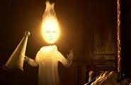
Task: Key Language – Dickens’s use of light.
Question: How does Dickens present the Ghost of Christmas Past and why is the motif of light important?
Answer this question.
Key words: Authorial intent Theme Moral growth Contrast Paradox Welfare Redemption Juxtaposition Symbolism Contradiction Memory Hope Reclamation

Slide 8
Task: Hot-Seating Scrooge
Write three questions for Old Scrooge (from Stave One) and three questions for Young Scrooge (from Stave Two) in the back of your exercise book.
Be ready to take the hot seat or ask a question!
Key words: Authorial intent Theme Moral growth Contrast Paradox Welfare Redemption Juxtaposition Symbolism Contradiction Memory Hope Reclamation

