Slide 1
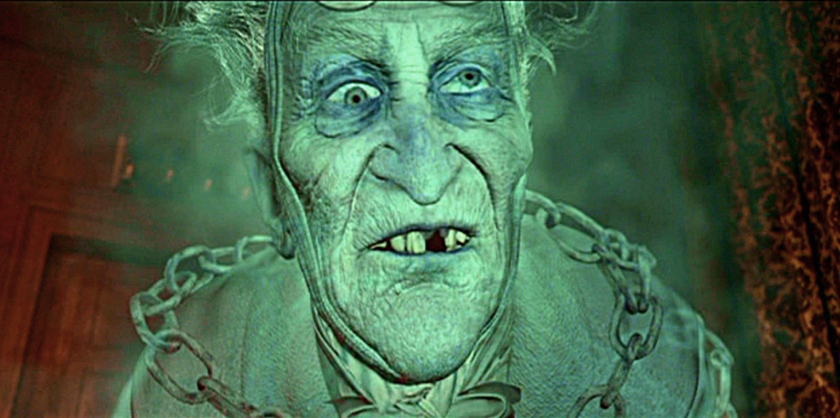
A Christmas Carol
Marley and his chains
LO: To explore Marley's arrival and purpose in the novella.
ST: I can analyse the language and structure.
Key words: Morality mankind spectre apparition humility fathom eternity laboured shun

Slide 2
Starter : Atmosphere Context
Meanwhile the fog and darkness thickened so, that people ran about with flaring links, proffering their services to go before horses in carriages, and conduct them on their way. The ancient tower of a church, whose gruff old bell was always peeping slyly down at Scrooge out of a Gothic window in the wall, became invisible, and struck the hours and quarters in the clouds, with tremulous vibrations afterwards as if its teeth were chattering in its frozen head up there. The cold became intense. In the main street at the corner of the court, some labourers were repairing the gas-pipes, and had lighted a great fire in a brazier, round which a party of ragged men and boys were gathered: warming their hands and winking their eyes before the blaze in rapture.
How does Dickens create mood and atmosphere in the following extract?
Tips for success:
Look for 4 ideas
Keep highlighted evidence short
Analyse language closely (always look for layers of meaning)
Ask yourself: how does this add to/change the atmosphere?
Track through and find points across the entire extract
Highlight and annotate around extract.
Key words: Morality mankind spectre apparition humility fathom eternity laboured shun

Slide 3
Peer Assessment : Read their annotations and assess their ideas.
Possible answers:
Scrooge’s evil attitude is linked to the weather: “fog and darkness thickened so” (pathetic fallacy)
The poor desperately hold on to their Christmas spirit: “ran about with flaring links” (symbolism)
God is watching, disapproving of Scrooge: “old bell was peeping slyly down at Scrooge” (personification)
The negative atmosphere grows: “The cold became intense.” (short sentence for effect)
The poor suffer yet support each other through their difficulties: “before the blaze in rapture.” (religious connotations)
Assessment Criteria:
Look for 4 ideas
Keep highlighted evidence short
Analyse language closely (always look for layers of meaning)
Ask yourself: how does this add to/change the atmosphere?
Track through and find points across the entire extract
Complete WWW and EBI on your partner’s work – set them a clear target!
Key words: Morality mankind spectre apparition humility fathom eternity laboured shun

Slide 4
Read to the end of Stave 1: Page 12 - 23
Key words: Morality mankind spectre apparition humility fathom eternity laboured shun

Slide 5
Task: P.E.T.E.R analysis
What does Marley attempt to teach Scrooge?
The chain was made “of cash-boxes, keys, padlocks, ledgers, deeds, and heavy purses wrought in steel.” (p. 19)
“I wear the chain I forged in life […] I made it link by link” (p. 23)
“Or would you know […] the weight and length of the strong coil you bear yourself?” (p. 23)
“In life my spirit never roved beyond the narrow limits of our money-changing hole” (p. 23)
Key words: Morality mankind spectre apparition humility fathom eternity laboured shun

Slide 6
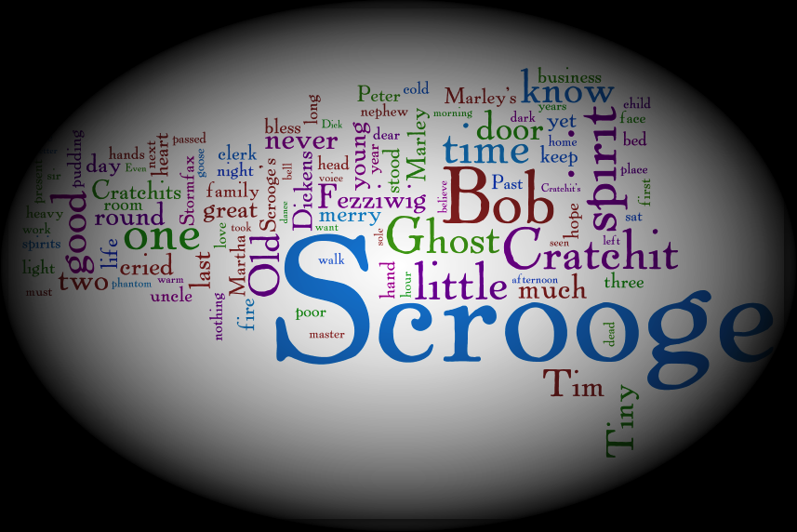
EXTENSION: What is Marley’s warning?
Key words: Morality mankind spectre apparition humility fathom eternity laboured shun

Slide 7
Plenary Task: Think, Pair, Share
Why would Dickens foreshadow the arrival of Marley by linking his face to a doorknocker?
Key words: Morality mankind spectre apparition humility fathom eternity laboured shun

