Slide 1
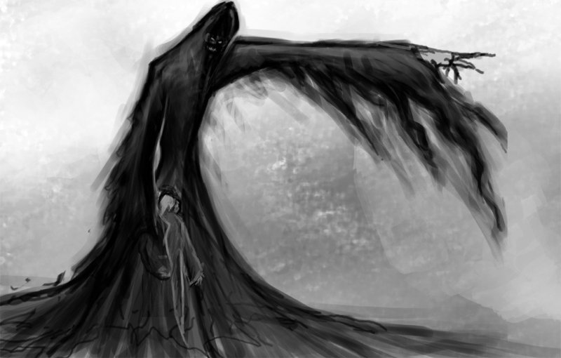
LO: To understand the results of living without care for others.
STAVE 4
The Ghost of Christmas Yet To Come
Key words: phantom hope poverty solemn spectral
slip-shod pendulous doom appalled infamous

Slide 2
Starter: A Quick Quiz
What time did the bell toll for the second visitation?
What was spread around the Ghost of Christmas Present when Scrooge entered the room?
Name one thing that the Ghost was wearing?
What did the Ghost show Scrooge first of all?
What did the Ghost do with his torch?
What was Mrs Cratchit ‘brave in’?
Who was the ‘founder of the feast’?
What is a pawnbrokers?
Who ‘means to give Scrooge the same chance each year’?
What happened to the Ghost as the night/time went on?
What does the Ghost quote to Scrooge at the end of the Stave? (quote )
What is ‘draped’ and ‘hooded’?

Slide 3
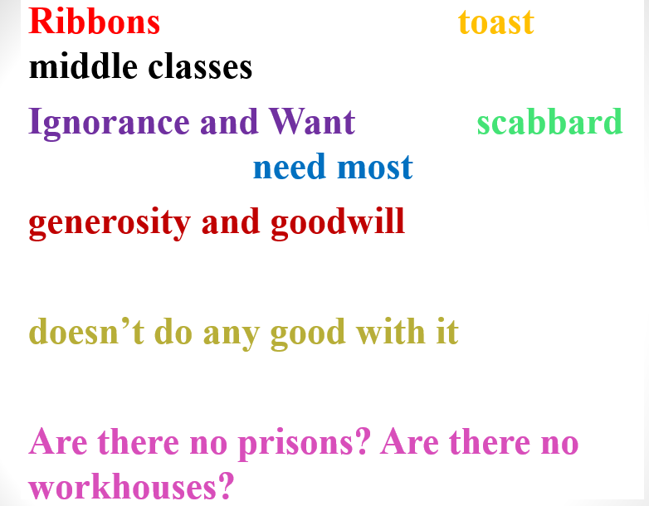
Stave Three Cloze Summary
Scrooge meets the Ghost of Christmas Present. He symbolises __________________________. He sits on a throne of food and wear a __________ with no sword (which symbolises peace). The ghost shows Scrooge the Christmas of other people: he waves his torch to spread the Christmas Spirit, focusing on poor people as they “______________”.
They visit the Cratchit family, who offer the reader an idealised version of the Christmas for the poor. They wear “____________” to celebrate the day and work as a team to create their meagre Christmas dinner. They _____________ Scrooge, despite the fact that he underpays Bob and treats him poorly. Scrooge becomes upset for Tiny Tim when the ghost reveals he will die.
At Fred’s Christmas party, everyone enjoys themselves. The Cratchit family represents the poor and Fred’s party represents the _________ ___________. They make fun of Scrooge and his behaviour. Fred says his wealth is of no use as he “_____________________________”.
The ghost shows Scrooge __________________________: they are personified problems of society. Scrooge is horrified and asked if they can be helped, but the ghost uses his own words to shame him: “_____________________________________”.
The Ghost dies.

Slide 4
Starter: A Quick Quiz
What time did the bell toll for the second visitation? One
What was spread around the Ghost of Christmas Present when Scrooge entered the room? Food
Name one thing that the Ghost was wearing? Green robe, mantle, holly wreath
What did the Ghost show Scrooge first of all? The street and shoppers
What did the Ghost do with his torch? Sprinkle goodwill
What was Mrs Cratchit ‘brave in’? ribbons
Who was the ‘founder of the feast’? Scrooge
What is a pawnbrokers? Money lender against goods
Who ‘means to give Scrooge the same chance each year’? Fred
What happened to the Ghost as the night/time went on? Became older
What does the Ghost quote to Scrooge at the end of the Stave? (quote ) Are there no prisons?
What is ‘draped’ and ‘hooded’? The next ghost

Slide 5
Let’s read: Page 73 - 77
Key words: phantom hope poverty solemn spectral
slip-shod pendulous doom appalled infamous

Slide 6
Task: Using your image add quotations and ideas about this last ghost.
Key words: phantom hope poverty solemn spectral
slip-shod pendulous doom appalled infamous

Slide 7
Task: Scrooge claims he has changed – so why does he still have to follow the Ghost?
Key words: phantom hope poverty solemn spectral
slip-shod pendulous doom appalled infamous

Slide 8
Let’s continue: Read page 77 - 85
Key words: phantom hope poverty solemn spectral
slip-shod pendulous doom appalled infamous

Slide 9
Task: Ignorance.
In Stave Three, Scrooge meets Ignorance and Want.
In Stave Four, Scrooge meets them again in human form.
Who do you think the characters are and why do they represent Ignorance?
Why might Dickens have chosen to structure the novella like this?
Answer the question using PETER paragraphs.
Key words: phantom hope poverty solemn spectral
slip-shod pendulous doom appalled infamous

