Slide 1
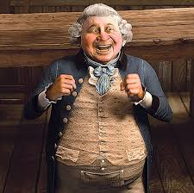
A Christmas Carol Fezziwig’s Party LO: To understand the function of Fezziwig. ST: I can evaluate this characterisation.
Key words: Jovial agility porter corroborated agitation avarice contrast negus business ethics
Notes:
Negus =a hot drink of port, sugar, lemon, and spice.

Slide 2
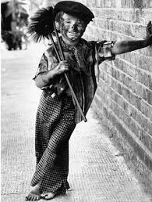
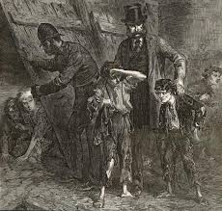
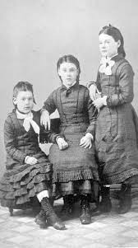
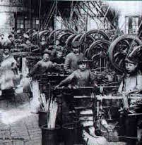
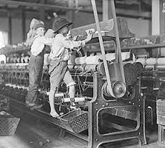
Starter: How does Dickens present childhood in the novella? List your ideas in pairs.
What do these images suggest?
Key words: Jovial agility porter corroborated agitation avarice contrast negus business ethics

Slide 3
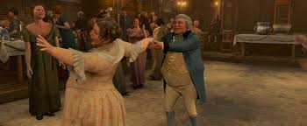
Task: Read Mr Fezziwig’s Ball – page 35-39.
Key words: Jovial agility porter corroborated agitation avarice contrast negus business ethics

Slide 4
Task: Summarise this part of the novella in 25 words!
What is Dickens showing about people?
Key words: Jovial agility porter corroborated agitation avarice contrast negus business ethics

Slide 5
Task: Analyse the character of Fezziwig. Copy out the quotes below. Fully annotate your ideas around each quote. How is this an important and pivotal character.
‘Called out in a comfortable, oily, rich, fat, jovial voice…’
‘laughed all over himself…’
‘skipping down…’
‘wonderful agility…’
‘No more work to-night. Christmas Eve.’
‘Organ of benevolence…’
Key words: Jovial agility porter corroborated agitation avarice contrast negus business ethics
Notes:
Benevolence=the quality of being well meaning; kindness

Slide 6
Plenary: How do we know Scrooge is starting to change?
Key words: Jovial agility porter corroborated agitation avarice contrast negus business ethics

